Slide 1
DATA STRUCTURES AND APPLICATIONS
- Integrated Professional Core Course

Slide 2
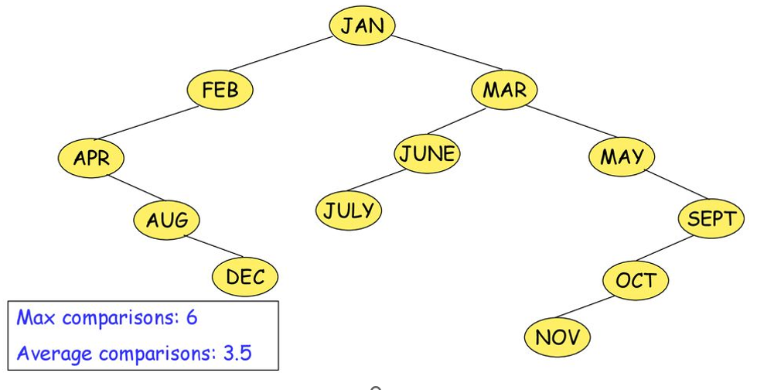

Slide 3
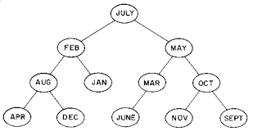
Now, Enter the nodes in the sequence: JULY, FEB, MAY, AUG, DEC,MAR,OCT,APR,JAN,JUNE, SEP,NOV
Average number of comparisons=3.1
Max comparisons=4

Slide 4
Now, Enter the months in the lexicographic order

Slide 5
Observations:
Average and maximum search time is reduced if binary tree is maintained as complete binary trees
However, such trees are difficult to grow dynamically
These balanced trees have satisfactory search, insertion and deletion time properties

Slide 6
AVL trees are balanced with respect to heights of sub-trees

Slide 7
DEFINITION
An empty tree is height-balanced
T is a non-empty binary tree with TL and TR as left and right subtrees,
then TL and TR are height balanced
|hL – hR| <=1, hL and hR are heights of TL and TR respectively

Slide 8
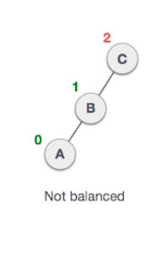
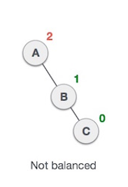
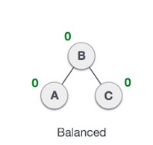
AVL tree checks the height of the left and the right sub-trees and assures that the difference is not more than 1. This difference is called the Balance Factor.

Slide 9
AVL Rotations
To balance itself, an AVL tree may perform the following four kinds of rotations:
Left rotation
Right rotation
Left-Right rotation
Right-Left rotation

Slide 10
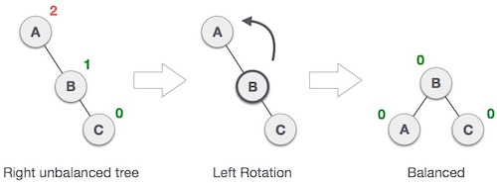
LEFT ROTATION for RR IMBALANCE

Slide 11
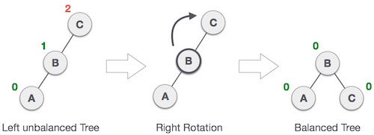
RIGHT ROTATION for LL IMBALANCE

Slide 12
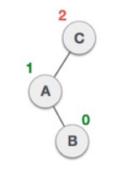
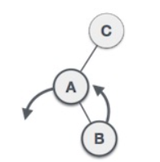
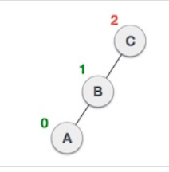
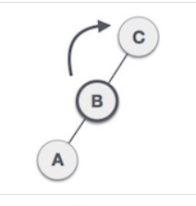
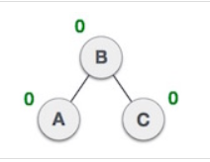
LEFT-RIGHT ROTATION for LR IMBALANCE

Slide 13
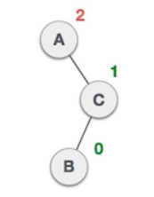
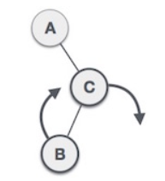
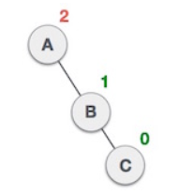
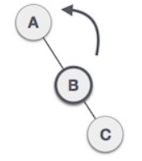
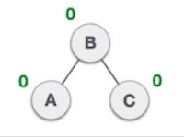
RIGHT-LEFT ROTATION for RL IMBALANCE

Slide 14
Demonstrate AVL TREE CREATION FOR THE SEQUENCE
MAR, MAY, NOV, AUG, APR, JAN, DEC, JUL, FEB, JUN, OCT,SEP,

Slide 15
MAR, MAY, NOV, AUG, APR, JAN, DEC, JUL, FEB, JUN, OCT,SEP,
0
1
2
MAR
MAR
MAR
0
1
MAY
MAY
0
NOV

Slide 16
2
MAR
1
RR imbalance
Soln: Left Rotate
0
MAY
MAY
0
0
0
MAR
NOV
NOV

Slide 17
INSERT AUG
1
MAY
1
0
MAR
NOV
0
AUG

Slide 18
INSERT APR
2
1
MAY
MAY
2
0
0
0
MAR
NOV
AUG
NOV
1
0
0
AUG
MAR
APR
LL imbalance
Soln: Right Rotate
0
APR

Slide 19
INSERT JAN
LR Imbalance problem
2
Find median in all elements on Left side except new node
L={APR, AUG,MAR,MAY}
Middle=> MAR
MAY
1
0
0
AUG
NOV
MAR
1
0
0
1
MAR
APR
AUG
MAY
0
0
0
0
JAN
APR
NOV
JAN

Slide 20
INSERT DEC
1
MAR
1
1
AUG
MAY
0
1
0
APR
JAN
NOV
0
DEC

Slide 21
INSERT JULY
1
MAR
1
1
AUG
MAY
0
0
0
APR
JAN
NOV
0
0
DEC
JULY

Slide 22
INSERT FEB
RL Imbalance problem
2
Find median in all elements on Right side except new node
L={APR,AUG,DEC,JAN,JULY}
Middle=> DEC
MAR
2
1
1
AUG
MAY
MAR
0
1
0
1
0
MAY
APR
NOV
DEC
JAN
1
0
0
1
0
AUG
JAN
NOV
DEC
JULY
0
0
0
0
APR
JULY
FEB
FEB

Slide 23
Demonstrate AVL TREE CREATION FOR THE SEQUENCE
63, 9, 19, 27, 18, 108, 99, 81

Slide 24
C STRUCTURE FOR AVL TREES
typedef struct
{
int data;
struct node *leftChild;
struct node *rightChild;
short int balance_factor;
}node;

Slide 25
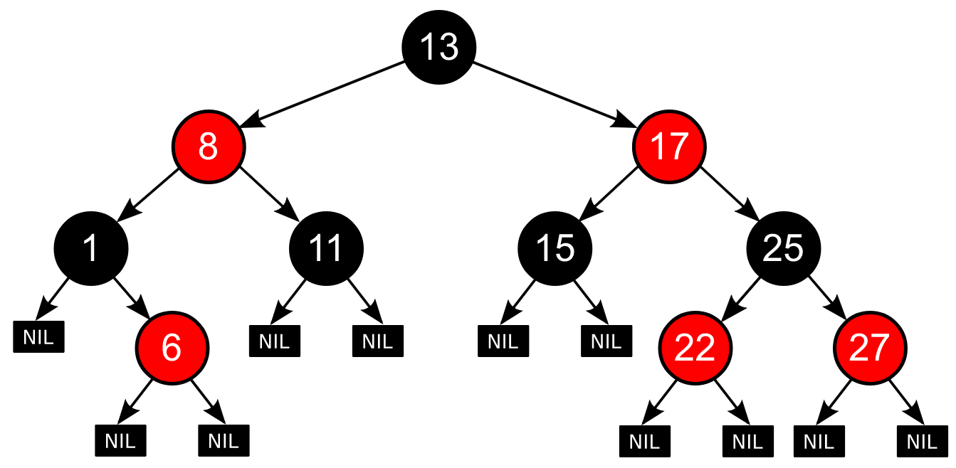
RED BLACK TREES

Slide 26
Definition:
Each node in the Red-black tree contains an extra bit that represents a color (Red or Black)
to ensure that the tree is balanced during any operations

Slide 27
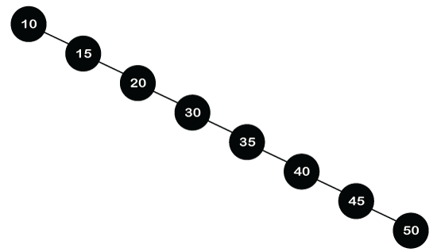
Searching performance of worst case will be same as linear search
Hence need of balanced trees
AVL with strict height, Red-Black with colors

Slide 28
Red-Black tree is used because the AVL tree requires many rotations when the tree is large, whereas the Red-Black tree requires a maximum of two rotations to balance the tree.
The main difference between the AVL tree and the Red-Black tree is that the AVL tree is strictly balanced, while the Red-Black tree is not completely height-balanced.
Insertion is easier in the AVL tree as the AVL tree is strictly balanced, whereas deletion and searching are easier in the Red-Black tree as the Red-Black tree requires fewer rotations.

Slide 29
Properties of Red-Black tree
Self balancing through rotation and recoloring
Each node stores 1 extra bit for color
Root node always black color
NIL vs Internal nodes – different
Node – Red, children should be black
Never! Red-Red parent-child relationship exists
Every path from a node to any of its descendant's NIL node should have same number of black nodes.

Slide 30
Root=EMPTY
YES
NO
Root-Newnode
Color:Black
Create Newnode
Color:Red
Parent sibling is red
NO
Parent is black
YES
NO
YES
A
B
Done

Slide 31
A
B
Recolor the node
Rotations
Grand parent is root
Recoloring
NOT
YES
Recolor the node
Done

Slide 32
Insertion into Red-Black tree
10, 18, 7, 15, 16, 30
10
10
10
18
18
7
10
10
18
7
18
7
15
15

Slide 33
16, 30
10
10
16
10
10
7
18
7
18
18
15
18
7
7
16
10
15
15
15
16
7
16
15
18

Slide 34
30
10
10
10
16
16
16
7
7
7
18
34
15
18
18
34
34
15
15
30
30

Slide 35
10
16
7
18
35
15
30

Slide 36
25
10
10
10
16
7
16
16
7
7
36
15
25
18
36
18
15
36
15
30
25
18
30
30
25

Slide 37
10
16
7
15
25
30
18

Slide 38
Perform Insertion into Red-Black tree for the sequence:
50,10,80,90,70,60,65
50
50
50
10
10
80

Slide 39
50,10,80,90,70,60,65
50
50
10
80
10
80
90
90

Slide 40
50,10,80,90,70,60,65
50
10
80
70
90

Slide 41
50,10,80,90,70,60,65
50
50
50
10
80
10
80
10
80
70
90
70
90
70
90
60
60
60

Slide 42
50,10,80,90,70,60,65
50
50
50
10
80
10
80
10
80
65
90
65
90
70
90
60
60
70
60
70
65

Slide 43
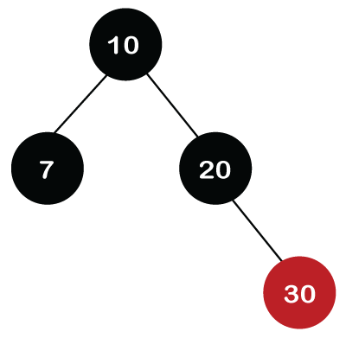
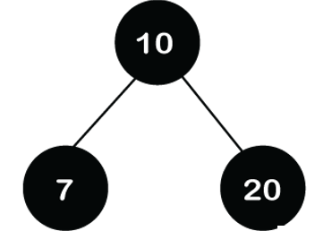
Deletion from a Red-Black tree
Case 1: Leaf Node (Internal node) and color is red
Locate node using BST rules
Just delete

Slide 44
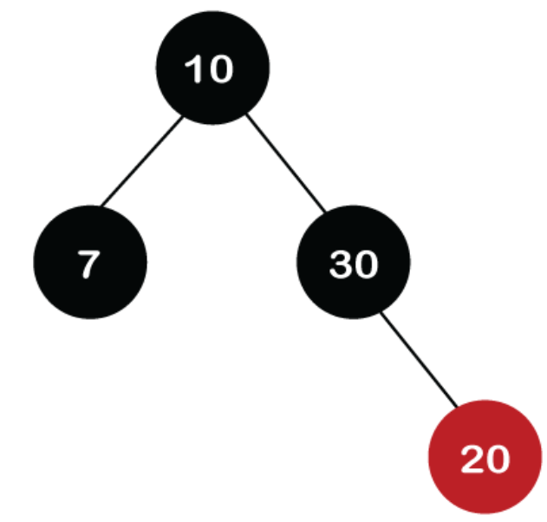
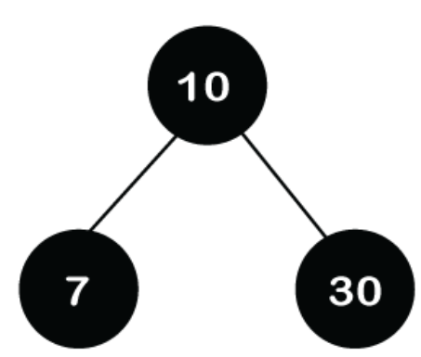
Case 2: Node has one child
Locate node using BST rules
Replace with its child
Later just delete

Slide 45
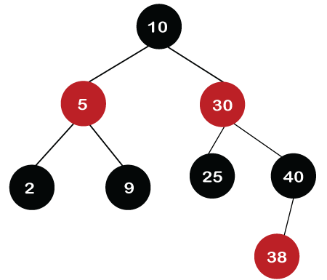
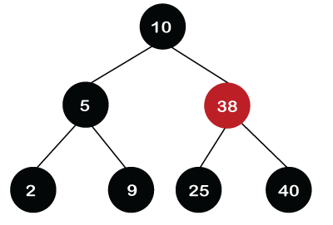
Case 3: Node has two children
Locate node using BST rules
Replace with its inorder succesor
Later just delete

Slide 46
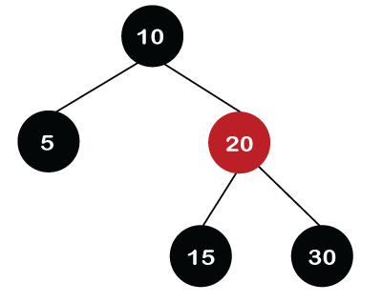
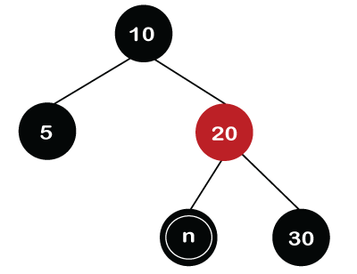
Case 4: Leaf Node (Internal node) and color is black
Locate node using BST rules
Mark it NIL and double black

Slide 47
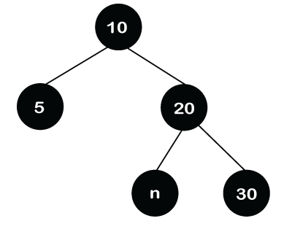
Mark parent black
Change double black to single black

Slide 48
C STRUCTURE FOR RED-BLACK TREES
typedef struct
{
int data;
struct node *leftChild;
struct node *rightChild;
short int color;
}node;

Slide 50
What is a Splay Tree?
A splay tree is a self-balancing tree.
AVL and Red-Black trees are also self-balancing trees then.
It has one extra property that makes it unique is splaying.
A splay tree contains the same operations as a Binary search tree, i.e., Insertion, deletion and searching, but it also contains one more operation, i.e., splaying. So. all the operations in the splay tree are followed by splaying.

Slide 51
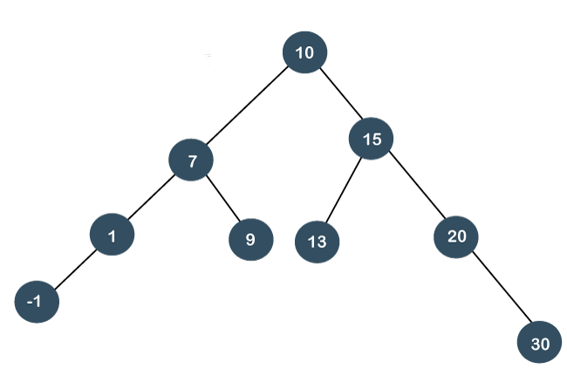
Splay trees are not strictly balanced trees, but they are roughly balanced trees.
SEARCH 7
Since parent on left, rotate right
Zig Rotation

Slide 52
7
1
10
-1
9
15
13
20
30

Slide 53
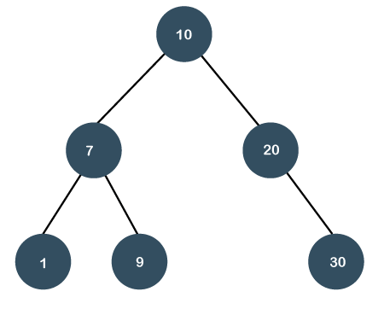
Since parent on right, rotate left
Zag Rotation
SEARCH 20
20
10
30
7
1
9

Slide 54
SEARCH 1
Zig Zig (RR) rotation as LL is the problem
10
7
7
15
1
10
1
15
9
13
20
-1
9
-1
13
20
30
30

Slide 55
1
7
-1
7
1
10
10
15
-1
9
15
9
13
20
13
20
30
30

Slide 56
SEARCH 20
Zag Zag (LL) rotation as RR is the problem
15
10
10
20
7
15
7
13
30
1
9
13
20
1
9
-1
30
-1

Slide 57
15
20
10
20
15
30
7
13
30
10
1
9
7
13
-1
1
9
-1

Slide 58
SEARCH 13
Zig Zag (RL) rotation as RL is the problem
10
10
7
13
7
15
15
1
9
1
9
13
20
20
-1
-1
30
30

Slide 59
10
13
7
13
10
15
15
1
20
9
7
20
-1
1
30
9
30
-1

Slide 60
SEARCH 9
Zag Zig (LR) rotation as LR is the problem
10
10
7
15
9
15
7
13
20
1
9
13
20
1
-1
30
30
-1

Slide 61
9
10
7
15
1
13
20
-1
30

Slide 62
Consider the sequence:
INSERTION OPERATION in Splay TRee
15, 10, 17, 7
15
15
10
10
15

Slide 63
15, 10, 17, 7
10
15
17
15
10
17
15
17
10

Slide 64
15, 10, 17, 7
17
17
17
7
15
10
7
17
10
7
15
10
10
7
15
15

Slide 65
DELETION OPERATION in Splay TRee
Types of Deletions:
There are two types of deletions in the splay trees:
Bottom-up splaying
Top-down splaying

Slide 66
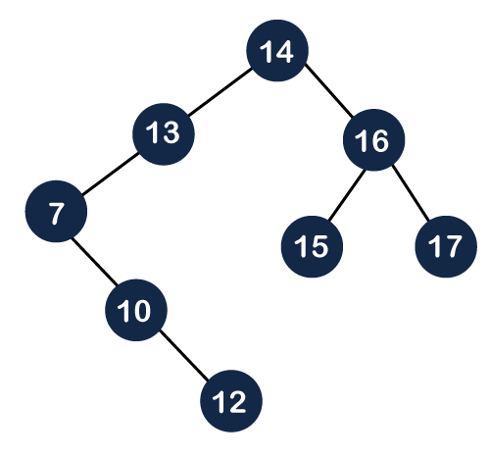
Bottom-up splaying
In bottom-up splaying, first we delete the element from the tree and then we perform the splaying on the deleted node.
14
13
16
7
15
17
Delete the node
Splay the parent
10

Slide 67
14
14
10
16
13
16
7
13
15
17
10
15
17
7

Slide 68
Delete the node 14
Splay the parent
10
10
7
14
7
15
16
13
16
13
15
17
17

Slide 69
Top-down splaying
In top-down splaying, we first perform the splaying on which the deletion is to be performed and then delete the node from the tree. Once the element is deleted, we will perform the join operation

Slide 70
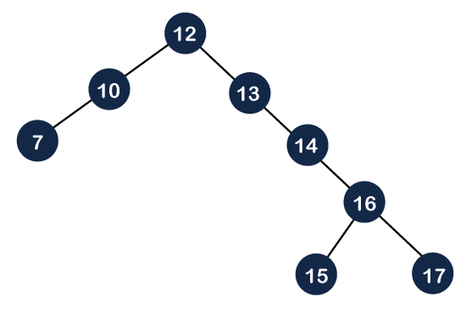
First Splay 16 to root
12
10
14
7
16
13
15
17

Slide 71
12
16
10
16
12
17
10
14
7
14
17
7
13
15
13
15

Slide 72
Now delete 16 which makes it into 2 subtrees
12
17
10
14
7
13
15

Slide 73
Find max in Left Subtree and splay it
12
14
15
12
15
10
14
14
10
13
12
7
13
15
7
10
13
7

Slide 74
Now attach right child to this tree
15
14
17
12
10
13
7

Slide 75
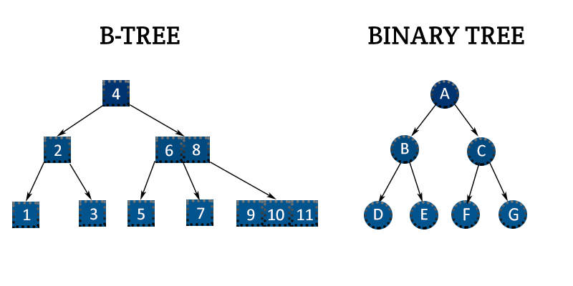

Slide 76
Definition
A B-tree of order m is an m-way search tree that is either empty or satisfies following properties:
Root node has atleast 2 children
All nodes other than root node have atleast $\left\lceil m/2\right\rceil$ children
All external nodes are at the same level.
When m=3, degree is (2,3) => 2-3 tree
When m=4, degree is (2,4)=> 2-3-4 tree

Slide 77
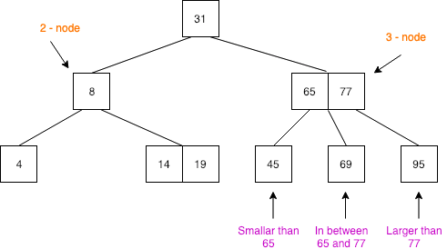

Slide 78
Example of 2-3-4 Tree
50
10
70
80
5
7
9
30
40
60
75
85
90
92

Slide 79
INSERTION INTO A B-TREE
Consider the sequence:
40,10,20,70,80,30,60
40
40
40
10
10
20

Slide 80
40,10,20,70,80,30,60
40,10,20,70,80,30,60
40
40
10
20
70
10
20
70
80

Slide 81
40,10,20,70,80,30,60
40,10,20,70,80,30,60
20
40
40
10
30
70
80
20
70
10
30
60
80

Slide 82
B-tree Insertion Algorithm:
Step 1: Location the position of node to be inserted
Step 2: If branch in which node is added is full, then take median of the node values and split nodes as left and right of median.
Step 3: Step 2 is repeated for all ancestral nodes if they are full

Slide 83
DELETION FROMA B-TREE
Consider the initial 2-3 B-tree:
50
80
50
80
10
20
60
70
90
95
10
20
60
90
95

Slide 84
50
80
50
80
10
20
60
90
95
20
60
90
95
50
80
50
90
20
60
90
95
20
80
95

Slide 85
50
90
50
20
80
95
20
80
90
50
50
20
80
90
20
80

Slide 86
50
50
80
20
80

Slide 87
B-tree Deletion Algorithm:
Step 1: Location the position of node to be deleted
Step 2: If deleting the node, does not cause underflow, proceed with deletion
Step 3: If underflow happens and right sibling exists, rotate left. If left sibling exists, rotate right
Step 4: If rotation causes underflow, do “joining” and deletion of the node.

Slide 89
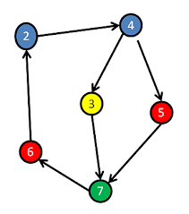
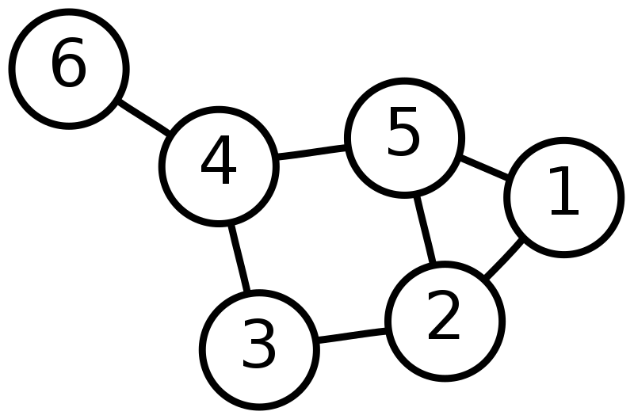
Definitions:
A graph G, consists of 2 sets V- vertices and E-edges
G=(V,E)
Undirected graph, pair representing edge is unordered and directed graph, it is ordered.
Undirected graph
Directed graph

Slide 90
Set Representations:
V={1,2,3,4,5,6}
E={(1,2), (1,5), (2,1), (2,3), (2,5), (3,2), (3,4), (4,5), (4,6)}
Self edges and multi-graphs are not allowed

Slide 91
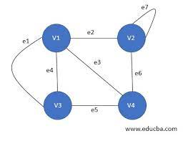
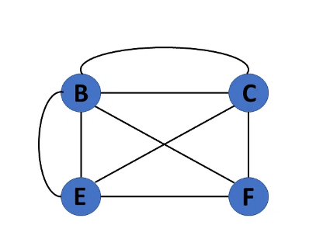
Graph with self edge
Multi graph

Slide 92
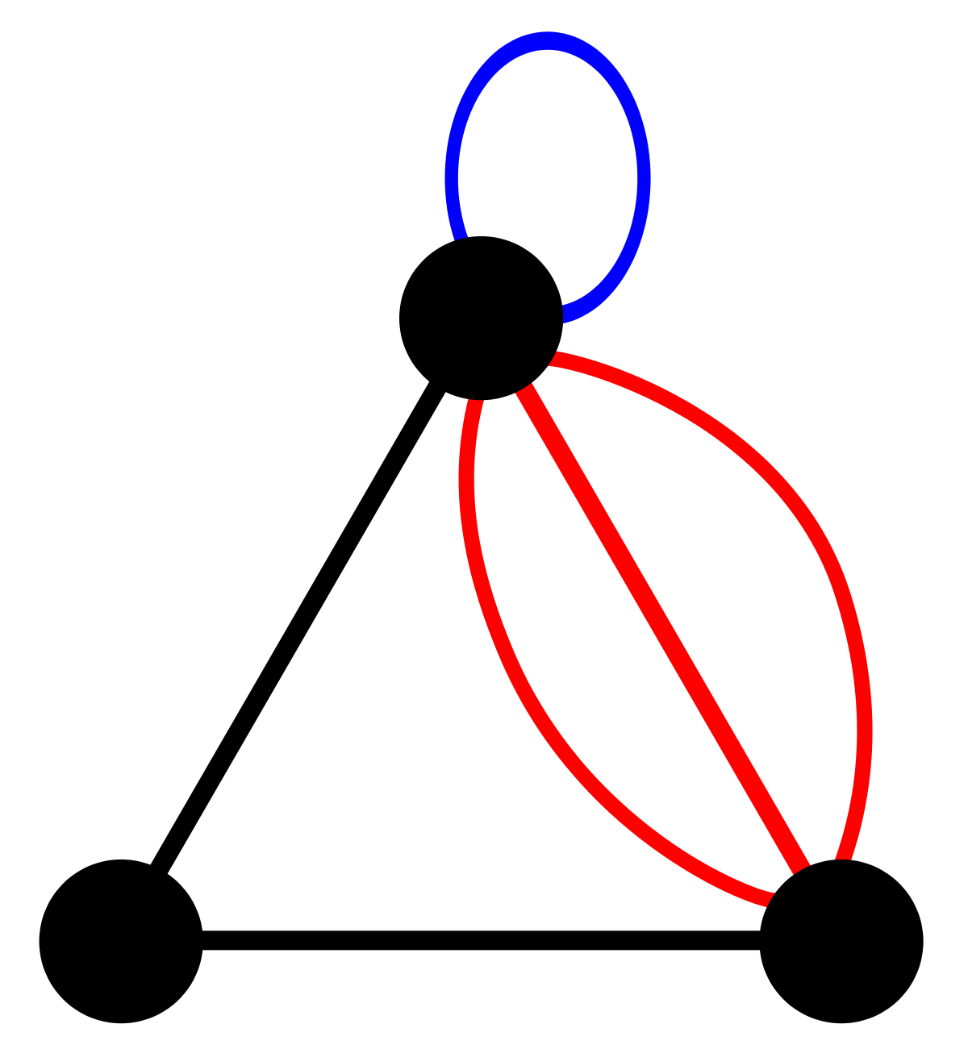
Multi graph with self edges

Slide 93
Maximum number of edges in a graph = n(n-1)/2
If (u,v) is an edge in G, then we say vertices u and v are adjacent and (u,v) is incident on vertices u and v
A tree is an acyclic graph
A subgraph of G is a graph G’ such that V(G’) is a subset of V(G) and E(G’) is a subset of E(G)

Slide 94
A path from vertex u to v is a set of vertices u,i1,i2..v such that (u,i1), (i1,i2)… (in,v) are edges
Length of path=no of edges in it
A simple path is a path in which all vertices except first and last are distinct
A cycle is a simple path in which first and last vertices are same

Slide 95
In an undirected graph G, two vertices u and v are connected iff there is a path from u to v
An undirected graph G is connected, iff for every distinct pair of vertices there exists a path
0
0
1
1
2
2
3
3
5
4
6
Connected graph
Connected graph

Slide 96
H1
H2
0
4
1
2
5
6
3
3
DisConnected graph
A connected component of an undirected graph is a maximal connected subgraph.

Slide 97
A directed graph G is strongly connected iff for every pair of distinct vertices (u,v) there is a directed path from u to v and v to u
0
1
2
Not Strongly connected graph, but has strongly connected component

Slide 98
Degree of a vertex is number of edges incident to that vertex.
For a directed graph, in-degree of a vertex is the number of incoming edges
For a directed graph, out-degree of a vertex is the number of outgoing edges

Slide 99
Abstract Data Type of a Graph
ADT Graph:
objects: set of vertices and edges
functions:
Graph Create()
::=returns an empty graph
Graph InsertVertex(graph,v)
::=returns a graph with v inserted
Graph InsertEdge(graph,v1,v2)
::=returns a graph with new edge between v1 and v2
Graph DeleteVertex(graph)
::=returns a graph with v and all edges incident on it is deleted

Slide 100
Graph DeleteEdge(graph,v1,v2)
::=returns a graph with edge between v1 and v2 deleted
Boolean IsEmpty(graph)
::=if(graph==emptygraph) return TRUE else return FALSE
List Adjacent(graph,v)
::=returns a list of all vertices that are adjacent to v

Slide 101
Graph Representations
Choice depends on:
Application
Function expected
Adjacency Matrix
Adjacency Lists
Adjacency MultiLists

Slide 102
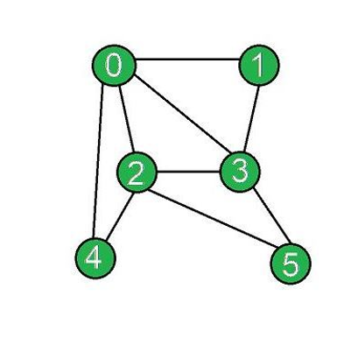
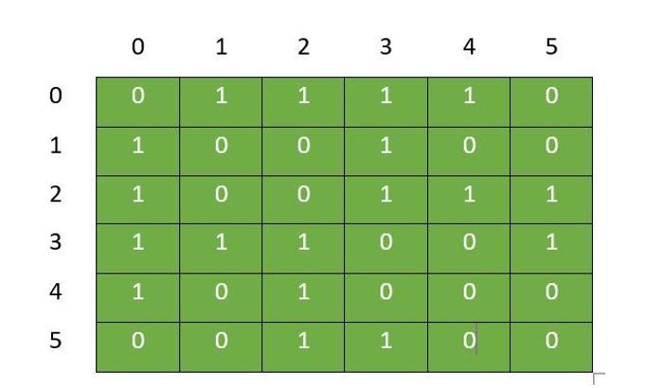
Adjacency Matrix Representation

Slide 103
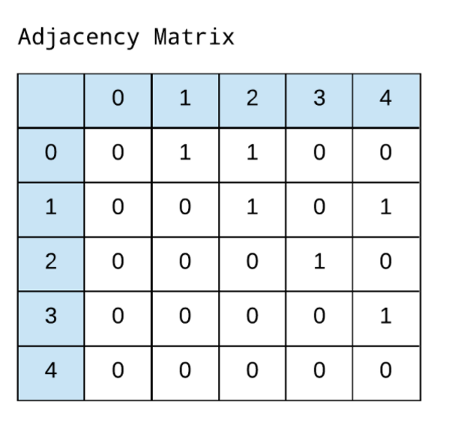
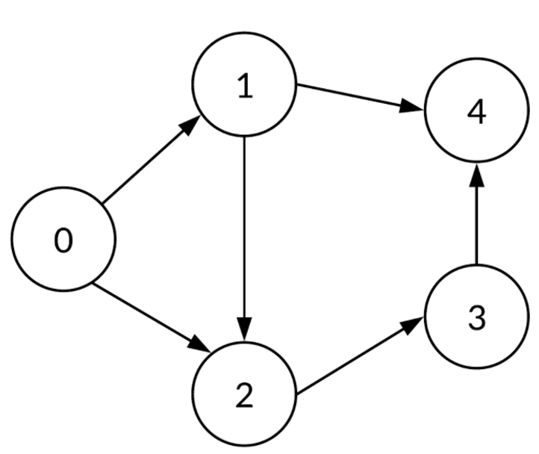

Slide 104
For an undirected graph, degree of any vertex is its row sum
For a digraph, row-sum is outdegree and column-sum is indegree
Drawback of Adjacency matrix is wastage of memory

Slide 105
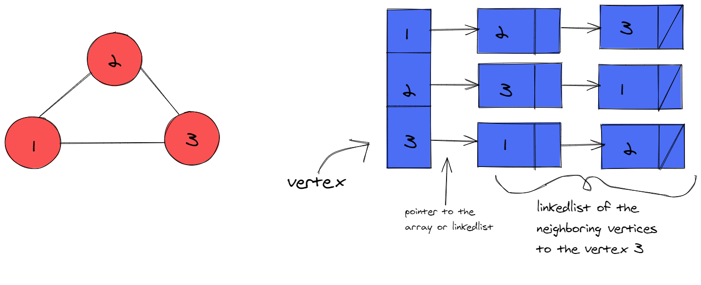
Adjacency List Representation

Slide 106
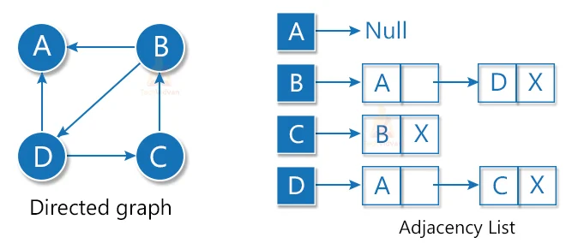

Slide 107
Create adjacency List Representation
0
0
1
2
3
/
1
2
1
0
2
3
/
2
0
1
3
/
3
3
0
1
2
/

Slide 108
0
1
2
/
1
0
3
4
/
0
2
0
5
6
/
1
2
3
1
/
4
1
/
3
4
5
6
5
2
/
6
2
/

Slide 109
Create adjacency List Representation
H1
H2
0
4
1
2
5
6
3
7
DisConnected graph

Slide 110
0
1
2
/
1
0
3
/
2
0
3
/
3
1
2
/
4
5
/
5
6
4
/
6
5
7
/
7
6
/

Slide 111
Create adjacency List and Inverse Adjacency List Representation
0
1
/
0
0
1
/
1
0
2
/
1
0
/
1
2
2
/
2
1
/

Slide 112
For an undirected graph, degree of any vertex is number of nodes in the chain of that vertex
For a digraph, out-degree is the number of nodes in the chain of that vertex
For a digraph, in-degree is the number of nodes in the chain of that vertex in Inverse Adjacency list

Slide 113
Write adjacency multi-list representation
0
0
N0
0
1
N1
N3
N1
0
2
N2
N3
1
1
2
N2
0
3
0
N4
2
3
N3
1
2
N4
N5
3
N4
1
3
0
N5
N5
2
3
0
0

Slide 114
For a digraph, obtain adjacency matrix, adjacency list, and adjacency multi-list representations
0
1
3
2

Slide 115
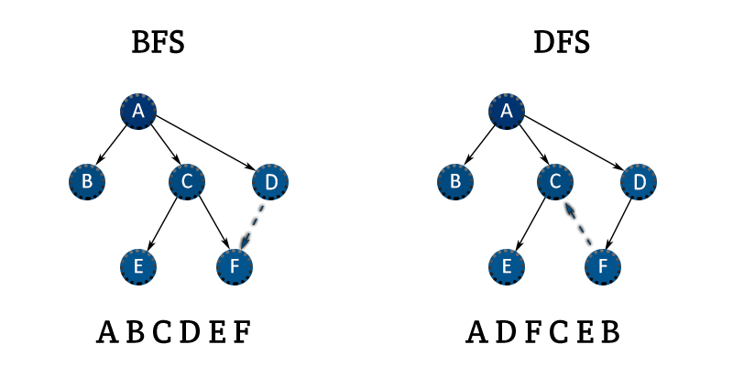

Slide 116
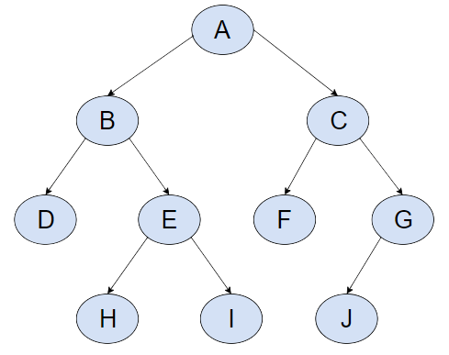
Apply BFS and DFS

Slide 118
Static Hashing
In Static hashing, dictionary pairs (key,value) are stored in a table called hash-table
Each bucket may also contain more slots
HASH TABLE
Each slot big enough to hold one dictionary pair
Partitioned to buckets
Each bucket – one slot

Slide 119
Key density of a hash table = n/T
n – number of pairs
T- total possible number of keys
Compute key density for keys which are atmost 6 digits long and there are 1000 dictionary pairs
T= total number of possible keys= 9*10^5=900000
n=1000
Hence, key density=1000/900000=1/900=0.00111111111
Hence fraction of the usage of keys is very small

Slide 120
Construct a hash table for C library functions, with first letter of the function goes to the appropriate bucket. Assume 2 slots for each bucket
Slot 0
Slot 1
0
acos
atan
acos
define
float
1
exp
char
atan
2
char
ceil
3
define
ceil
floor
clock
4
exp
5
float
floor
6
Collision
25

Slide 121
When no overflow occurs, time required to insert, delete or search using hashing depends only on time required to compute hash function and time to search one bucket.
Hash table with 26 buckets and 2 slots is not useful due to large number of collisions

Slide 122
Desirable properties of hash functions:
Easy to compute
Minimizes the number of collisions
Collisions are unavoidable, hence mechanisms to handle collisions is desired.

Slide 123
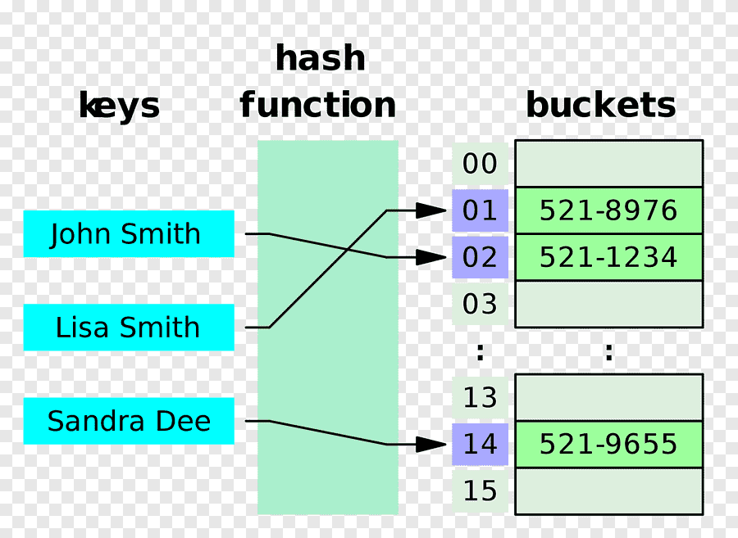
Hash function maps a key to a bucket

Slide 125
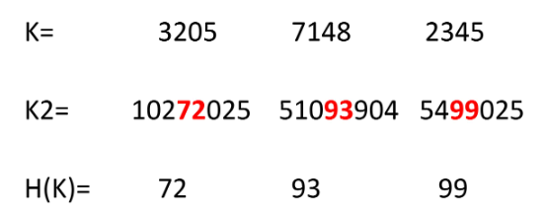

Slide 126
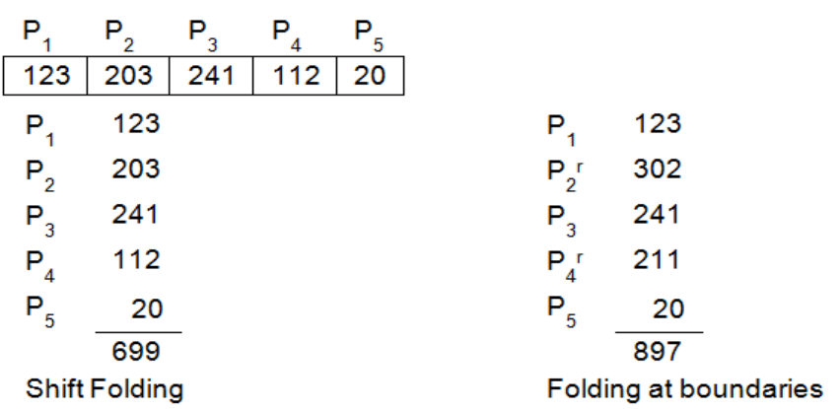
Folding Method

Slide 129
Random Probing

Slide 130
index=(index+1)%list_size

Slide 131
Chaining

Slide 134
Dynamic Hashing
Overcome the problems of static hashing like bucket overflow.
Data buckets grow or shrink as the records increases or decreases. This method is also known as Extendable hashing method.
This method makes hashing dynamic, i.e., it allows insertion or deletion without resulting in poor performance.

Slide 135
How to search a key
Calculate the hash address of the key.
Check how many bits are used in the directory, and these bits are called as i.
Take the least significant i bits of the hash address. This gives an index of the directory.
Now using the index, go to the directory and find bucket address where the record might be.

Slide 137
Inserting a new record
Follow the same procedure for retrieval, ending up in some bucket.
If there is still space in that bucket, then place the record in it.
If the bucket is full, then split the bucket and redistribute the records.

Slide 138
Insert key 9 with hash address 10001

