Slide 1


MICRO-CONTROLLER AND EMBEDDED SYSTEMS (MES)

Slide 2

Businesses runs on software and softwares run on hardware

Slide 3

Operating system is a bridge that connects software and hardware

Slide 4

Hardware of a computer essentially comes in 2 forms: microprocessors and microcontrollers

Slide 5
Differences between microprocessors and microcontrollers
Parameter | Microprocessor | Microcontroller
Definition | IC that has only CPU inside it and RAM, ROM and other peripherals need to be added externally | IC that has integration of CPU RAM, ROM and other peripherals
Tasks used | General purpose | Specific purpose
Preference | Relationship between input and output is not clearly defined | Relationship between input and output is clearly defined

Slide 6
Parameter | Microprocessor | Microcontroller
Suitability for embedded applications | Not suitable | Ideally suitable due to low power consumptions
Suitability for general purpose applications | Ideally suitable due to capability of satisfying huge resource demands | Not suitable
Price | Costlier | Cheaper
Speed | High (1Ghz) | Slow (20-50Mhz)
Memory | External (in GBs) | KBs of internal for RAM and ROM

Slide 7
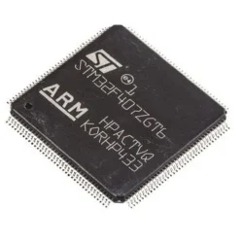
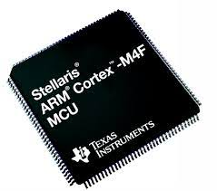
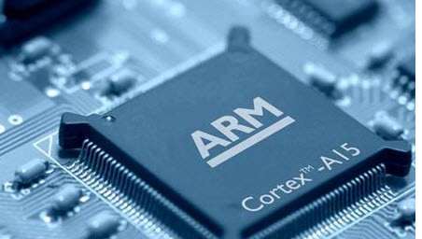

Slide 8
ARM FeatuRes
ARM stands for Advanced RISC Machine. It is one of the most licensed and extensive processor cores in the world.
Specially used in portable devices like digital cameras, mobile phones, home network modules, wireless communication technologies, etc..
Advanced RISC Machine Architecture is better than x86.
ARM Processor is not only limited to mobile phones but is also used in Fugaku, the world’s fastest supercomputer.
ARM can be used as a microprocessor, microcontroller and both

Slide 9
MODULE-1
ARM processor fundamentals
MODULE-2
ARM Instruction Set
C compilers with ARM
MODULE-3
ARM C programming with optimization
ARM ALP programming
About Microcontrollers and Embedded systems

Slide 10
MODULE-4
Sensors and actuators
MODULE-5
Real time Operating Systems (RTOS)
Embedded System Development Environment
Embedded System components

Slide 11


Slide 12
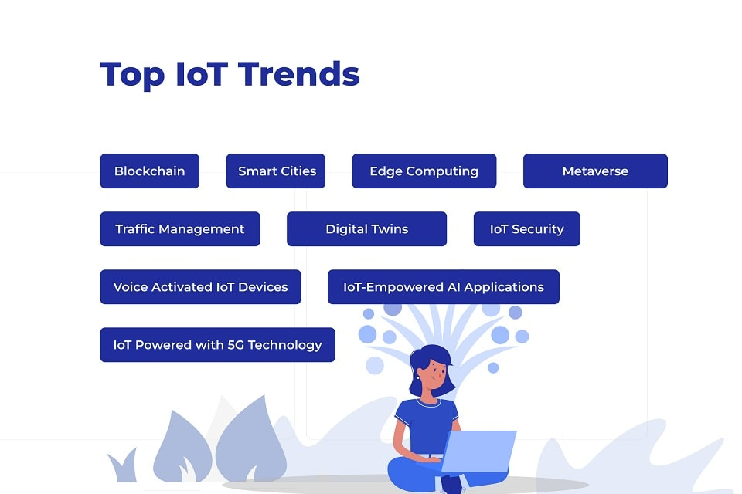

Slide 13
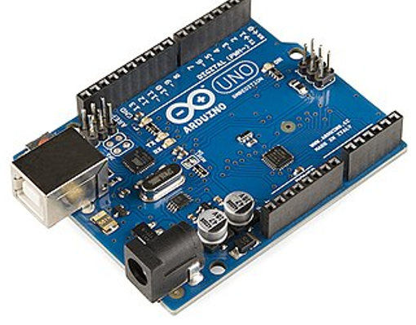
Arduino is a open-source project.
Supports hardware and software platform to design and build electronic devices.
The designs of Arduino boards use a variety of controllers and microprocessors.

Slide 14

Raspberry Pi, developed by Raspberry Pi Foundation in association with Broadcom, is a series of small single-board computers and perhaps the most inspiring computer available today.
It is a cheap, credit-card-sized device that uses a daily keyboard and mouse and joins to a TV or computer monitor.
It is a thin weighable computer that let every person to explore the internet and watching high-definition video, word-processing, to creating spreadsheets, and it can do every possible thing we'd expect a desktop computer to do and playing sports.

Slide 15
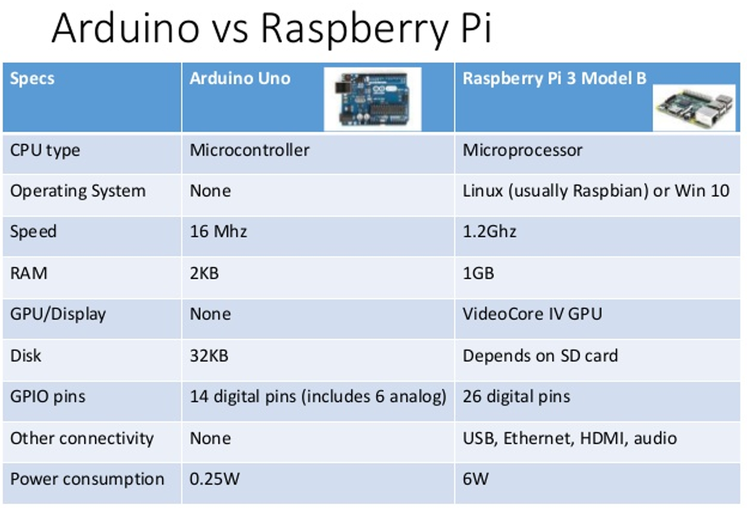

Slide 16
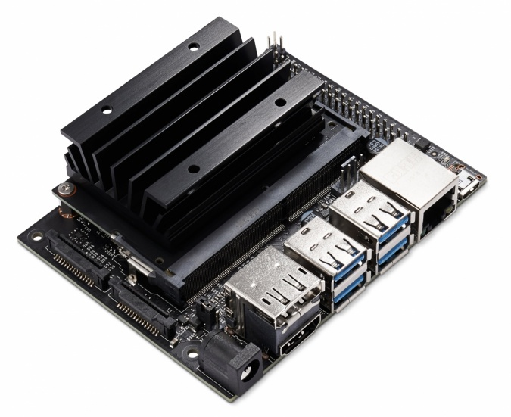
NVIDIA Jetson Nano is an embedded system-on-module
Useful for deploying computer vision and deep learning
128 core MAXWELL GPU
ARM CPU

Slide 17
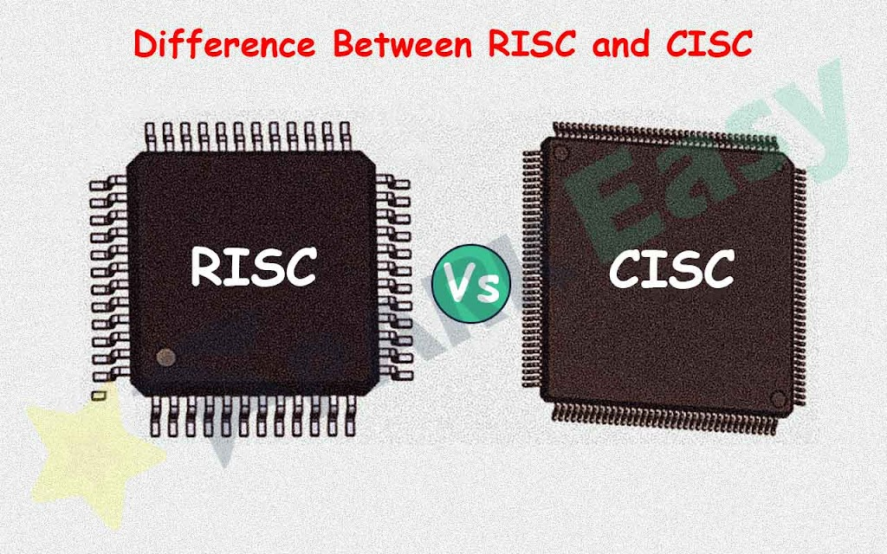
RISC – Reduced Instruction Set Computer
CISC – Complex Instruction Set Computer

Slide 18

RISC – Simple but powerful
CISC – Complex
Hardware

Slide 19
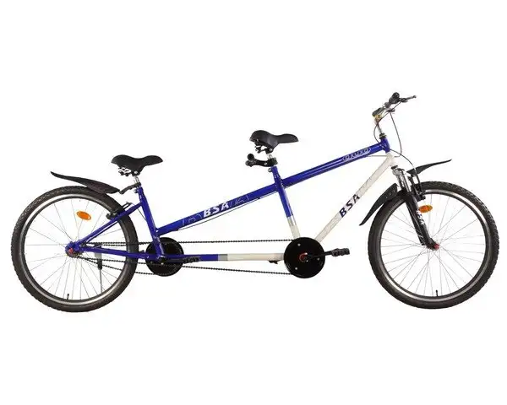

RISC – Single cycle per instruction
CISC – One or Two cycles per instruction

Slide 20

RISC – relies on intelligence of software and lesser complex hardware
CISC – relies on complex hardware

Slide 21
CISC
Greater Complexity
RISC
Compiler
Compiler
Code Generation
Code Generation
Processor
Processor
Greater Complexity
RISC – compiler complexity
CISC- hardware complexity

Slide 22

Major design rules of RISC
Instructions
Simple
Synthesis
Fixed length
Prefetch
One clock cycle
Derive new instructions from old
Reduced number of instructions
CISC drawbacks: variable size instructions, many clock cycles might be required

Slide 23

Pipelines: Instructions divided into smaller units and run parallelly in pipelines
Instructions decoded in one pipeline stage
CISC drawbacks: microcode required

Slide 24

RISC has too many general purpose registers
CISC has few dedicated registers
Register
Data or Address

Slide 25

Operating directly on memory not allowed in RISC unlike CISC
Register
Memory
LOAD
Register
Memory
STORE

Slide 26

ARM

Slide 27


High code density
-due to cost
-physical size restrictions
Price sensitive
Extended battery operation
Smaller area used by embedded processor
Incorporated hardware debug technology

Slide 28
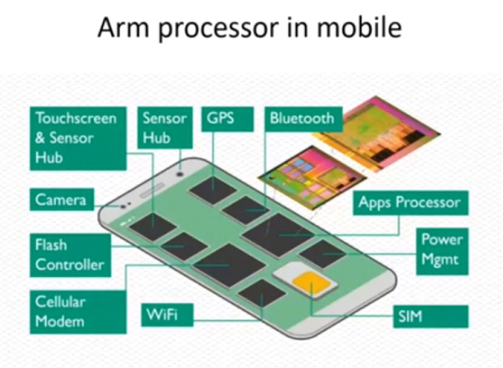

Slide 29

Instruction set,
Special registers,
Special instructions

Slide 30

Instruction SET FOR EMBEDDED SYSTEMS
Few instructions incur variable cycle. Load and Store depends on number of registers used

Slide 31
Inline barrel shifter leading to complex instructions
Thumb 16 bit instruction set
Conditional execution
Enhanced Digital Signal Processing Instructions

Slide 32
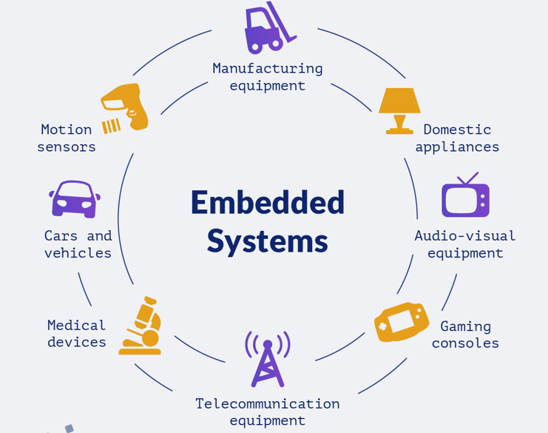

Slide 33
Embedded SYSTEMS
An embedded system is a combination of computer hardware and software designed for a specific function.
Embedded systems may also function within a larger system.
The systems can be programmable or have a fixed functionality.

Slide 34
Embedded SYSTEMS HARDWARE BASED on ARM
SRAM, FLASH, DRAM
ARM Processor
Memory Controller
AHB External bridge
AHB Arbiter
Interrupt Controllers
AHP-APB Bridge
Real time clock
Ethernet
Driver
Serial UART
Counters/Timers

Slide 35
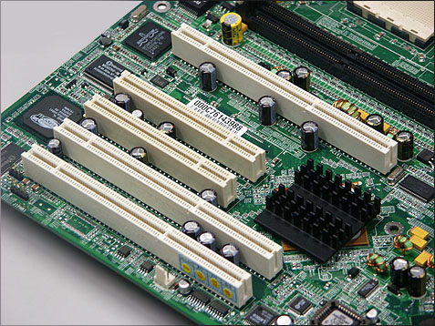
ARM BUS TECHNOLOGY
PCI Bus:
Used in x86
Interconnect Hard disk drives and video cards
External or off-chip

Slide 36
ARM Bus:
Used in Embedded devices
Interconnect different peripherals with ARM Core
Internal or on-chip

Slide 37

ARM BUS – MASTER SLAVE ARCHITECTURE
Master- ARM Core processor who can initiate data transfer
Slaves – Peripherals – capable of responding to transfer requests

Slide 38


ARM BUS – ARCHITECTURE LEVELS
Electrical characteristics and bus width
Protocol between processor and peripherals

Slide 39
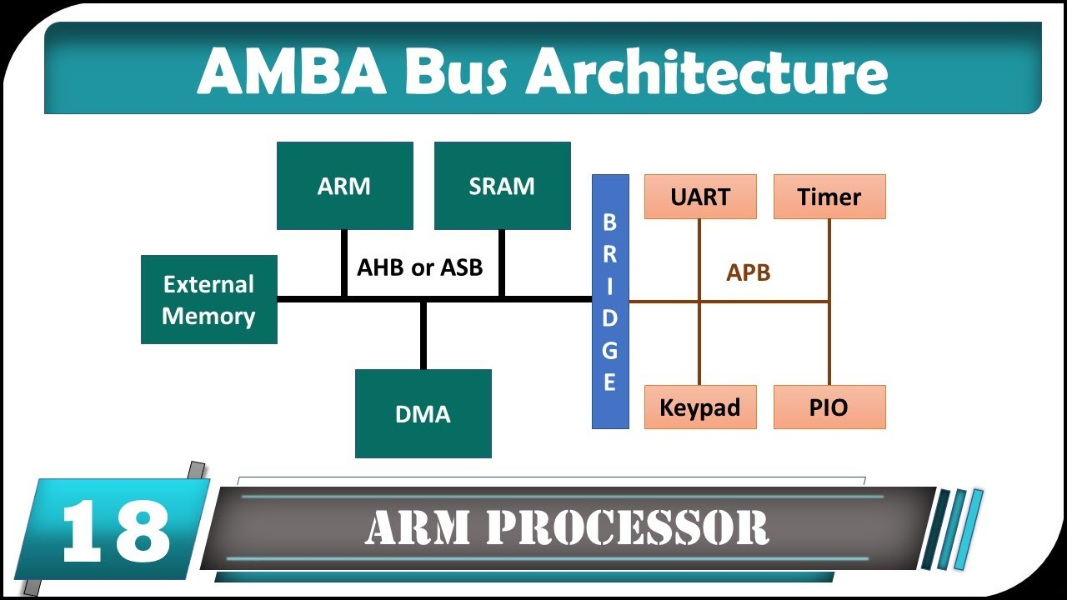

Slide 40
ASB – ARM System Bus
AHB – ARM High Performance Bus with larger bandwidths (64 /128 bit)
Multi-layer AHB and AHB Lite
APB – ARM Peripheral Bus with slower bandwidth
AHB New interconnects supports multiple processors, supporting operations in parallel

Slide 41

Embedded system needs memory to store and execute code
MEMORY

Slide 42
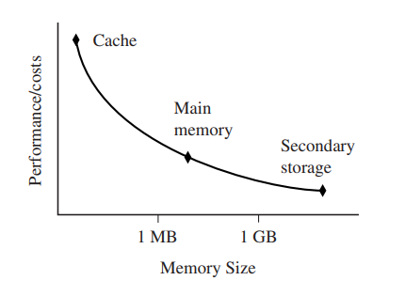
Storage Tradeoffs

Slide 43
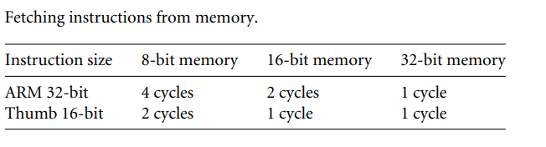

Slide 44
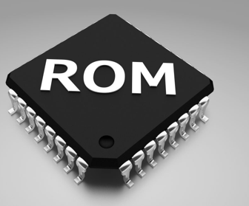
TYPES OF MEMORY
Read Only Memory
Permanently set during production time and cannot be reprogrammed
Contains boot code

Slide 45
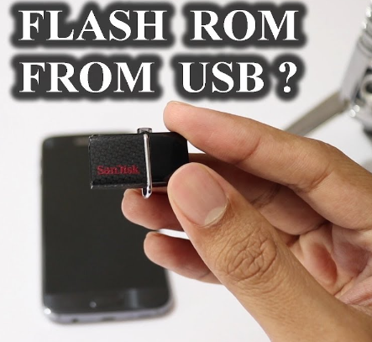
Can be written but slow
Not for dynamic data
Suitable for firmware data
Erasing and writing of flash is software controlled

Slide 46
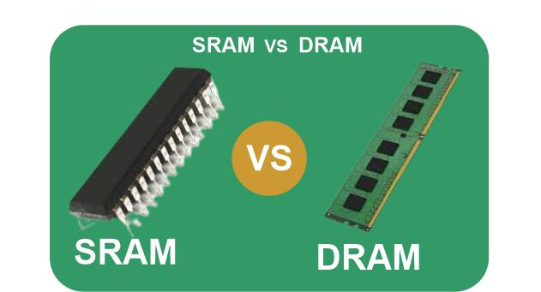
DRAM cheaper than SRAM
DRAM slower as it requires refresh than SRAM

Slide 47

Can run at much higher clock speeds than conventional memory
It synchronizes itself with the computer’s system clock. This makes it easy to manage faster

Slide 48

Peripheral device
Connect ARM to outside world
Comprises of input and output devices
Can be on-chip
Can connect other sensors and actuators
ARM peripherals are memory-mapped. (memory address registers).
Controllers are specialized peripherals to control access to memory or interrupts

Slide 49
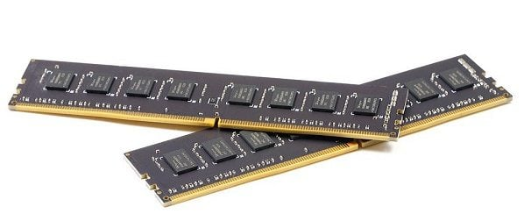
Memory Controllers
Connect different types of memory to AHB
On power up, certain memory devices are made active.
These memory devices execute initialization code.
They also enable refreshing required as in DRAM.

Slide 50

Interrupts are raised to gain attention
In this case, interrupts raised by peripherals to get attention of ARM processor.
Interrupts go through Interrupt controllers

Slide 51
Peripherals
Standard Interrupt Controller (SIC)
Interrupt Handler
IGNORE OR ALLOW
ARM

Slide 52

Peripherals
Vector Interrupt Controller (VIC)
Interrupt Handler
ARM

Slide 53
Embedded SYSTEMS SOFTWARE
APPLICATIONS
OPERATING SYSTEM
INITIALIZATION CODE
DEVICE DRIVER
HARDWARE DEVICE

Slide 54

An embedded system gets into action by first executing boot code (initialization code)
It sets up memory devices, caches, peripheral devices
Deals with administrative work before actual OS image is loaded

Slide 55
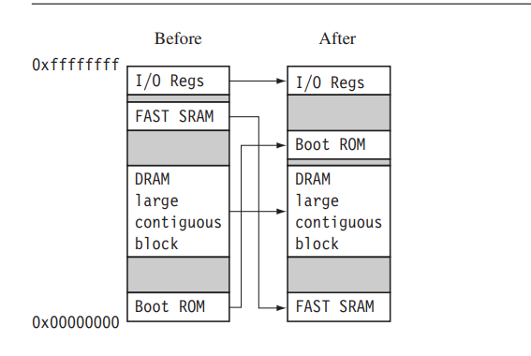
Phase-1: Initialize hardware configuration be reorganizing memory

Slide 56

Phase-2: Diagnostics
Diagnose whether hardware is working or not
Helps in isolating faults

Slide 57

Phase-3: Booting an image
Load relevant OS image
Copy code and/or data into RAM
Sometimes image decompression is required
Complex when task is to boot from multiple OS images

Slide 58


Operating Systems
OS is like manager which manages various resources like memory, processor and peripherals
ARM has more than 50 OS, but 2 categories: RTOS and PSOS

Slide 59
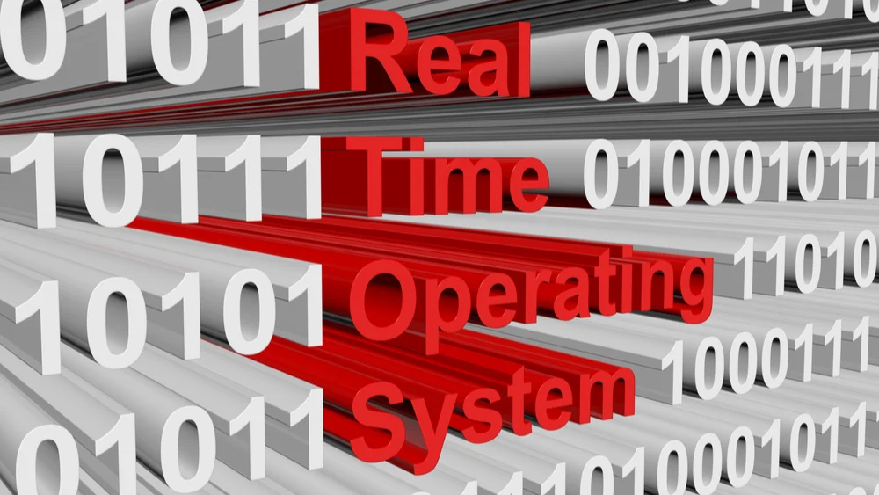
RTOS
It has deadlines and guaranteed response
Hard RTOS provides guaranteed response
Soft RTOS provides good response
RTOS do not have secondary storage

Slide 60

Platform Specific Operating Systems
POS
No deadlines
Large exclusive memory manager for real time applications
Tend do have secondary storage

Slide 61
Embedded SYSTEMS APPLICATIONS

Slide 62
ARM processors suitable to applications that are price sensitive and high volume.
ARM processors not found in applications that require leading edge high performance.

Slide 63

ARM CORE PROCESSOR COMPONENTS
View of programmer
Data flow through various functional units is shown
Bus communication is also depicted
Von-nuemann vs Harvard architecture

Slide 64
Data/Instruction
Write
Read
Instruction Decoder
Sign Extend
r15
Rd
Register file r0- r15
pc
Result
Rn
Rm
Acc
Barrel Shifter
MAC
A
B
N
ALU
Address Register
Incrementer
Address

Slide 65
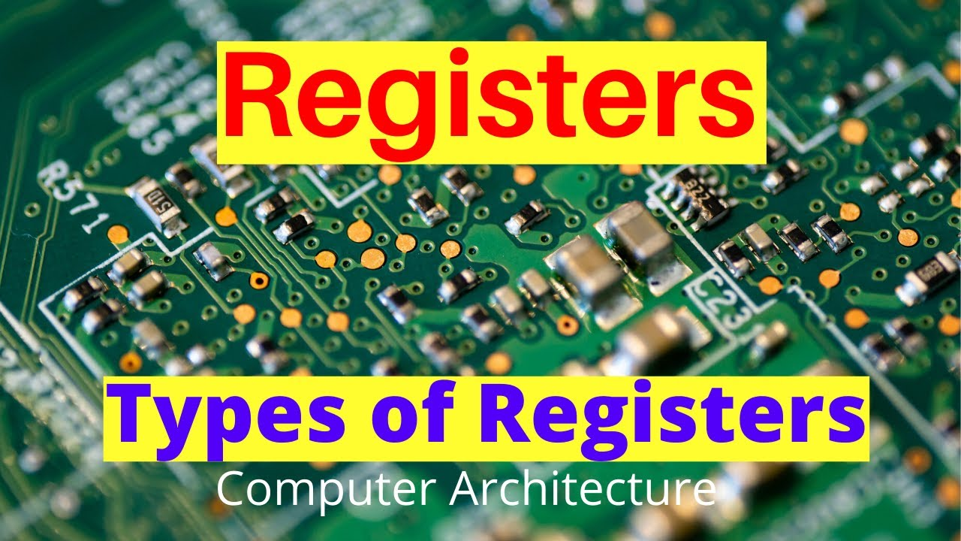

Slide 66
ARM Register
Prefixed with letter r
Data or Address
18 active registers in user mode:
r0
r1
r2
r3
r4
r5
r6
r7
r8
r9
r10
r11
r12
sp- Stack pointer
lr-Link register
pc-Program Counter
r13-sp
r14-lr
r15-pc
Registers r0 to r13 are orthogonal
cpsr
spsr
cpsr- Current Program status register
spsr-Saved program status register

Slide 67
Program STATUS REGISTER
Flags
Status
Extension
Control
N
Z
C
V
I
F
T
Mode
31
30
29
28
7
6
5
4
0
Thumb state
Processor Mode
Condition flags
Interrupt Masks

Slide 68

PROCESSOR MODES
PRIVILEGED
NON-PRIVILEGED
In privileged mode- full read-write access to cpsr
In non-privileged mode – read only access

Slide 69
PROCESSOR MODES
Processor Mode | Explanation | Type
Abort | Failure to access memory | Privileged
Fast Interrupt Request | Peripherals signaling attention of processor with high priority | Privileged
Interrupt Request | Peripherals signaling attention of processor with normal priority | Privileged

Slide 70
Processor Mode | Explanation | Type
Supervisor | OS mode | Privileged
System | Special version of user mode that allows full readwrite access to the user | Privileged
undefined | Wrong instruction | Privileged
User | Enter user mode | Non-Privileged

Slide 71
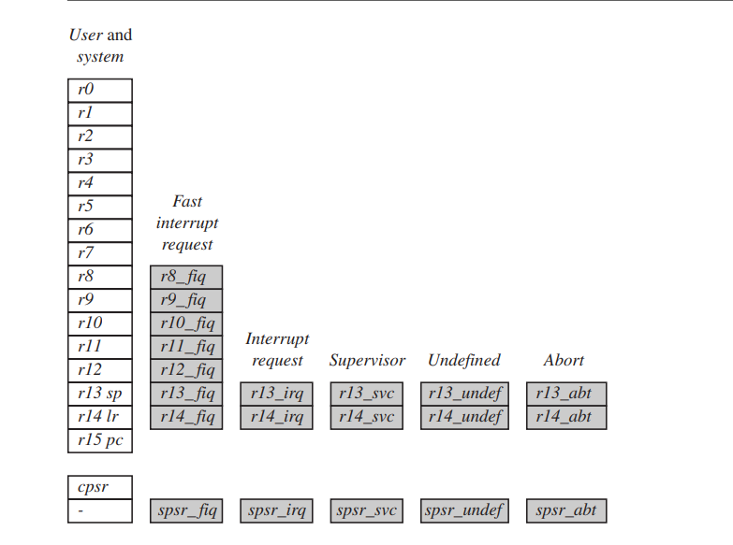
bANKED REGISTERS
Visible 17 registers
Hidden 20 registers called Banked Registers

Slide 72
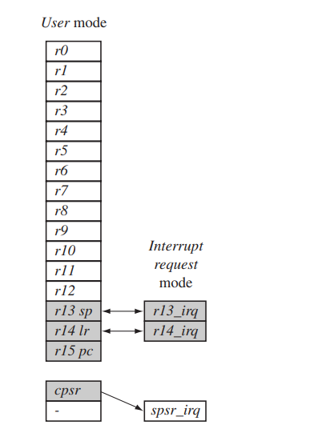
Changing mode on exception
Interrupts and exceptions changes mode
Reset, interrupt request, fast interrupt request, software interrupt, data abort, prefetch abort, undefined instruction

Slide 73
Every processor mode except user mode can change mode by directly writing to cpsr
Can be changed by program or hardware
Saved program status register stores previous modes cpsr
spsr only modified with privileged mode
spsr only done when hardware changes processor mode

Slide 74
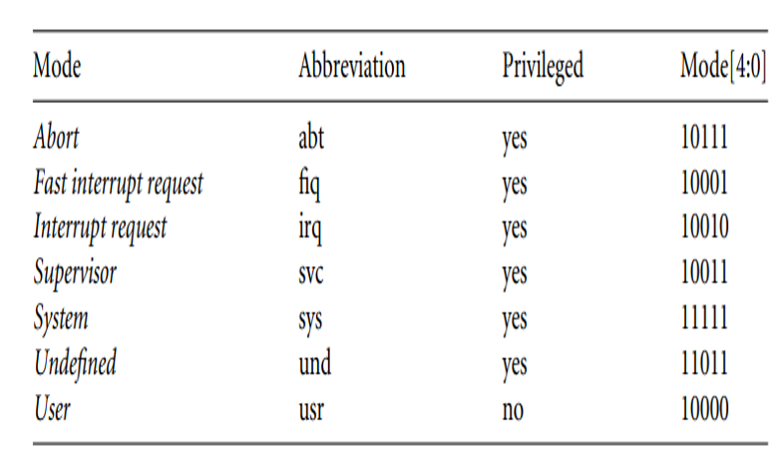
PROCESSOR MODE VALUES

Slide 75



ARM INSTRUCTION SETS
ARM
THUMB
JAZELLE
In state field T=1 => Thumb Mode,
J=1 => Jazelle Mode

Slide 76
ARM vs THUMB
Parameter
ARM
THUMB
Instruction size
32 bit
16 bit
Core
58
30
instructions
Conditional
most
Only branch
Execution
Data processing
Combined access
Separate access
to barrel shifter
to barrel shifter
and ALU
and ALU
Program status
Read
-
write in
No direct access
register
privileged access
Register usage
15 GP + pc
8GP +7high+pc

Slide 77
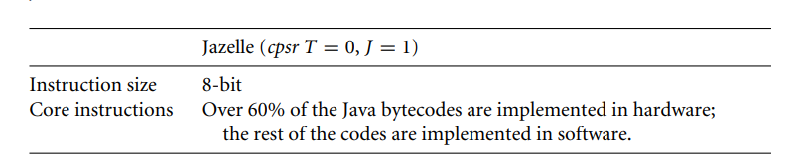

Slide 78


Interrupt Mask
IRQ- Interrupt Request
FIQ- Fast Interrupt Request
Interrupt Service

Slide 79
CONDITION FLAGS
Mainly affected by ALU operations
Flag
Flag Name
When
Q
Saturation
DSP instruction
overflow
V
oVerflow
Signed overflow
C
Carry
Unsigned carry
Z
Zero
Comparison results
in equality
N
Negative
Bit 31 is 1

Slide 80

Conditional execution will determine whether ARM processor will execute a specific instruction or not

Slide 81
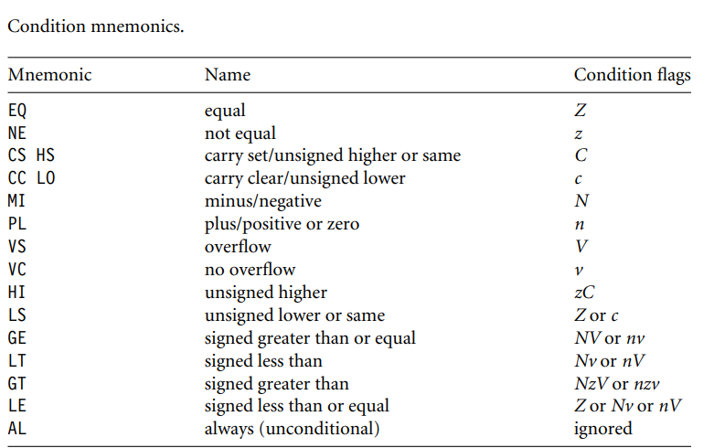

Slide 82
Pipelines: Instructions divided into smaller units and run parallelly in pipelines
Instructions decoded in one pipeline stage

Slide 83
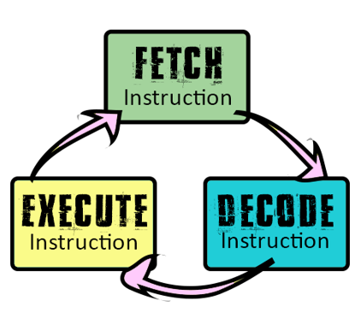
ARM 3 StAGE PIPELINE
Fetch an instruction from memory
Decode identifies instruction
Execute executes the instruction and writes result back to register

Slide 84
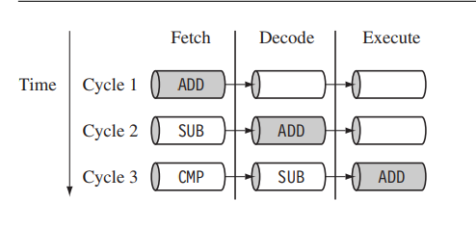
EXAMPLE PIPELINE SEQUENCE
Filling of Pipelines

Slide 85
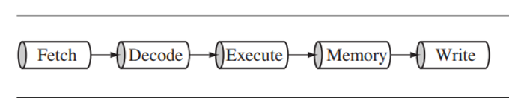
5 stage pipeline
7 stage pipeline
Increased pipeline length a tradeoff between performance and latency

Slide 86
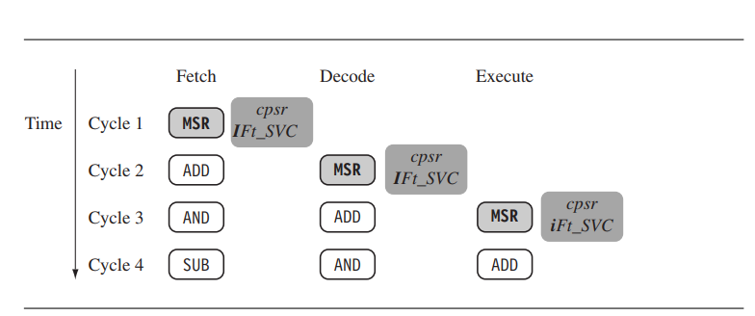
PIPELINE EXECUTING CHARACTERISTICS
Pipelines and Interrupts

Slide 87
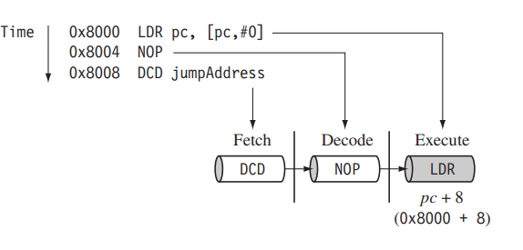
Pipelines and Program Counter

Slide 88
Execution of branch instruction causes ARM core to flush its pipeline
Loading the new branch address prior to the execution of instruction.
Instruction in the execute stage will complete even though an interrupt has been raised.

Slide 89


Exceptions
Interrupts
When exception or interrupt, processor sets pc to special address from vector table.

Slide 90
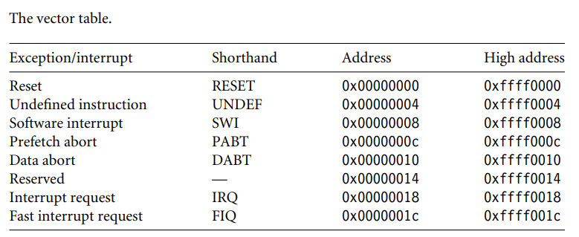

Slide 91
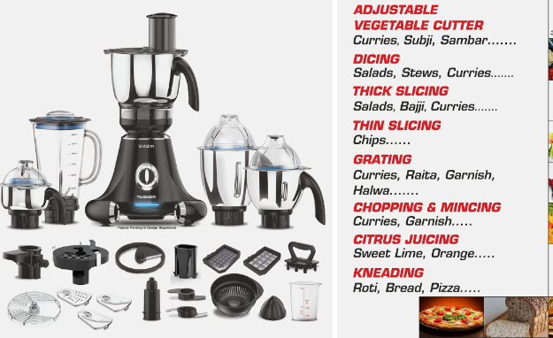
ARM processor is given extensions to improve performance, do extra functionality and provide flexibility.

Slide 92
ARM EXTENSIONS
CACHE and TIGHTLY COUPLED MEMORY
MEMORY MANAGEMENT
COPROCESSOR

Slide 93
Von Neuman
ARM Core
Unified cache
Logic and Control
Main Memory
AMBA bus interface unit
On-chip AMBA Bus

Slide 94
ARM Core
Harvard
Logic and Control
D
I
Data cache
Instruction cache
D
I
Main Memory
AMBA bus interface unit
D + I
On-chip AMBA Bus

Slide 95
ARM Core
Harvard with TCM
Logic and Control
I
D
D
I
Data cache
Data TCM
Instruction cache
Instruction TCM
D
D
I
I
Main Memory
AMBA bus interface unit
D + I
On-chip AMBA Bus

Slide 96
ARM CORE MEMORY MANAGEMENT HARDWARES
Nonprotected memory
Memory Protection Units (MPU) with limited protection.
Memory Management Units (MMU) with full protection

Slide 97
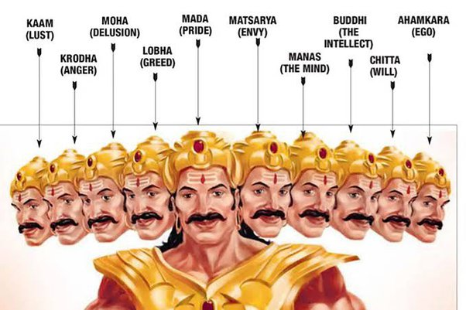
COPROCESSORS –ADDITIONAL TO PROCESSORS

Slide 98
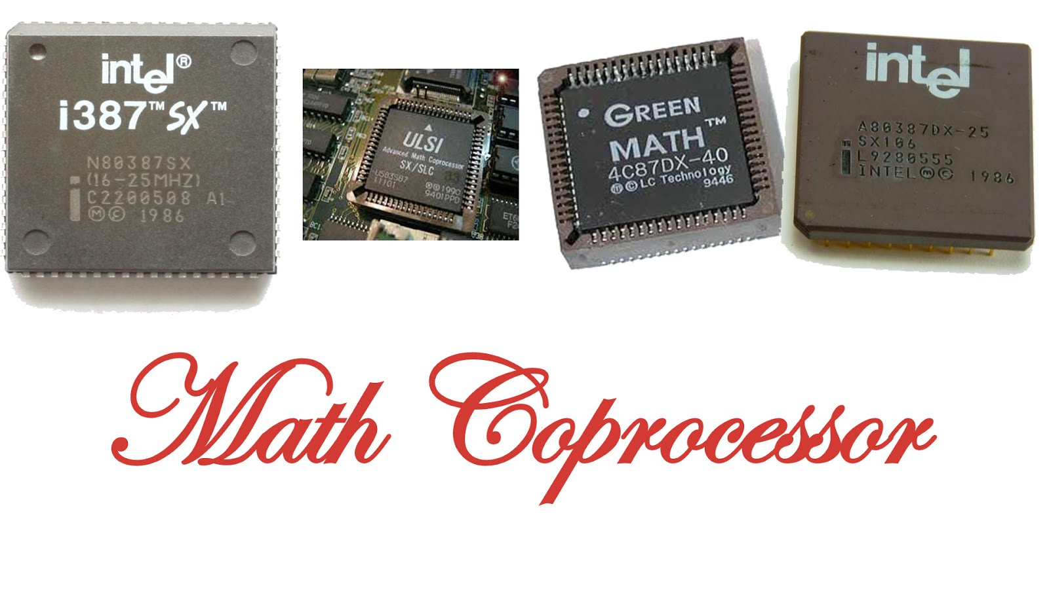
Coprocessors extend the basic capabilities of processors

