Slide 2
BRANCH ENTRY
NEP INTERNSHIP
BRANCH INAUGURATION

Slide 3
STUDENT CHAPTER INAUGURATION
III SEM ACADEMICS
DS/ADE/CO…
JAVA LAB

Slide 4
IV SEM
EVENTS
IV SEM ACADEMICS
MES/OS/DAA…
PYTHON LAB

Slide 7
PROGRAM 100

Slide 8
CLASS REPRESENTATIVES
FALCONi
JNNACM
BEFORE
29-11-2023

Slide 12
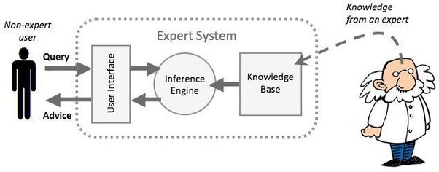

Slide 14
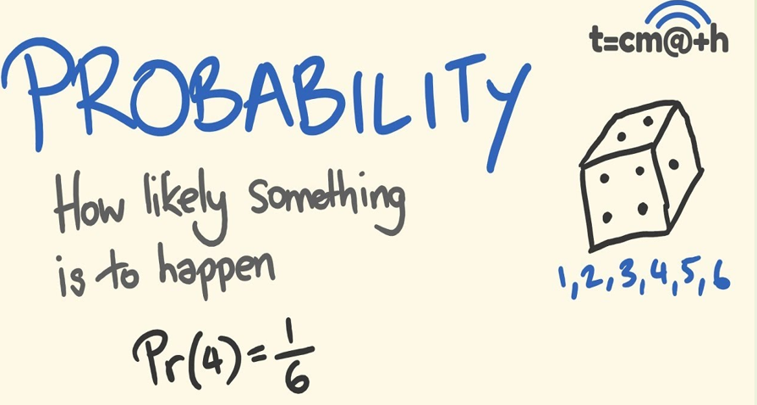

Slide 16
REPORT
BACK END->FRONT END->BL
DESIGN
DISCUSS IDEA AND FINALIZE TOPIC
MAKE BATCHES of 4 members

Slide 17
AI
ANGULAR JS FRONT END
PYTHON FLASK
DATABASE

Slide 18
What is AI??
Thinking humanly
Machine with minds
Automation of human activities
Thinking rationally
Machine with models
Study of computations
Acting humanly
Create machines working as people
Acting rationally
Intelligent agents

Slide 19
Acting humanly
Create machines working as people

Slide 21
A machine passes Turing Test if human interrogator cannot differentiate whether responses came from human or machine.
Natural Language Processing
TO PASS TURING TEST
MACHINE REQUIRES
Knowledge representation
Automated Reasoning
Machine Learning

Slide 22
Total Turing test is a turing test + testing subject’s perceptual abilities.
TOTAL TURING TEST REQUIRES COMPUTER VISION AND ROBOTICS

Slide 23
Thinking humanly
Machine with minds
Automation of human activities

Slide 24
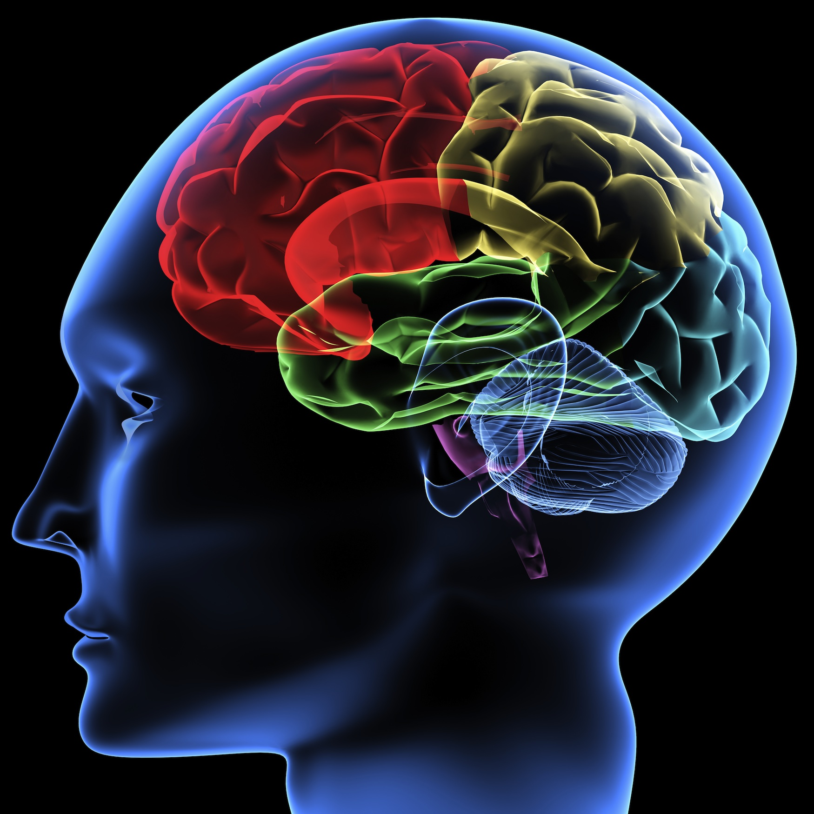
Cognitive Science
How humans think
Introspection
Psychological experiments
Brain imaging

Slide 25
Numerical Reasoning
identify the hidden pattern in the series of numbers below, and use it to predict the next / missing number:
8 | 3 | 9 | 10 | 17 | ?

Slide 26
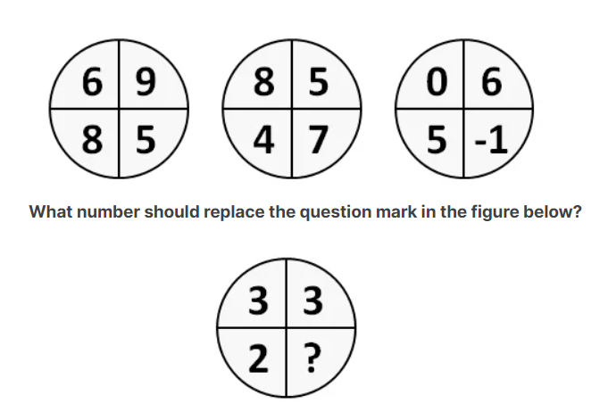
Abstract Reasoning

Slide 27
Deductive Reasoning
If the first two statements are true, is the final statement true?
Most snakes are green. Most snakes are quick.
At least one snake is both green and quick.

Slide 28
Thinking rationally
Logic

Slide 29
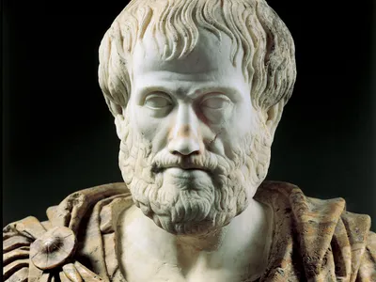
Drawbacks of logicist approach:
Difficult to make every informal issue formally
Principle vs practice – 2 different things

Slide 30
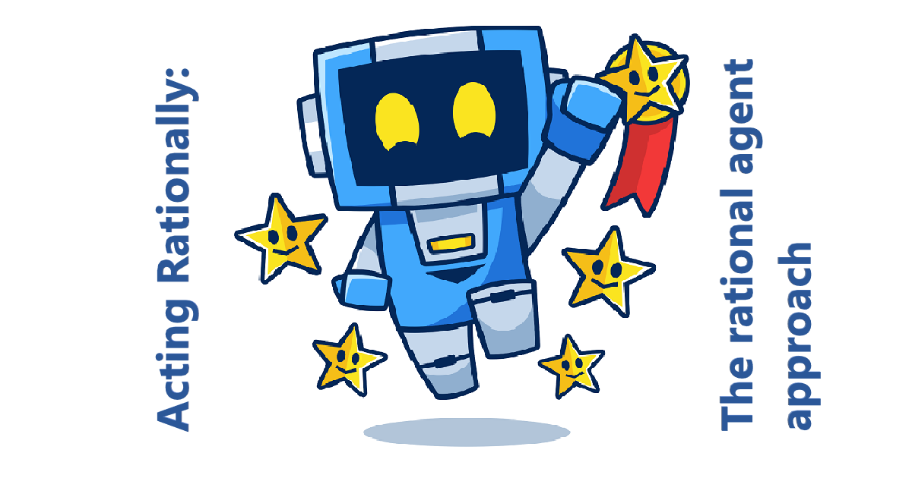

Slide 32
Historical Evolution of AI

Slide 33
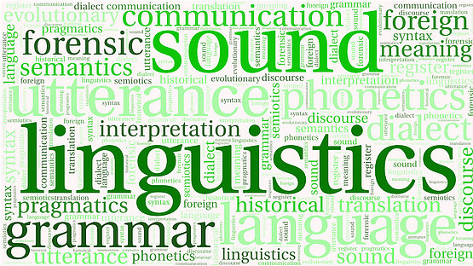
Historical Evolution of AI

Slide 34
Can formal rules be used to draw valid conclusions?
Deduction – deriving conclusion by widely accepted facts
Induction – generalization from samples
Abductive reasoning– decide by available information
Rember by de:from, in-into, ab-away

Slide 35
How does the mind arise from physical brain?
Rationalism – correctness only
Duality – physical and emotional
Materialism – physical

Slide 36
Where does the knowledge come from?
Empiricism – get data from senses
Induction – Generalization
Logical positivism= Empricism+logical rules
Confirmation theory – Experience

Slide 37
How does knowledge lead to action?
Goal Analysis
Decision making
Expert system

Slide 38
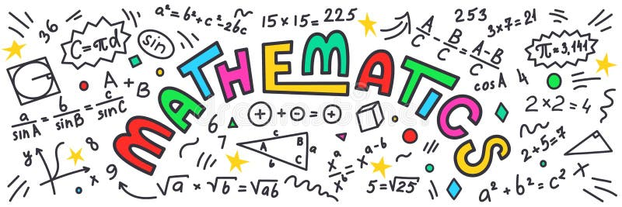
Design of Algorithms
Should be complete
Should be computable
Should be tractable
NP-complete
Probability theory

Slide 39
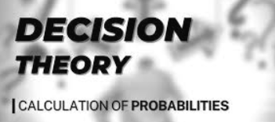
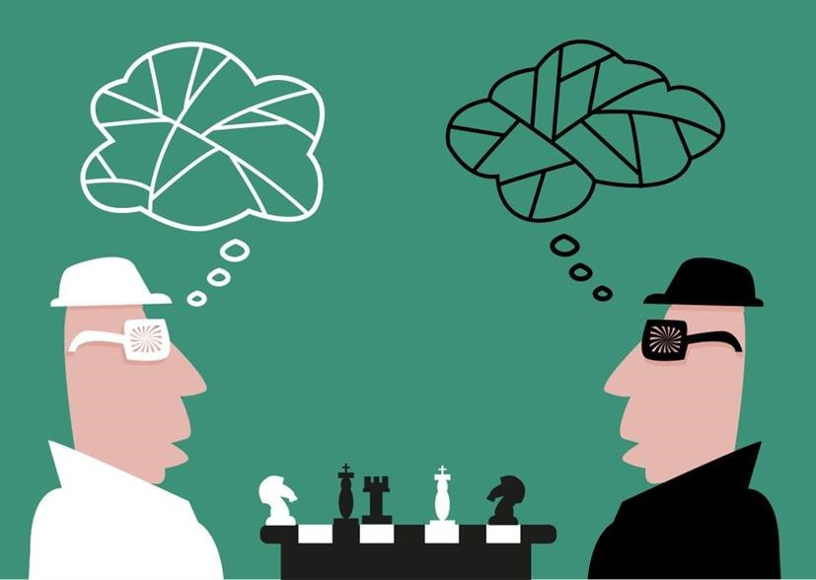
Game Theory
Satisficing Property

Slide 40
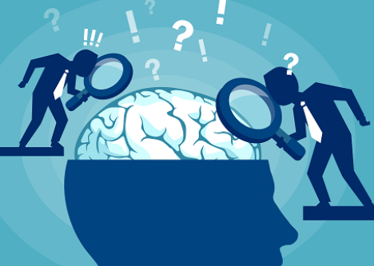
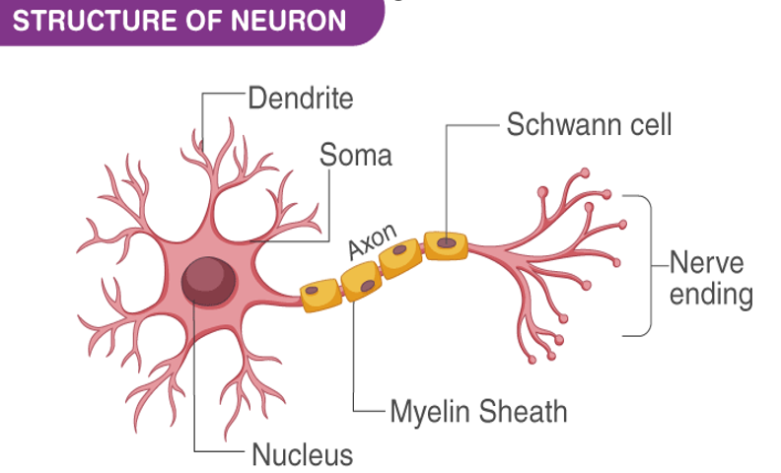
Neuroscience is the study of human brain

Slide 43
Cognitive Psychology

Slide 46
Gestation of AI (1943-1955)
Knowledge of basic psychology, functions of neurons in the brain and propositional logic
Neuron on or off based on stimulation by neighboring neurons
Simple neural network with logical connectives like AND, OR, NOT etc
Hebbian learning rule for updation of neurons connectivity

Slide 47
1956

Slide 48
Birth of AI- why AI a separate branch
AI to duplicate human facilities such as creativity, self-improvement and language use
Uses computer science methodologies
Design autonomous systems

Slide 49
Early Enthusiasm, Great Expectations
A physical symbol system takes physical patterns (symbols), combining them into structures (expressions) and manipulating them (using processes) to produce new expressions.
Eg:
Formal logic
Algebra
Chess
Computer program

Slide 51
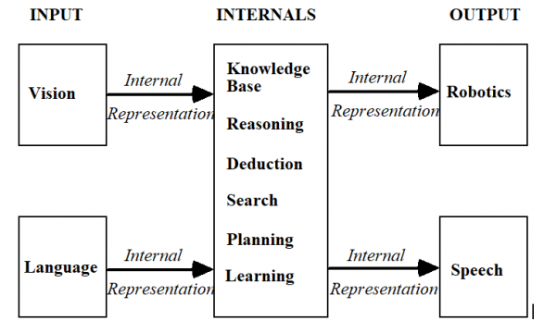

Slide 52
1960-70s
Too early for wide applications
Intractability issues
Genetic algorithms also faced intractability
Generalization of neural networks did not work
WEAK METHODS!!

Slide 56
AI becomes an industry
Digital Equipment Corporation (DEC) -1988- 40 expert systems
Japanese-Fifth Generation Intelligent Computers in Prolog
“AI Winter” – companies fall away as they could not deliver extravagant promises

Slide 57
Neural Network returns!!

Slide 58
AI adopts scientific methods
Hidden Markov Models
TF-DF-IDF-NLP-BERT-CHATGPT
Traditional Neural Networks-CNN-RNN-LSTM
Bayesian Networks using Probability

Slide 59
Emergence of Intelligent Agents
Bots design
Agents concept in control theory and economics
Human level AI
Artificial General Intelligence

Slide 60
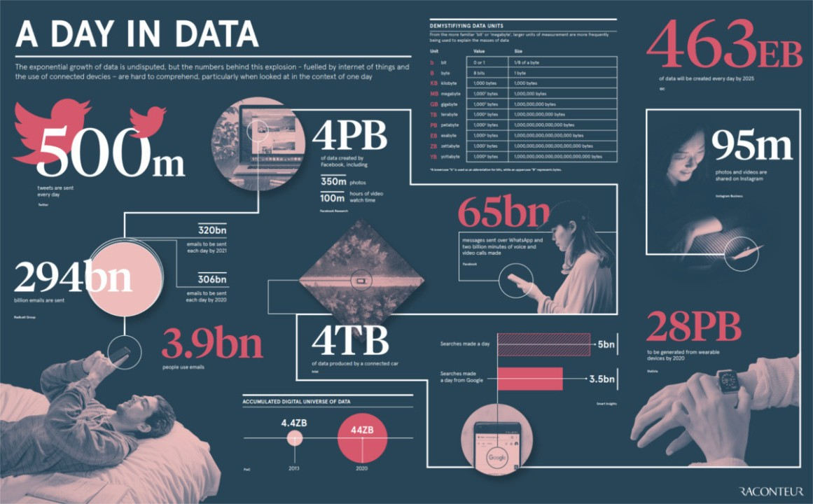
Increasing size of the data sets –both structured and unstructured

Slide 62
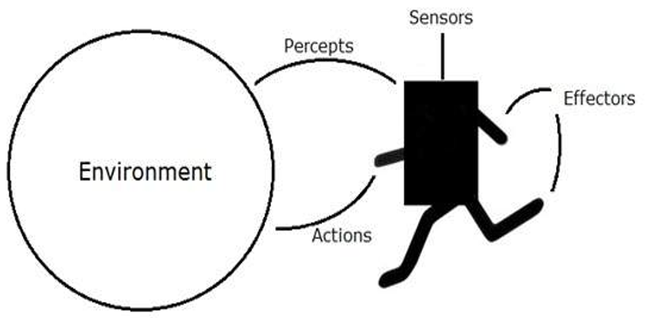
Agents and Environment

Slide 63
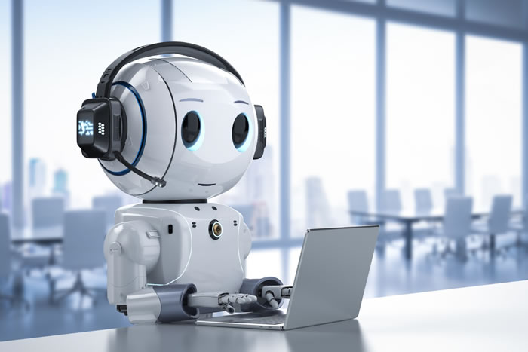
Chatbot-chatting
Robot-Room
Vehicles-Road

Slide 64
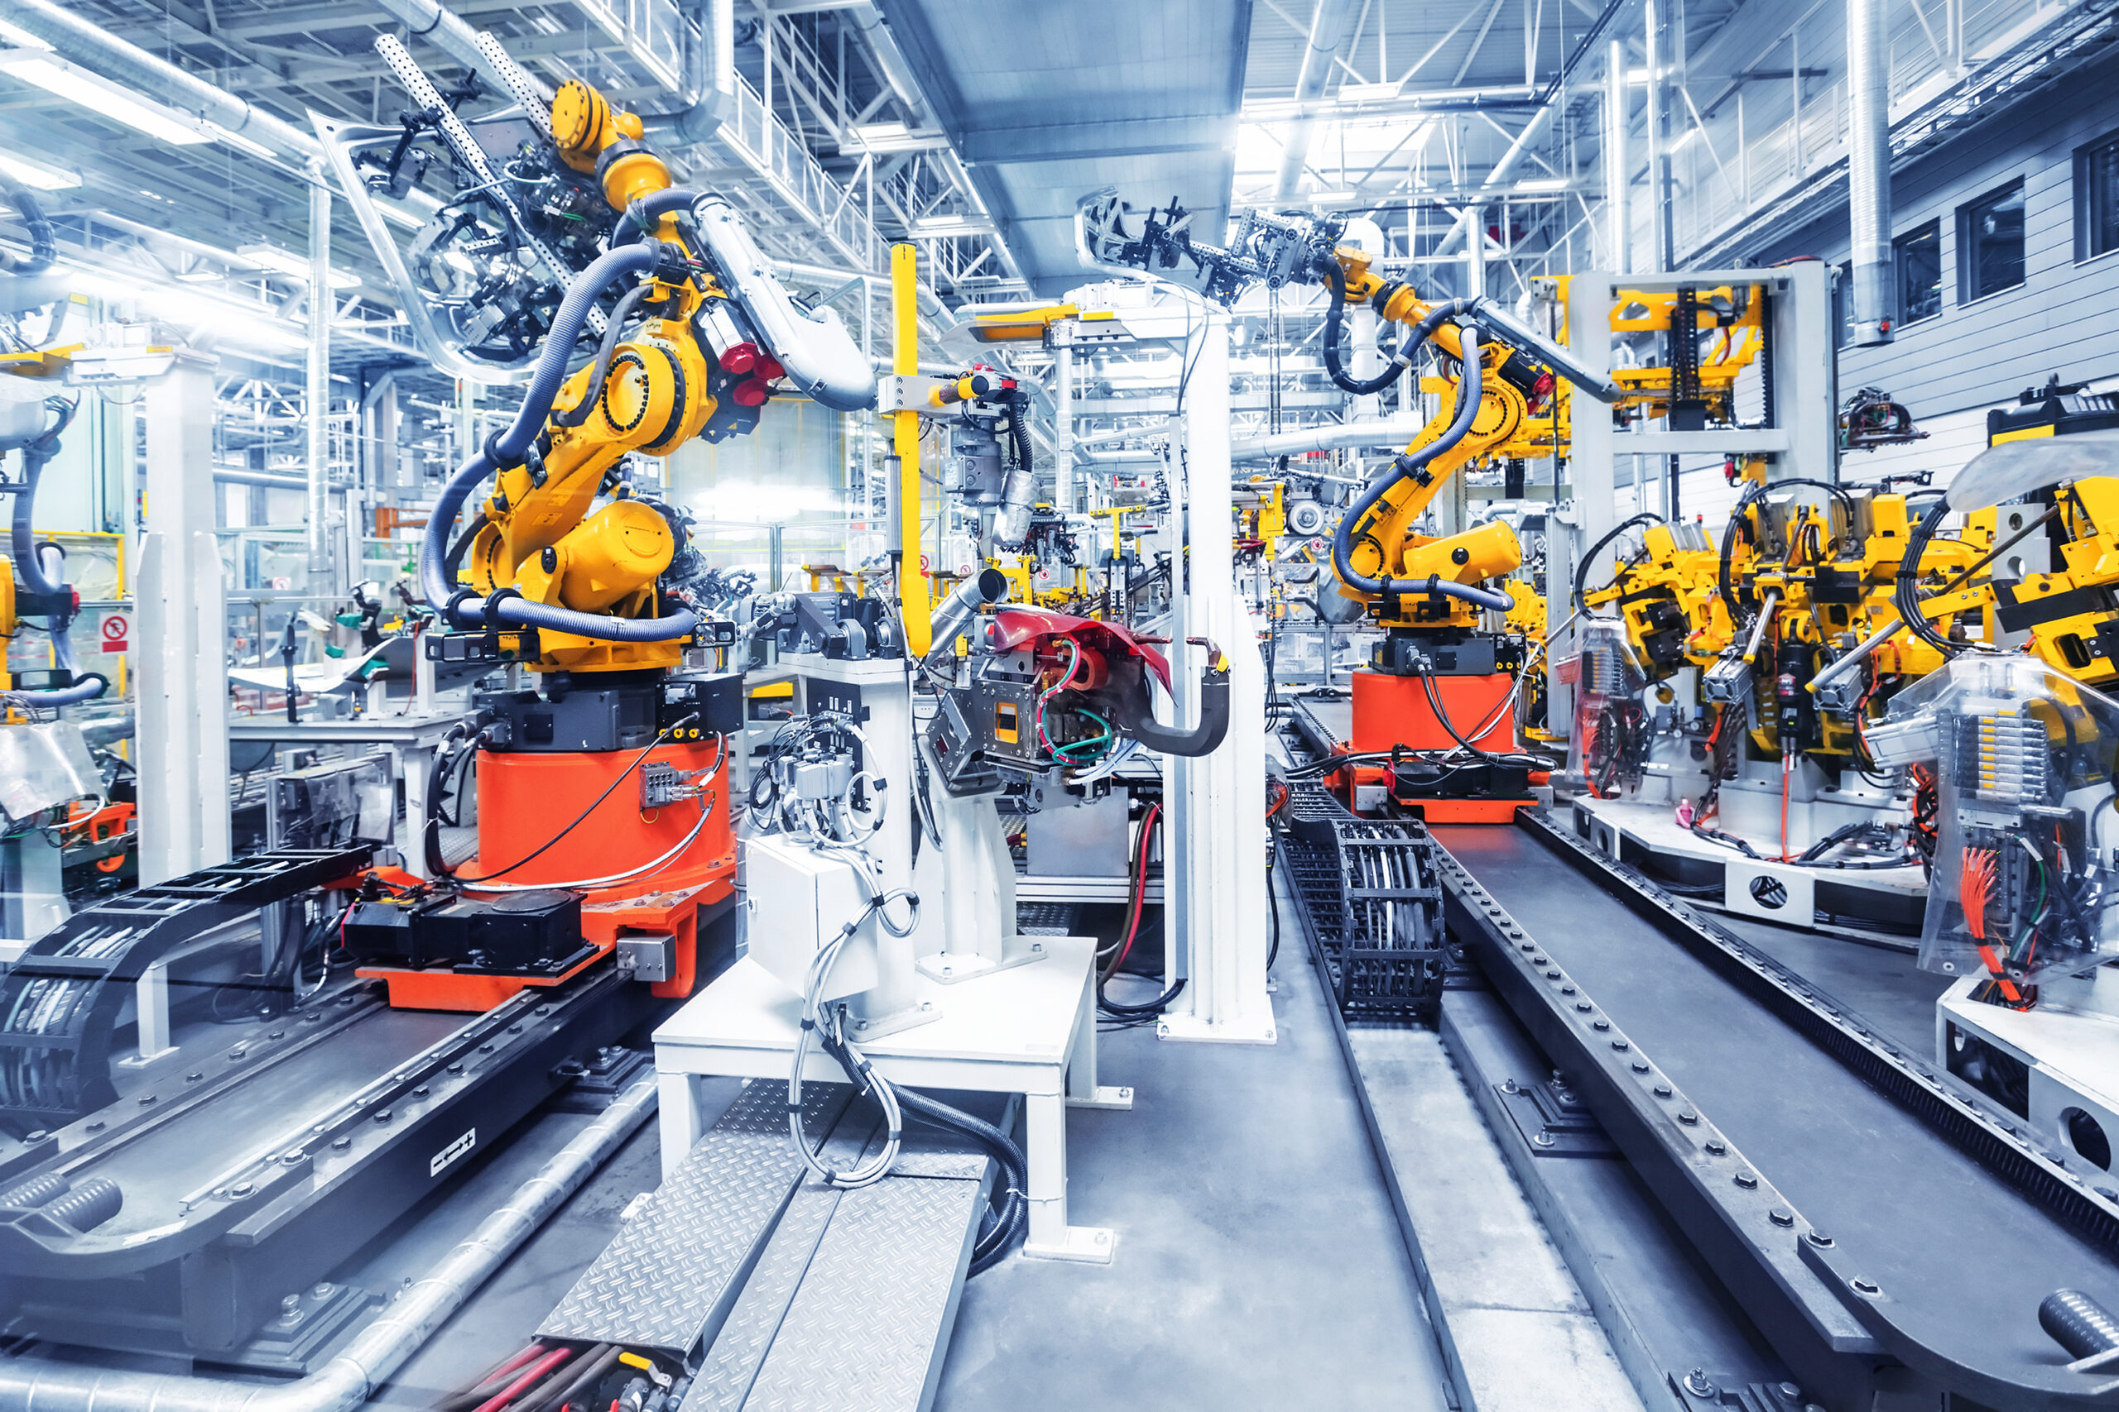
Machines - field

Slide 65
Program- data and rules

Slide 66
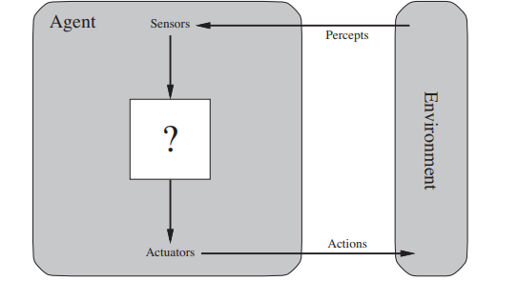
What are Agents?
Agents – anything that perceives environment through sensors and acts on environment with actuators

Slide 67
Human Agents
Sensors- sense organs
Actuators-hands, legs,
vocal tract
Robot Agents
Sensors- Cameras and IR
Actuators - Motors
Software Agents
Sensors- keystroke, file inputs, network packets
Actuators – screen, file outputs, network packets

Slide 68
Percept sequence – complete history of everything the agent has ever perceived to date, but not on anything it has not perceived
Agent function maps any given percept sequence to action
Agent program implements agent function in a physical system

Slide 69
Vacuum Cleaner

Slide 70
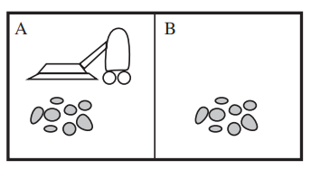
Vacuum Cleaner for 2 locations
Percept Sequence
[A, clean]
[right]
[A, dirty]
[suck]
[B, clean]
[left]
[B, dirty]
[suck]

Slide 71
Percept Sequence
[A, clean],[A,clean]
[right]
[A, clean],[A,dirty]
[suck]
[A, clean],[A,clean],[A,clean]
[right]
[A,clean],[A,clean],[A,dirty]
[suck]

Slide 72
Agents should exhibit good behavior.
Such agents are called Rational agents
Performance measures to evaluate
Impact on environment
Given a percept sequence, rational agent selects action that maximizes performance measure

Slide 73
Rational Vacuum Cleaner agent
The performance measure awards one point for each clean square at each time step, over a “lifetime” of 1000 time steps.
The “geography” of the environment is known a priori but the dirt distribution and the initial location of the agent are not.
Clean squares stay clean and sucking cleans the current square.
The only available actions are Left, Right, and Suck.
The agent correctly perceives its location and whether that location contains dirt.

Slide 74
Omniscience is impossible in reality.
Rationality maximizes expected performance and perfection maximizes actual performance
Information gathering for future percept sequence
Exploration

Slide 75
Agents should become autonomous
Learn by experience

Slide 76
PEAS specification: Performance, Environment, Actuators and Sensors
PEAS for vacuum cleaner

Slide 77
PEAS for automatic taxi driver
P-Performance
Safe, fast, legal, comfortable, maximize profits
E-Environment
Roads, other traffic, pedestrians, customers
A-Actuators
Steering, Accelerator, Brake, horn, indicator
S-Sensors
Cameras, Speedometer, GPS, Accelerometer, Engine sensors

Slide 78
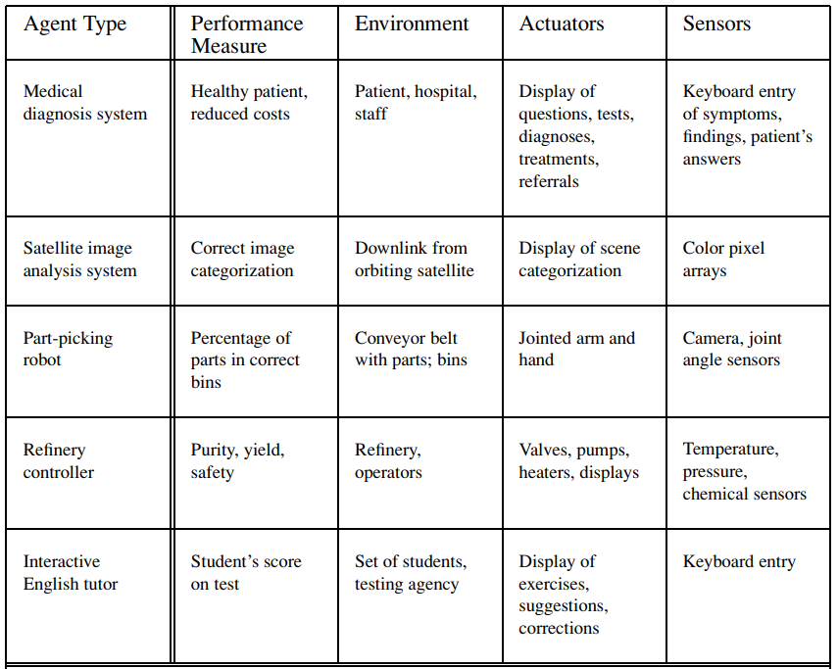

Slide 79
Various AGENT ENVIRONMENTS

Slide 80
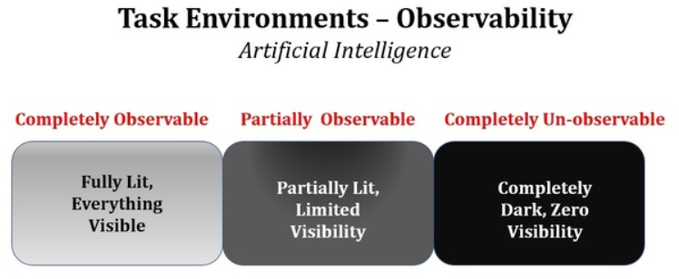
Game of chess/carrom
Full
Automatic taxi driver
Partial
Vacuum agent with local dirt sensors
Partial

Slide 81
Competitive
Cooperative
Crossword/Exam
Single
Carrom/Chess Game
Multiple
Taxi drivers
Multiple

Slide 82
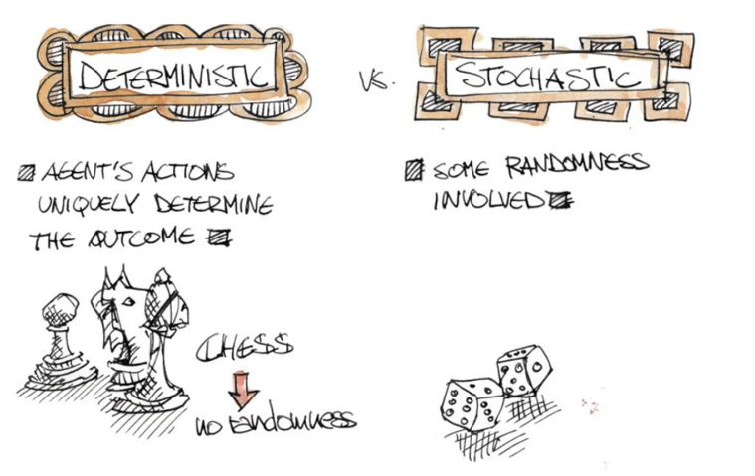
Taxi drivers, Attendance, Spinwheel, games
Outcome –depends fully on agent action –deterministic
Outcome - depends partially on agent action –deterministic

Slide 83
Environment is uncertain if it is not fully observable or not deterministic
Environment is episodic if current action of an agent does not depend on previous nor determines future
Environment is sequential if current action of an agent depends on previous and has both short term and long term effects.

Slide 84
Crossword/Exam
Sequential
Carrom/Chess Game
Sequential
Taxi drivers
Sequential
Vacuum cleaners
Episodic
Email Classification
Episodic

Slide 85
Environment is static if environment remains same throughout the deliberation of agents
Environment is dynamic if environment keeps changing with the deliberation of agents
Environment is semi-dynamic if environment does not change, but performance score of agents do change

Slide 86
Identify Static, Dynamic or Semi-dynamic
Crossword/Exam
Static
Carrom/Chess Game
Semi-dynamic
Taxi drivers
Dynamic
Vacuum cleaners
Dynamic
Email Classification
Dynamic

Slide 88
Environment
Discrete
Continuous
Discrete set of states
Discrete set of percepts
and actions
Continuously changing percepts and actions

Slide 89
Identify discrete/continuous
Crossword/Exam
Discrete
Carrom/Chess Game
Discrete
Taxi drivers
Continuous
Vacuum cleaners
Discrete

Slide 90
Identify known/unknown
Crossword
Unknown
Carrom/Chess Game
Known
Video Games
Known
Taxi drivers
Unknown
Game of cards
Known and partial observable
New video game
Unknown and fully observable

Slide 91
Classify the Environment
Observability
Partial
Agents
Single
Deterministic/Stochastic
Stochastic
Medical diagnosis
Episodic/Sequential
Sequential
Static/Dynamic
Dynamic
Discrete/Continuous
Continuous

Slide 92
Classify the Environment

Slide 93
Agent Program
Agent
Architecture
Program
=
+
Sensors
Actuators
The job of AI is to design an agent program that implements the agent function— the mapping from percepts to actions.

Slide 94
Table driven Agent Program
function
TABLE-DRIVEN-AGENT
(percept)
returns an action
persistent:
percepts, a sequence initially empty
table, table of actions for each percept
append percept to the end of percepts
action<- LOOKUP(percepts,table)
return action

Slide 95
Table driven Agent Program fails
. Let
P be the set of possible percepts
T be the lifetime of the agent (the total
number of percepts it will receive).
The lookup table will contain$\sum_{t=1}^{T}{\left|P^{t}\right|}$
entries
Automated taxi driver
$${10}^{250,000,000,000}$$
Chess Board
$${10}^{150}$$

Slide 96
Table driven Agent Program fails
No physical agent has space to create such tables
Designers do not have time to create such table
No agent could ever learn
No guidance to the designer how to fill up entries

Slide 97
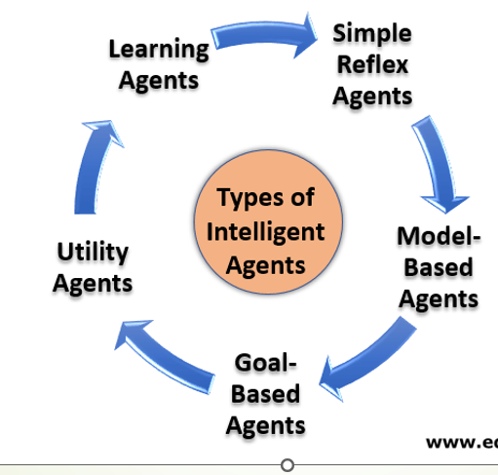

Slide 99
Reflex Agent for Vaccuum cleaner
function
REFLEX-VACCUUM-AGENT
([location,status])
returns an action
if status=Dirty
then return Suck
else if location=A
then return Right
else if location=B
then return Left

Slide 100
Simple Reflex Agent
E
N
V
I
R
O
N
M
E
N
T
AGENT
Sensors
What the world is like now
Condition Action rules
What action I should take now
Actuators

Slide 101
Simple Reflex Agent Structure
function
SIMPLE-REFLEX-AGENT
(percept)
returns an action
persistent:
rules, a set of condition-actions
state <- INTERPRET-INPUT (percept)
rule<- RULE-MATCH(state, rules)
action<- rule.ACTION
return action
Forever looping
Randomization
During partial observability

Slide 102
Model based Reflex Agent
E
N
V
I
R
O
N
M
E
N
T
Sensors
AGENT
State
What the world is like now
World Evolves
Impact of my actions
What action I should take now
Condition Action rules
Actuators

Slide 103
Model Reflex Agent Structure
function
MODEL-BASED-REFLEX-AGENT
(percept)
returns an action
persistent:
rules, a set of condition-actions
state, agents current conception
model, how next state depends on
current action
action, most recent action
state <- UPDATE_STATE(state, action, percept, model)
rule<- RULE-MATCH(state, rules)
action<- rule.ACTION
return action

Slide 104
Goal based Agent
E
N
V
I
R
O
N
M
E
N
T
Sensors
AGENT
State
What the world is like now
World Evolves
Impact of my actions
What if some action done
Goals
What action I should take now
Actuators
Searching and Planning

Slide 105
Utility based Agent
E
N
V
I
R
O
N
M
E
N
T
Sensors
AGENT
State
What the world is like now
World Evolves
Impact of my actions
What if some action done
Utility
Happiness measure
What action I should take now
Actuators

Slide 106
Learning Agent
E
N
V
I
R
O
N
M
E
N
T
Performance Standard
Sensors
Critic
feedback
changes
Performance Element
Learning Element
Learning goals
knowledge
Problem Generator
Actuators
AGENT

Slide 107
Utility Agent Characteristics
An agent’s utility function is essentially an internalization of the performance measure.
An agent choses actions to maximize its utility
An agent choses actions to maximize its expected utility when environment is uncertain or partially observable or stochastic

Slide 108
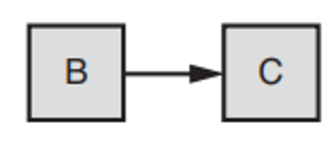
Working of Agent components
Black Box-Atomic

Slide 109
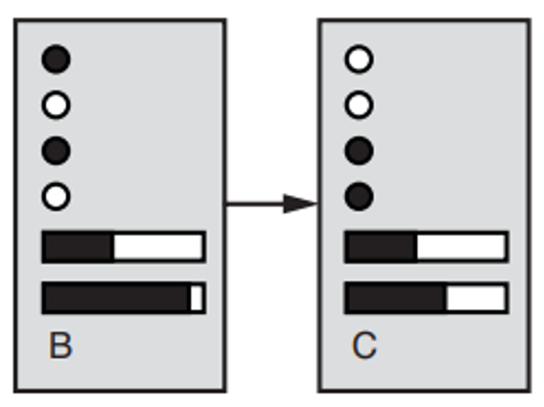
Working of Agent components
Factored

Slide 110
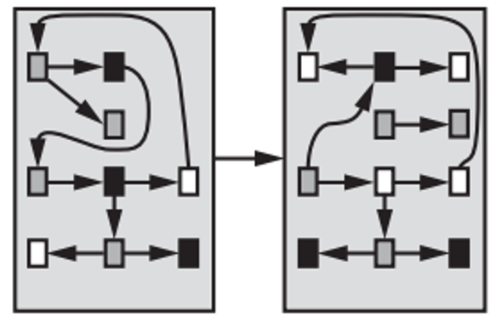
Working of Agent components
Structured

