Slide 1
Inheritance and Interfaces
MODULE III

Slide 2
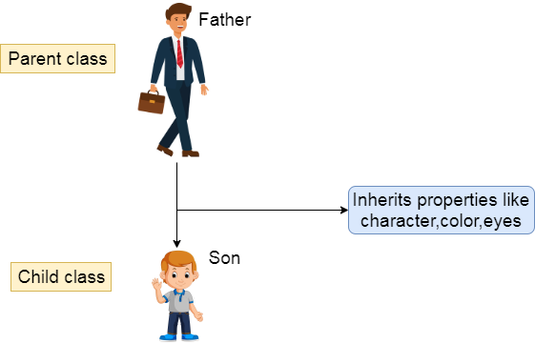

Slide 3
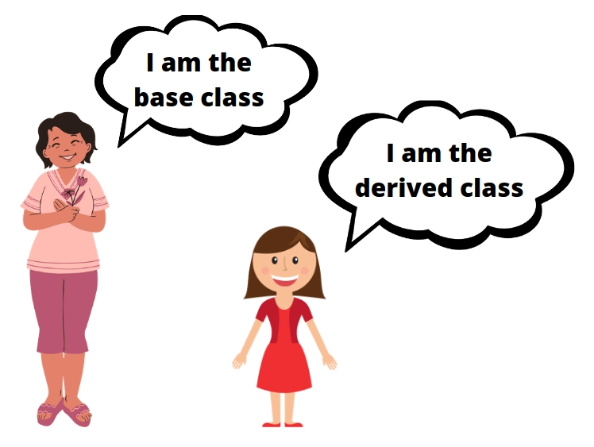

Slide 4
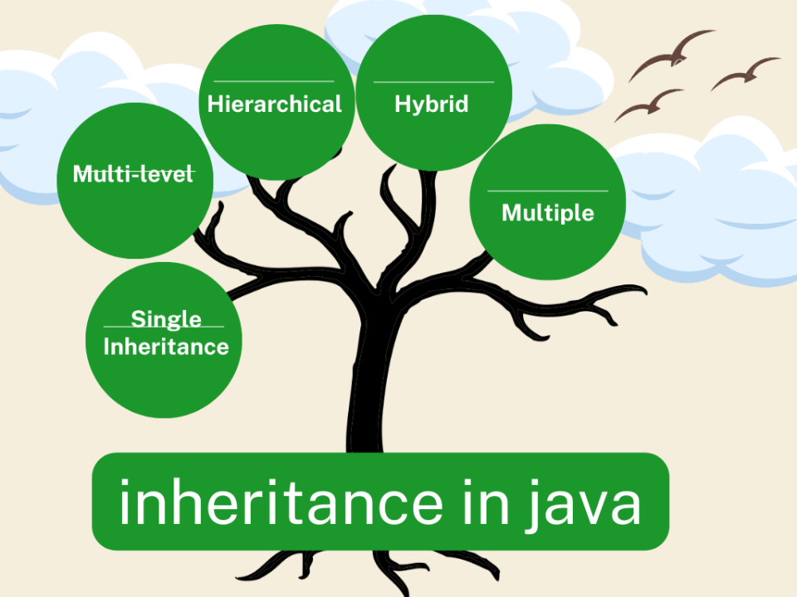

Slide 5
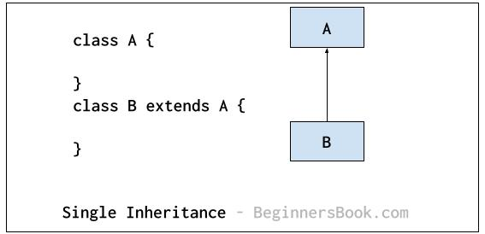
Java program to illustrate inheritance

Slide 6
Java program to demonstrate behaviour of private in inheritance

Slide 7
width
depth
height
Box
WeightBox
ColorBox
weight
color
Java program to illustrate creation of WeightBox and Colorbox

Slide 11
width
depth
height
Box
weight
WeightBox
ColorBox
color
Shipment
cost
Java program to illustrate Multilevel hierarchy

Slide 13
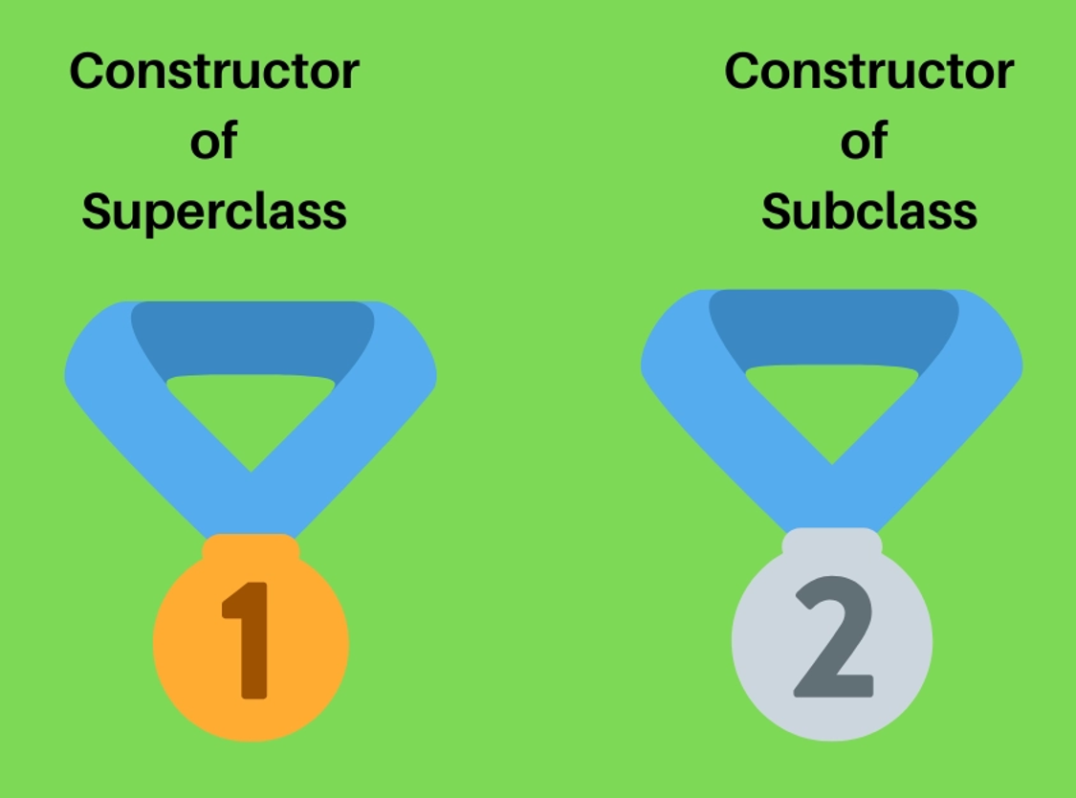

Slide 14
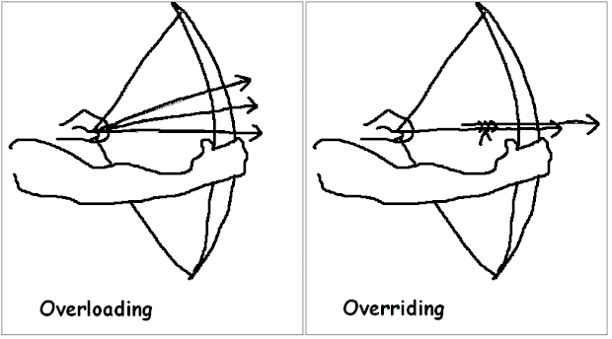

Slide 15
In Method overriding, the method name and its signature of the super class and subclass should be exactly same
In case of overriding, sub class method is selected.
To select superclass method use super keyword
If superclass and subclass methods differ in parameters, it become method overloading

Slide 16
Runtime Polymorphism
Find the appropriate class of the invoked method during run time

Slide 18
Abstract method – method without code

Slide 19
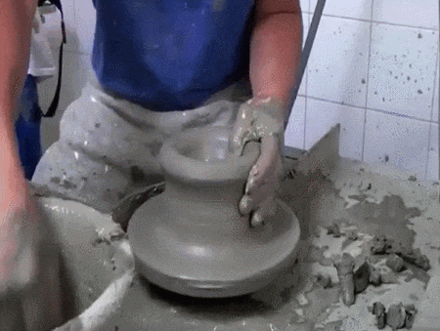

Slide 20
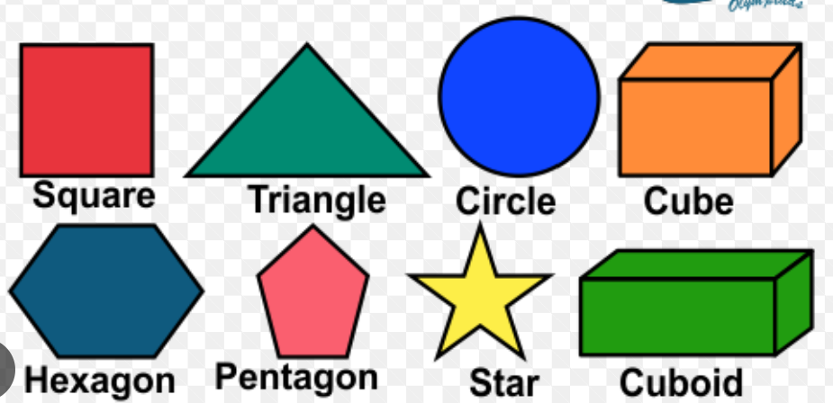
Everything is a shape and are subclasses of parent class Shape
However, Shape itself has no meaning and objects can be created
Shape is hence called Abstract class

Slide 21
Abstract methods do not have code
Abstract classes contain atleast one abstract method .
Abstract classes can also have non-abstract methods
Abstract classes acts as a general placeholder for subclasses

Slide 22
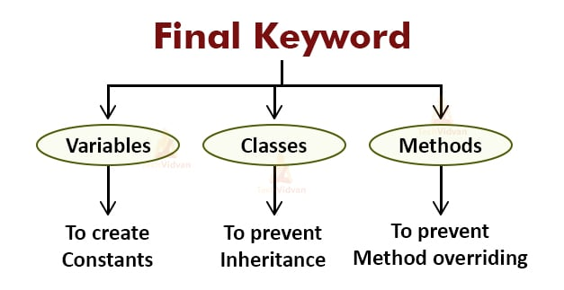
Example program

Slide 23
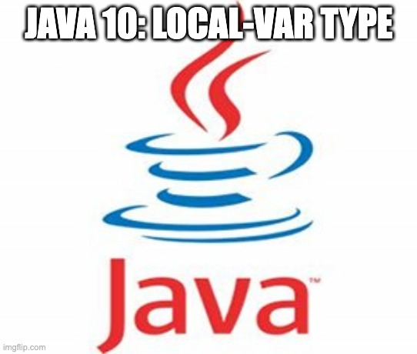
Can hold the object of any class

Slide 25
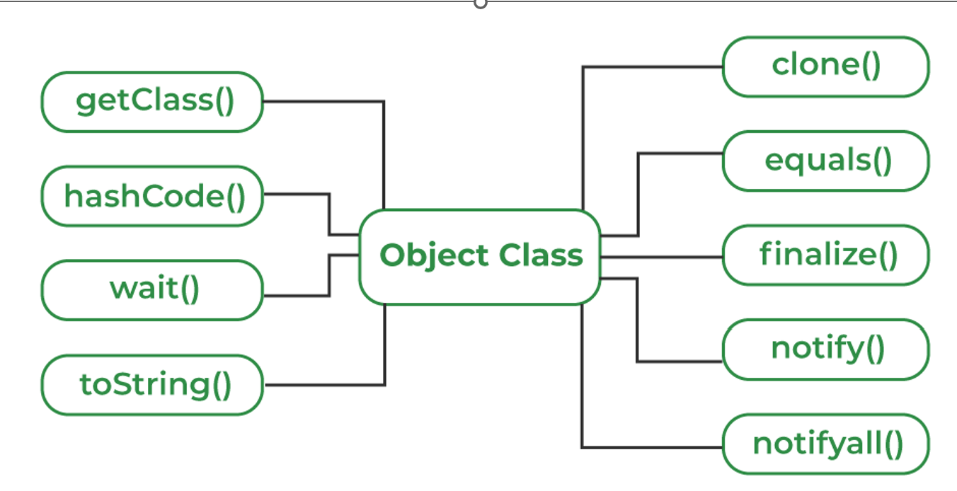

Slide 26
Singe question paper answered by multiple students

Slide 27
Single treadmill multiple people

Slide 28
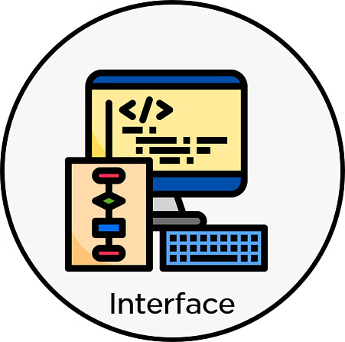
Interfaces are like classes
They have only abstract methods
They have only final variables
They are implemented by classes
They provide run-time polymorphism

Slide 29
public
package

Slide 30
Interface AtdShortage
Faculty
Mentor
Parent
VTU
Program to demonstrate interfaces

Slide 31
Interfaces uses All or Nothing paradigm to implementing class.
Alternative – make class abstract

Slide 32
Class
Interface
Nested Interfaces
Program to demonstrate nested interfaces

Slide 33
Program to demonstrate Interfaces with only variables (final variables)

Slide 34
Interface IA
Interface IA
Interface IB
Interface IB
Interface IC
Class A
Interface IC
Hierarchical interfacing
Class A
Multi level interfacing

Slide 35
Interface IA
Interface IB
Interface IC
Class A
Multiple interfacing

Slide 37
Motivations of default method of the Interfaces:
New methods can be added to interfaces without crashing existing programs
Make implementation of some methods optional

Slide 38
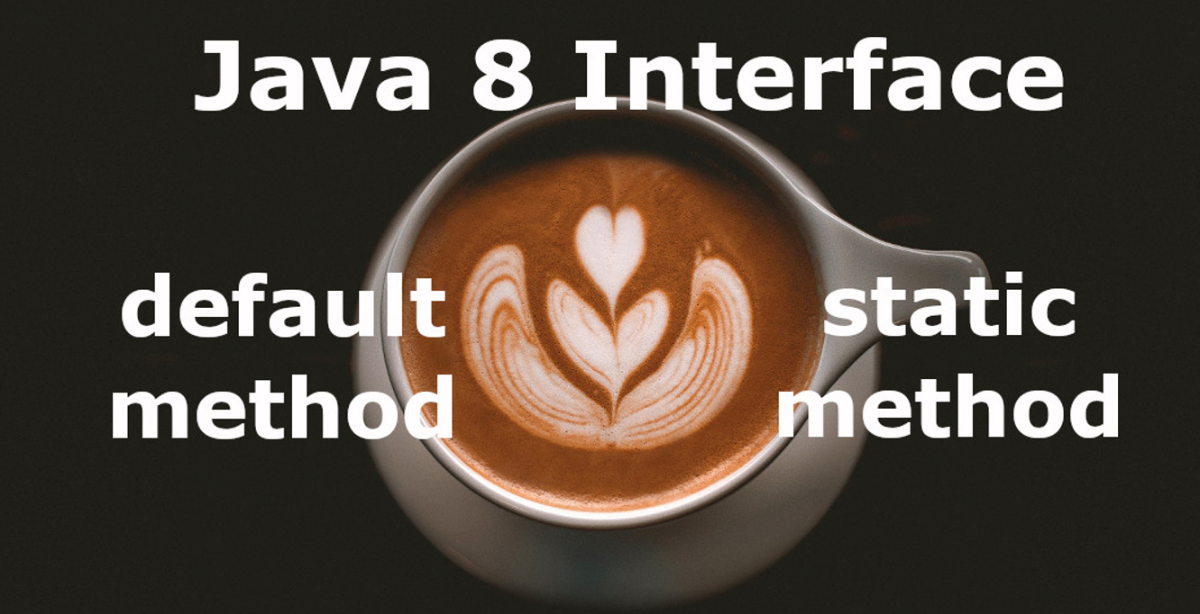

Slide 39
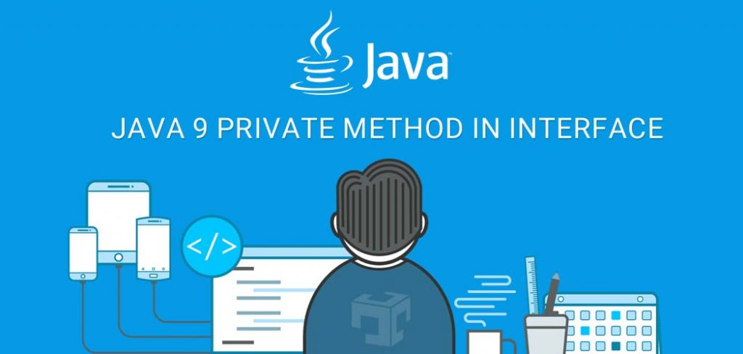
Private methods can be written inside an interface.
However they can be only called inside default methods

