Slide 1
Packages and Exceptions – Module IV

Slide 2
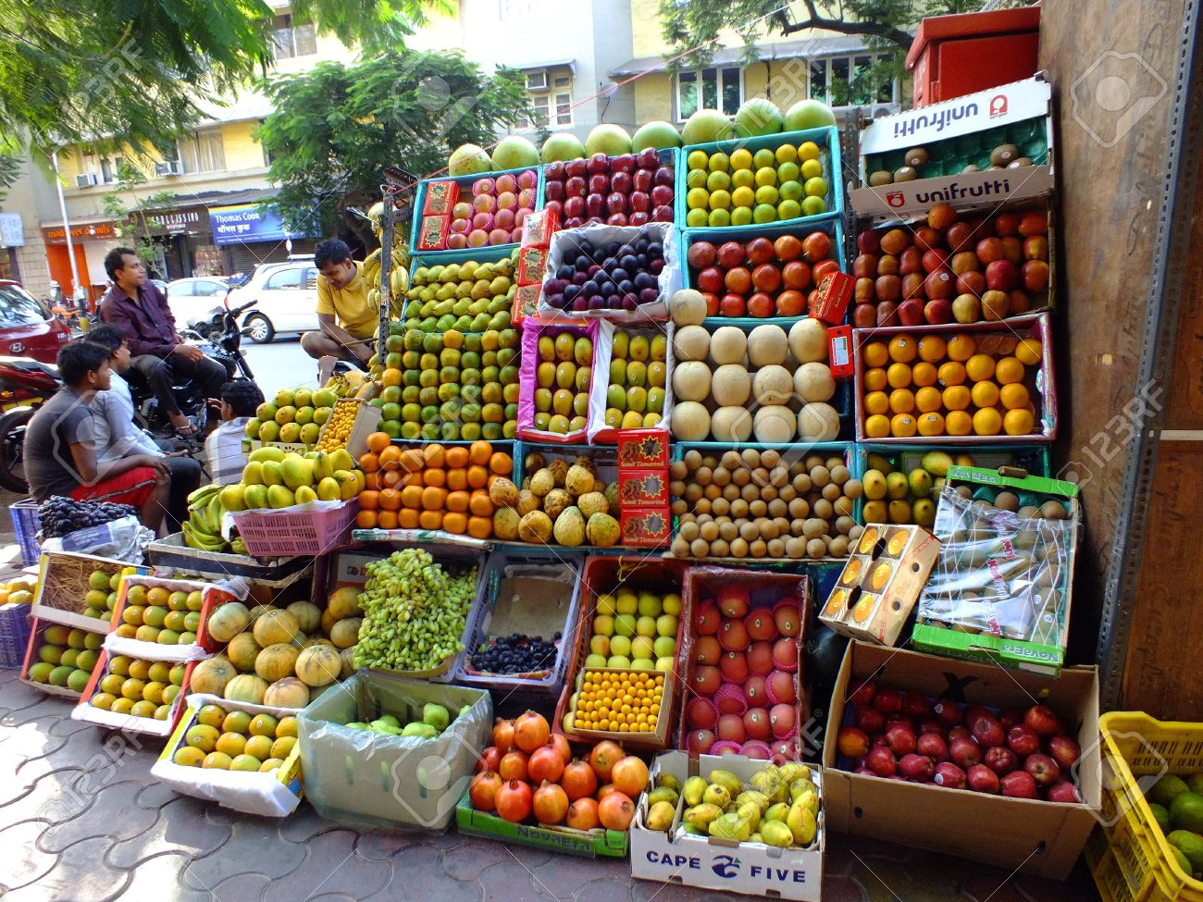

Slide 3
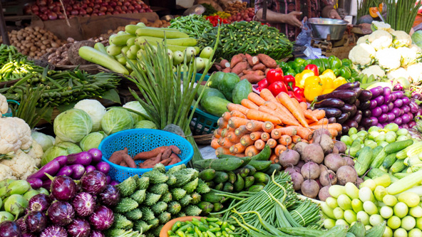

Slide 4
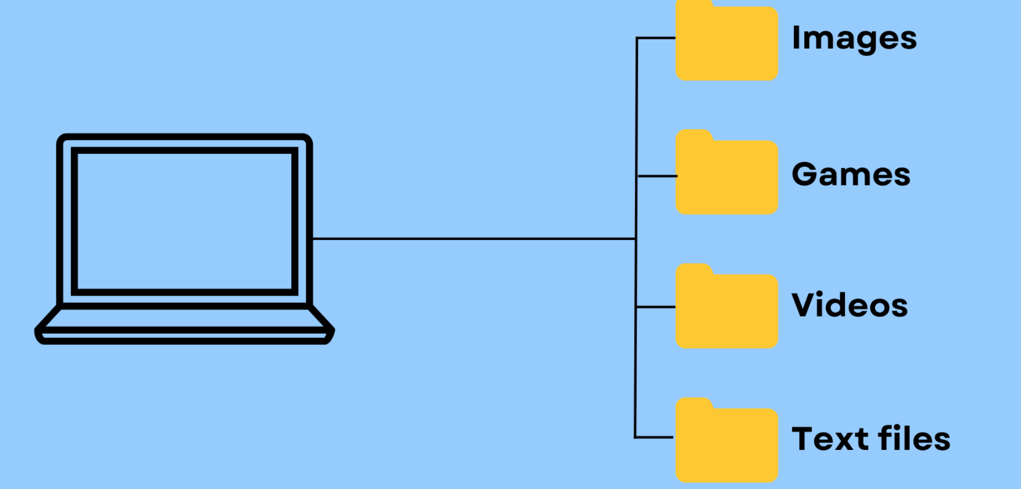

Slide 5
Packages and their use
Packages allow related classes and interfaces to be grouped together
Packages allow better organization
Use of packages help in easier accessibility.
Packages facilitate flexibility in adding new features
Packages also allow reuse of classes and interfaces

Slide 6
Defining and Importing packages
Package represents a folder
Subpackages represent subfolder
To create package: package statement
To use package: import statement
Example Java program to illustrate the definition and use of packages

Slide 7
Member access and packages
private
default
protected
public
Same class
Yes
Yes
Yes
Yes
Same package subclass
No
Yes
Yes
Yes
Same packages non-subclass
No
Yes
Yes
Yes
Different package subclass
No
No
Yes
Yes
Different packages non-subclass
No
No
No
Yes

Slide 8
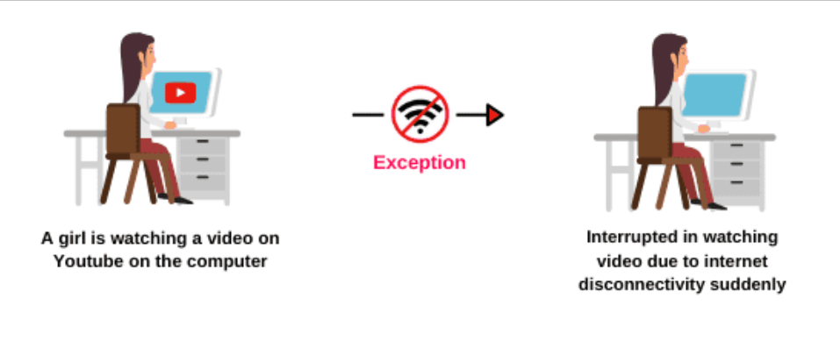
Exception handling

Slide 9
Exception handling
Java exceptions are runtime errors

Slide 10
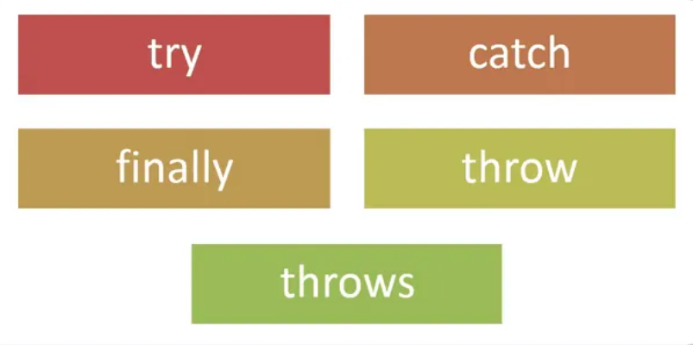
Java Exception handling keywords

Slide 11
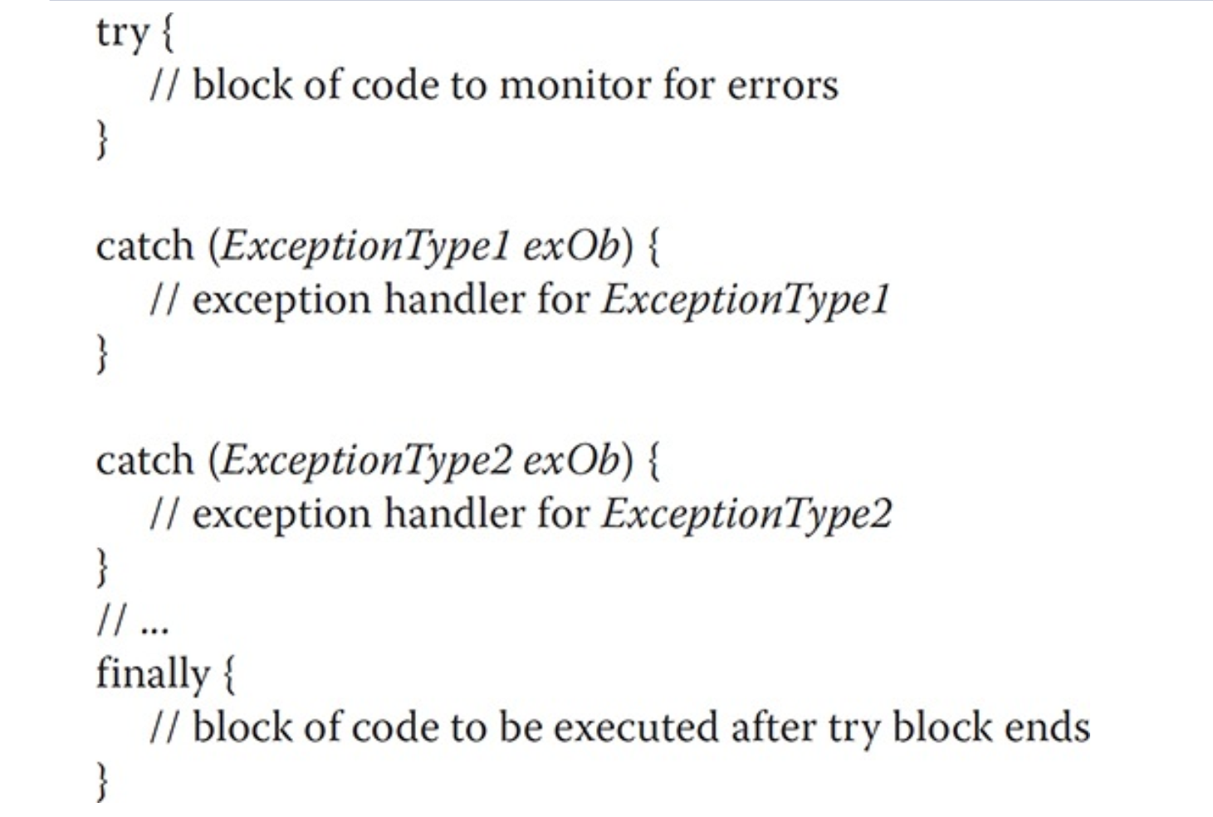
Format of try, catch, finally

Slide 12
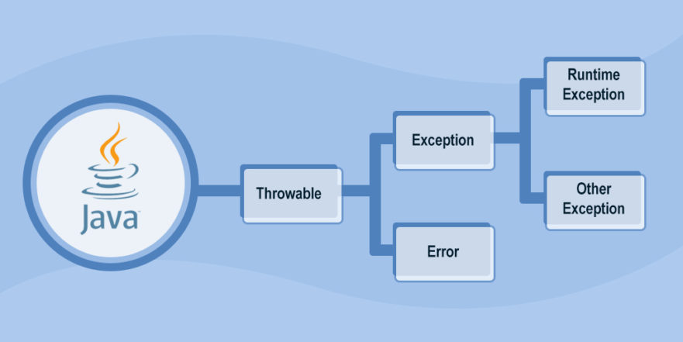
Top-level Exception hierarchy in Java

Slide 13
Exception handling programs
Uncaught Exception
Using try-catch
Display details of caught exception
finally

Slide 14
Exception handling programs
Using multiple catch
Using nested try
throw
throws

Slide 15
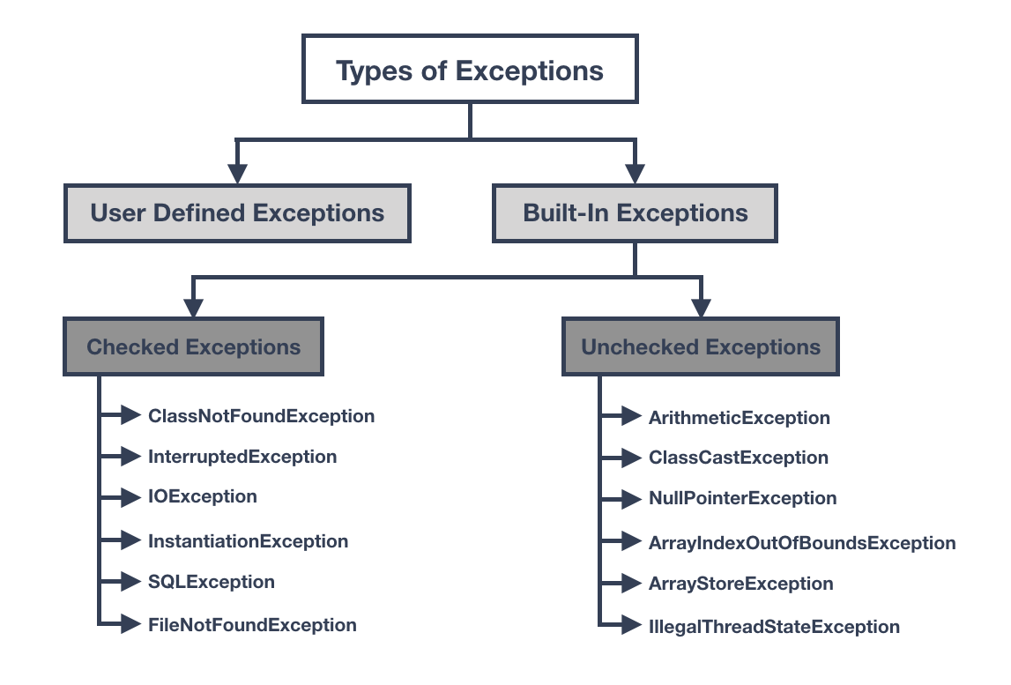

Slide 16
Checked Exceptions in Java
If some code within a method throws a checked exception, then the method must either handle the exception or delegate using throws.
In checked exceptions, there are two types: fully checked and partially checked exceptions.
A fully checked exception is a checked exception where all its child classes are also checked.
A partially checked exception is a checked exception where some of its child classes are unchecked.

Slide 17
Unchecked Exceptions in Java
If some code within a method throws a unchecked exception, it is not mandatory to handle or delegate.
Program to demonstrate checked exception and unchecked exception (Eg NullPointerException).

Slide 18
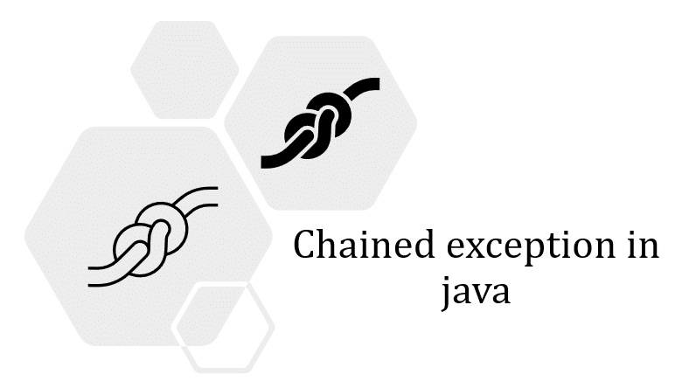
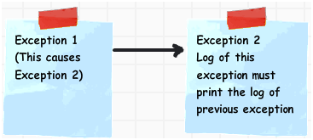
Java program to demonstrate chained exceptions

Slide 20
Program to demonstrate user defined exception for a company employee applying number of leaves beyond 15

Slide 21
Program to demonstrate user defined exception when level of petrol of vehicle reduces to less than some threshold

