Slide 1

Slide 1
Machine Learning

Slide 2
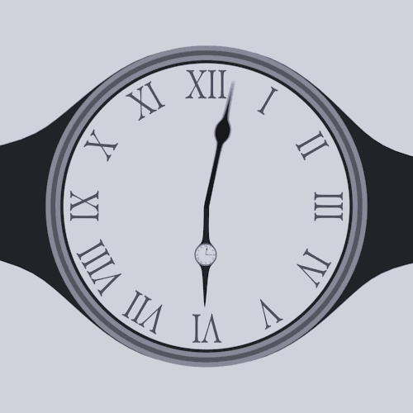

Slide 3
Syllabus Amalgamation
Machine Learning
NLP
2 modules
1 module
Data Science
Time for a short video

Slide 4
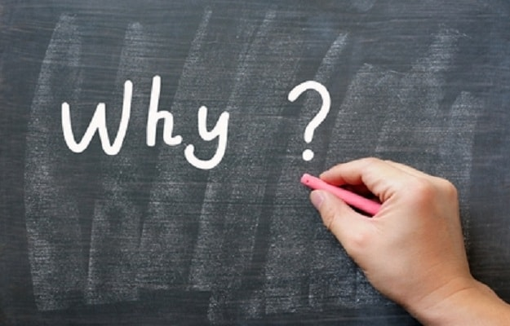
A breakthrough in machine learning would be worth ten Microsoft's” (Bill Gates, Microsoft)
It is the next Big thing
A large subset of Artificial Intelligence (AI) and AI is everywhere

Slide 5
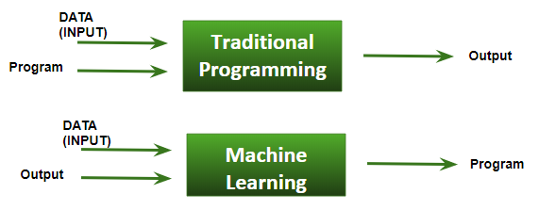
What is Machine Learning?

Slide 6

Machine Learning is like gardening with seeds->algorithms, nutrients->data,
plants->programs

Slide 7
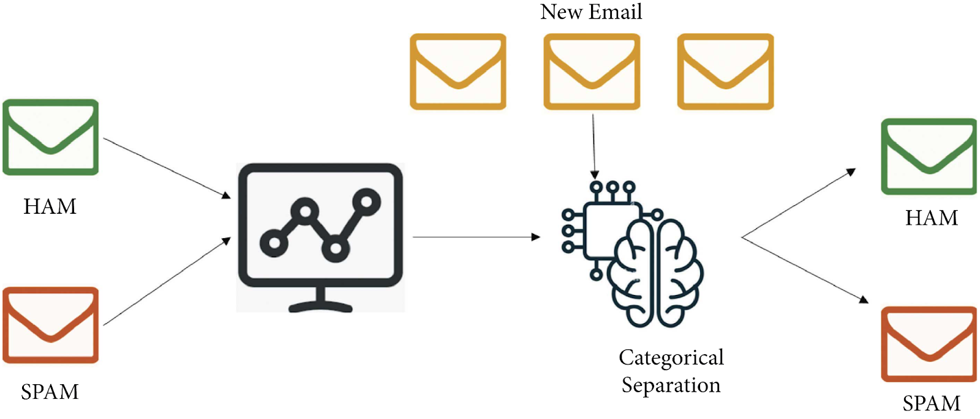
Spam filters with Machine Learning

Slide 8
Definitions
Machine Learning is the science (and art) of programming computers so they can learn from data
A computer program is said to learn from experience E with respect to some task T and some performance measure P, if its performance on T, as measured by P, improves with experience E

Slide 9
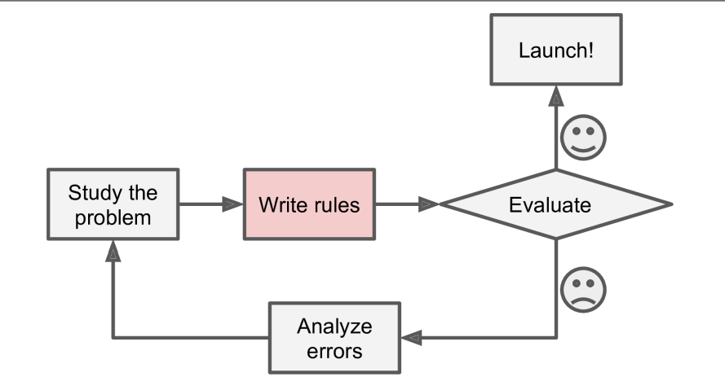
Traditional programming

Slide 10
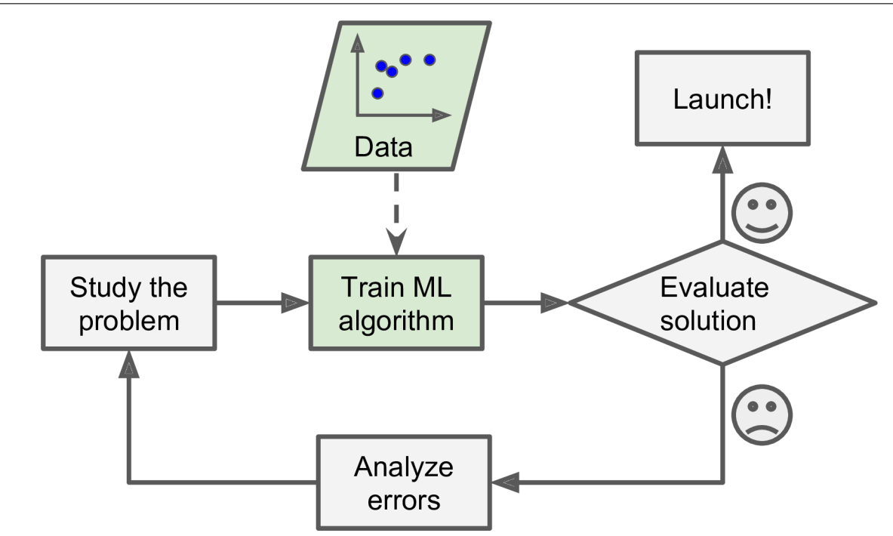
Machine Learning

Slide 11
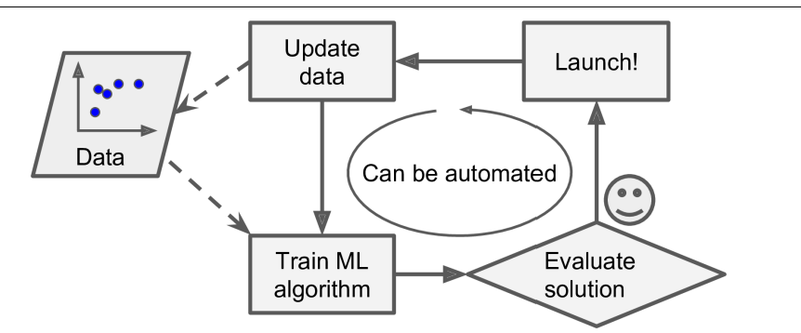
Machine Learning automatically updates for change

Slide 12
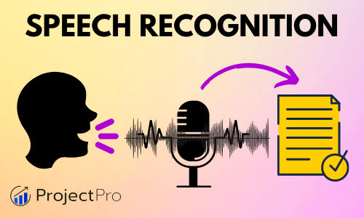
Machine learning works on huge data and different languages and environments

Slide 13
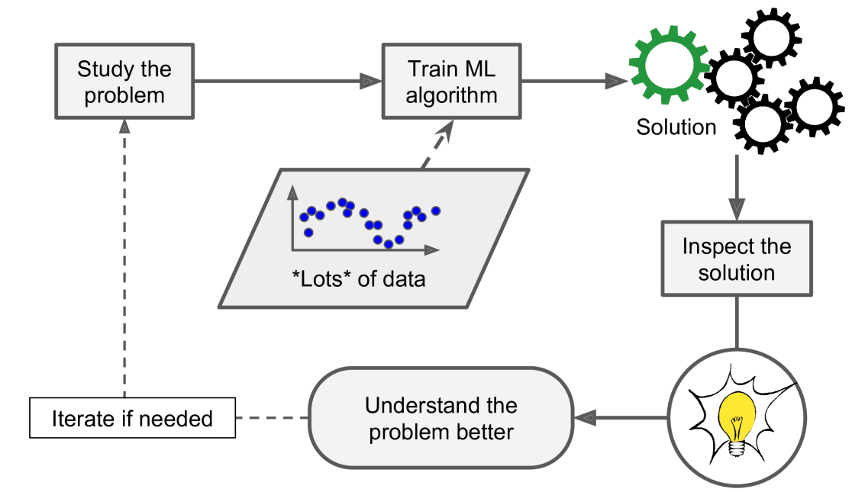
Machine learning can help humans learn

Slide 14
To summarize, Machine Learning is great for:
Problems for which existing solutions require a lot of hand-tuning or long lists of rules.
Complex problems for which there is no good solution at all
Fluctuating environments (adapt to new data)
Getting insights about complex problems and large amounts of data.

Slide 15
Types of Machine Learning
Based on how they are supervised during training
Ability to learn incrementally on the fly
Matching new data with old one or find patterns/trends/abnormalities

Slide 16


Supervised and Unsupervised Learning

Slide 17
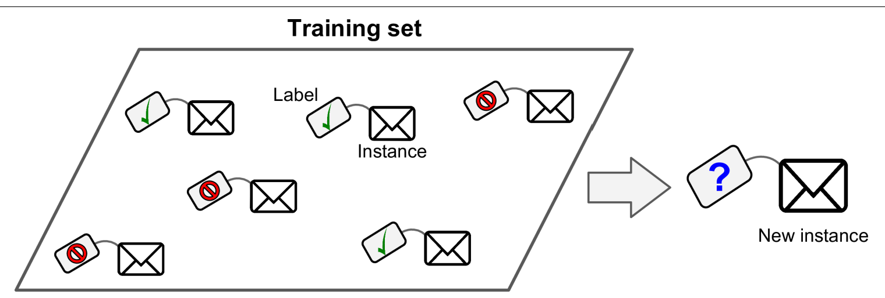
Training Supervision
Supervised learning - Classification

Slide 18
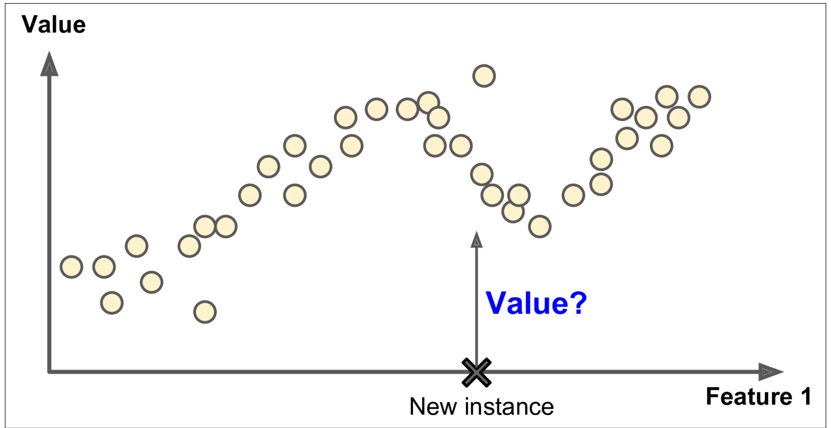
Training Supervision
Supervised learning - Regression

Slide 19
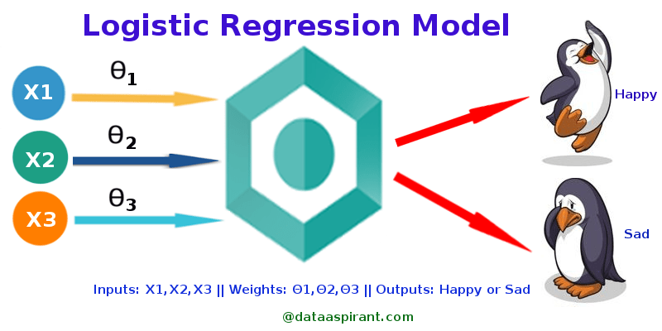
Training Supervision

Slide 20
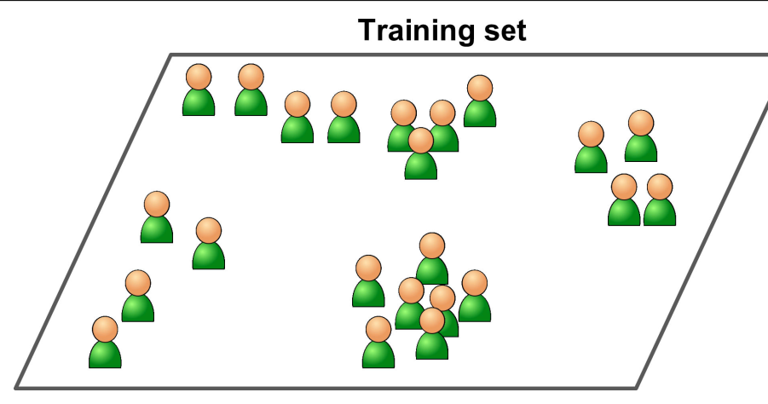
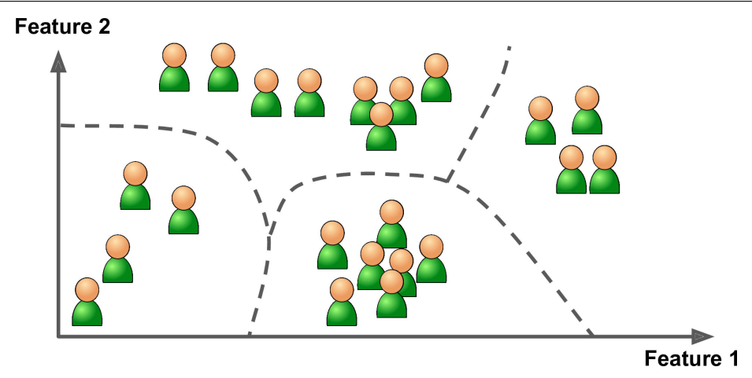
Training Supervision
Unsupervised learning - clustering

Slide 21
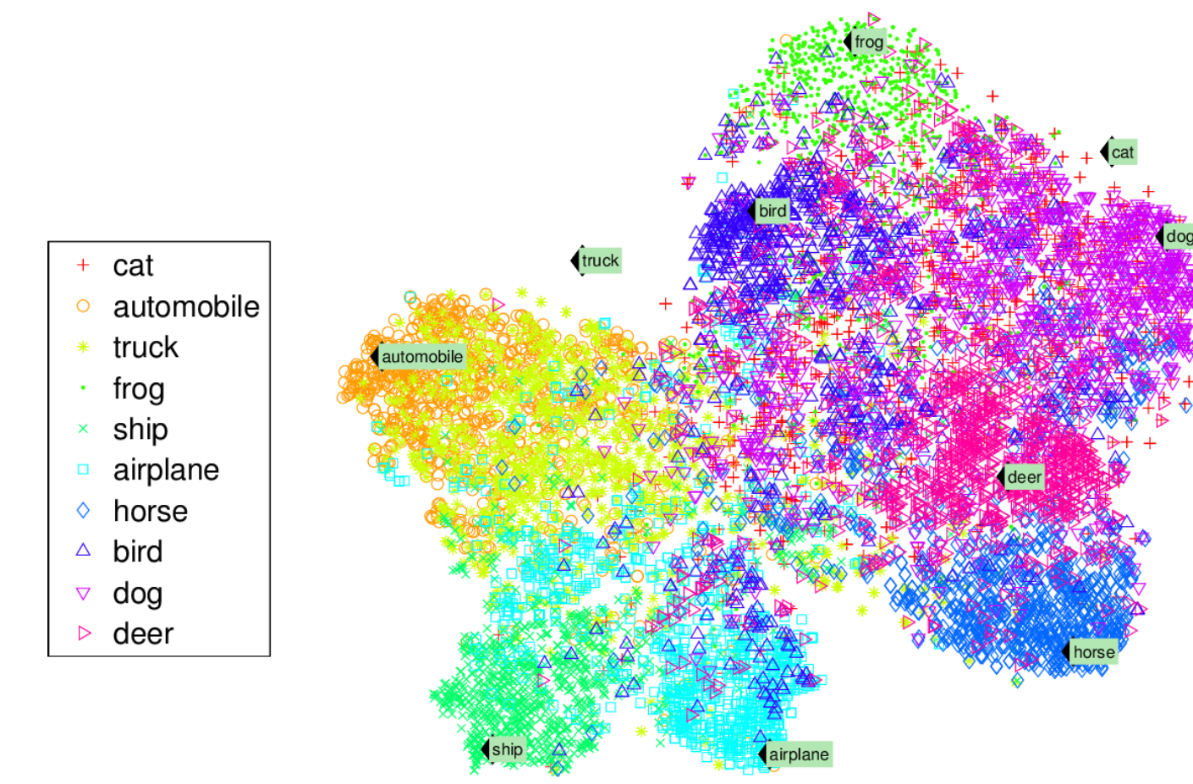
Training Supervision
Visualization algorithms

Slide 22
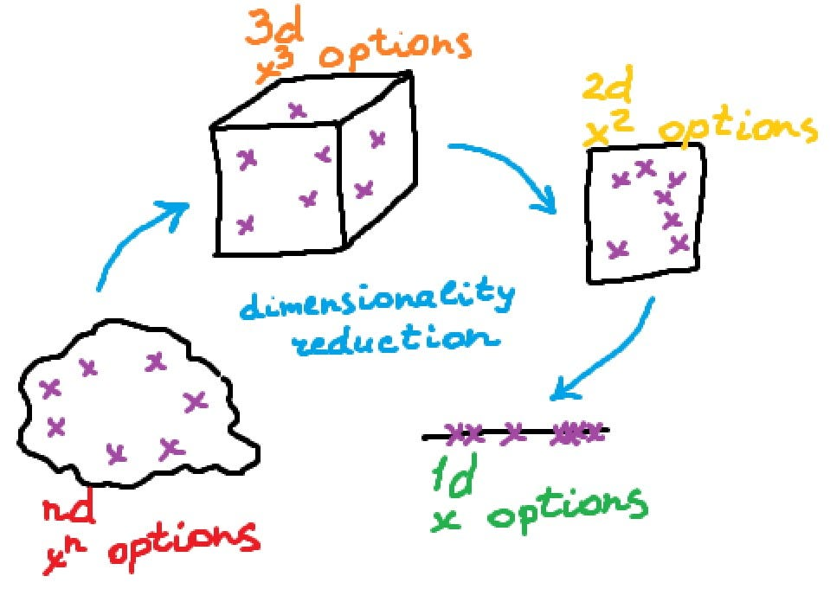
Training Supervision

Slide 23
Dimensionality Reduction
The number of input features, variables, or columns present in a given dataset is known as dimensionality,
and the process to reduce these features is called dimensionality reduction (Feature extraction).
A dataset contains a huge number of input features in various cases, which makes the predictive modeling task more complicated.
Because it is very difficult to visualize or make predictions for the training dataset with a high number of features, for such cases, dimensionality reduction techniques are required to use.

Slide 24
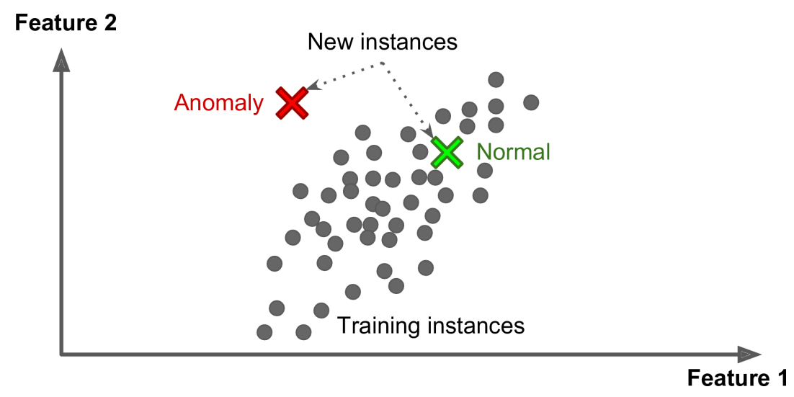
Training Supervision
Anamoly detection

Slide 25
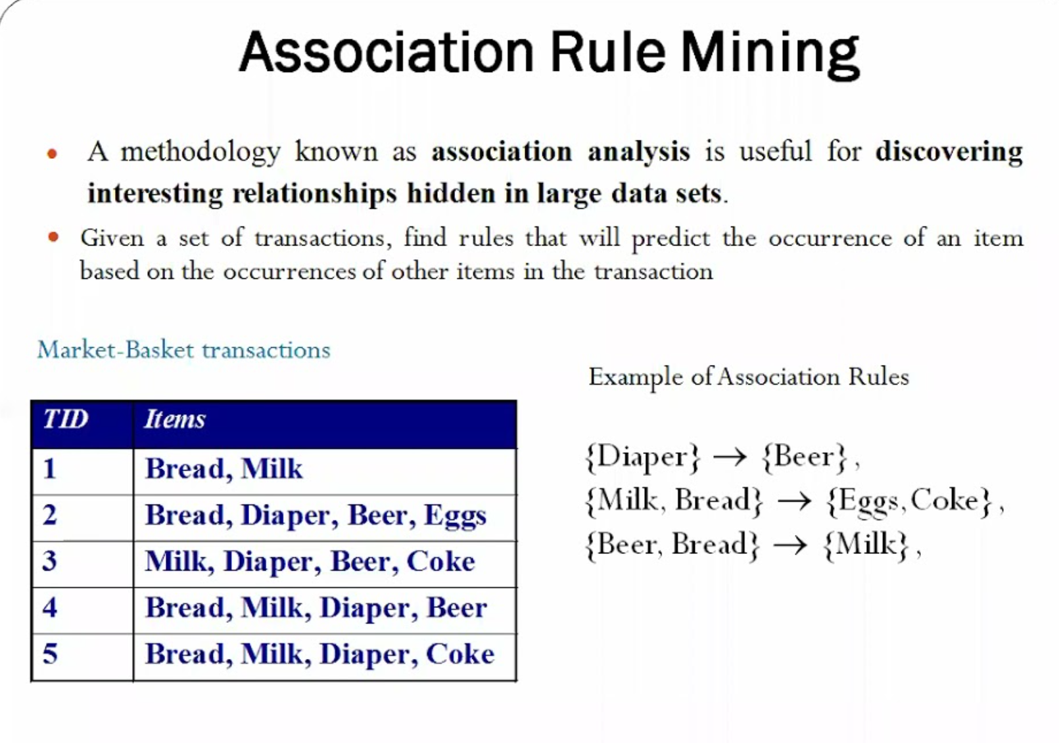
Training Supervision

Slide 26
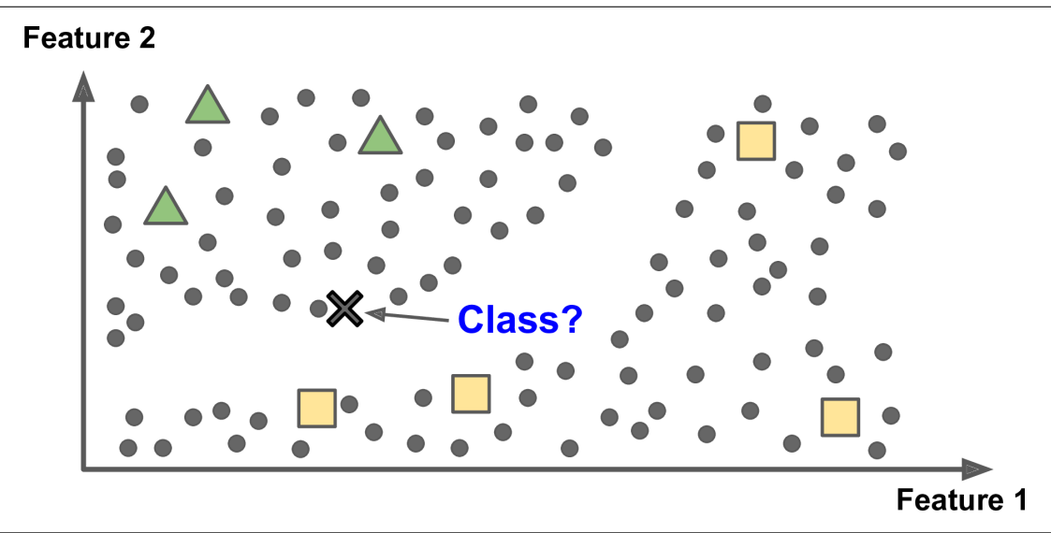
Semi-supervised Learning
Semi-supervised learning is a type of machine learning that falls in between supervised and unsupervised learning.
It is a method that uses a small amount of labeled data and a large amount of unlabeled data to train a model.

Slide 27

Semi-supervised learning is used in Google Photos service
Unsupervised learning is used for identification of clusters of photos
Labelling used for a cluster- Supervised learning

Slide 28
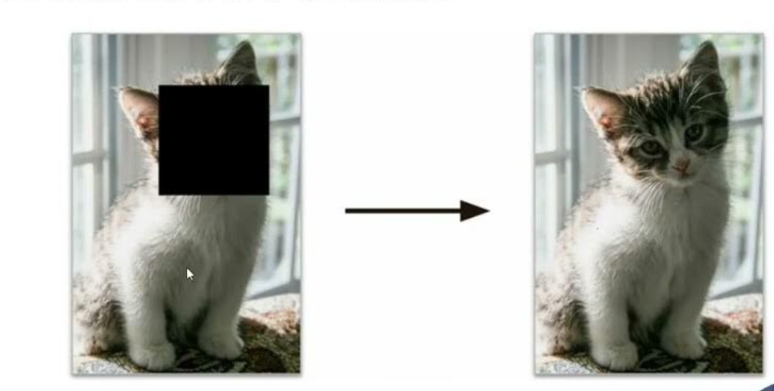
Self-supervised Learning
Self-supervised learning is a machine learning process where the model trains itself to learn one part of the input from another part of the input.

Slide 29

Pet classification Model

Slide 30
Reinforcement Learning
Reinforcement learning is an area of Machine Learning.
It is about taking suitable action to maximize reward in a particular situation.
It is employed by various software and machines to find the best possible behavior or path it should take in a specific situation.

Slide 31
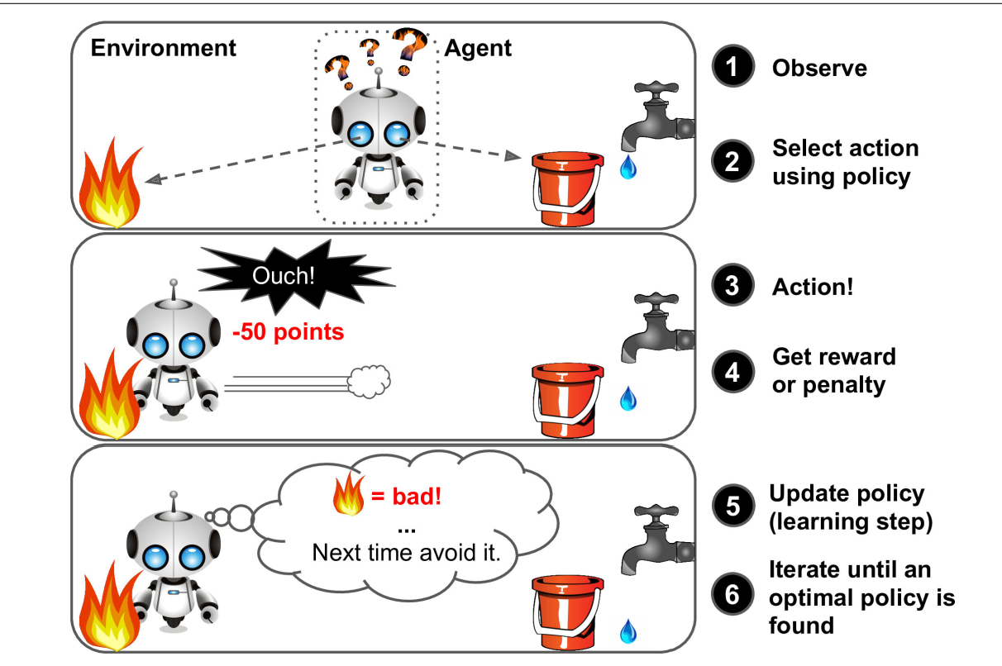

Slide 32
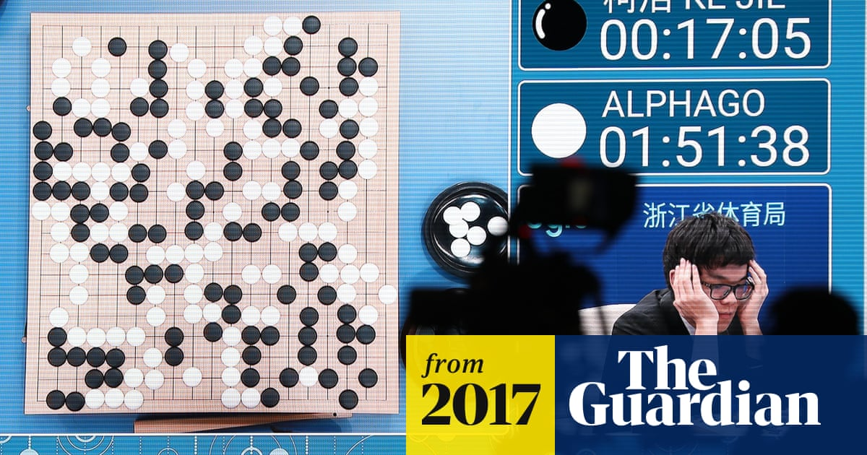

Slide 33
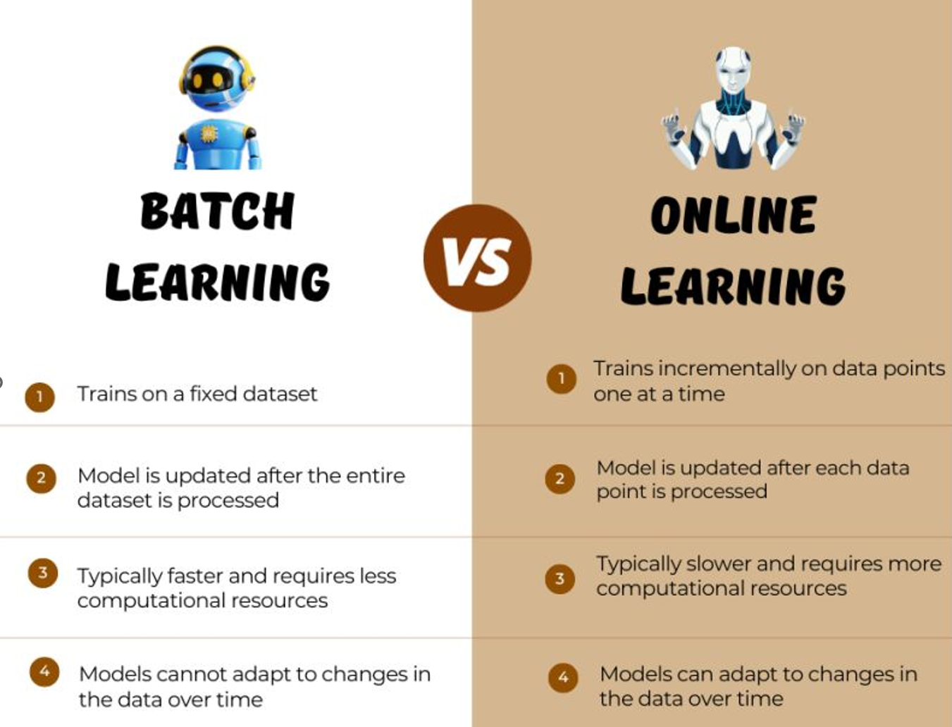

Slide 34
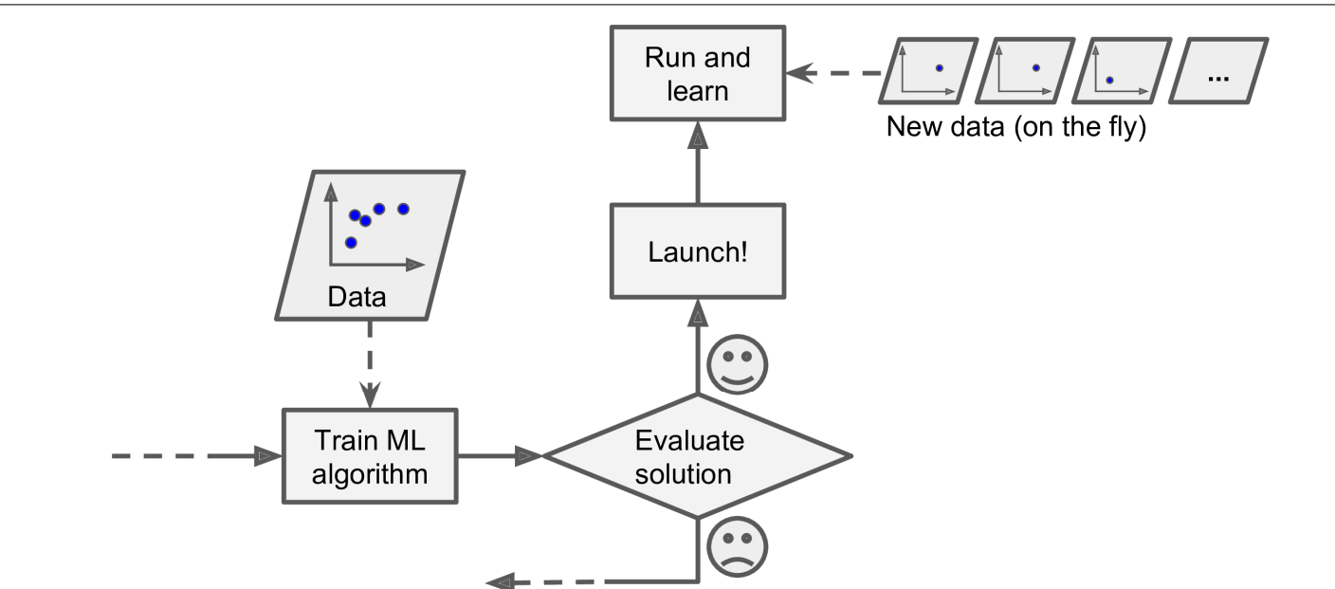
Online Learning

Slide 35
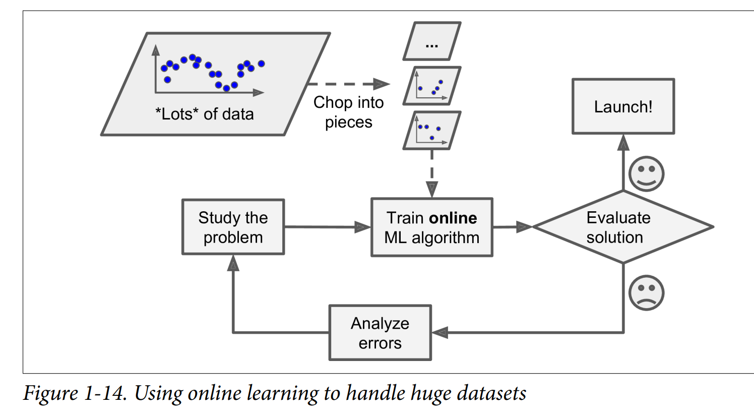

Slide 36
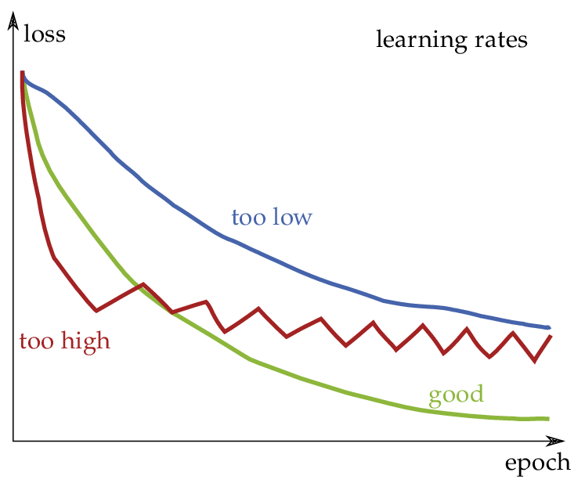

Slide 37
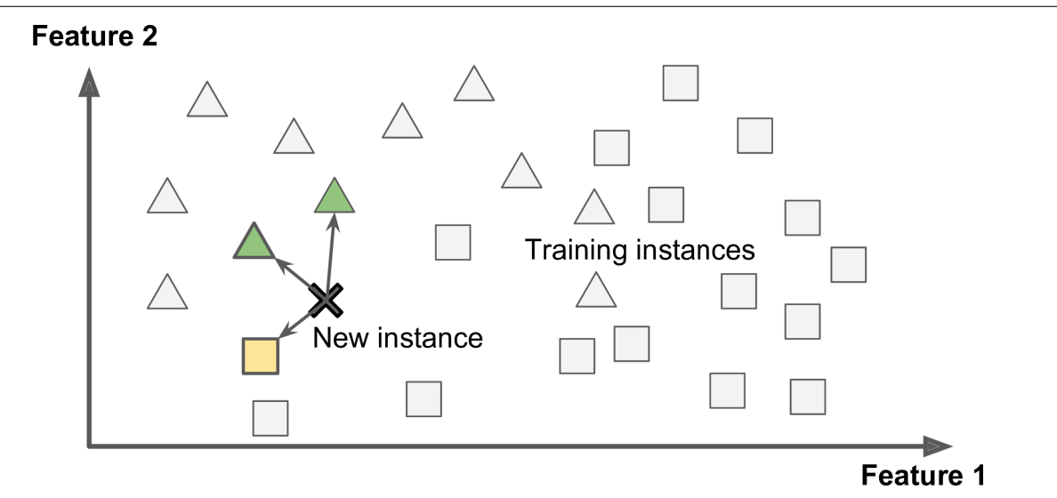
Instance based Learning

Slide 38
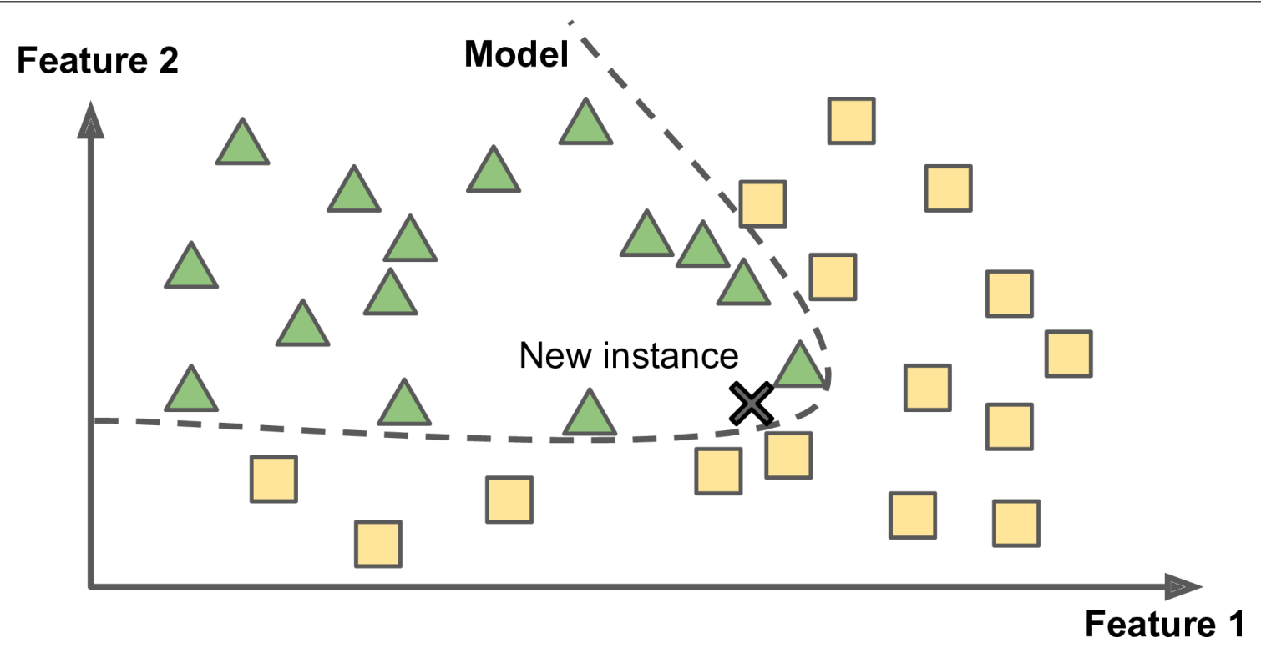
Model based Learning

Slide 39
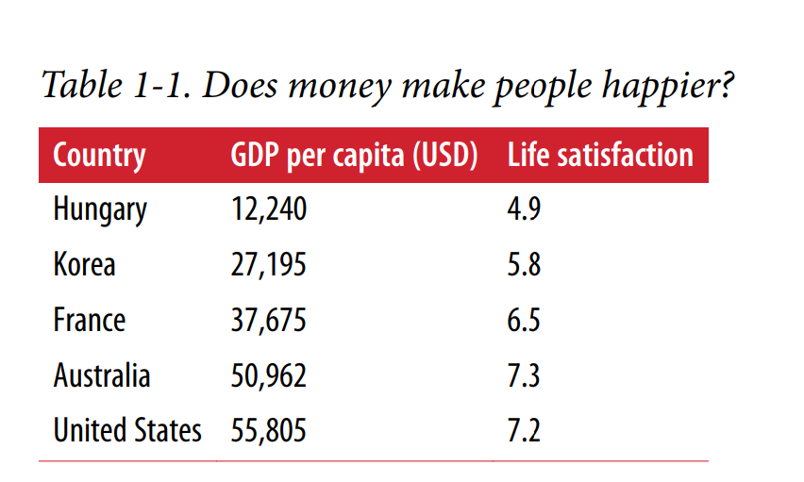

Slide 40
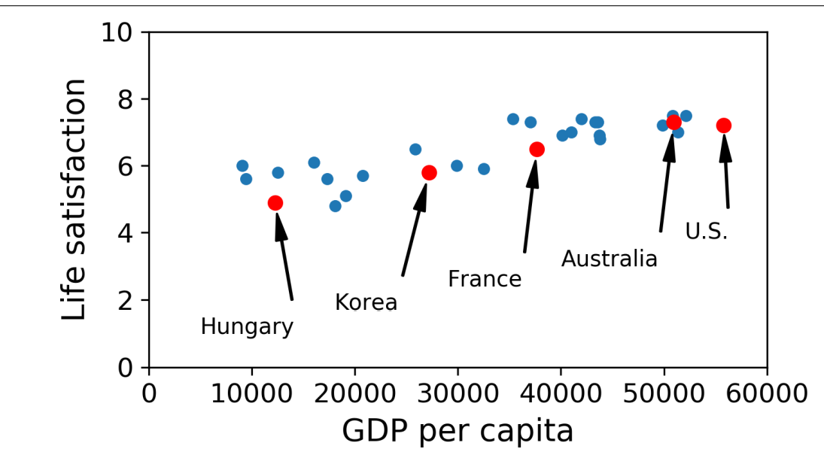

Slide 41
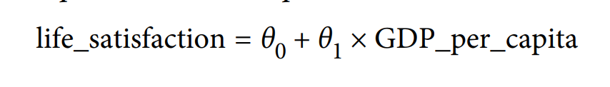
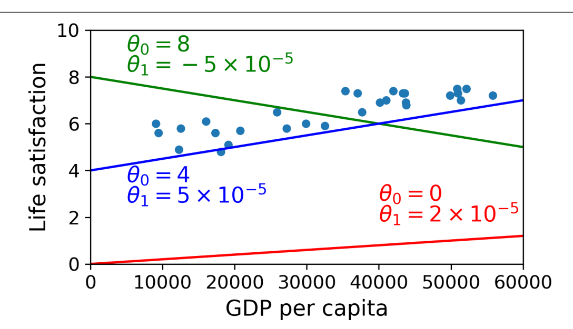

Slide 42
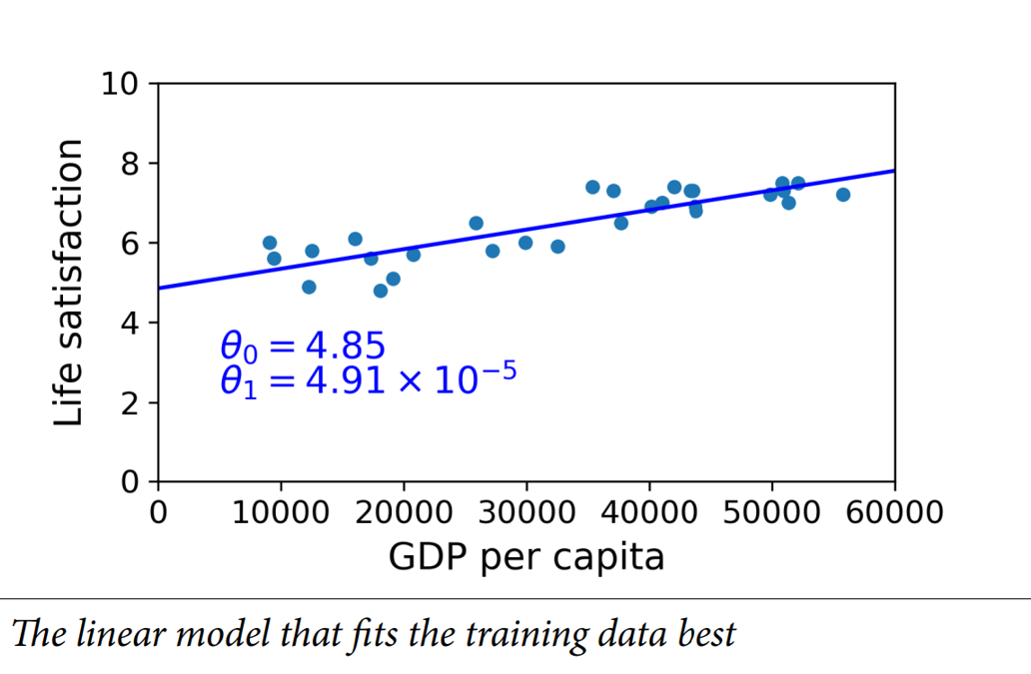

Slide 43


Challenges in Machine Learning
Insufficient quantity of Training data
Toddler recognizing apple
Machine recognizing apple

Slide 44
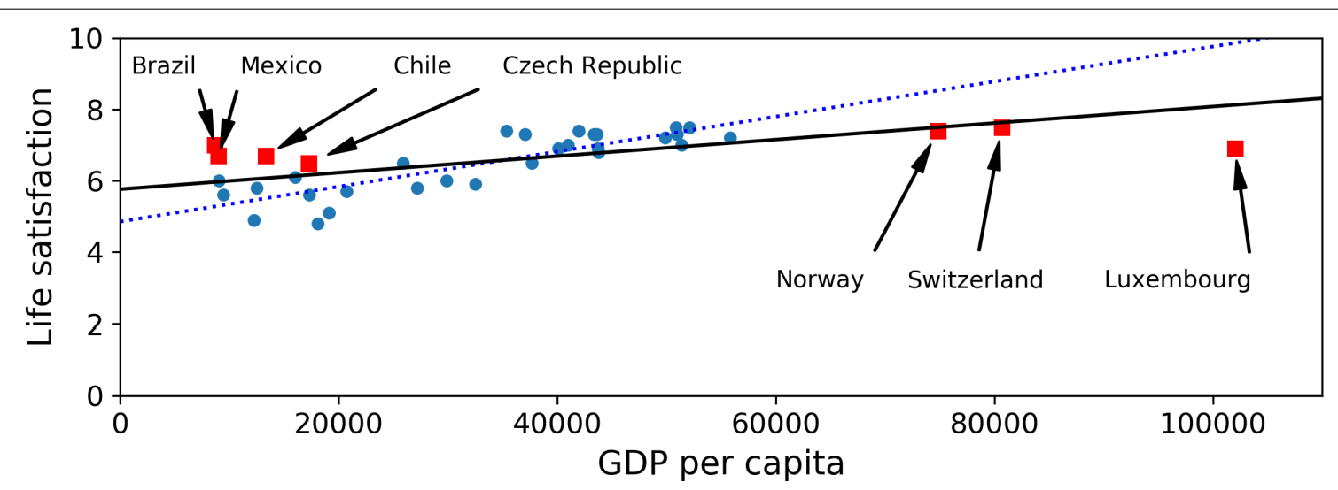
Challenges in Machine Learning
Non-representative Training data

Slide 45
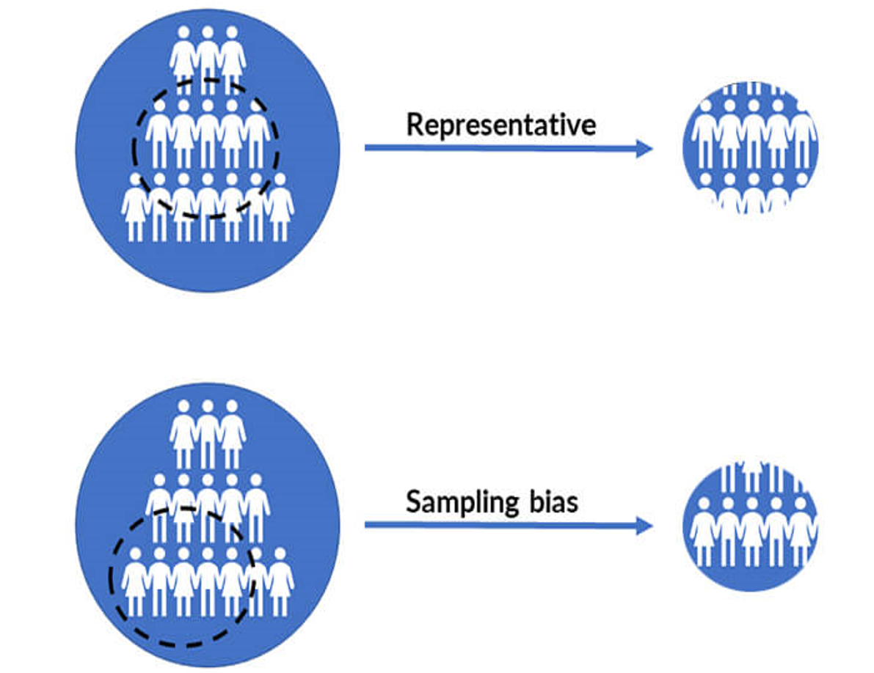

Slide 46
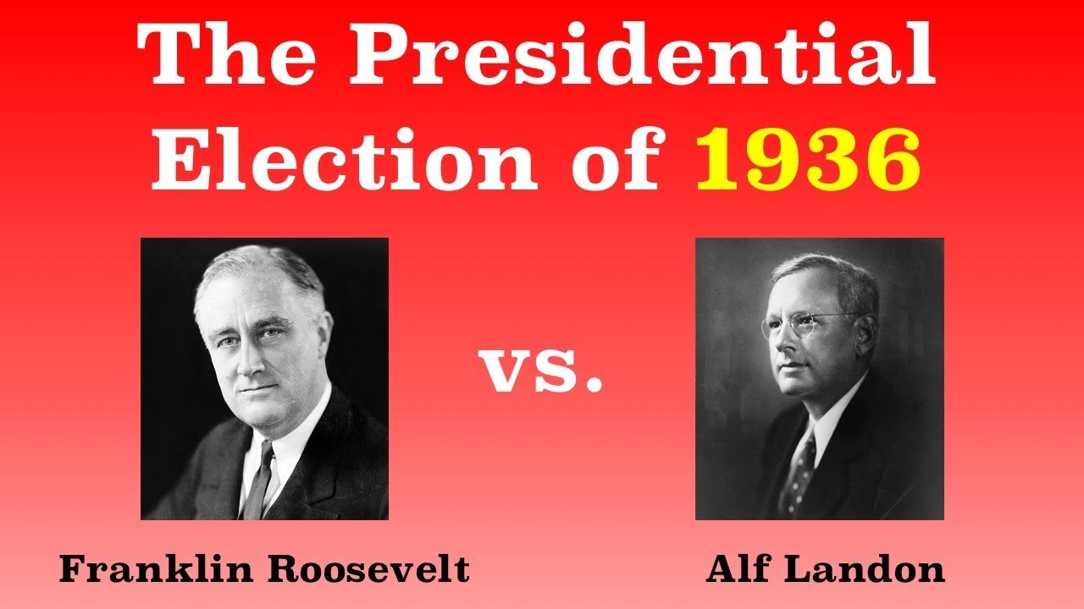
Poll based sampling via email conducted by Literary digest
Phone Directories, Magazine subscribers, club membership lists,
25% responded- Nonresponse bias

Slide 47
Poor Quality data
Noise data
Missing data
Outliers
Data scientists spend significant mount of time in data cleaning

Slide 48

Irrelevant Features

Slide 49
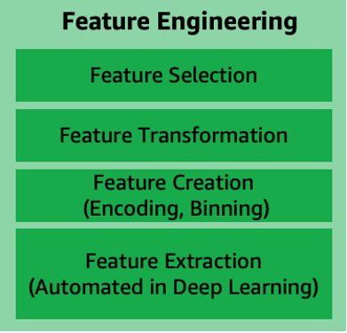

Slide 50
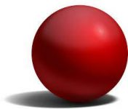
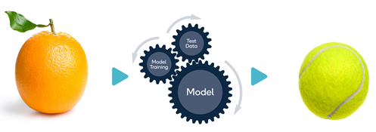
Overfitting and underfitting
Predict a ball
Feature: is_circle
Wrong prediction due to underfitting

Slide 51
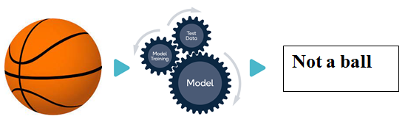
Features: Sphere,Play,Eat,Radius=5cm
Wrong prediction as radius=15cm and overfitting

Slide 52
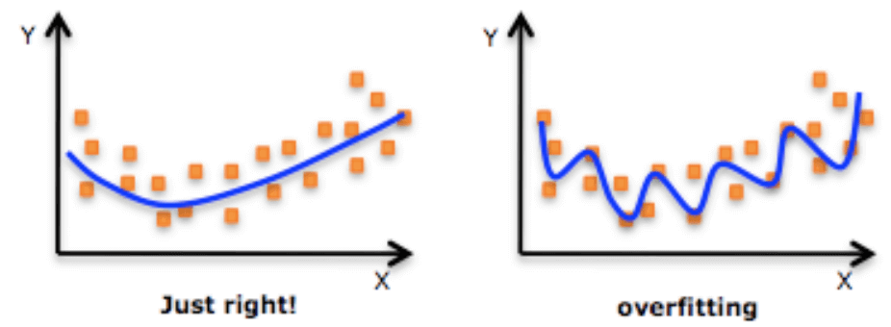
Overfitting
Overfitting happens when model performs well on trained data but does not generalize well.
Simplify model, more training data, reduce noise to avoid overfitting

Slide 53
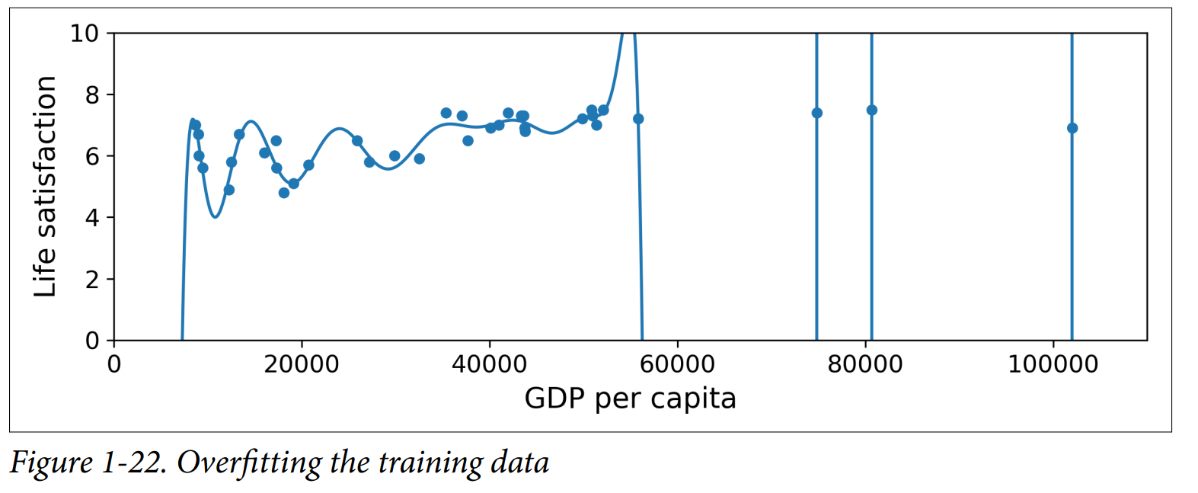

Slide 54
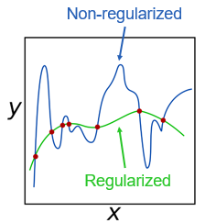
Regularization constrains a model and reduces the risk of overfitting
Amount of regularization is called hyperparameter
Tuning of hyper parameters is challenging task

Slide 55
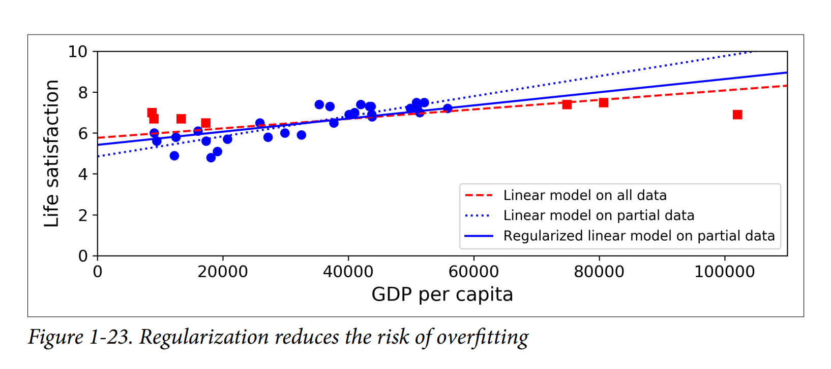

Slide 56
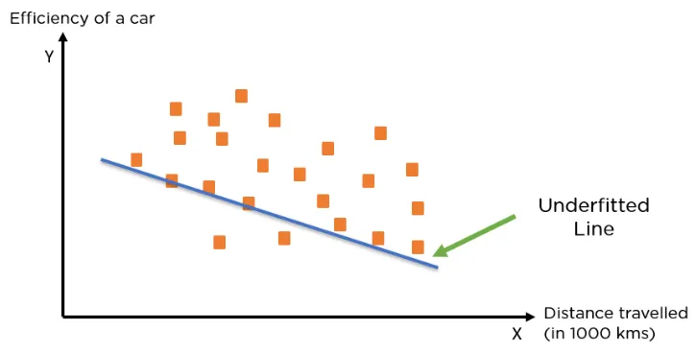
When a model has not learned the patterns in the training data well and is unable to generalize well on the new data, it is known as underfitting.
An underfit model has poor performance on the training data and will result in unreliable predictions.

Slide 57
