Slide 1
Probability based machine learning
Module v

Slide 2
SKILL LAB

Slide 3
SKILL LAB

Slide 5
The sum of three tests, two assignments, and quiz/seminar/group discussion will be out of 100 marks and will be scaled down to 50 marks

Slide 7
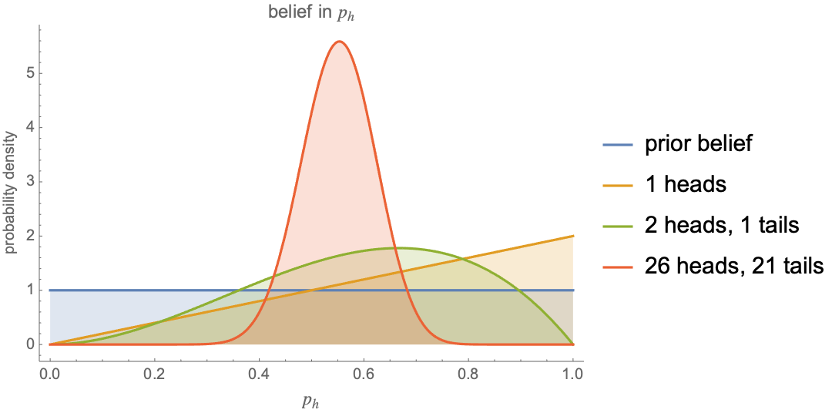
Bayesian Learning

Slide 8
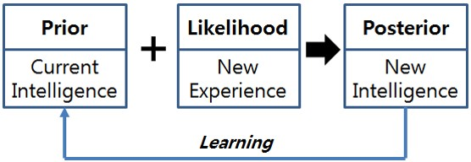
Bayesian Learning Model

Slide 9
Features of Bayesian Learning
Each observed training example can incrementally decrease or increase the estimated probability that a hypothesis is correct
Prior knowledge can be combined with observed data to determine the final probability of a hypothesis
Accommodate hypothesis that make probabilistic predictions
Classify based on combining predictions of multiple hypothesis
Provides optimal decision making

Slide 10
Bayes theorem in Machine Learning
P(h) is prior probability of hypothesis h
P(D) is prior probability of training data D
P(h|D) is posterior probability of h given D
P(D|h) is posterior probability of D given h
P(h|D) increases with increase in P(D|h) and P(h)
P(h|D) decreases with increase in P(D)

Slide 11
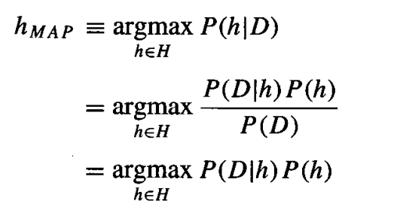
Maximum a posteriori (MAP) hypothesis
Maximum likelihood hypothesis

Slide 12
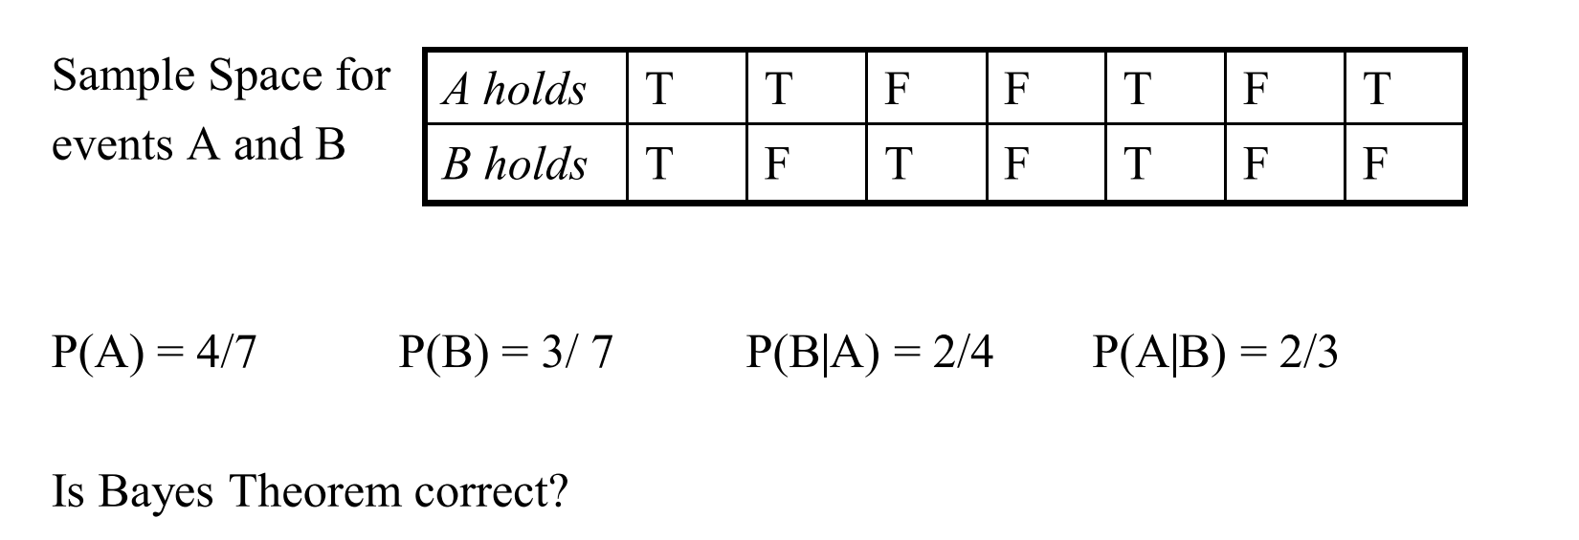

Slide 13
we now observe a new patient for whom the lab test returns a positive result. Should we diagnose the patient as having cancer or not?

Slide 14
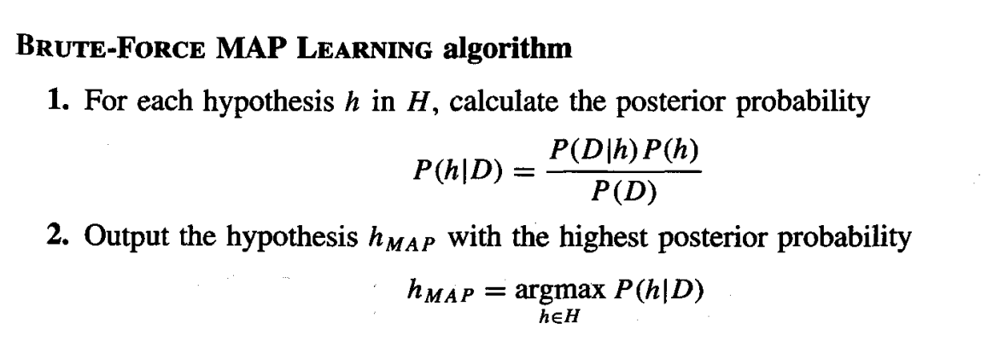
This algorithm consumes Significant resources

Slide 15
Assumptions of Bruteforce MAP
1. The training data D is noise free
2. The target concept c is contained in the hypothesis space H
3. We have no a priori reason to believe that any hypothesis is more probable than any other.

Slide 16
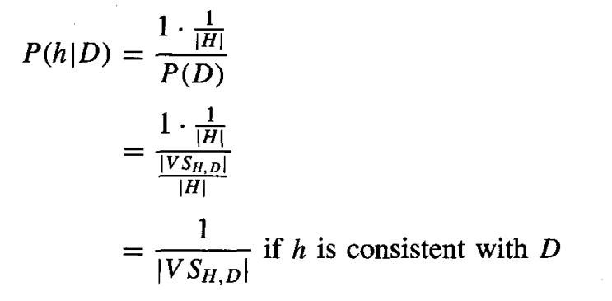

Slide 17
Maximum Likelihood and Least Squared Error hypothesis
To prove: Any learning algorithm that minimizes the squared error between the output hypothesis predictions and the training data will output a maximum likelihood hypothesis
Instance space X
{x1, x2,…xm}
Hypothesis space, H
{h1, h2,…hn}
Each h:X->R

Slide 18
Maximum Likelihood and Least Squared Error hypothesis
To prove: Any learning algorithm that minimizes the squared error between the output hypothesis predictions and the training data will output a maximum likelihood hypothesis
Noise distribution is Normal distribution
Training instance
<xi,di>
di=f(xi)+ei
f(xi)-noise free target
ei-random variable for noise

Slide 19
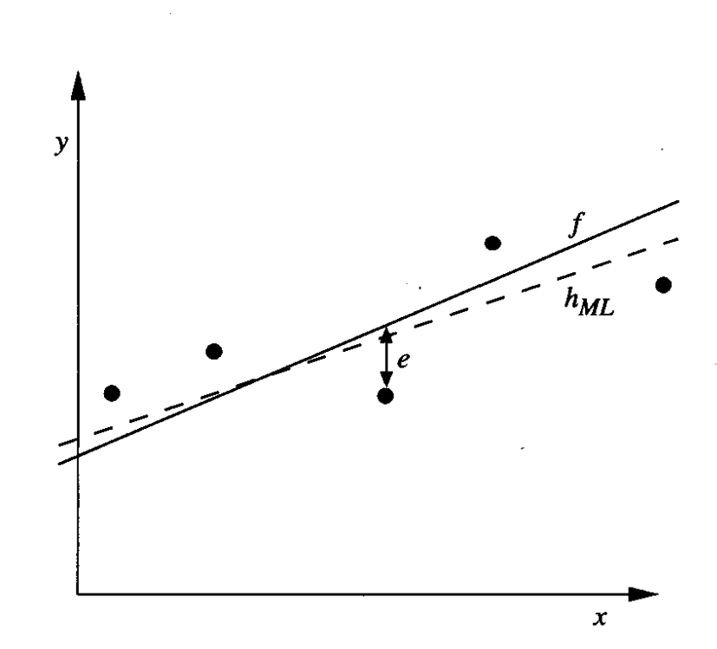
Learning a real valued function

Slide 20
Maximum Likelihood and Least Squared Error hypothesis
To prove: Any learning algorithm that minimizes the squared error between the output hypothesis predictions and the training data will output a maximum likelihood hypothesis
Probabilities for continuous values-probability density function

Slide 21
Continuous probability
Normal distribution

Slide 22
(Take log)
(Take out independent term)

Slide 23
(Max of –ve is same as min of +ve)
(Take out independent term)

Slide 24
Hence proved: Any learning algorithm that minimizes the squared error between the output hypothesis predictions and the training data will output a maximum likelihood hypothesis

Slide 25
Maximum Likelihood for predicting probability (Discrete case)
Instance space X
{x1, x2,…xm}
Learning function
f:X->{0,1}
$$Need to find f^{′}:X→\left[0,1\right]$$
$$such that{ f}^{′}\left(x\right)=P(f\left(x\right)=1)$$

Slide 26
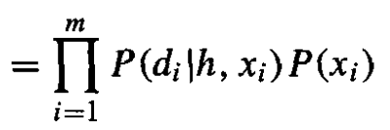
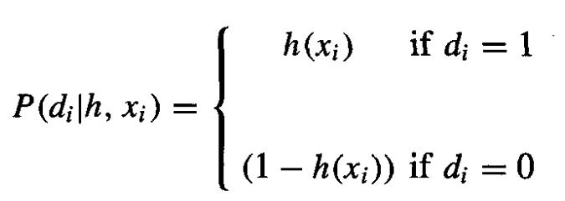
(product theorem)
(apply for all m samples)

Slide 27
(substitution)
(Take out independent term)

Slide 28
Negative of this term is called cross entropy

Slide 30
MDL- choose the shortest explanation for the observed data.

Slide 32
Bayes Optimal Classifier
Answers the question: what is the most probable classification of the new instance given the training data

Slide 33
Apply Bayes optimal classifier and find what is the classification result

Slide 34
Gibbs Algorithm
Choose a hypothesis h from H at random, according to posterior probability distribution over H
Use h to predict the classification of the next instance
Less computationally complex
misclassification error for the Gibbs algorithm is at most twice the expected error of the Bayes optimal classifier

Slide 35
Naïve Bayes classifier

Slide 36
Assumption : feature attributes are independent of each other

Slide 37
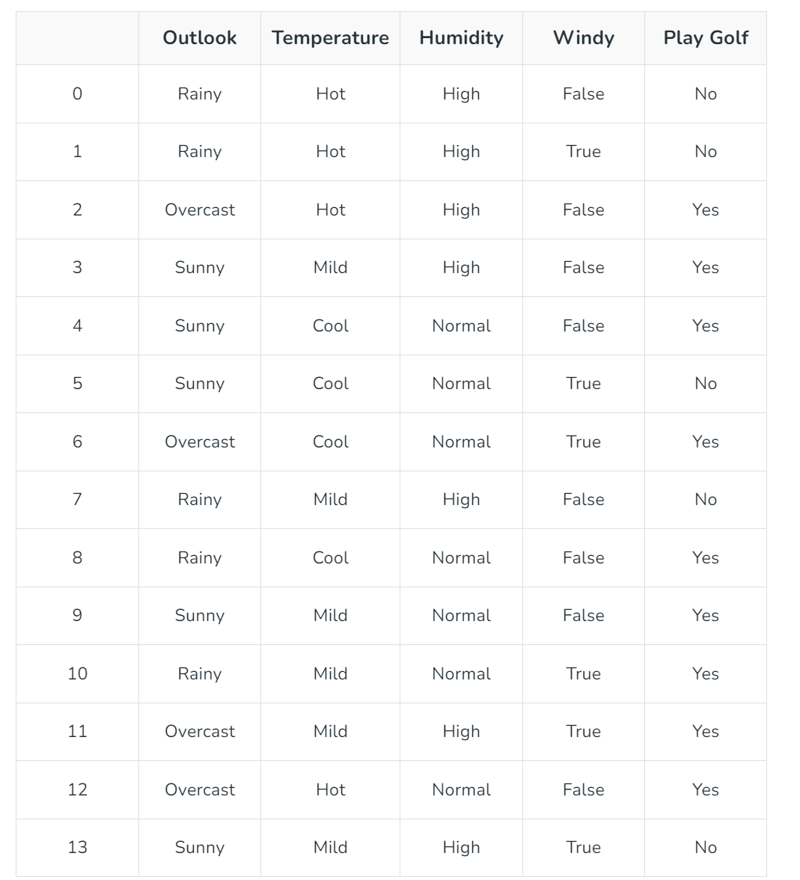
Feature Matrix
Response Vector

Slide 38
Compute FOLLOWING:
P(P1ayTennis = yes)
P(P1ayTennis = no)
P(Wind = strong|PlayTennis = yes)
P(Wind = strong|PlayTennis = no)

