Slide 1
MODULE III

Slide 2
Time to work under the hood
Closed form equation for linear regression
Gradient descent
Polynomial regression for nonlinear data

Slide 3
Linear Regression
$\hat{y}=θ_{0}+θ_{1}x_{1}+θ_{2}x_{2}$+…+ $θ_{n}x_{n}$
$\hat{y}=h_{θ}$(x)= $θ$.x
$$MSE(x,h_{θ})={\frac{1}{m}\sum_{i=1}^{m}{{(θ^{T}x^{i}−y^{i})}^{2}}}_{}$$

Slide 4
Normal Equation
$\hat{θ}={(x^{T}x)}^{−1}$ $x^{T}$y
Python code to test Normal Equation

Slide 5
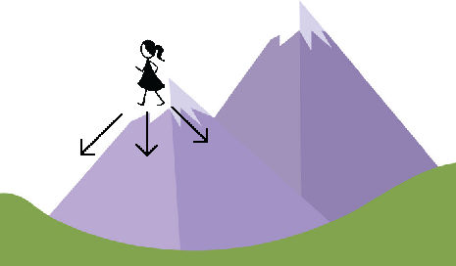
Gradient Descent Algorithm
Loss function
Learning rate

Slide 6
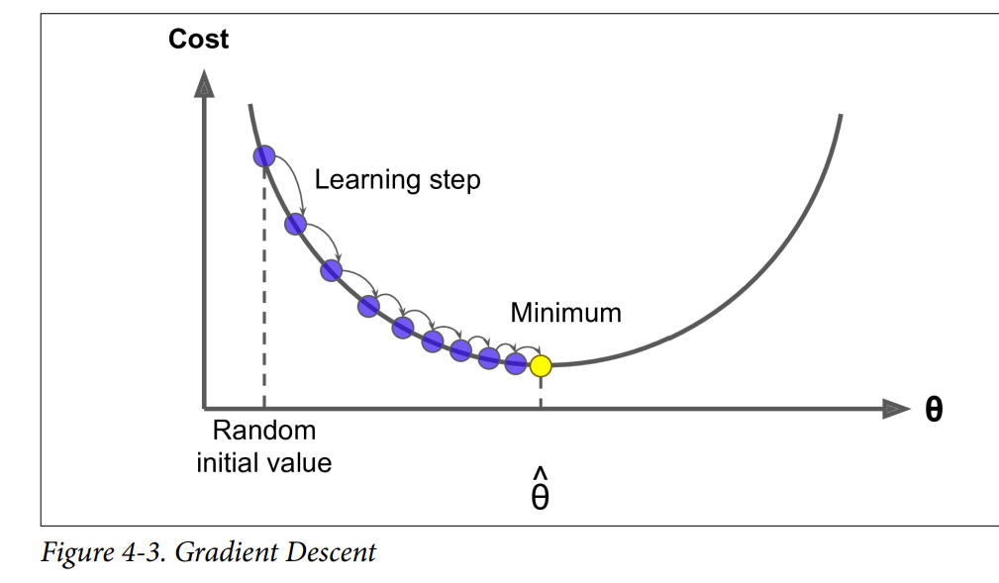

Slide 7
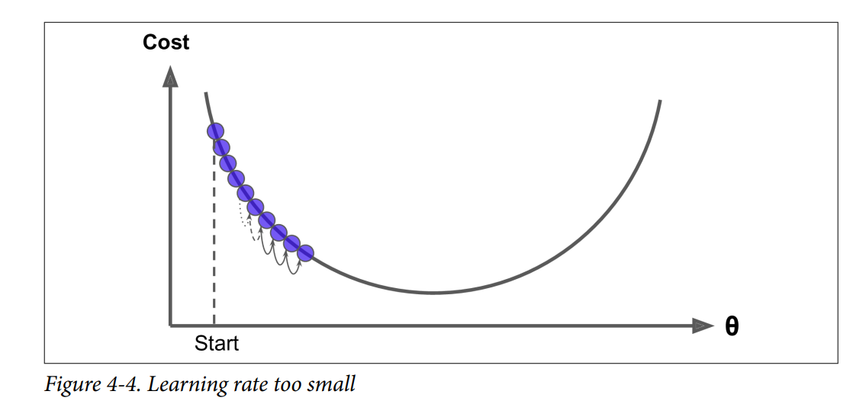

Slide 8
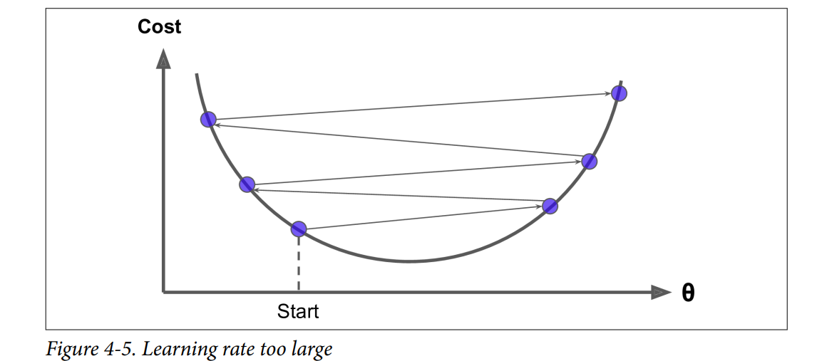

Slide 9
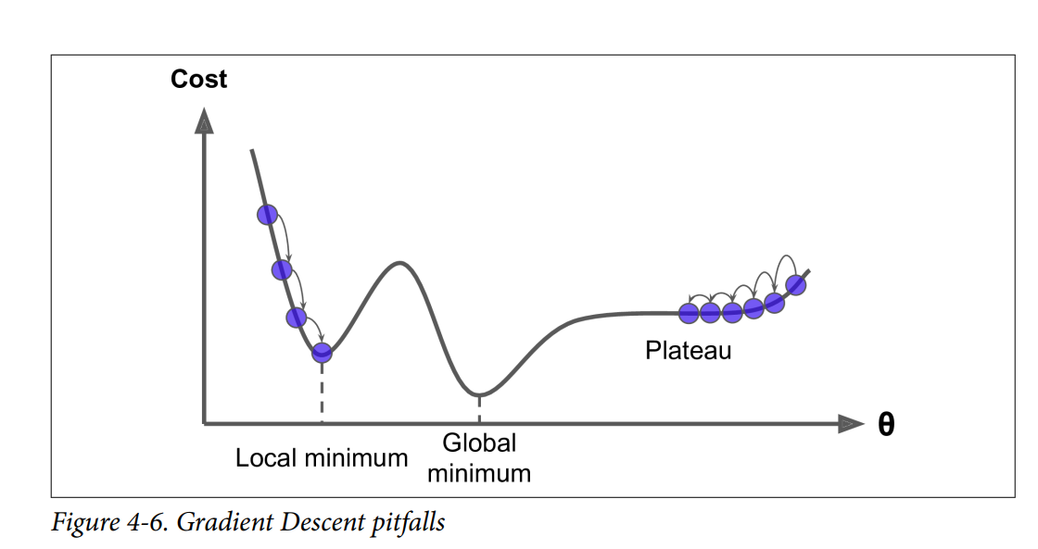

Slide 11
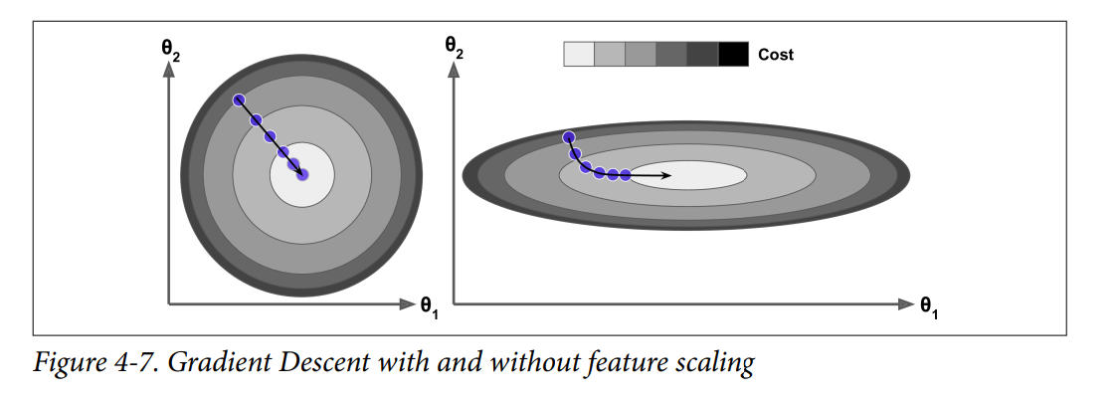

Slide 12
Batch/Full Gradient Descent
$$MSE(θ)={\frac{1}{m}\sum_{i=1}^{m}{{(θ^{T}x^{i}−y^{i})}^{2}}}_{}$$
$\frac{∂}{∂θ_{j}}MSE\left(θ\right)$=$\frac{2}{m}\sum_{i=1}^{m}{(θ^{T}x^{i}−y^{i})x_{j}^{i}}$
$$∇_{θ}MSE\left(θ\right)=\begin{matrix}\frac{∂}{∂θ_{0}}MSE\left(θ\right) \\ \frac{∂}{∂θ_{1}}MSE\left(θ\right) \\ \frac{∂}{∂θ_{n}}MSE\left(θ\right)\end{matrix}$$
$$=\frac{2}{m}x^{T}\left(xθ−y\right)$$

Slide 13
Gradient descent step
$$θ^{nextstep}=θ−η∇_{θ}MSE(θ)$$
Python code for Batch Gradient Descent

Slide 14
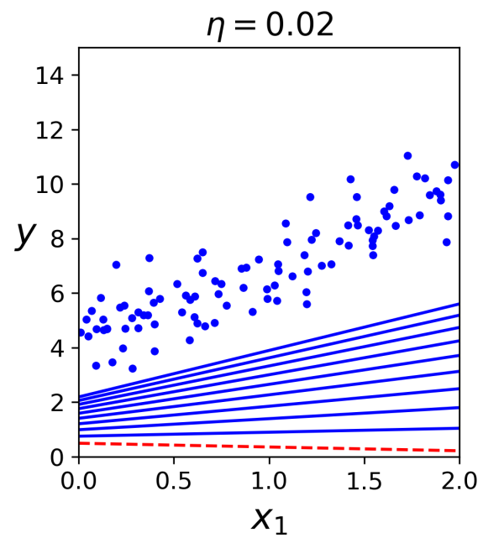
Slow learning rate

Slide 15
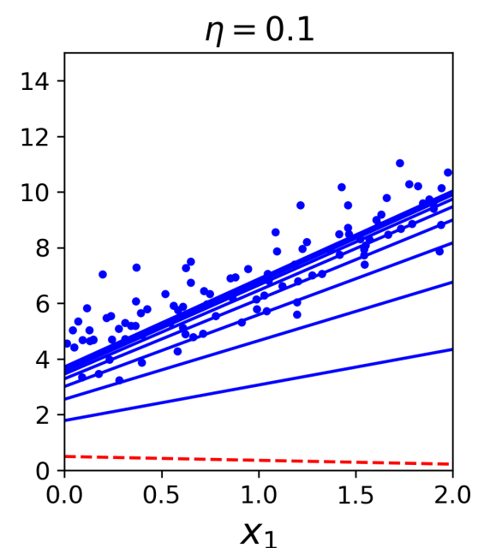
Average learning rate

Slide 16
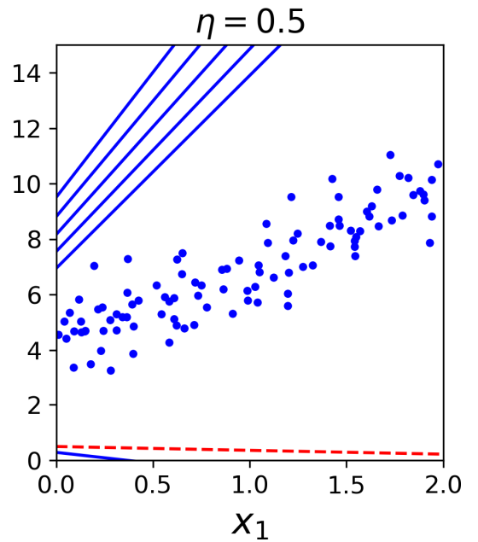
Fast learning rate

Slide 17
Stochastic Gradient Descent
Problem with batch gradient descent is that it takes entire training set to compute gradients
On the other hand, stochastic gradient descent, it picks a random instance in the training set at every step and computes the gradient only on that instance

Slide 18
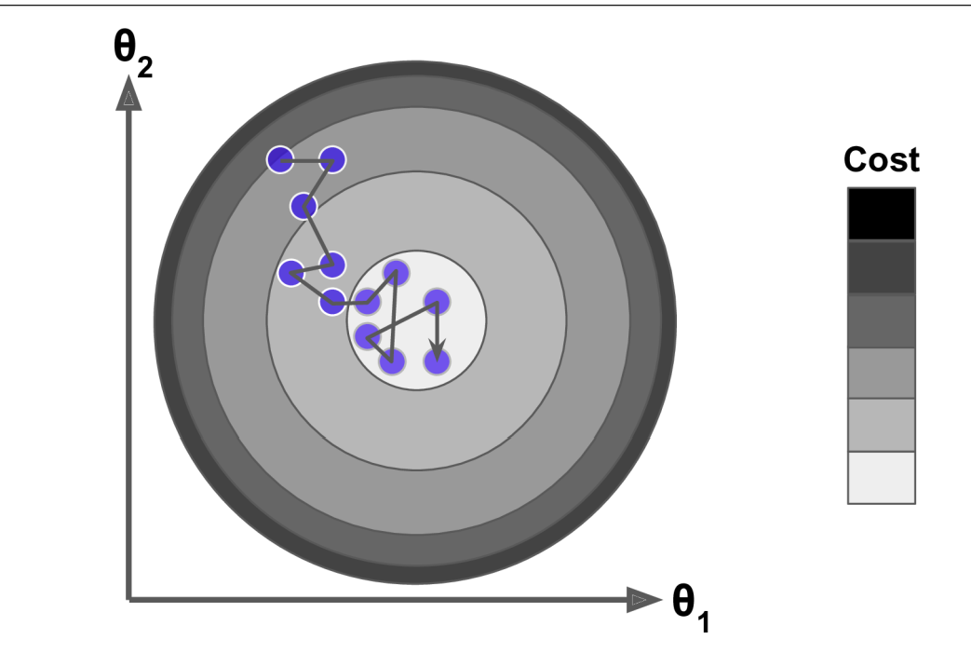
Bouncing cost function but very fast

Slide 19
Python code for Stochastic Gradient Descent

Slide 20
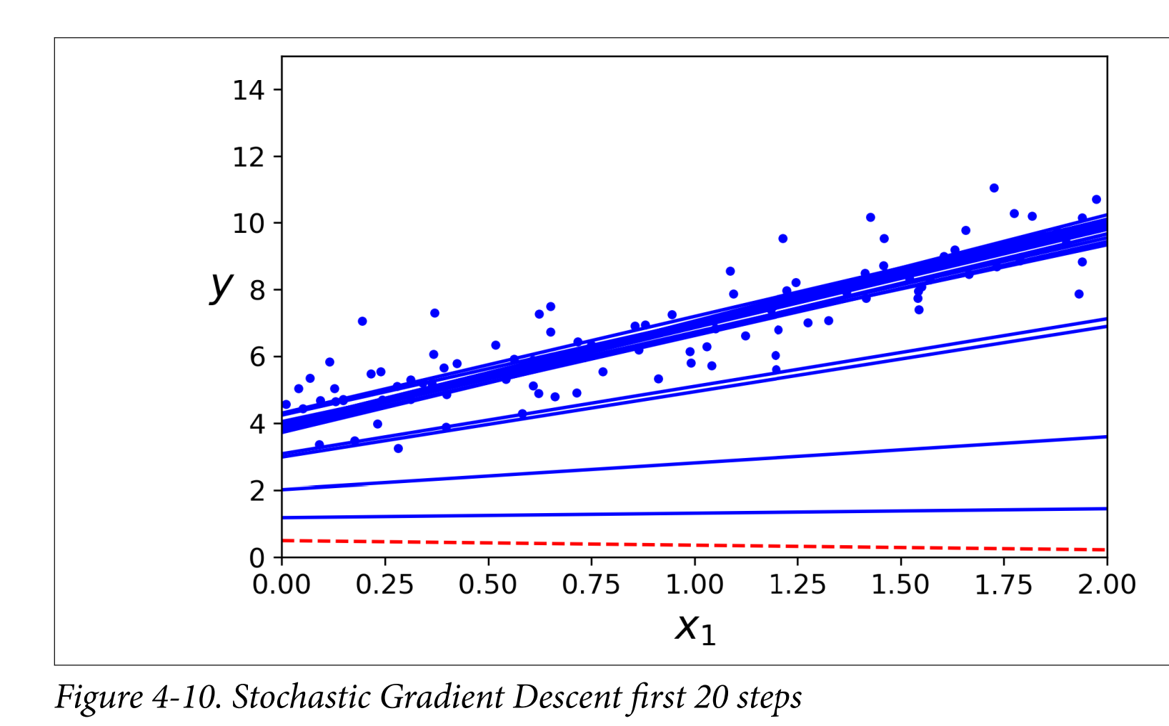

Slide 21
Mini-Batch Gradient Descent
Problem with batch gradient descent is that it takes entire training set to compute gradients and problem with stochastic gradient is it is erratic in updation of loss functions
On the other hand, mini-batch descent uses sets of random instances at each step called mini-batches.

Slide 22
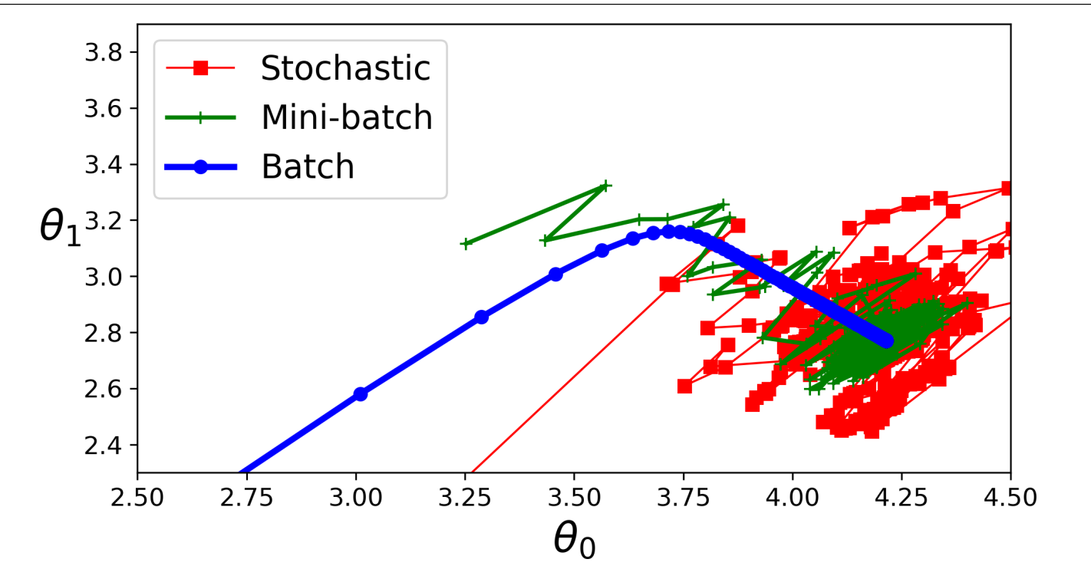
Stochastic – erratic updation, batch-regular but slow, mini-batch-faster and regular

Slide 24
Polynomial Regression
If the data is non-linearly related with target, still linear regression can be used with technique of Polynomial Regression.
In polynomial regression, add powers of each feature as new features and train on these new features.
Python code for polynomial regression

Slide 25
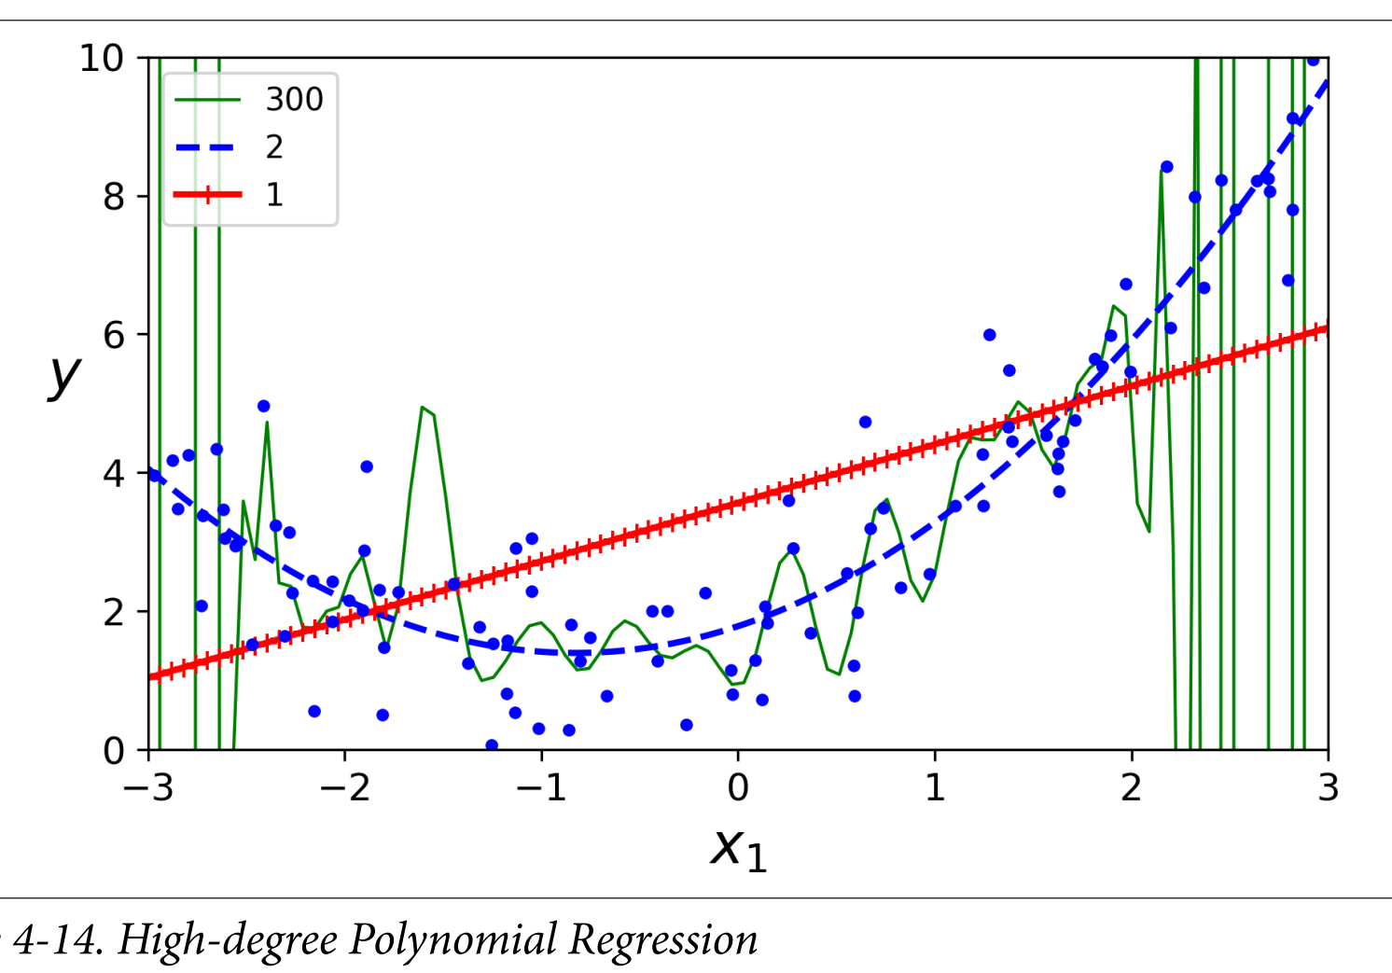

Slide 27
Finding the right degree of a polynomial is a challenge and learning curves help in resolving it
Learning curves are the plots of training and validation error as a function of the training iteration
Python code for illustrating the use of learning curves

Slide 28
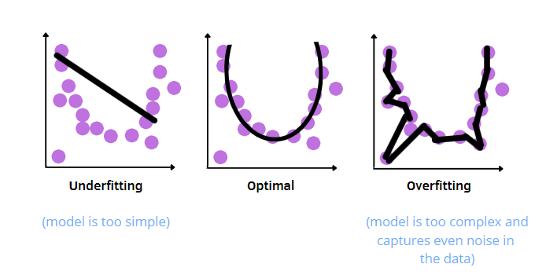

Slide 29
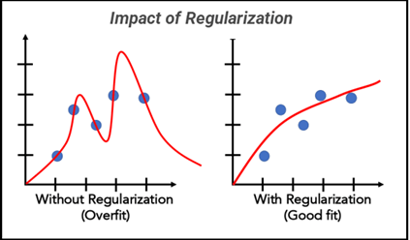
Polynomial Regression – reduce degrees
Linear Regression – constrain weights

Slide 30
Regularization Techniques
Ridge Regression
Lasso Regression
Elastic net Regression

Slide 31
Ridge Regression
$$J\left(θ\right)=MSE\left(θ\right)+\frac{α}{m}\sum_{i=1}^{m}{θ_{i}^{2}}$$
Normal Equation
$\hat{θ}={(x^{T}x)}^{−1}$ $x^{T}$y
Normal Equation with Ridge regression
$\hat{θ}={(x^{T}x+αA)}^{−1}$ $x^{T}$y
A is the (n+1)X(n+1) Identity Matrix except with 0 at the top-left cell

Slide 32
Python code
from sklearn.linear_model import Ridge
ridge_reg = Ridge(alpha=1)
ridge_reg.fit(X, y)
Or
sgd_reg = SGDRegressor(penalty="l2")

Slide 33
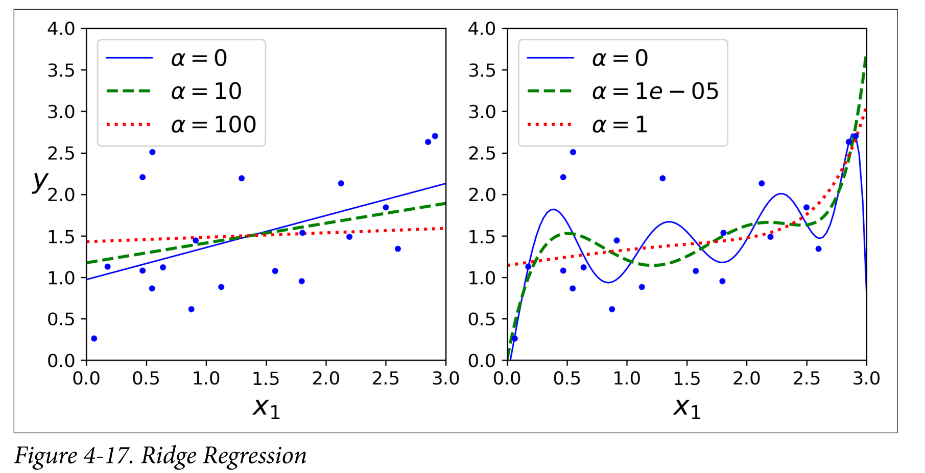

Slide 34
Lasso Regression
Least absolute shrinkage and selection operator
$$J\left(θ\right)=MSE\left(θ\right)+2α\sum_{i=1}^{m}{\left|θ_{i}\right|}$$
Python code
from sklearn.linear_model import Lasso
lasso_reg = Lasso(alpha=0.1)
lasso_reg.fit(X, y)

Slide 35
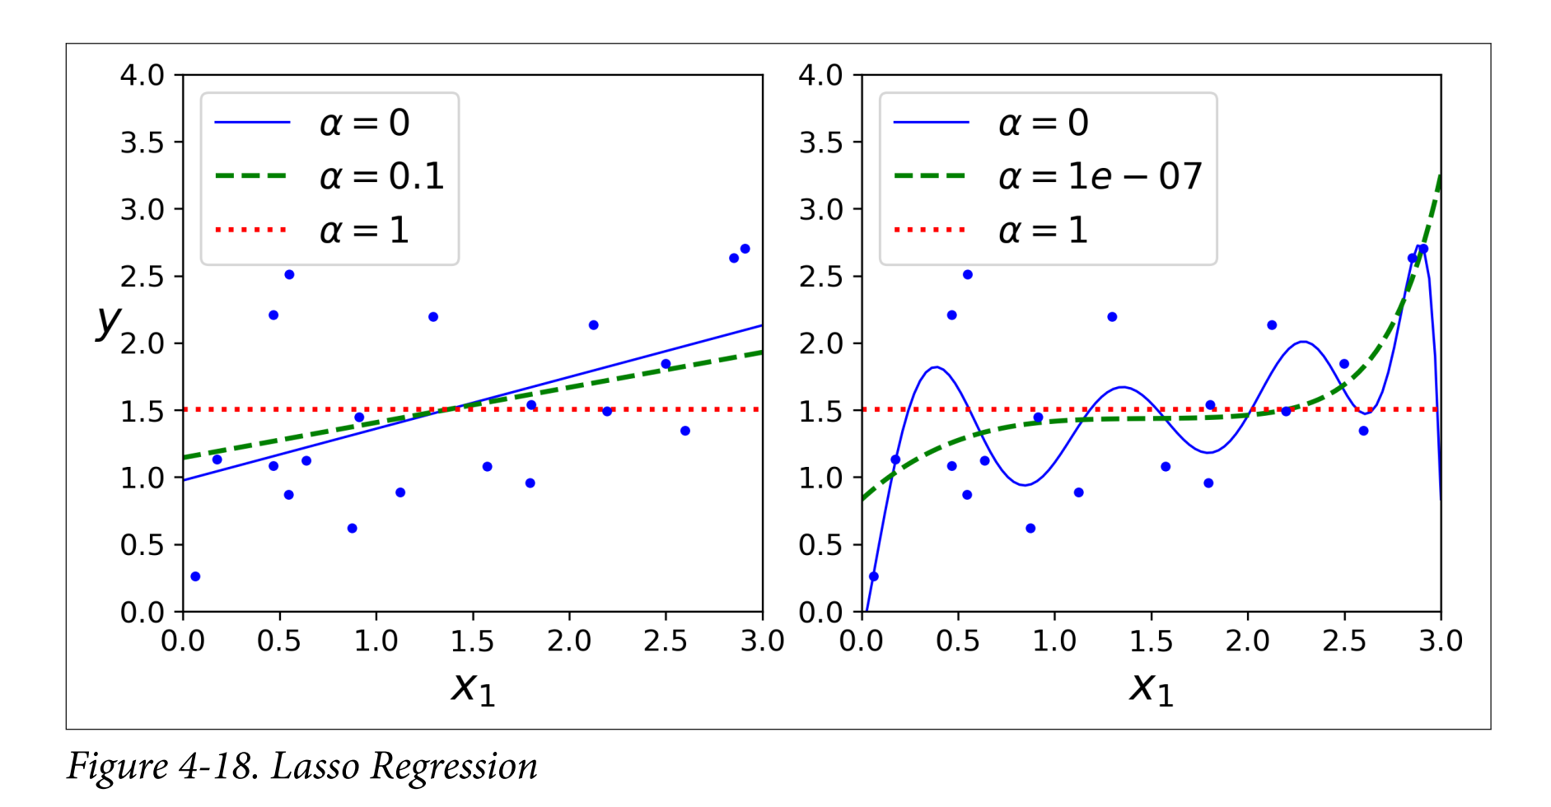

Slide 36
Elastic Net Regression
Middle ground between Ridge and Lasso
$$J\left(θ\right)=MSE\left(θ\right)+\left(1−r\right).\frac{α}{m}\sum_{i=1}^{m}{θ_{i}^{2}}+r.2α\sum_{i=1}^{m}{\left|θ_{i}\right|}$$
Python code
from sklearn.linear_model import ElasticNet
el_reg = ElasticNet(alpha=0.1,l1_ratio=0.5)
el_reg.fit(X, y)

Slide 37
Early Stopping
A very different way to regularize is to stop training as soon as validation error reaches minimum.

Slide 38
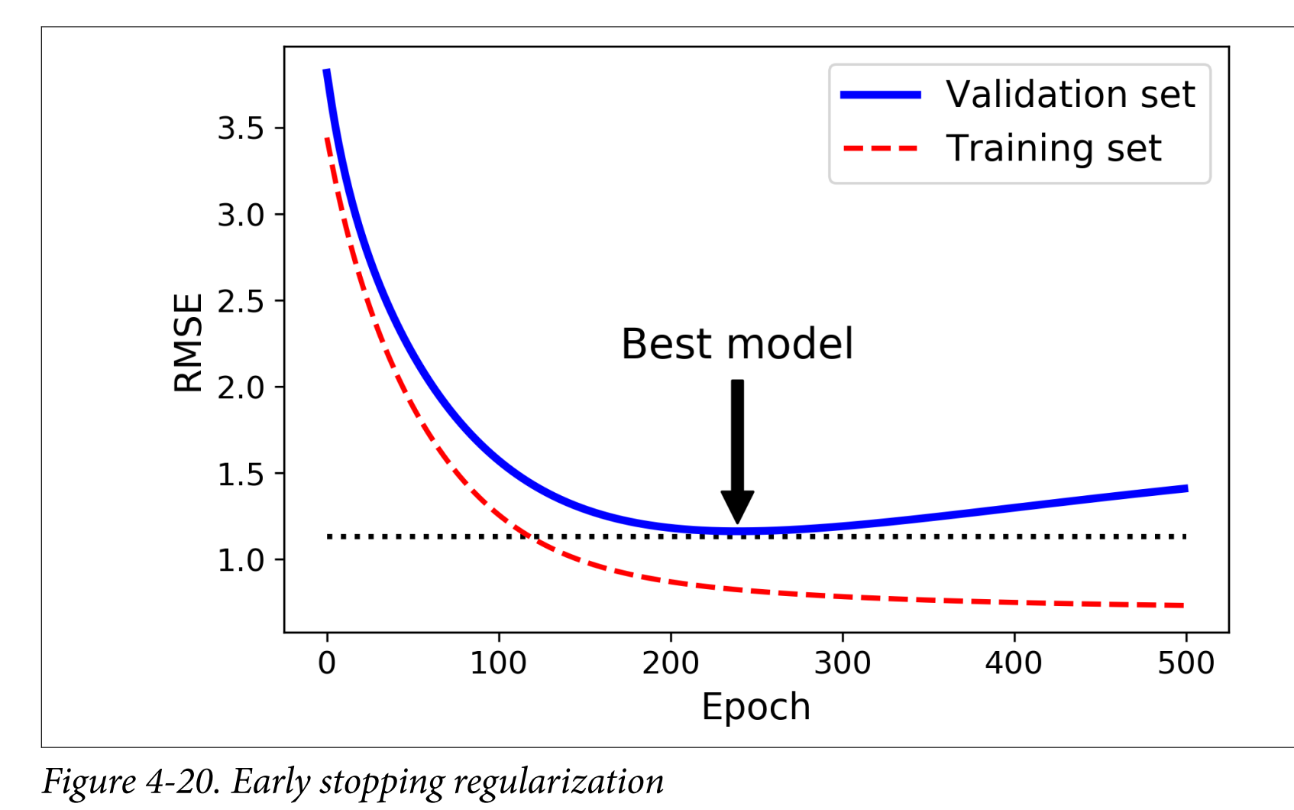

Slide 39
Logistic regression (Logits) is used to estimate the probability that an instance belongs to particular class .
Hence it is a regression algorithm used for classification

Slide 40
Estimating probabilities
$$\hat{p}=σ(θ^{T}x)$$
$$σ(t)=\frac{1}{1+exp(−t)}$$
$$\hat{y}=\left\{\begin{aligned}0 if\hat{ p}<0.5 \\ 1 if\hat{ p}≥0.5\end{aligned}\right.$$

Slide 41
Training and Cost functions
$$c\left(θ\right)=\left\{\begin{aligned}−log\left(\hat{ p}\right) if y=1 \\ −log\left(1−\hat{ p}\right) y=0\end{aligned}\right.$$
$$J\left(θ\right)=\frac{−1}{m}\sum_{i=1}^{m}{\begin{aligned}[y^{\left(i\right)}log\left({\hat{ p}}^{\left(i\right)}\right)+ \\ {(1−y}^{\left(i\right)})log\left(1−{\hat{ p}}^{\left(i\right)}\right)]\end{aligned}}$$

Slide 42
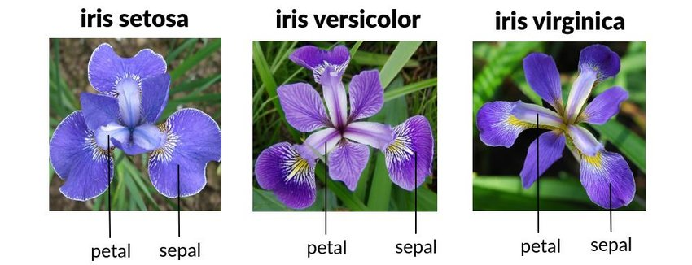
Decision boundary
Python code to apply Logistic regression on iris dataset

Slide 43
Softmax regression
Softmax regression is a generalized Logistic regression to support multiple classes
$$s_{k}(x)={((θ^{k})}^{T}x)$$
$$\hat{p_{k}}=σ\left(s_{k}\left(x\right)\right)=\frac{exp(s_{k}(x))}{\sum_{j=1}^{k}{exp(s_{j}(x))}}$$
$\hat{y}=argmax\hat{{(p}_{k}}$)

Slide 44
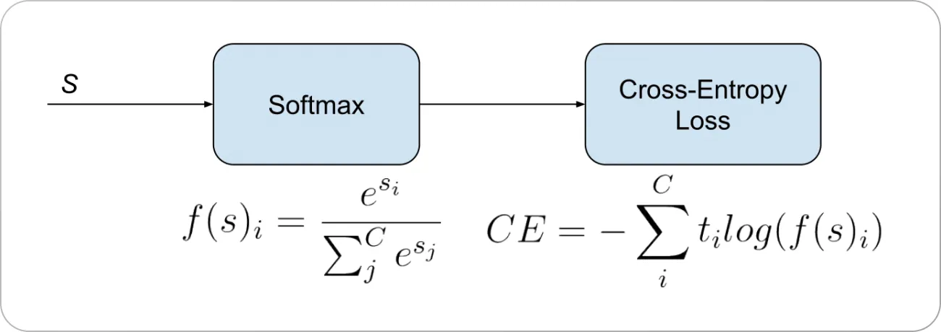

Slide 46
SVM is a versatile ML model that works for both linear and non-linear classification and regression.
Shines well for hundreds to thousands of dataset.
However they don’t scale for larger datasets

Slide 47
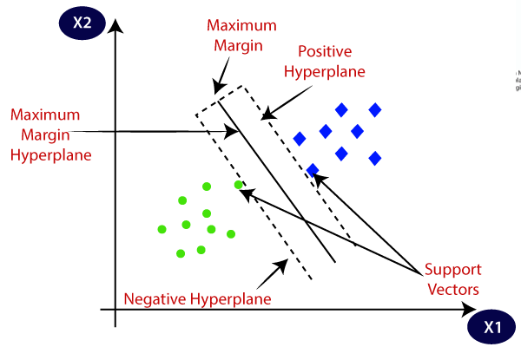

Slide 48
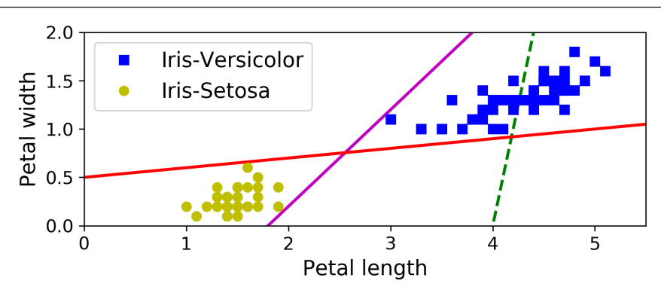
Not good linearly separable lines

Slide 49
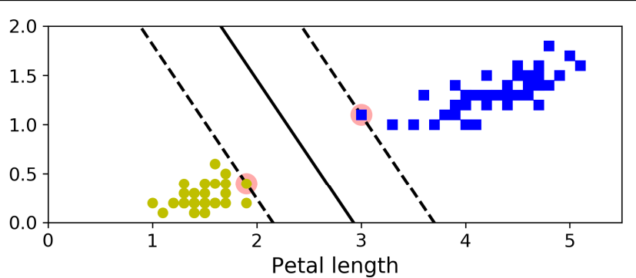
Very good linearly separable line
SVM classifier aims at finding widest possible line between classes – Large margin classification

Slide 50
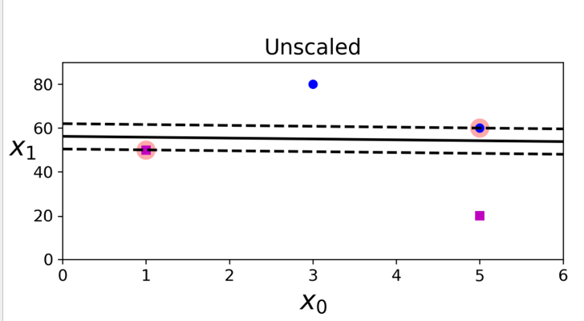
Unscaled features make decision boundaries closer to instances

Slide 51
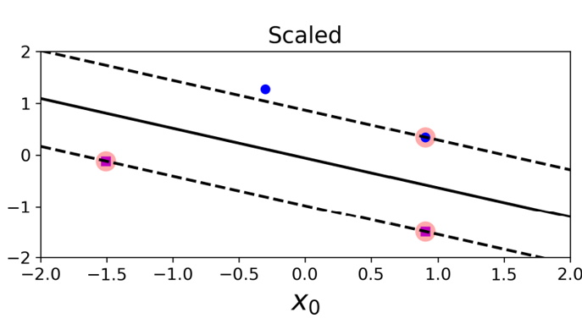
Scaled features make decision boundaries wider from instances

Slide 52
Problems with Hard Margin Classification
If we strictly impose that all instances must be wider from decision boundary, it is called Hard margin classification.
Hard margin classification only works if data is linearly separable.
It is sensitive to outliers.

Slide 53
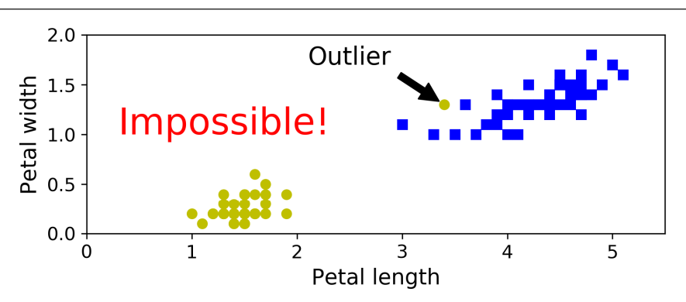

Slide 54
Soft Margin Classification
It aims at finding a good balance between keeping margin as large as possible and limiting margin violations
Use hyper parameter C (regularization) in the scikit learn for a good balance based on the application

Slide 55
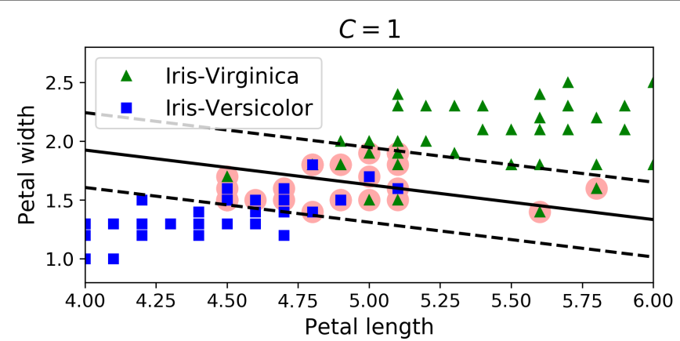

Slide 56
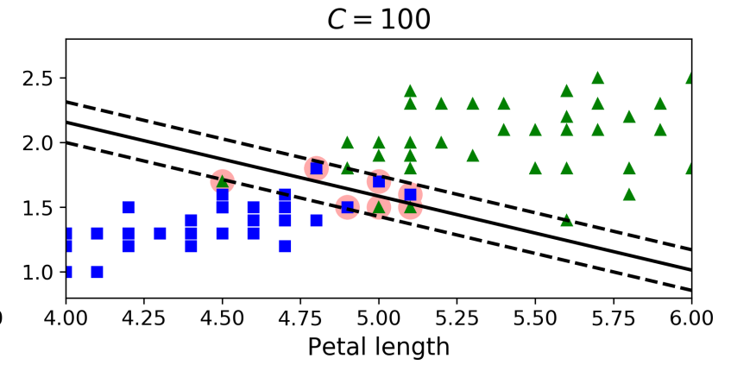
Python code to illustrate the use of Linear SVC

Slide 57
Nonlinear SVM Classification
If the dataset is not linearly separable, add features, make it polynomial and subsequently they became linearly separable.

Slide 58
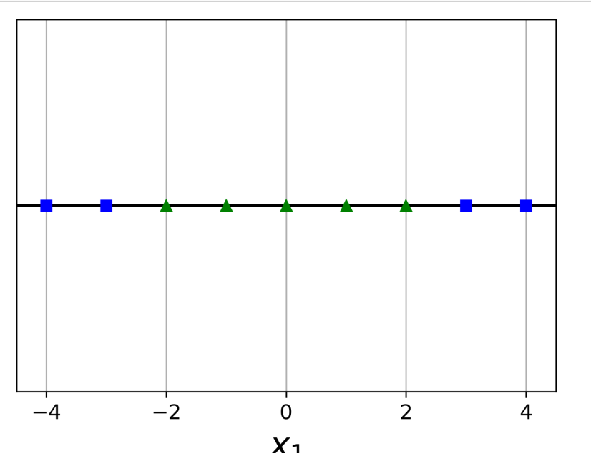
Not linearly separable

Slide 59
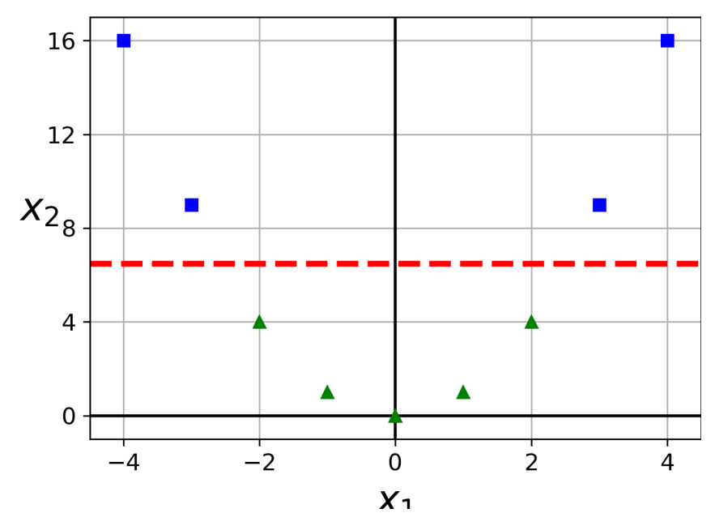
Feature change makes it linearly separable

Slide 60
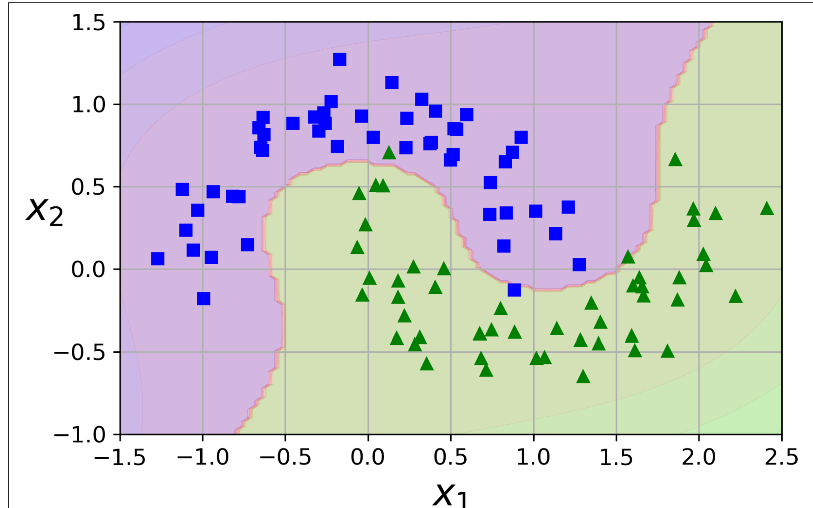
Python code for nonlinear SVM on make moons dataset

Slide 61
Polynomial kernel
Low degree polynomials does not perform well with complex datasets and need higher degree polynomials.
However, higher degree polynomials are very slow.
Using a kernel trick called polynomial kernel, same performance can be achieved even at a higher degree.

Slide 62
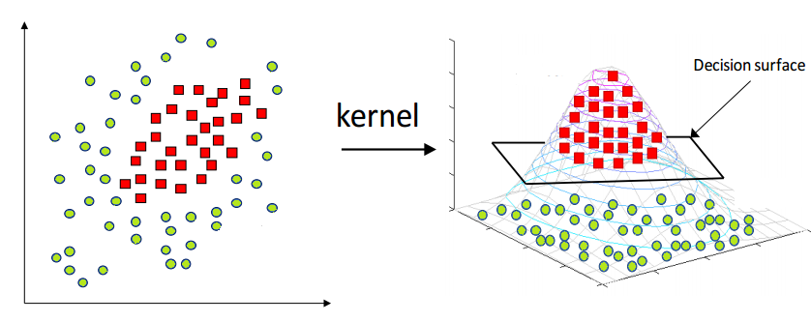
Kernel trick
Kernel Function is used to transform n-dimensional input to m-dimensional input, where m is much higher than n

Slide 63
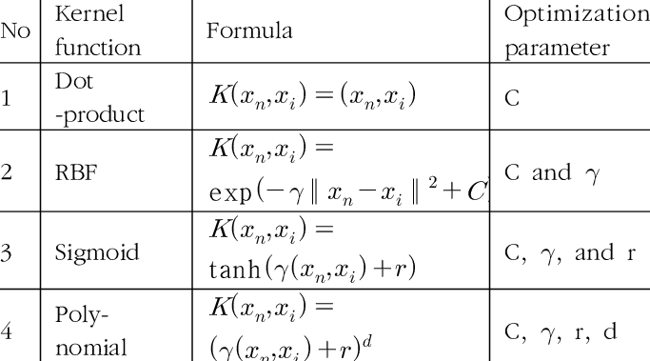
Various types of kernels

Slide 64
Code for polynomial kernel
from sklearn.svm import SVC
polyclf = Pipeline([
StandardScaler(),
SVC(kernel="poly", degree=3, coef0=1, C=5)) ])
polyclf.fit(x, y)

Slide 65
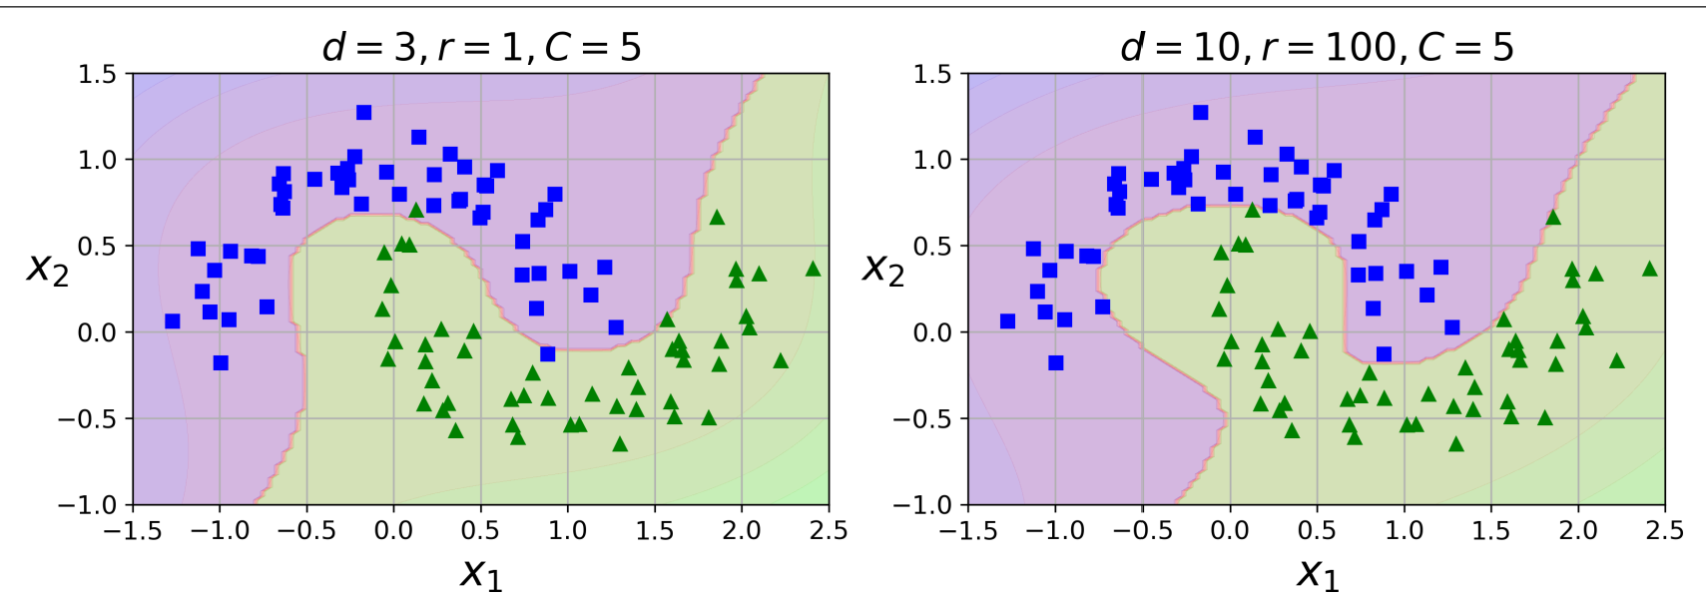

Slide 66
Code for RBF kernel
from sklearn.svm import SVC
rbfclf = Pipeline([
StandardScaler(),
SVC(kernel=“rbf", gamma=5, C=0.001)) ])
rbfclf.fit(X, y)

Slide 67
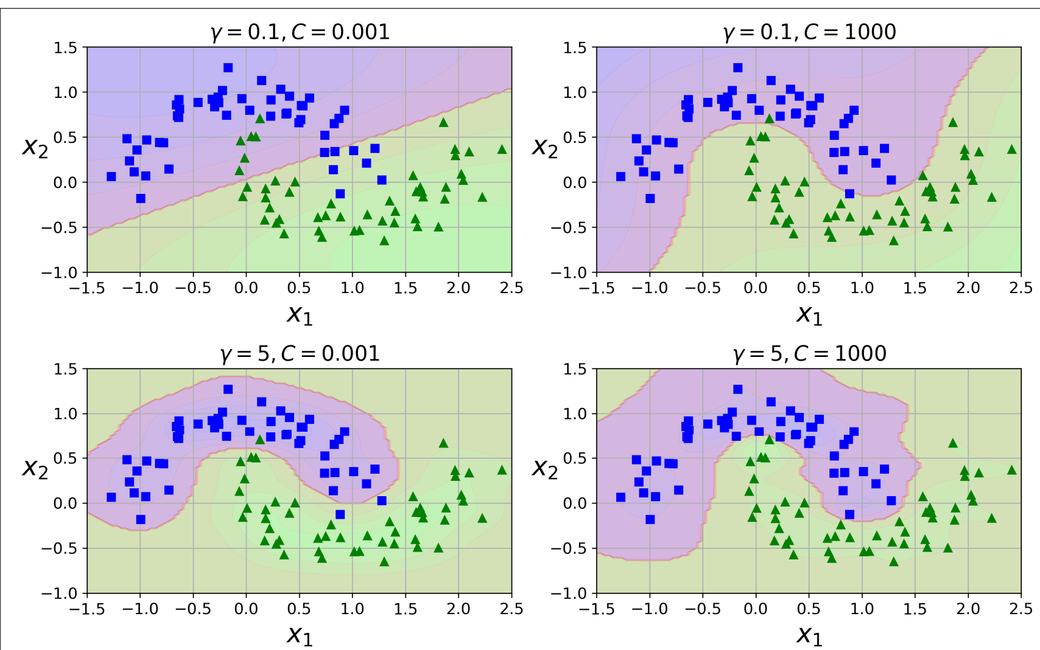

Slide 68
SVM Regression
SVM can be used for regression by tweaking the objective.
The change is to get maximum number of support vectors on the decision boundary or hyperplane.
It also tries to optimize on the margin violations.

Slide 69
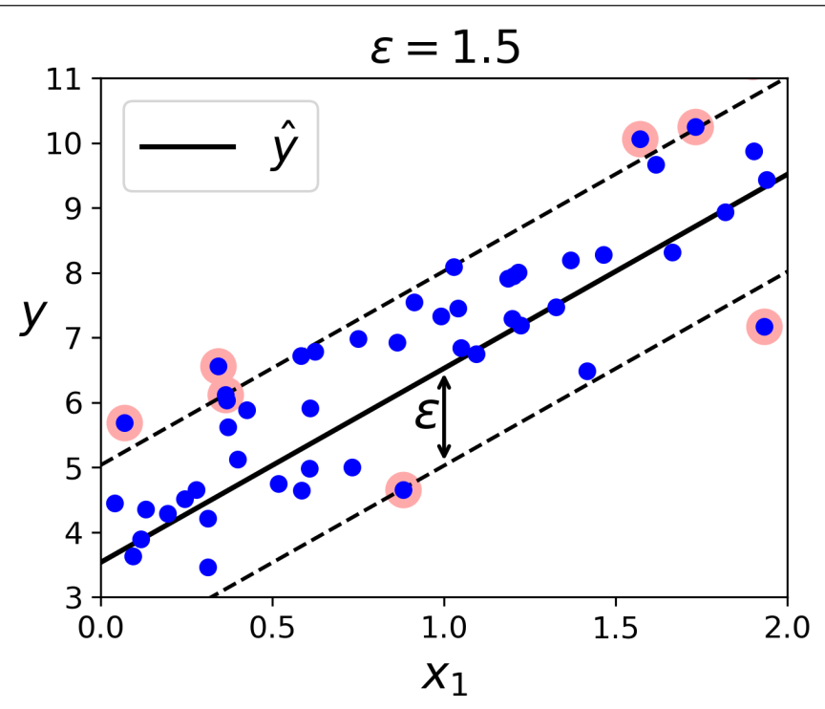
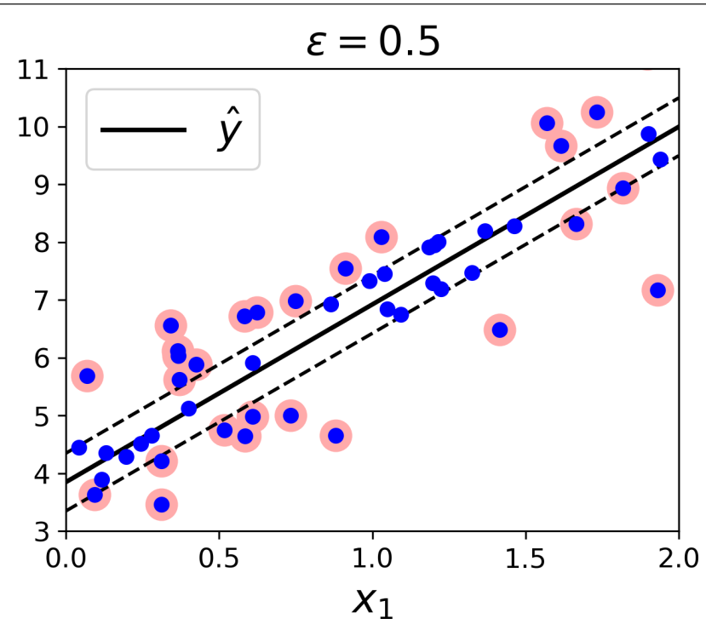
Better to reduce epsilon parameter

Slide 70
Code for Linear SVM
from sklearn.svm import LinearSVR
lc = Pipeline([
StandardScaler(),
LinearSVM(epsilon=0.5)) ])
lc.fit(x, y)

Slide 71
SVM Non-linear Regression
SVM can be used for nonlinear regression by kernelized SVM model.
from sklearn.svm import SVR
nlc = Pipeline([
StandardScaler(),
SVR(kernel=“poly”,degree=2,C=0.01,
epsilon=0.1)) ])
nlc.fit(x, y)

Slide 72
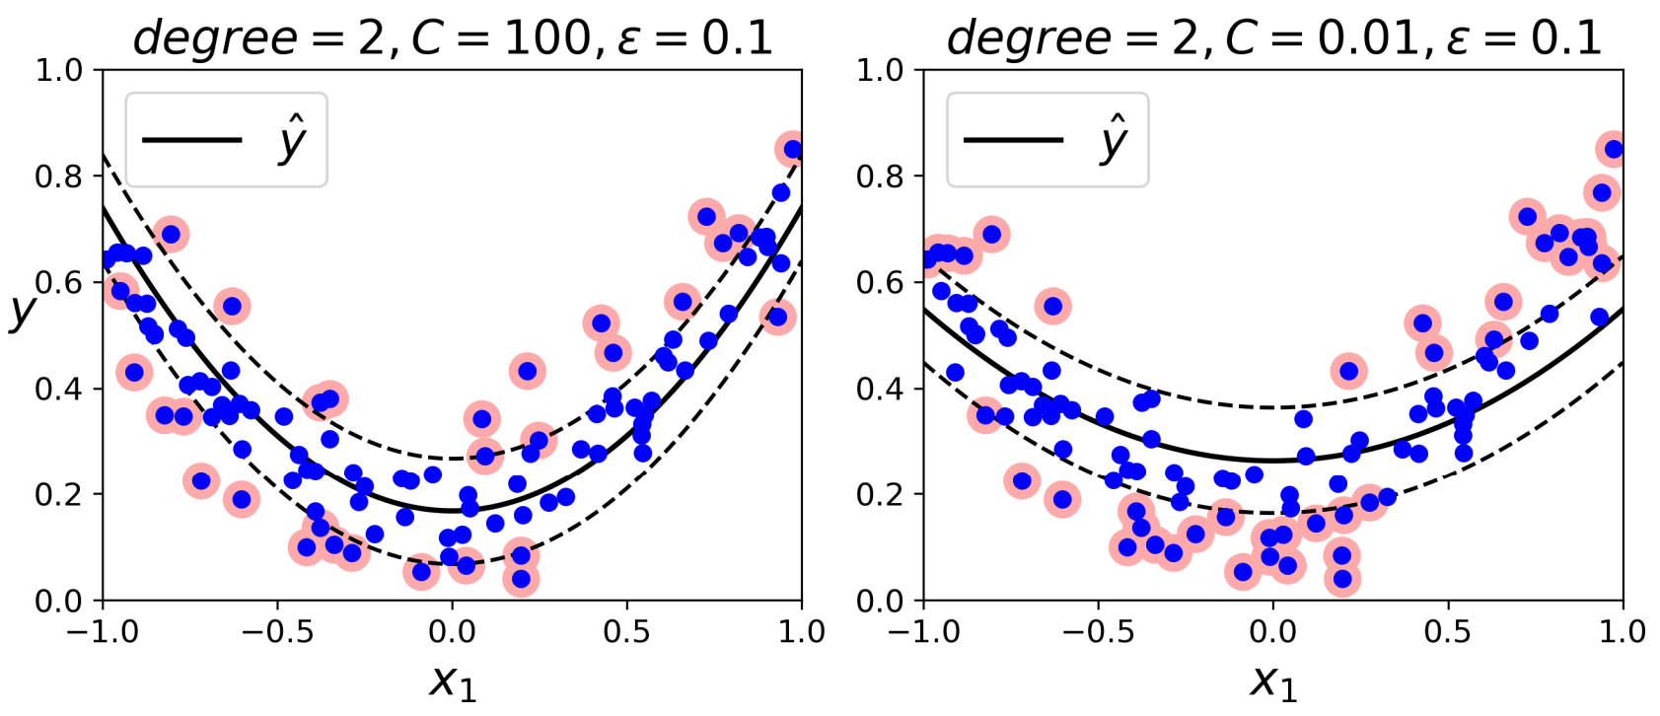
Regularization of plots with reduction in C hyperparameter

