Slide 1
Decision Trees and Random Forest
MODULE IV

Slide 2
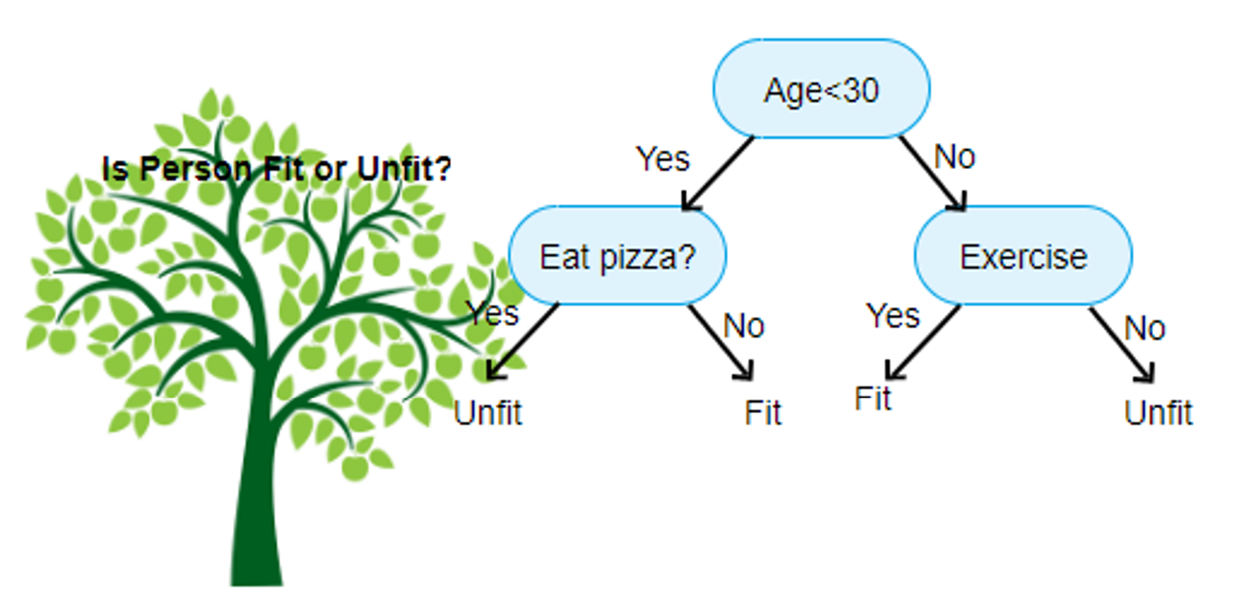
Decision trees are versatile ML algorithms used for classification, regression and multi-output classification. Also suitable for any complex datasets.

Slide 3
Computation of Gini Impurity.
$$G_{i}=1−\sum_{k=1}^{n}{{p_{i,k}}^{2}}$$
$$G_{i}−Gini impurity at the ith node$$
$p_{i,k}$- ratio of class k instances among training instances in the ith node

Slide 4
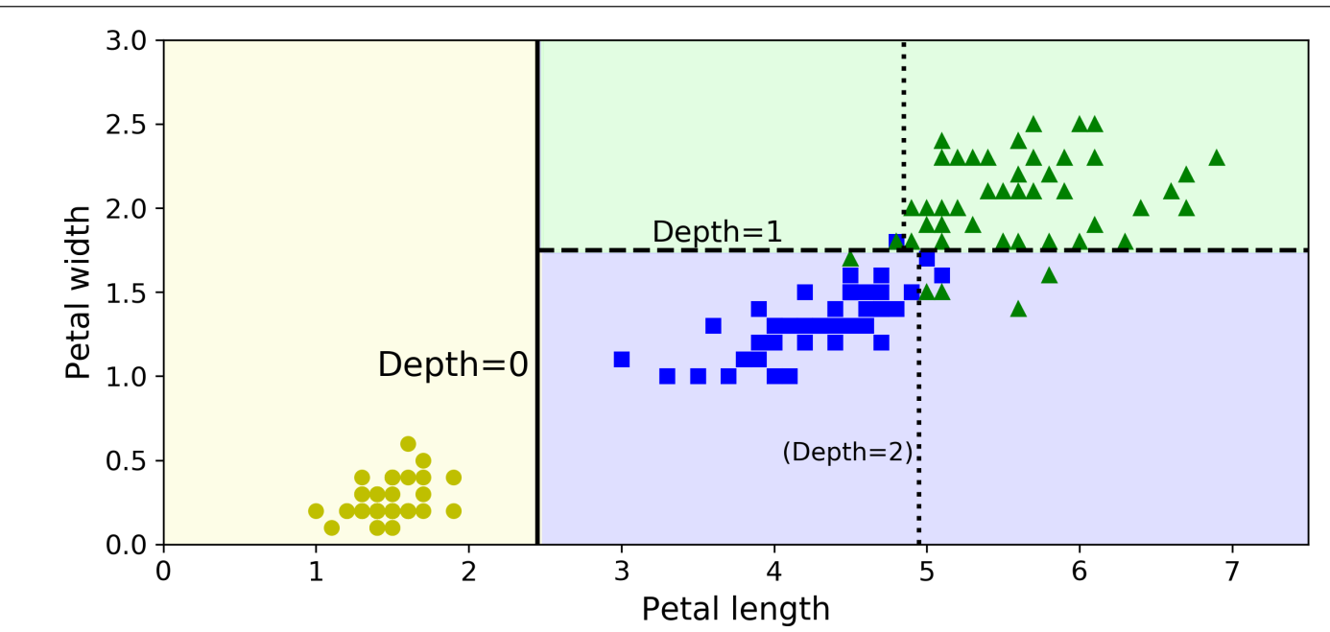
Decision tree decision boundaries

Slide 6
Estimating class probabilities
$Traverse the tree to find leaf node instance$
Return ratio of training instances of class k in this node
Test for petals-5cm long and 1.5 cm wide
Python code for prediction of decision trees

Slide 8
CART Training Algorithm
Scikit learn uses CART training algorithm to train decision trees (also called growing trees)
Splits training dataset into two subsets using single feature k and threshold tk
It searches for pair (t,tk) that produces purest subsets weighted by their size.

Slide 9
CART Cost Function for classification

Slide 10
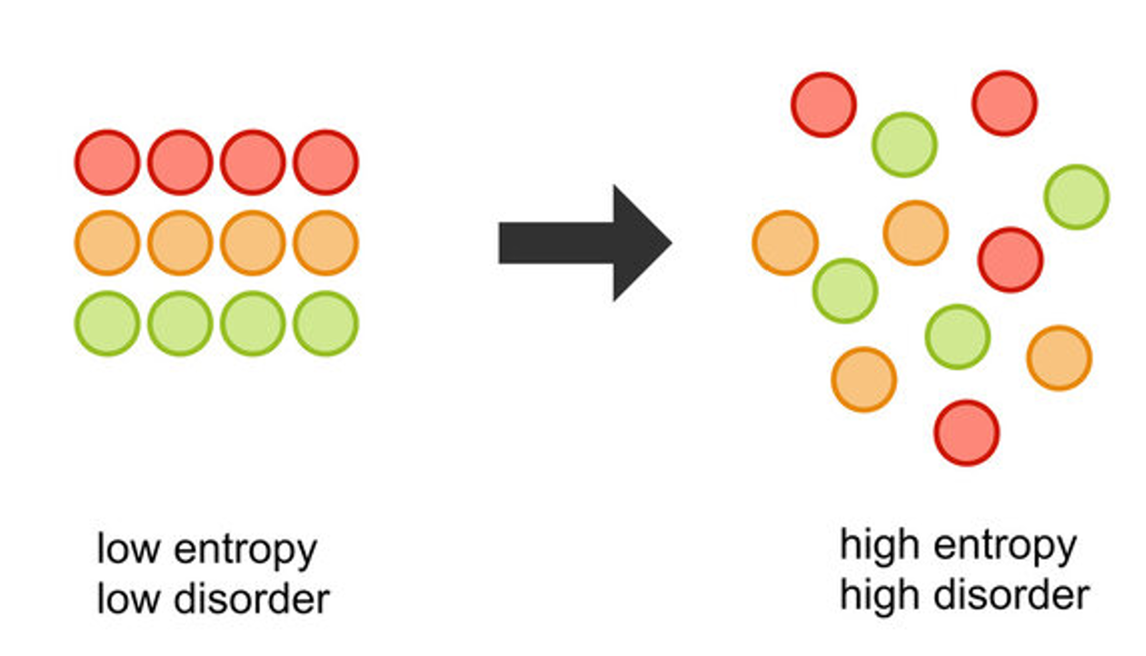

Slide 11
Computation of Entropy.
$$H_{i}=−\sum_{k=1}^{n}{p_{i,k}\log_{2}}p_{i,k}$$
Entropy is an impurity measure
For pure classes, entropy=0 and equally distributed classes, entropy=1
In the python library, DecisionTreeClassifier, set criterion=entropy

Slide 15
Parametric Decision trees
max_features
max_leaf_nodes
min_samples_split
min_samples_leaf
min_weight_fraction_leaf

Slide 16
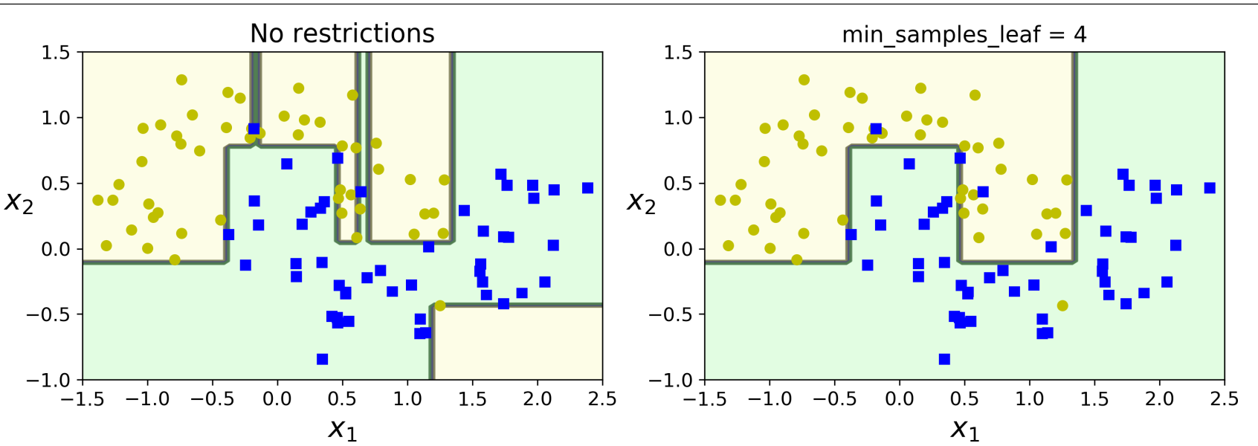
Regularizing a decision tree classifier

Slide 17
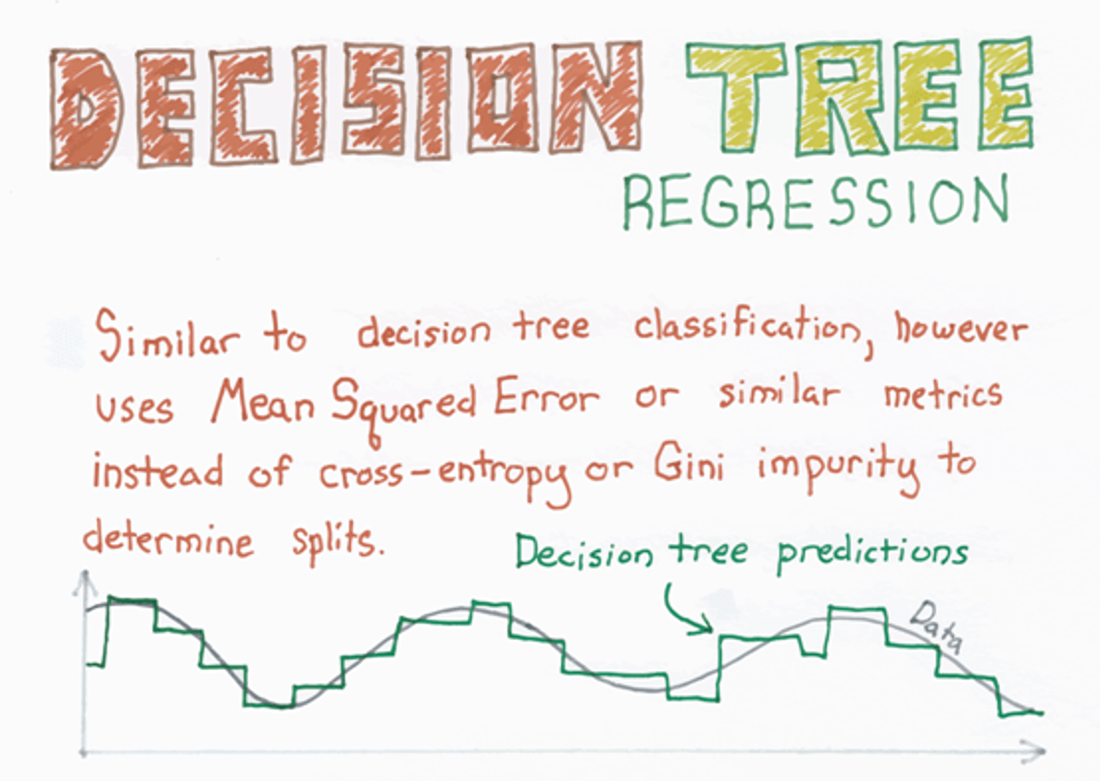
Decision tree for regression
Python code

Slide 18
CART Cost Function for regression

Slide 19
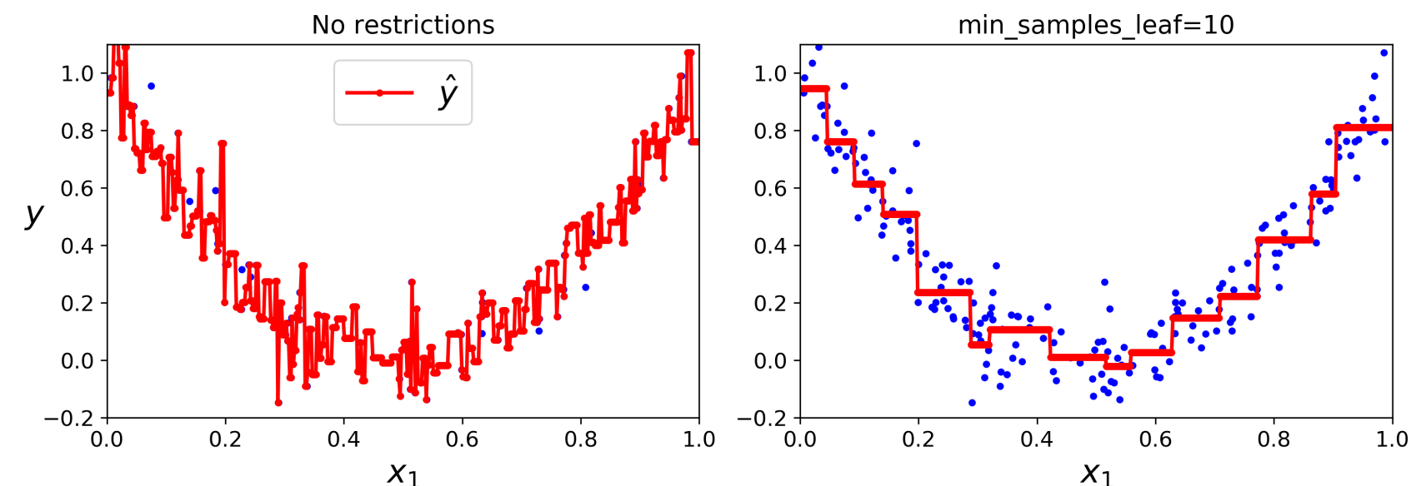
Regularizing a decision tree regressor

Slide 21
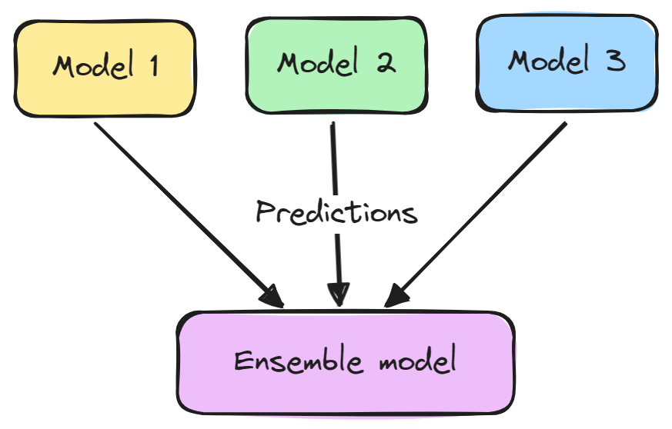
Aggregating the predictions of group of predictors (regressors/classifiers) is called ensemble learning

Slide 22
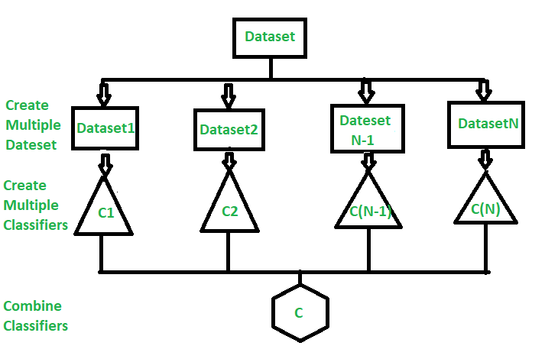

Slide 23
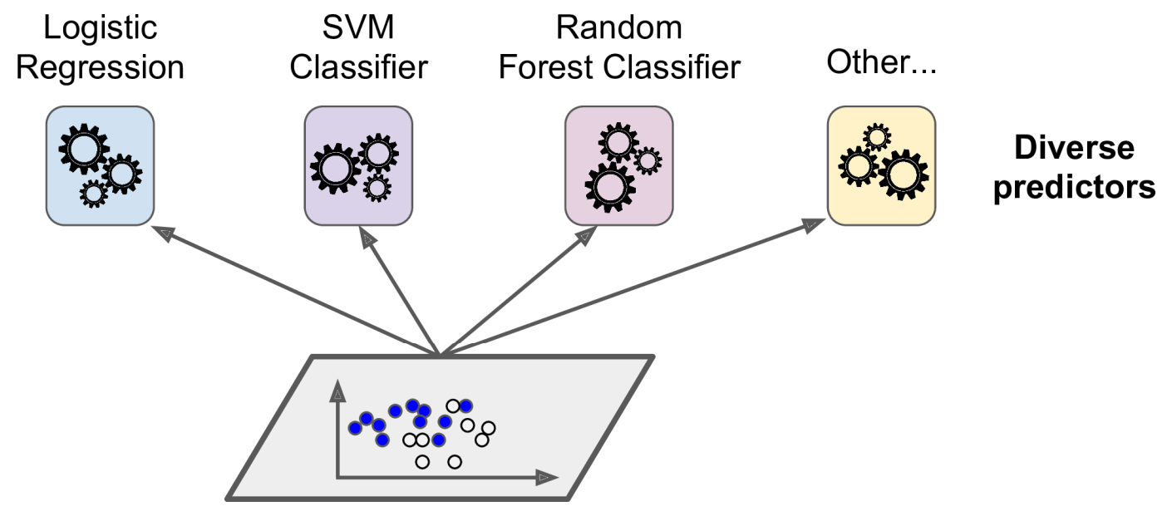
Voting classifiers

Slide 24
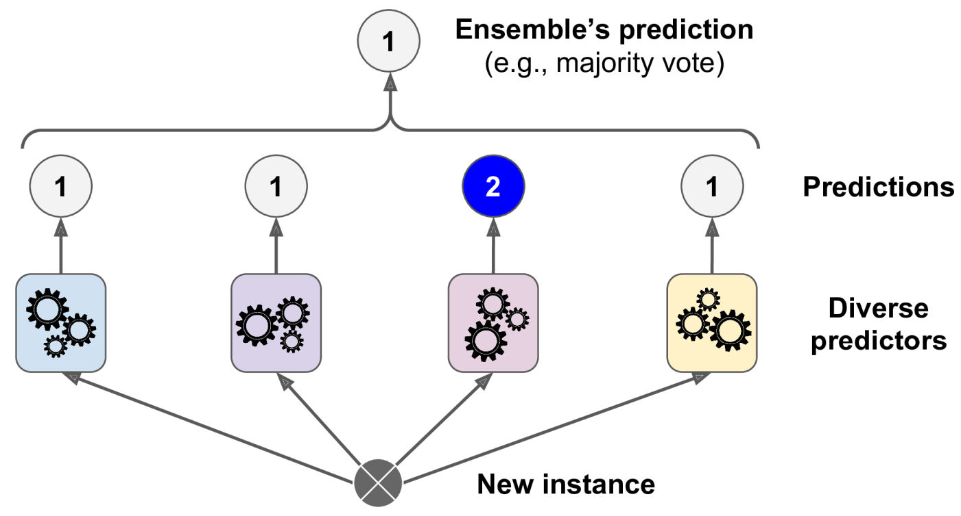
Hard voting classifier predictions

Slide 25
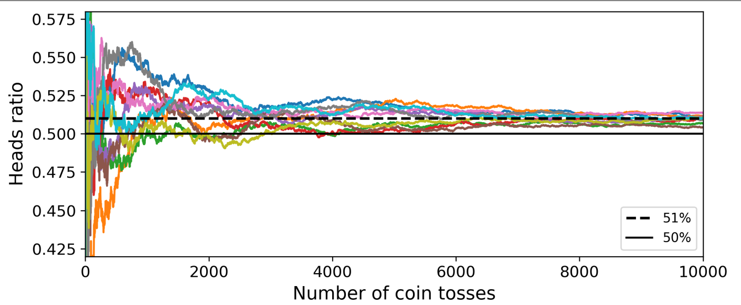
Mystery behind Voting classifiers
Law of large numbers

Slide 26
Python code to demonstrate VotingClassifiers

Slide 27
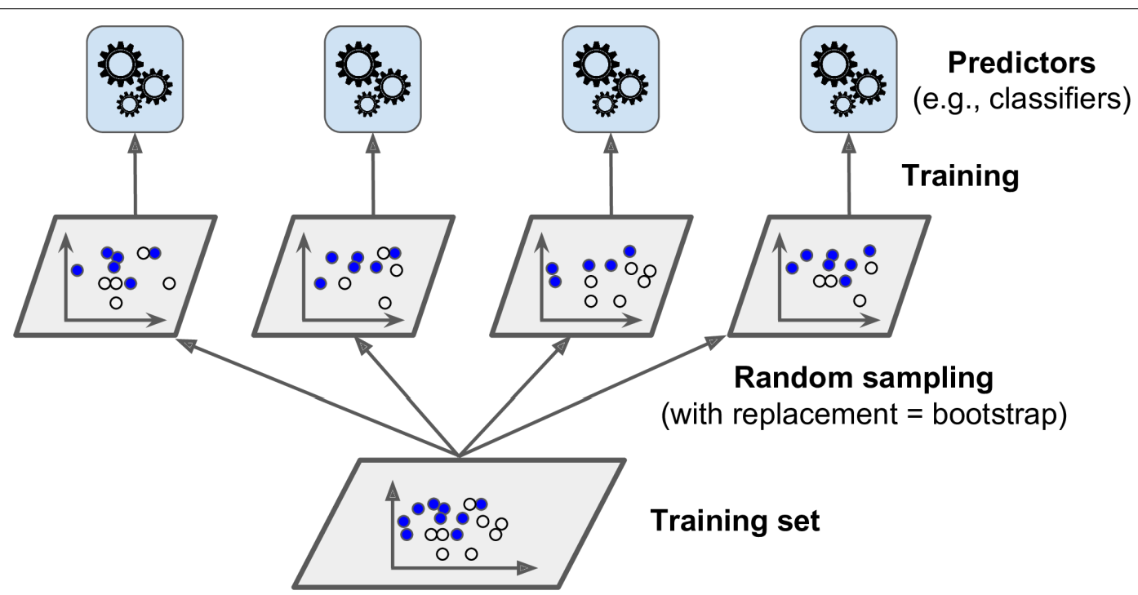
Bagging and Pasting
Bagging-sampling with replacement
Pasting – sampling without replacement

Slide 28
Python code to demonstrate BaggingClassifiers

Slide 29
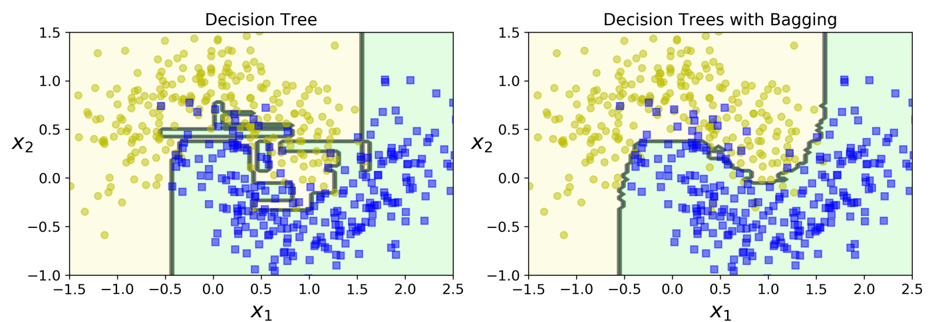
Impact of Bagging-generalization

Slide 30
Out-of-Bag Evaluation
With bagging, some training instances may be sampled several times for any predictor while others may not at all be sampled.
Only 63% of training instances are sampled on an average
Remaining 37% of training instances are called Out-of-Bag Instances
OOB can be used as a validation dataset

Slide 31
Python code to demonstrate
Out-of-Bag Evaluation

Slide 32
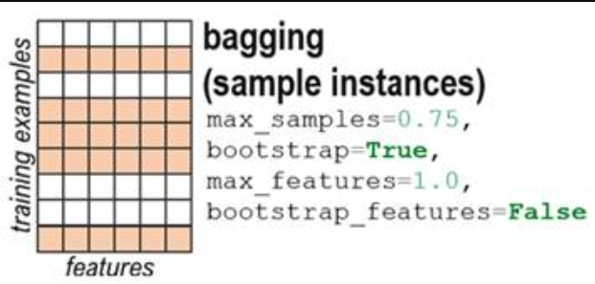

Slide 33
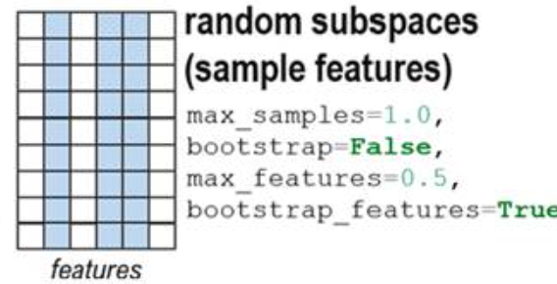

Slide 35
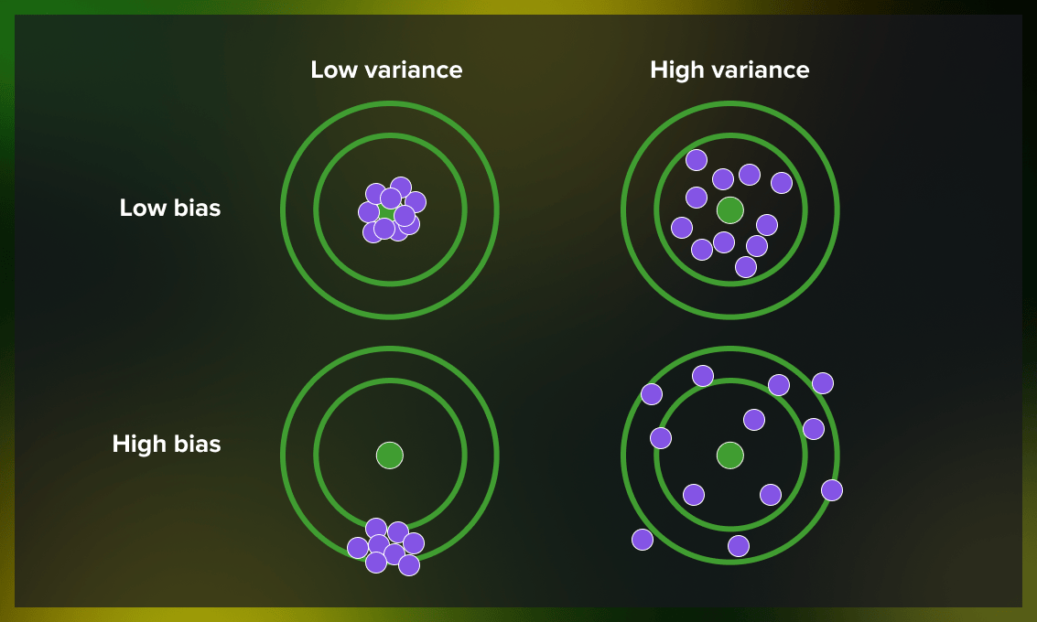

Slide 36
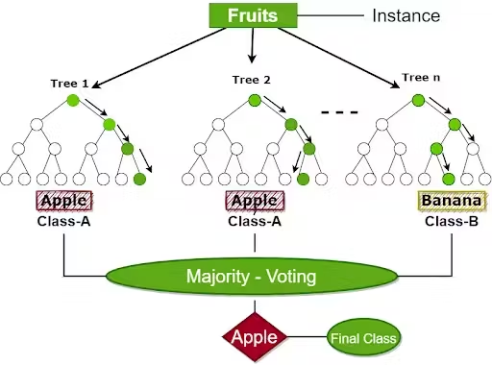

Slide 37
Random Forest Classifiers
Ensemble of Decision trees, trained with bagging method
max_samples=1.0
No need of pipelines in building classifiers/regressors
For splitting node, uses best feature among random subset of features
Python code to demonstrate
Random Forest Classifiers

Slide 38
Make trees more random by considering random thresholds for each feature.
Extremely Randomized Trees

Slide 39
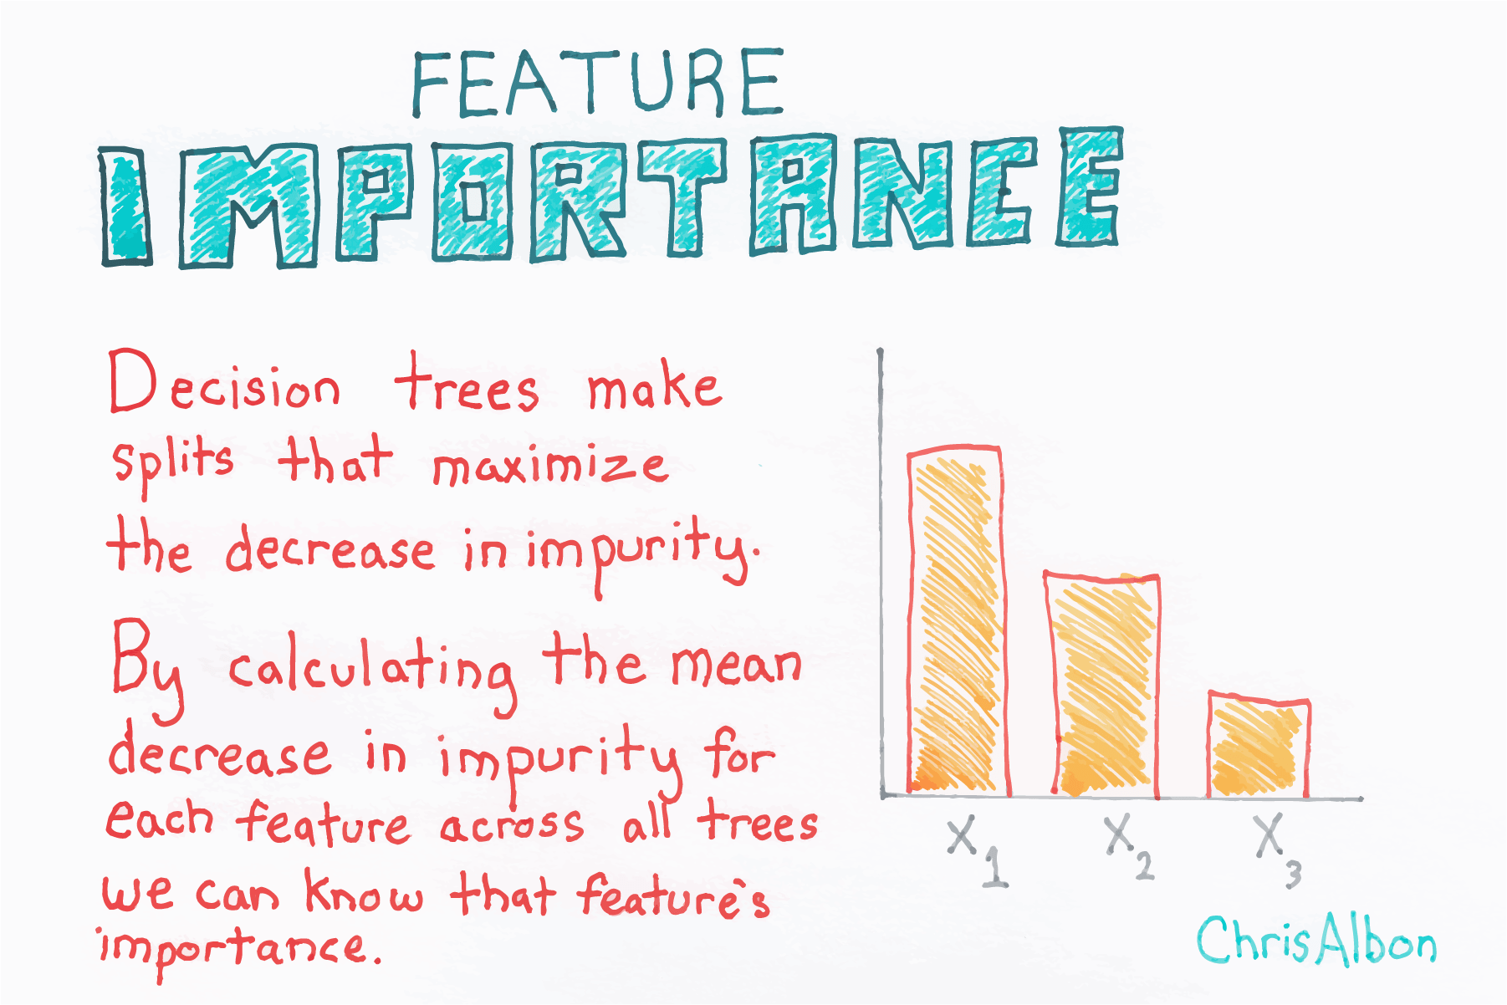
Python code to demonstrate
usage of feature importance

Slide 40
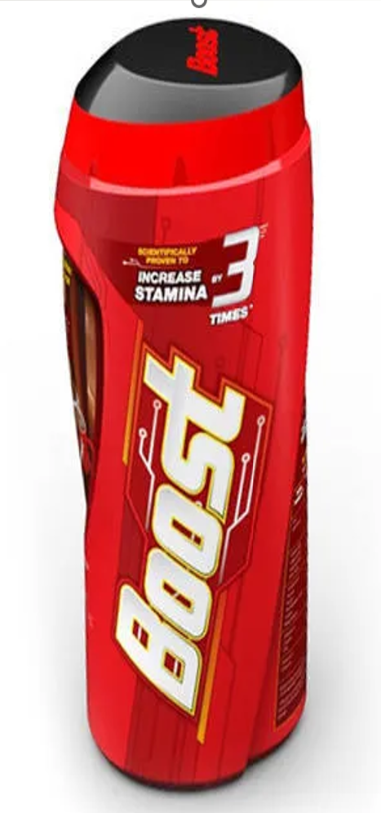
Boosting is an ensemble technique that combines several weak learners into a strong learner
Train each predictor sequentially, each trying to correct its predecessor
AdaBoost (Adaptive Boosting)
Gradient boosting

Slide 41
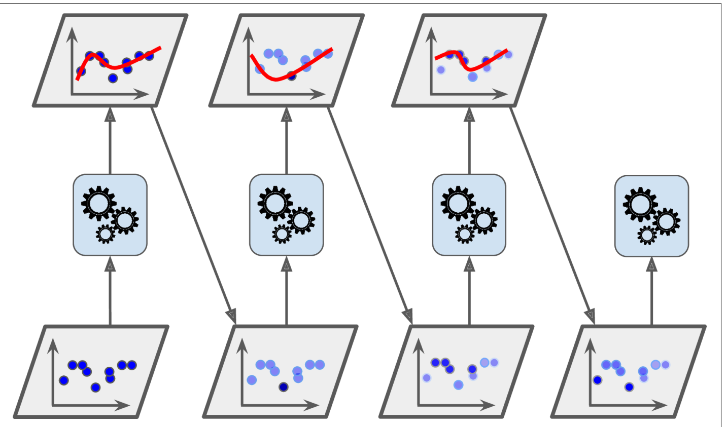
AdaBoost sequential training with instance weight updates

Slide 42
from sklearn.ensemble import AdaBoostClassifier
acl=AdaBoostClassifier( DecisionTreeClassifier(max_depth=1),
n_estimators=30,
learning_rate=0.5)
acl.fit(xtrain,ytrain)

Slide 43
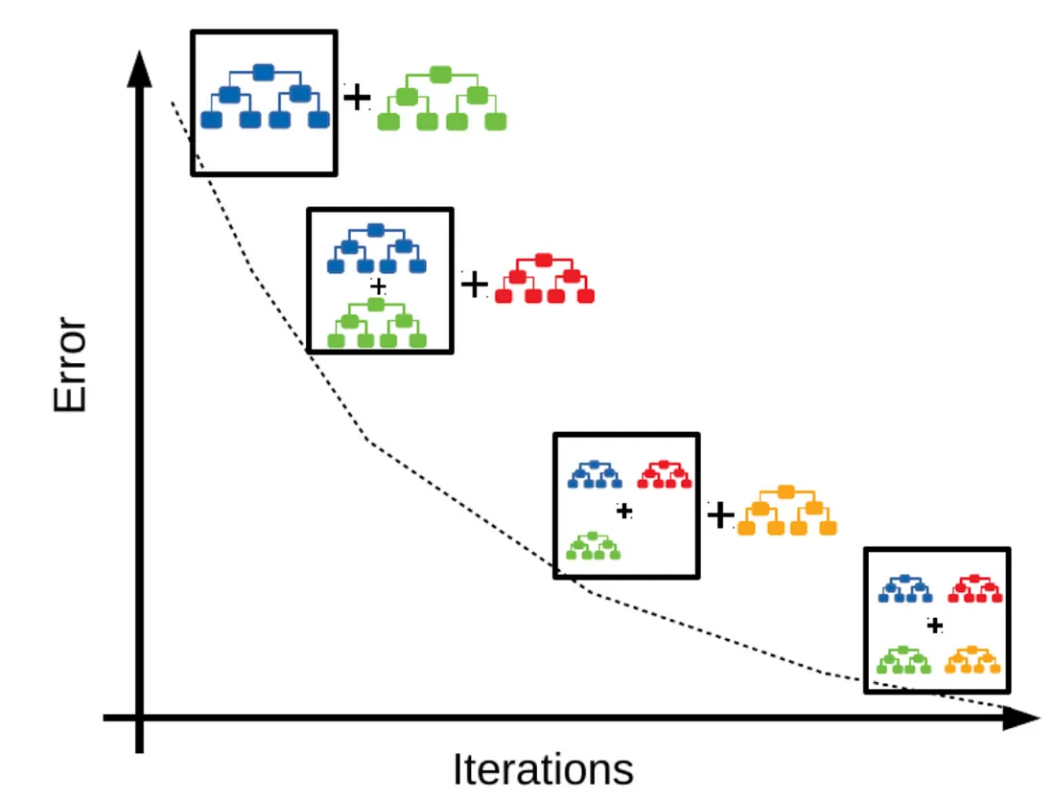
Gradient Boosting
Python Code

Slide 44
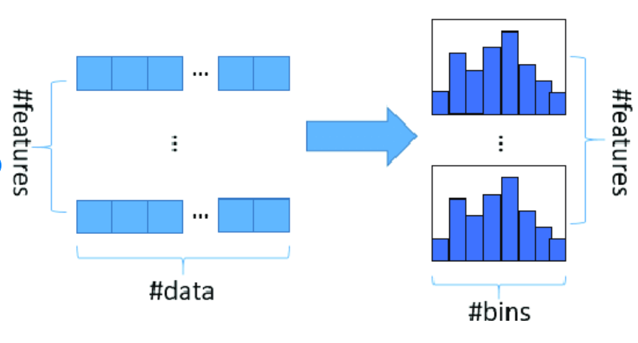
Histograms

Slide 45
Histogram based Classifiers
Uses concept of binning
Optimized for large datasets
learning_rate,
max_iter,
max_depth,
l2_regularization

Slide 46
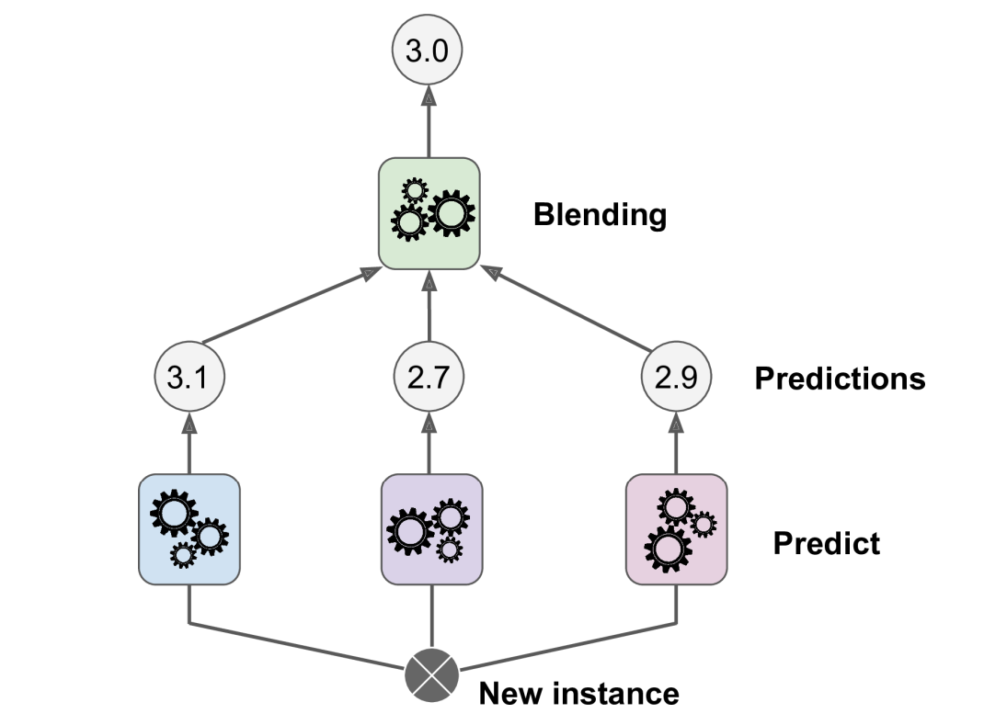
Stacking

Slide 47
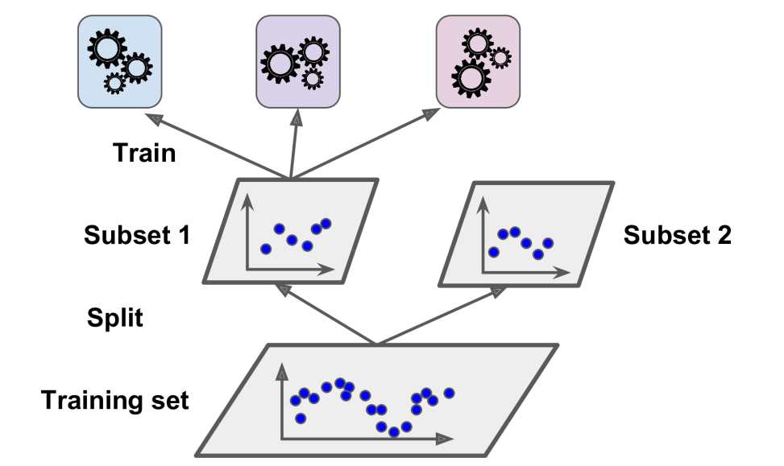
Building the blender

Slide 48
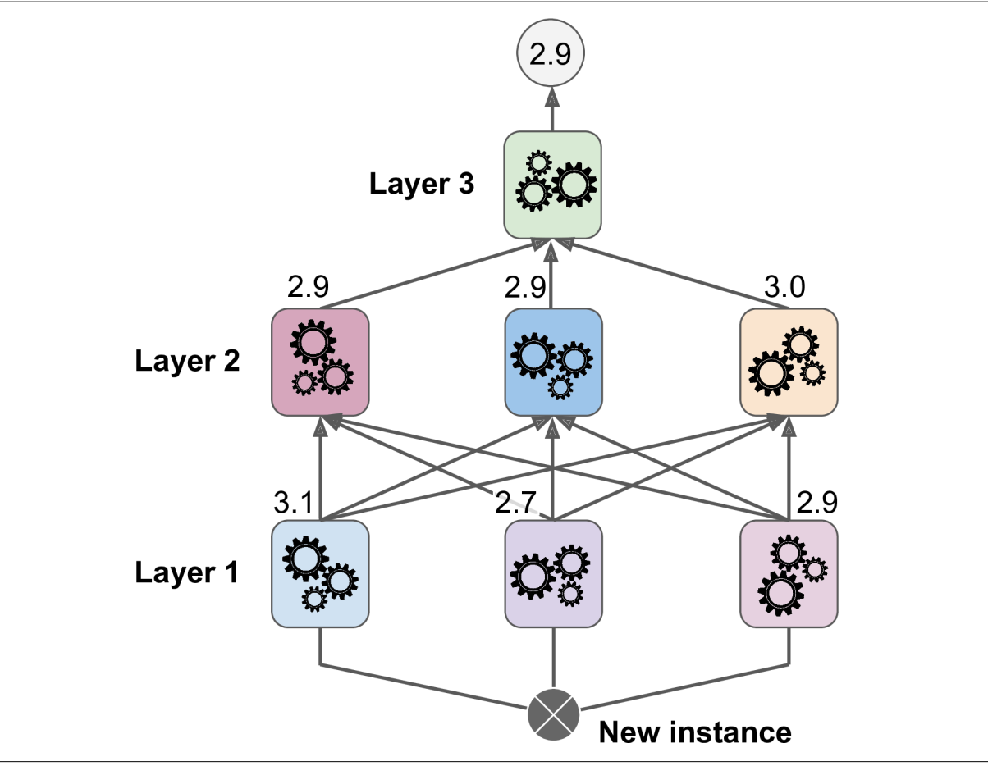
Multilayer Stacking Ensemble

