Slide 2
Walkthrough of an end-to-end Machine Learning project
Look at the big picture
Get the data
Explore and visualize data
Prepare data for machine learning algorithms
Select a model and train it
Fine-tune the model

Slide 3
Working with real data
• Popular open data repositories:
Open ML.org
Kaggle datasets
Amazon’s AWS datasets
PapersWithCode.com
UC Irvine Machine Learning Repository
TensorFlow datasets

Slide 4
Meta portals (they list open data repositories):
— http://dataportals.org/
— http://opendatamonitor.eu/
— http://quandl.com/
• Other pages listing many popular open data repositories:
— Wikipedia’s list of Machine Learning datasets
— Quora.com question
— Datasets subreddit

Slide 5
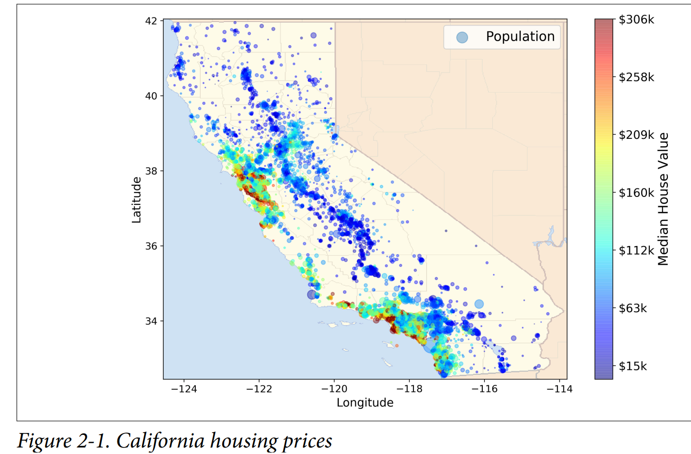

Slide 6
Frame the problem
Know the business objective
Algorithms to be selected
Performance measure used to evaluate model
Effort for tweaking model
Manual estimations are complex and inaccurate.

Slide 7
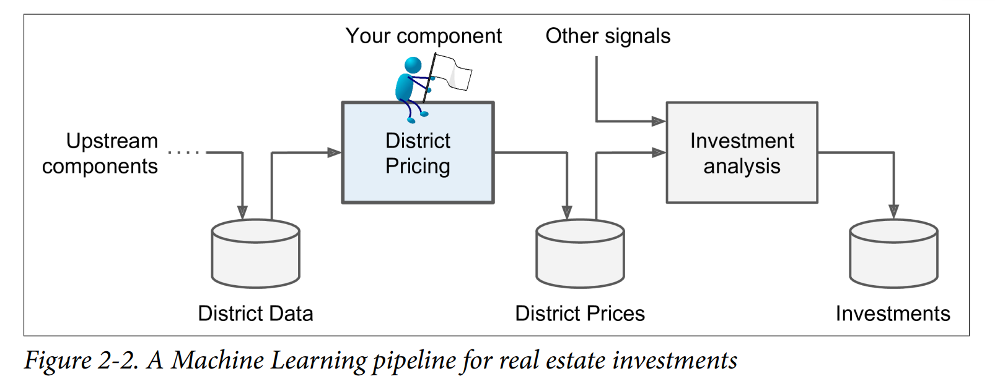
A sequence of data processing components is called data pipeline.

Slide 8
Machine Learning solution
Supervised learning
Regression
Multiple Regression
Univariate Regression
Batch learning

Slide 9
Performance measure
Root Mean Square Error
$$RMSE\left(X,h\right)=\sqrt{\frac{1}{m}}\sum_{i=1}^{m}{{(h\left(x^{\left(i\right)}\right)−y^{\left(i\right)})}^{2}}$$
Mean Absolute Error
$$MAE\left(X,h\right)=\frac{1}{m}\sum_{i=1}^{m}{\left|h\left(x^{\left(i\right)}\right)−y^{\left(i\right)}\right|}$$
RMSE is called L2-norm denoted by ${\left\|.\right\|}_{2}$
MAE is called L1-norm denoted by $\left\|.\right\|$ and also known as Manhattan distance
Higher the norm index it focusses on larger values and neglects small ones

Slide 11
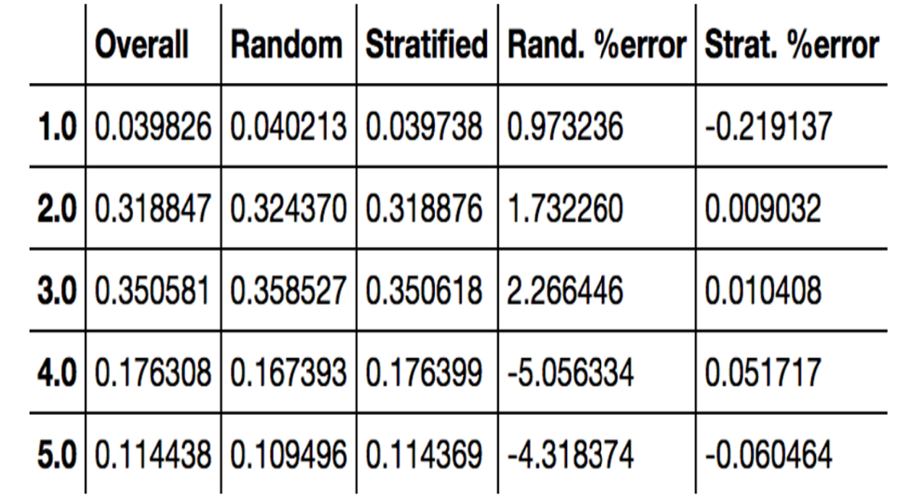
Sampling bias comparison

Slide 12
Binary Classification
Multiclass Classification
Support Vector
Logistic Regression
Stochastic Gradient Descent
Random Forest
Gaussian NB

Slide 13
Binary classifier – to – Multiclass classifier
0 or non-0
1 or non-1
2 or non-2
…
9 or non-9
0 or 1, 0 or 2,..0 or 9
1 or 2, 1 or 3,..1 or 9
2 or 3, 2 or 4 .. 2 or 9
…
8 or 9
OneVsRest (OVR)
OneVsAll (OVA)
OneVsOne (OVO)

Slide 14
Demonstrate the use of OneVsOne classifier with SVC
Demonstrate the use of OneVsRest classifier with SVC
ERROR ANALYSIS
ConfusionMatrixDisplay usage to view errors
ConfusionMatrixDisplay usage to view errors in percentage
ConfusionMatrixDisplay usage to zoom up errors

Slide 15
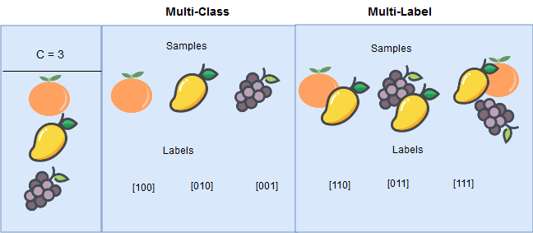
KNeighbourClassifier

Slide 16
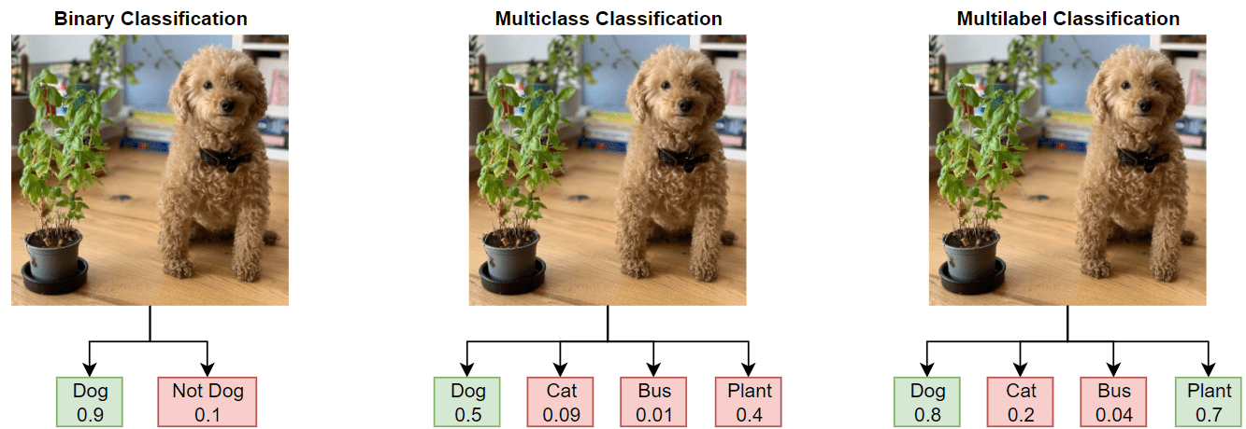

Slide 17
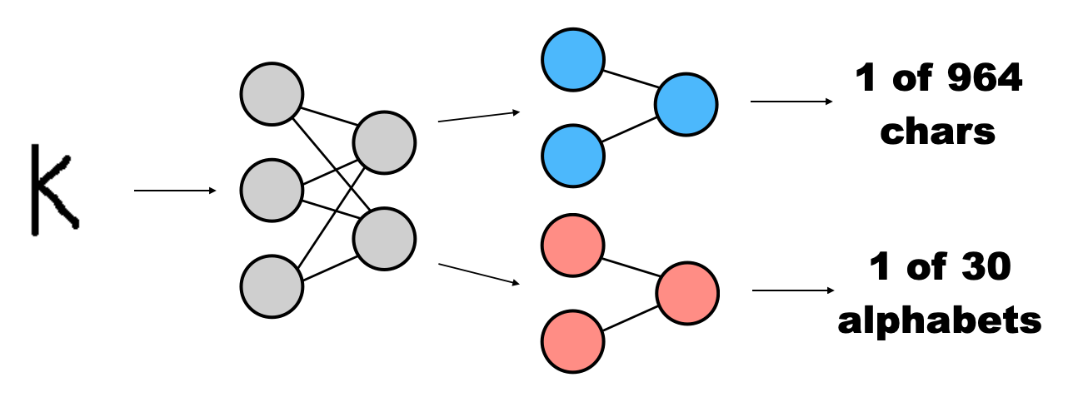
Multi output classification

Slide 18
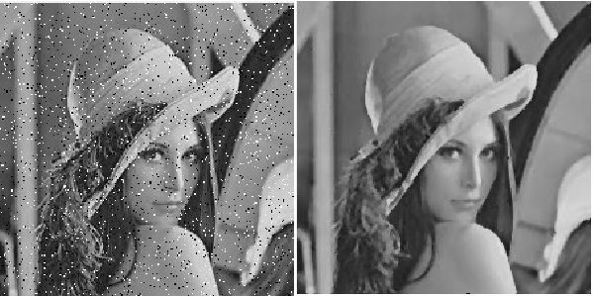
Image noise removal

