Slide 1
Problem Solving
Module-ii

Slide 2
Types of Agents
Simple Reflex Agents
Model based Reflex Agents
Goal based
Utility based
Learning based
Agent representations
Atomic
Factored
Structured
PROBLEM SOLVING AGENTS

Slide 3
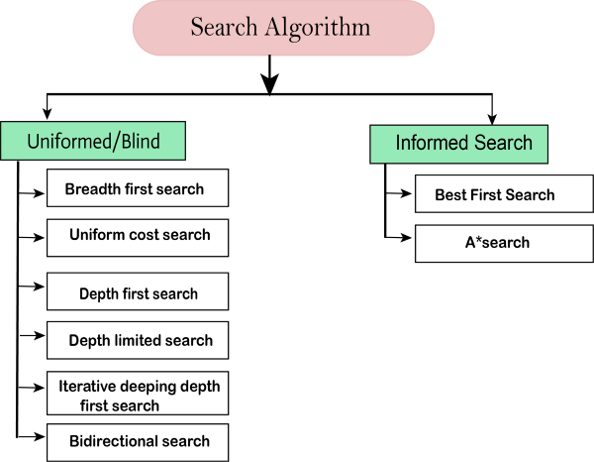

Slide 4
Goal formulation for an agent is based on the current situation and agent’s performance
Eg: Agent planning to travel a certain place

Slide 5
Problem formulation for an agent is deciding based on the agent’s states and actions. It is always oriented towards goal
Eg: Agent planning to travel a certain place

Slide 6
Agent Assumptions
Environment is observable
Environment is discrete
Environment is known
Environment is deterministic
Under these assumptions, the solution to any problem is a fixed sequence of actions.

Slide 7
Searching- finding the sequence of actions that reaches the goal
Search algorithm takes problem as input and provides action sequence as solution
Formulate- Search-Execute strategy

Slide 8
Simple Problem solving Agent
function
SIMPLE-PROBLEM-SOLVING-AGENT
(percept)
returns an action
persistent:
seq, action sequence
state, agents current conception
goal, the goal formulation
problem, problem formulation
state <- UPDATE_STATE(state, percept)
if seq is empty then
goal<- FORMULATE-GOAL(state))
problem<- FORMULATE-PROBLEM(state,goal))
seq<- SEARCH(problem)

Slide 9
if seq==failure then return null action
action<-FIRST(seq)
seq<-REST(seq)
return action
percepts are ignored: Open loop systems

Slide 10
Problem Definition
STATE SPACE
Initial state
In(state)
Possible actions
{A1,A2..An}
Applicable actions
Description
Result(s,A)
Transition model
Any state reachable from a given state by a single action is called Successor

Slide 11
Problem Definition- Graph
State space – graph in which nodes(vertices) are states and links(edges) are actions
Sequence of states connected by sequence of actions is called path
Goal test determines whether agent is in the Goal state
Path cost function assigns a numerical cost to each path
Path cost might be sum of all step costs
Agent strives for optimal path which is finding least cost path

Slide 12
Abstraction
State Abstraction
Action Abstraction
Eases problem formulation

Slide 14
States
Agent location, Dirt location
Initial state
Any state
Actions
Suck, Left, Right
Transitional model
State with Actions
Goal test
Keep all squares clean
Vacuum cleaner problem
Path cost
Sum of all step costs

Slide 15
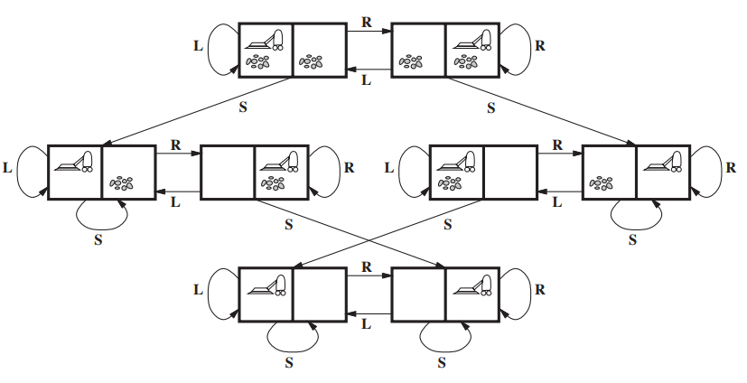
State space of vacuum cleaner

Slide 16
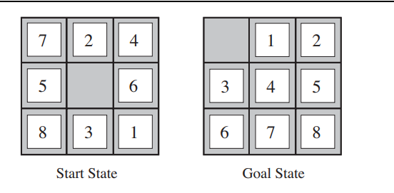
8 puzzle Game

Slide 17
States
Location of numbers and blank
Initial state
Any state
Actions
Left, Right, Up and Down
Transitional model
State with Actions
Goal test
Reach Goal State
Path cost
Sum of all step costs
Belongs to class of Sliding block puzzles

Slide 18
8-puzzle has 181,440 reachable states
15-puzzle has 1.3 trillion states
24-puzzle has ${10}^{25}$ states

Slide 19
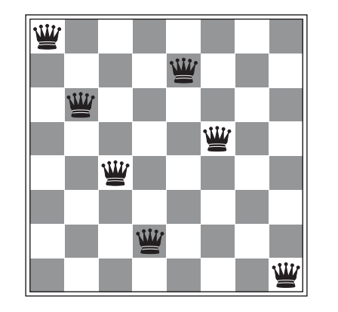
8 queen problem
Failed solution

Slide 20
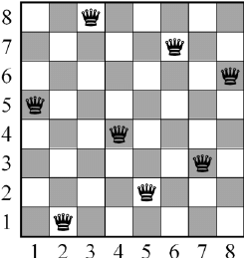
8 queen problem
Passed solution

Slide 21
States
Arrangement of queens
Initial state
Empty chess board
Actions
Add a queen
Transitional model
State with Actions
Goal test
All 8 queens on board with none attacked
Path cost
Sum of all step costs

Slide 22
620,448,401,733,239,439,360,00 states

Slide 23
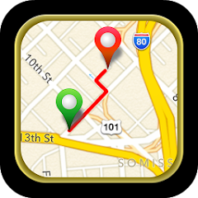
Route finding

Slide 24
States
Locations
Initial state
Source
Actions
Flight
Transitional model
State with Actions
Goal test
Reached destination
Path cost
Monetary cost, Time, Seat quality, Customs and migration procedures

Slide 27
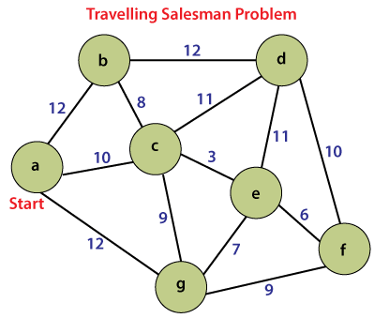

Slide 28
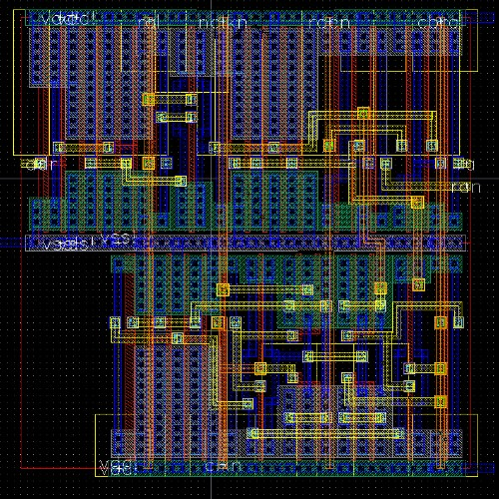
VLSI layout problem

Slide 29
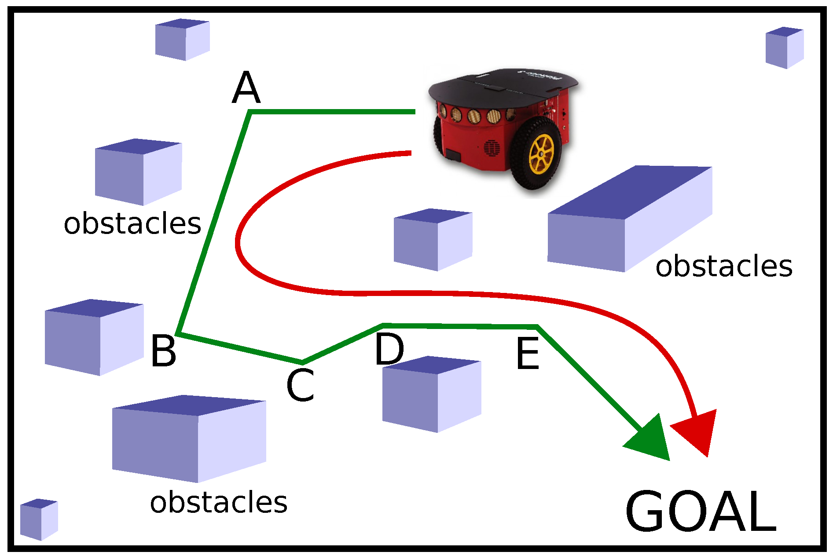
Robot Navigation problem

Slide 30
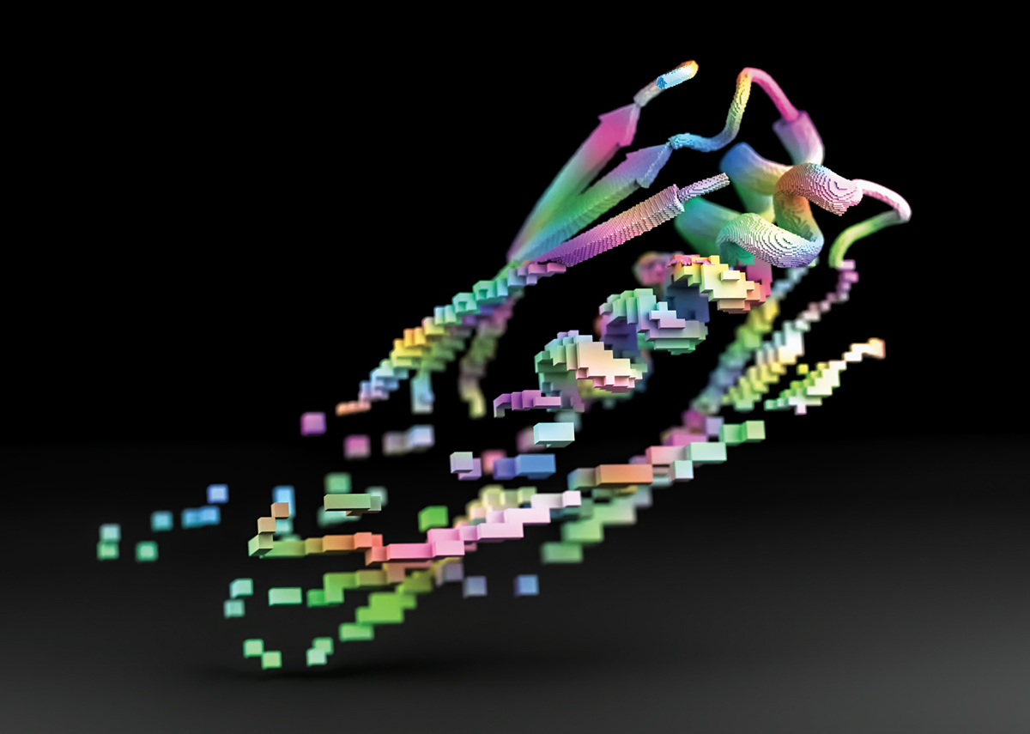
PROTEIN DESIGN

Slide 31
FIND SOLUTION

Slide 32
Searching – find the right solution sequence
Search Tree
Root node, Parent node and Leaf nodes
Expand the search tree
Set of leaf nodes available for expansion at any given point is called “frontier”
Expansion terminates at a solution or no more states to expand

Slide 33
General Tree Search Algorithm
function
TREE-SEARCH
(problem)
returns an solution or failure
Initialize frontier using initial state of problem
loop do
if frontier is empty, return failure
chose a leaf node and remove from frontier
if node contains goal state, return solution
Expand node, add children to frontier
Search strategy decides which state to expand next

Slide 34
REDUNDANCY

Slide 35
General Graph Search Algorithm
function
GRAPH-SEARCH
(problem)
returns an solution or failure
Initialize frontier using initial state of problem
Initialize explored set to be empty
loop do
if frontier is empty, return failure
chose a leaf node and remove from frontier
if node contains goal state, return solution
add node to the explored set
Expand node, add children to frontier if not in the explored set
Graph Search avoids redundancy and loopy paths

Slide 36
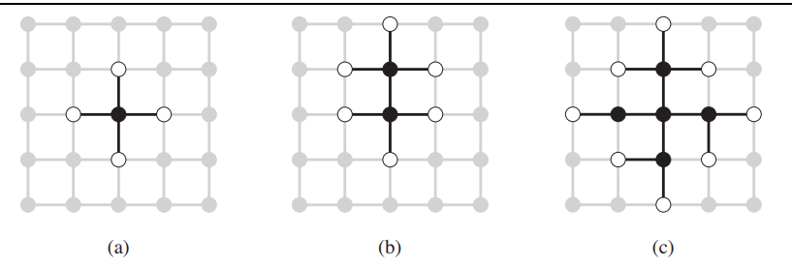
Graph Search separation property illustration

Slide 37
Infrastructure for Search Algorithms
For each node n of the tree:
n.STATE - state space
n.PARENT – node in the search tree that generated this node
n.ACTION – action applied by parent to reach here
n.PATH-COST –cost of path from initial state to this node

Slide 38
Computing data for child nodes
function
CHILD-NODE
(problem,parent,action)
returns a node
return a node with
STATE = problem.RESULT(parent.STATE, action)
PARENT=parent
ACTION=action
PATH-COST=parent.PATH_COST +
problem.STEP-COST(parent.STATE, action)

Slide 39
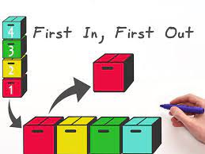
Maintenance of frontier

Slide 40
PRIORITY QUEUE

Slide 41
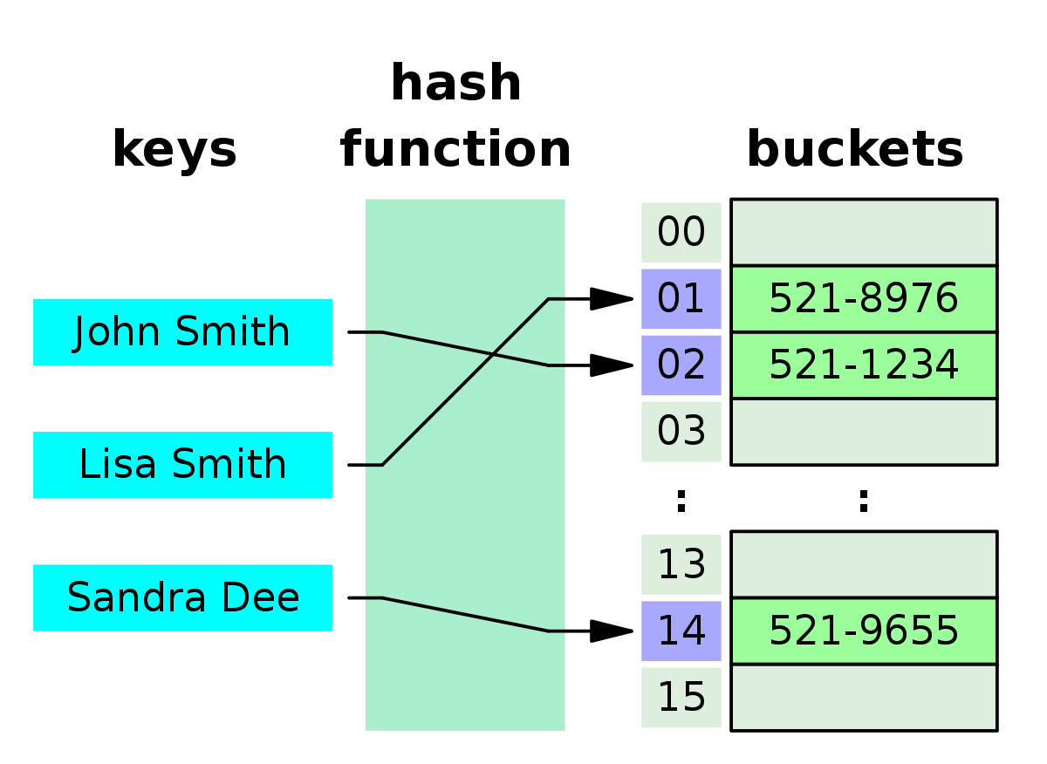
Maintenance of explored set
Use of canonical forms

Slide 42
Measuring problem solving performance
Completeness
Optimality
Time complexity
Space complexity
Complexity measured for search trees using:
Branching factor or number of successors of any node
Depth of shallowest goal node
Search cost based on the time
Total cost=Search cost+Path cost

Slide 43
BLIND SEARCH OR UNINFORMED STRATEGIES
WHERE SIMPLY NODE EXPANSION HAPPENS
AND DISTNICTION BETWEEN GOAL AND NONGOAL STATE IS MADE.
NO WAY TO TELL ONE NODE IS PROMISING THAN OTHERS

Slide 44
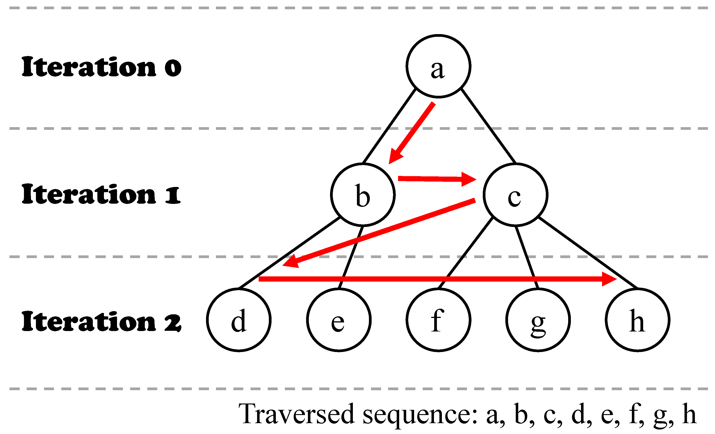
Breadth First Search

Slide 45
Breadth First Search Algorithm
function
BFS
(problem)
returns a solution or failure
node<- root node
If problem.GOAL-TEST(node.STATE)
returns a SOLUTION(node)
frontier=FIFO queue with node
explored=empty set

Slide 46
loop do
if EMPTY(frontier), return failure
node=POP(frontier)
add node.STATE to explored set
for each action in problem.ACTION(node.STATE)
child<-CHILD_NODE(problem,node,action)
if child.STATE is not in explored or frontier
if problem.GOAL_TEST(child.STATE)
then return SOLUTION
frontier<- INSERT(child,frontier)
Complexity=O($b^{d}$)

Slide 47
Time and space complexity of BFS

Slide 48
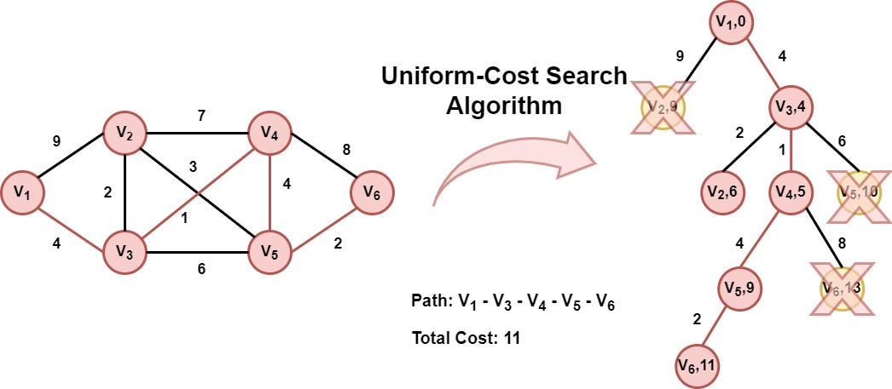

Slide 49
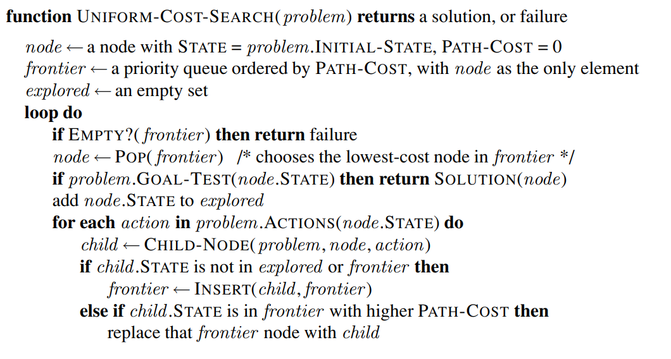

Slide 50
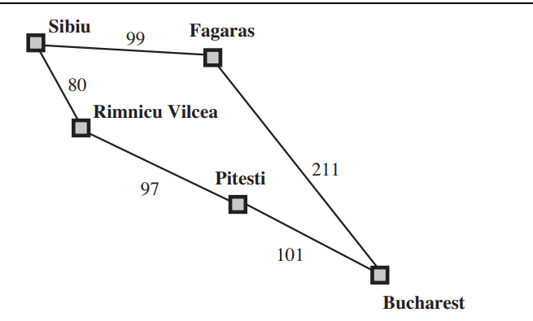

Slide 51
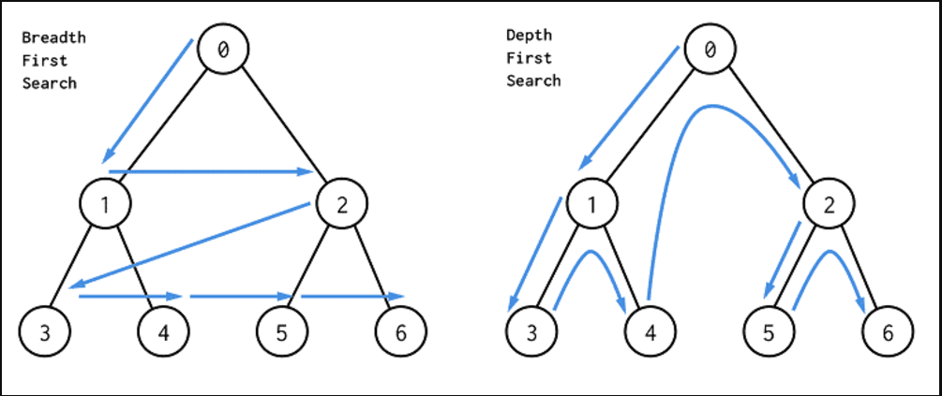

Slide 52
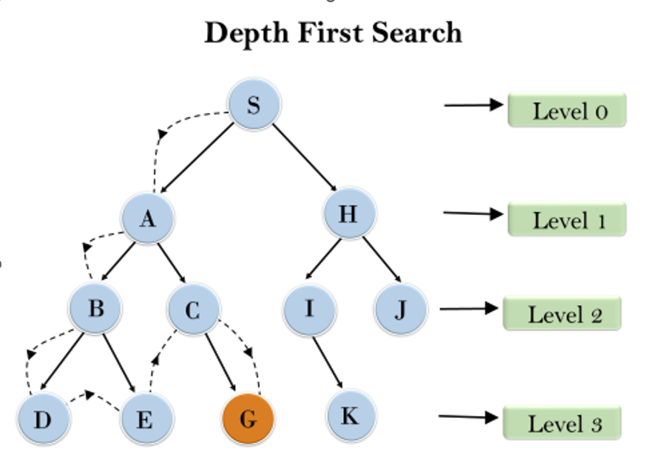

Slide 53
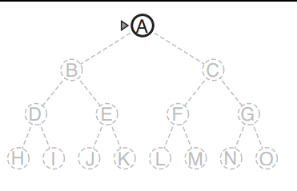
Depth First Search
Algorithm same as BFS, but frontier implemented using Stack (LIFO)
Problem : A to M
Solve stepwise
Space Complexity=O(bm)

Slide 54
Generate only one successor at a time
Space Complexity=O(m)

Slide 55
Depth Limited Search Algorithm (DLS)
A depth-limited search algorithm is similar to DFS with a predetermined limit.
the node at the depth limit will treat as it has no successor nodes further.
can solve the drawback of the infinite path in the DFS

Slide 56
Depth-limited search can be terminated with two Conditions of failure:
Standard failure value (SFV): It indicates that problem does not have any solution.
Cutoff failure value (CFV): It defines no solution for the problem within a given depth limit.

Slide 57
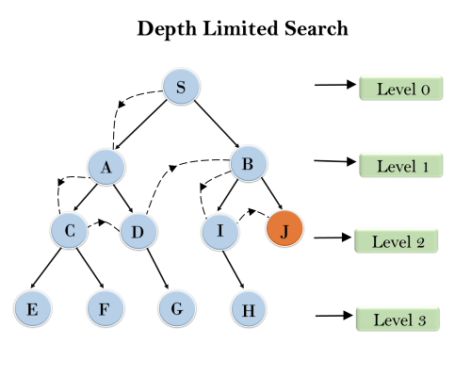
Limit=2

Slide 58
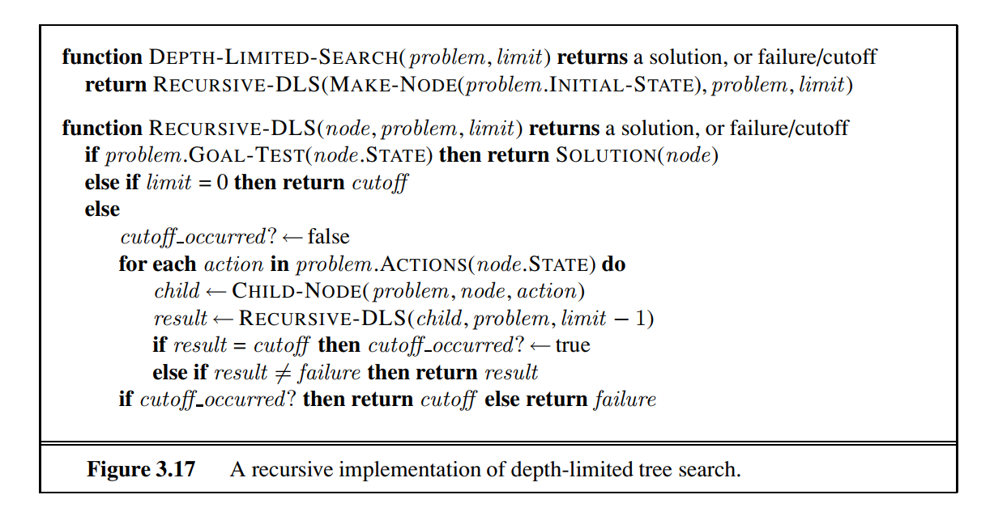

Slide 59
Advantages:
Depth-limited search is Memory efficient as the diameter of search state space is reduced.
Disadvantages:
DLS can have a disadvantage of incompleteness.
It may not be optimal

Slide 60
Iterative Deepening Search
A
B
C
D
E
F
G

Slide 61
IDS combines depth-first search’s space-efficiency and breadth-first search’s fast search (for nodes closer to root).
It calls DFS for different depths starting from an initial value. In every call, DFS is restricted from going beyond given depth.
Preferred when the search space is large and the depth of the solution is not known

Slide 62
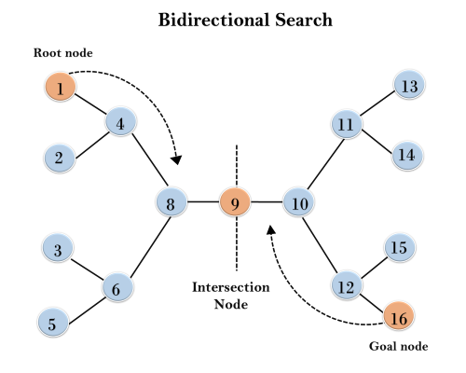

Slide 63
