Slide 1
Informed Search Strategies and Logic
Module III

Slide 2
Impart additional knowledge on problem
Evaluation function f(n)
Heuristic function h(n)

Slide 4
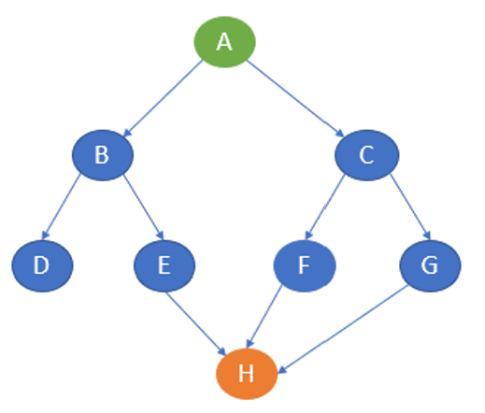
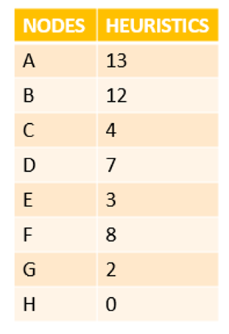
Greedy Best first Search
A->C->G->H

Slide 5
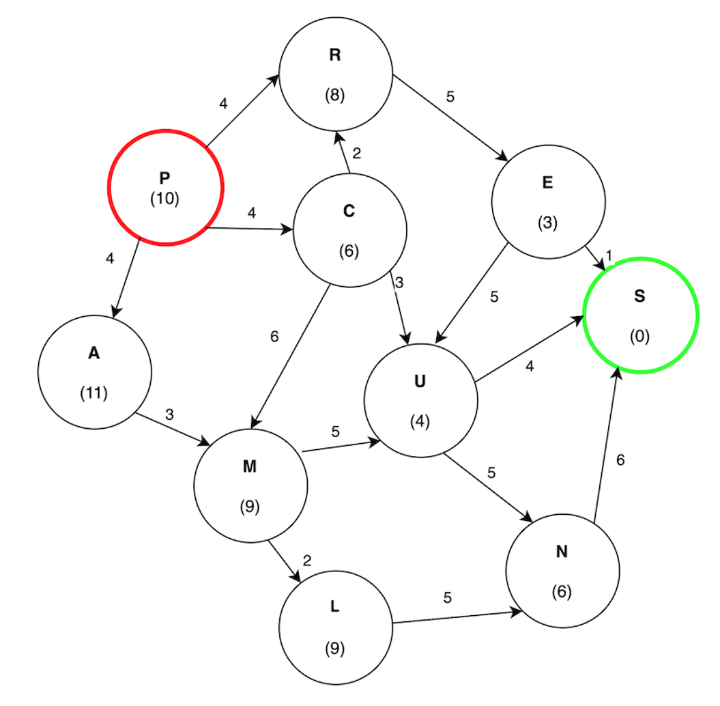
Demonstrate Open and Closed lists
Solution: P->C->U->S

Slide 6
Greedy best-first search uses the properties of both depth-first search and breadth-first search.
Greedy best-first search traverses the node by selecting the path which appears best at the moment.
The closest path is selected by using the heuristic function.

Slide 7
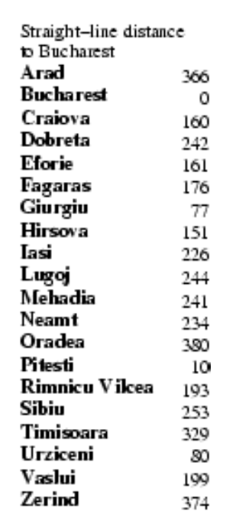
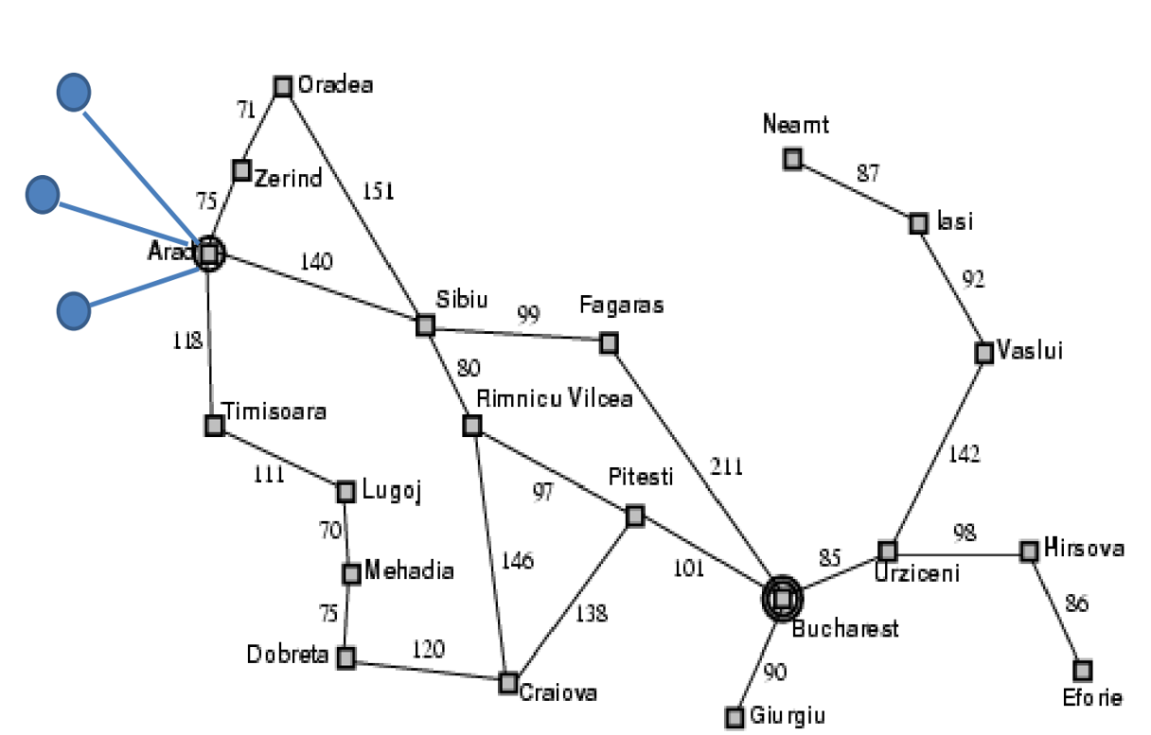
Source: Arad, Goal: Bucharest
100
Arad->Sibiu->Fagaras->Bucharest

Slide 8
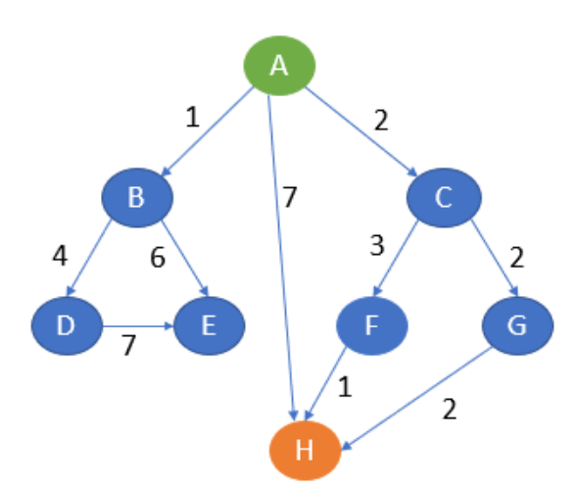
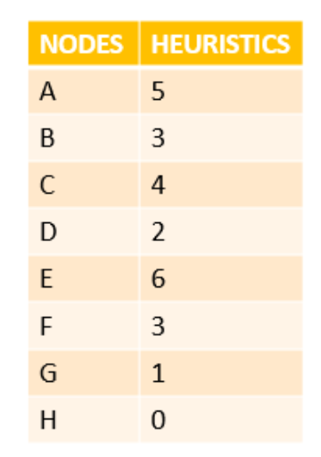
A* Search

Slide 9
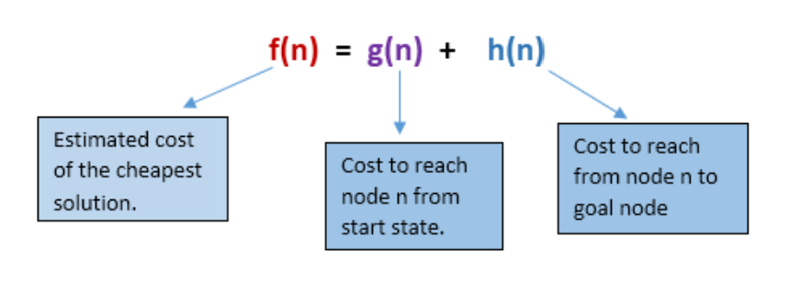

Slide 10
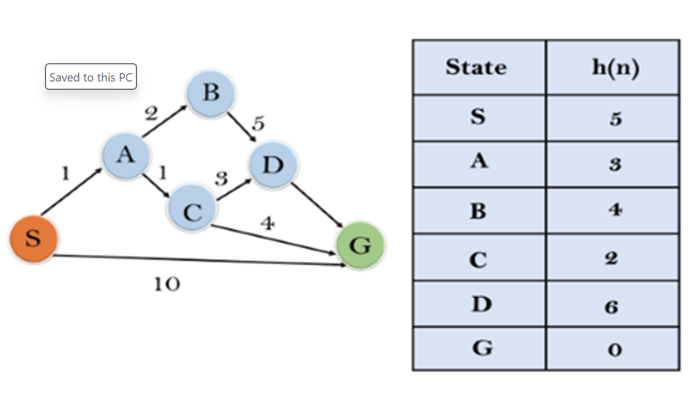
Solution:S->A->C->G
Demonstrate Open and Closed lists

Slide 11
A* search algorithm is a combination of both uniform cost search and greedy best-first search algorithms.
It uses a heuristic function to find the shortest path.
A* search algorithm uses the sum of both the cost and heuristic of the node to find the best path.

Slide 12
Source: Arad, Goal: Bucharest
100
A->S->R->P->B

Slide 13
Admissibility of A* Search
The heuristic function h(n) is called admissible if h(n)<=h*(n). [h*(n) is True cost]
A* is admissible if it uses an admissible heuristic, and h(goal) = 0.
A* is guaranteed to find an optimal solution.

Slide 14
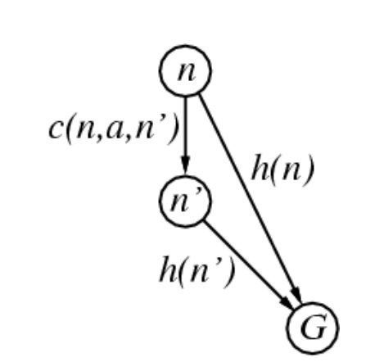
Consistency of A* Search
A heuristic is consistent if
h(n)<=c(n,a,n’)+h(n’)
If h is consistent, f is non-decreasing (monotonic)
f(n’)>=f(n)
This is called triangle inequality
Every consistent heuristic is also admissible

Slide 15
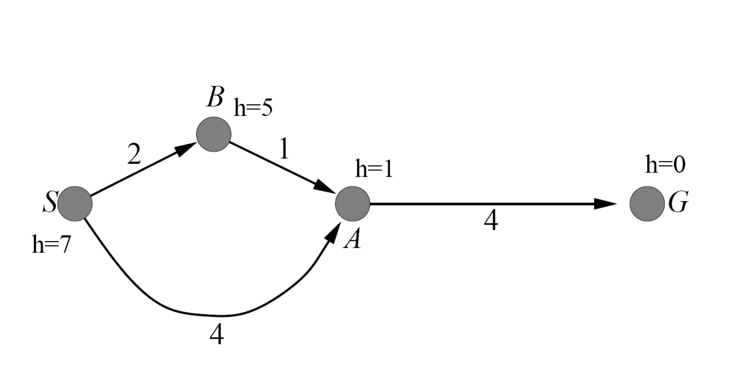
Verify Admissibility and Consistency
Admissible but inconsistent

Slide 16
A* is only optimal if two conditions are met:
The heuristic is admissible,
The heuristic is monotonic (consistent)
A∗ is optimally efficient for any given consistent heuristic. That is, no other optimal algorithm is guaranteed to expand fewer nodes than A∗
$$Absolute Error,∇≡h^{∗}−h$$
$$Relative Error,∈≡\frac{h^{∗}−h}{h^{∗}}$$

Slide 17
Recursive BFS
Recursive best keeps only one node is kept for backtracking.
The algorithm works like a normal depth first search with picking up the best node based on heuristic value.
When all nodes are explored, the best node is explored but second best is preserved in memory.
If the best node is explored and all children are found to be worse, the search process backtracks to the second best node

Slide 18
Source: Arad, Goal: Bucharest
100
Arad->Sibiu->RV->Pitesti->Bucharest

Slide 19
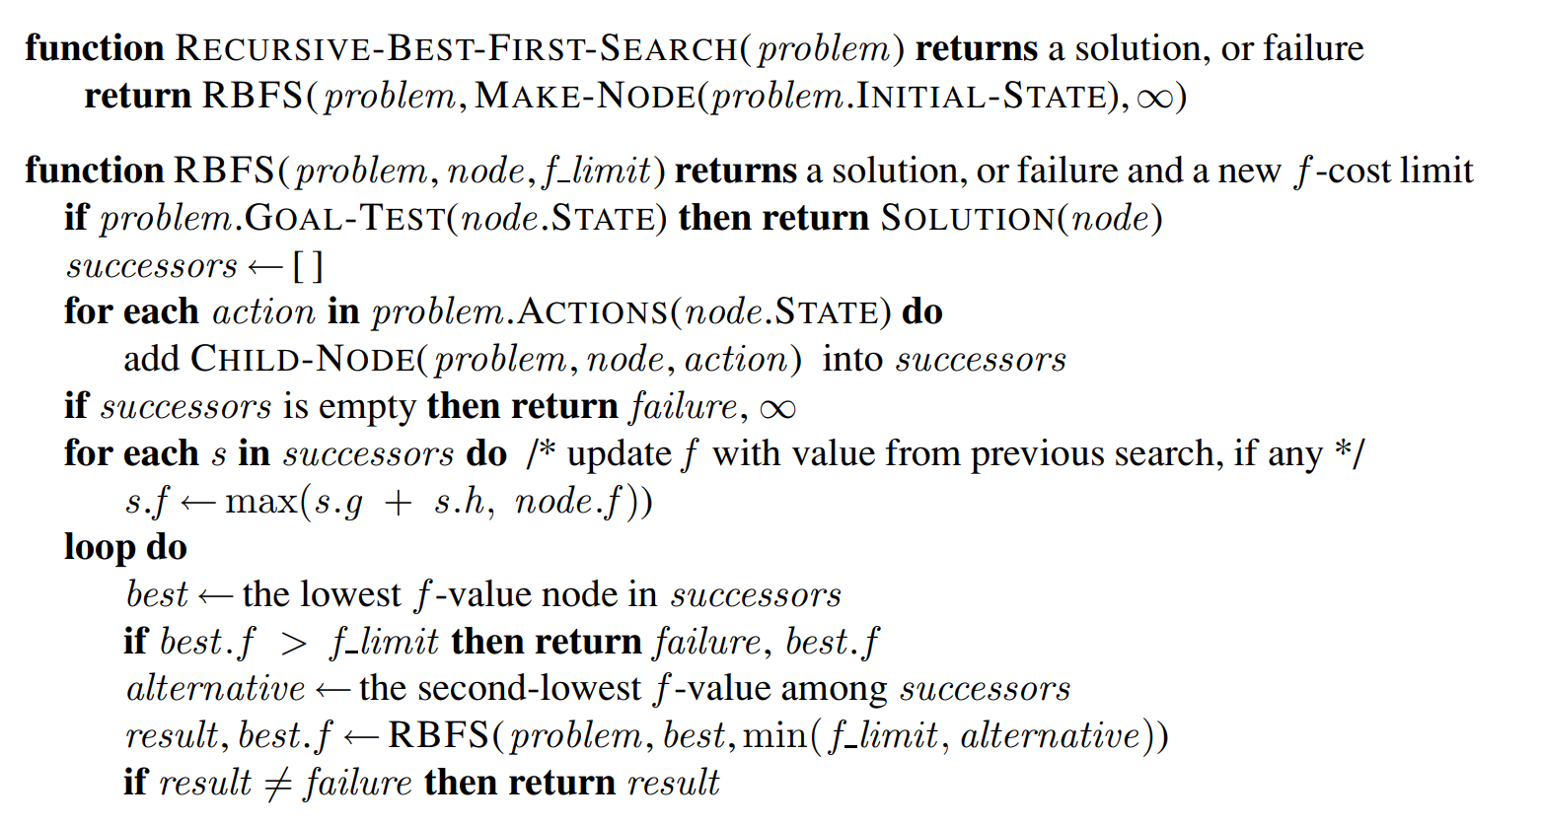

Slide 20
IDA*
MA*
SMA*
Heuristic function

Slide 21
Other Assesment-40 Marks

Slide 23
Knowledge based Agents (KBA)
Central component is knowledge base (KB).
KB is a collection of sentences
Sentences expressed in Knowledge Representation Language
Add new sentences to KB (TELL)
Query for information from KB (ASK)

Slide 24
TAP
function
KB-AGENT(percept)
returns an action
persistent: KB, t=0
TELL(KB,
MAKE-PERCEPT-SENTENCE(percept,t)
action=ASK(KB,
MAKE-ACTION-QUERY(t)
TELL(KB,
MAKE-ACTION-SENTENCE(action,t)
t=t+1

Slide 25
Levels of KBA
Logical
Implementation
Knowledge
What you know
What is the goal
Logical rules
Physical implementation using other levels

Slide 26
Approaches for designing KBA
Declarative approach -TELL sentences one by one until agent knows how to operate
Procedural approach – Encode desired behavior as program code

Slide 27
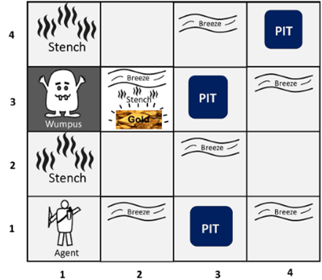
Wumpus World problem in AI

Slide 28
PEAS specification
Performance Metrics: +1000 for golden cave
-1000 for pit
-1 for each action
-10 for using arrow
Environment: 4 X 4 grid of rooms
Starts at (1,1)

Slide 29
PEAS specification
Actuators: Forward, TurnLeftby 90,
TurnRightby90, Shoot,
Grab, Climb
Sensors: Stench, Breeze, Glitter,
Bump, Scream
percept=[Stench,Breeze,Glitter,Bump,Scream]

Slide 30
Knowledge Acquired in Wumpus World
1,4
2,4
3,4
4,4
1,3
2,3
3,3
4,3
1,2
2,2
3,2
4,2
OK
1,1
OK
2,1
OK
3,1
4,1
A
V
B

Slide 31
Knowledge Acquired in Wumpus World
1,4
2,4
3,4
4,4
1,3
2,3
3,3
4,3
1,2
2,2
3,2
4,2
OK
P?
1,1
OK
2,1
OK
3,1
4,1
A
V
B
V
P?

Slide 32
Knowledge Acquired in Wumpus World
1,4
2,4
3,4
4,4
1,3
2,3
3,3
4,3
W?
1,2
2,2
3,2
4,2
S
OK
OK
V
1,1
OK
2,1
OK
3,1
4,1
A
V
B
V

Slide 33
Knowledge Acquired in Wumpus World
1,4
2,4
3,4
4,4
1,3
2,3
OK
3,3
4,3
W?
G
1,2
2,2
3,2
4,2
S
OK
OK
V
V
1,1
OK
2,1
OK
3,1
4,1
A
V
B
V

Slide 34
Logic
Logic is a formal language to express real world sentences
Syntax – notation to express sentences
Semantics – meaning of the sentences
Truth value – sentence truth value (True or False)
Model – World for sentences

Slide 35
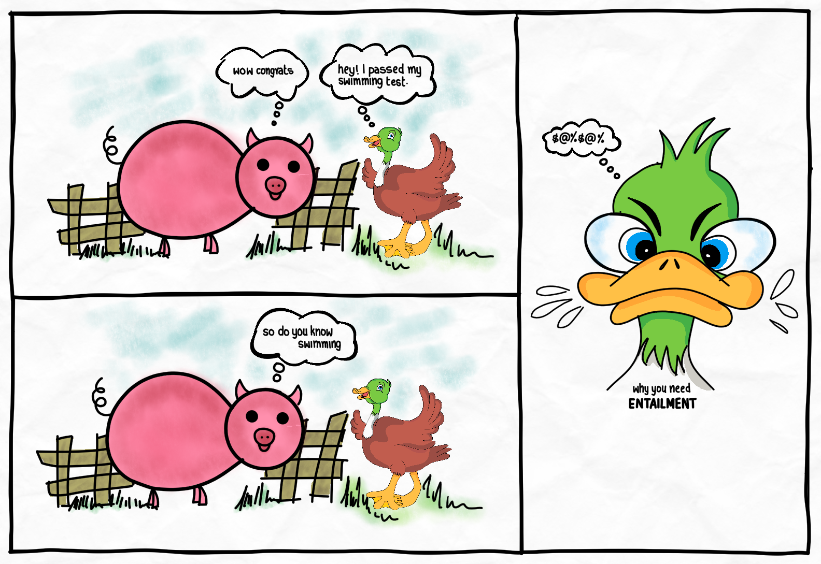
Entailment
$$α|=β$$

Slide 36
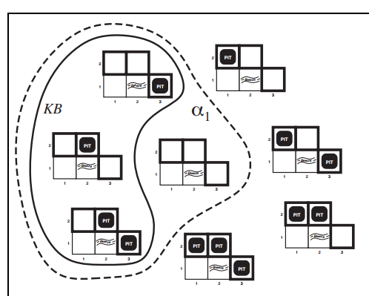
$α_{1}$-No pit in [1,2]
$$KB|=α_{1}$$

Slide 37
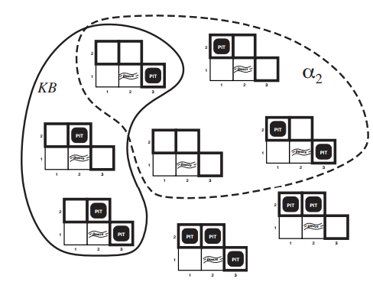
$α_{2}$-No pit in [2,2]
$$KB|≠α_{2}$$

Slide 38
Finding needle in the haystack
Haystack – model
Needle – Entailment
INFERENCING
ALGORITHM
$$KB|=_{i}α_{1}$$

Slide 39
An inference algorithm that derives only entailment is called “sound”
An inference algorithm that derives all possible entailment is called “complete”

Slide 41
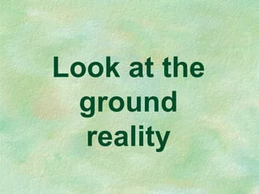

Slide 42
Propositional Logic-Syntax
BNF

Slide 43
Propositional Logic-Semantics-Truth Tables
Negation
P
Q
$¬$P
$¬$Q
false
false
true
true
false
true
true
false
true
false
false
true
true
true
false
true

Slide 44
Conjunction
Disjunction
P
Q
P$ΛQ$
P
Q
P$νQ$
false
false
false
false
false
false
false
true
false
false
true
true
true
false
false
true
false
true
true
true
true
true
true
true
Implication
Double Implication
P
Q
P$⇒Q$
P
Q
P$⟺Q$
false
false
true
false
false
true
false
true
true
false
true
false
true
false
false
true
false
false
true
true
true
true
true
true

Slide 45
Write the following English sentences in symbolic form
If it rains, then I will stay at home.
P $⇒$Q
2. He is poor but honest.
P$ΛQ$
3. Birds fly if and only if sky is clear.
P$⟺Q$

Slide 46
4. I will go only if he stays.
I will go if he stays.
P $⇒ Q$
5. It is hot or else it is both cold and cloudy.
P $ν (QΛ$R)
6. Either today is Sunday or Monday
P $ν Q$

Slide 47
There is no pit in [1,1]
A square is breezy if and only if there is a pit in a neighboring square.

Slide 48
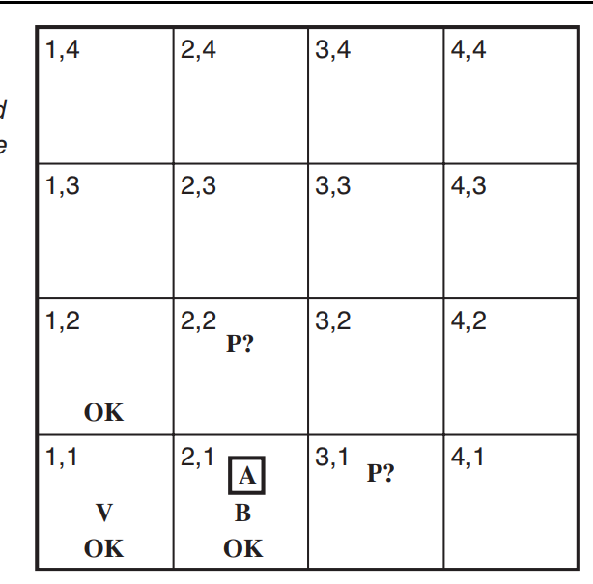
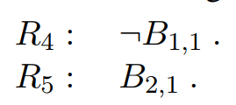
Write breeze for squares visited

Slide 49
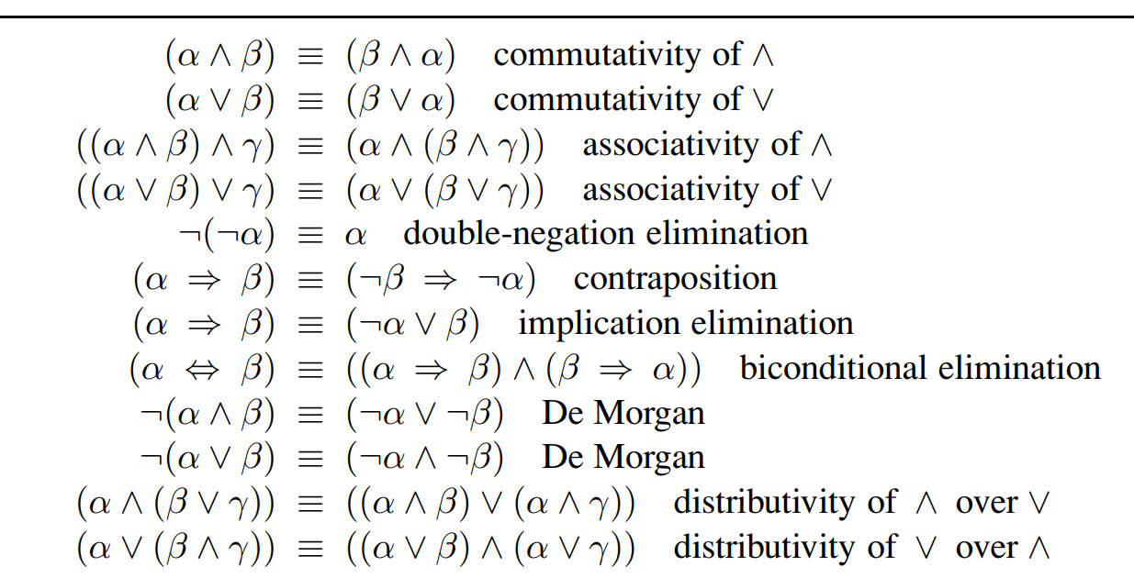
Standard logical equivalences

Slide 50
Truth table Enumeration algorithm for Entailment

Slide 52
Logical Equivalence
$$α≡β iff α|=β and β|=α$$
Eg: P$ΛQ≡$ Q$ΛP$
A tautology is a compound statement which is true for every value of the individual statements.
Prove ($p→q)V\left(q→p\right)$ is a tautology

Slide 53
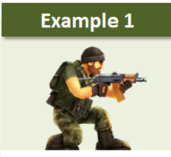
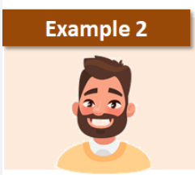
Examples of tautology
Armed gunman
gunman
Single bachelor
bachelor

Slide 54
Deduction Theorem
Satisfiability

Slide 55
Proof by Inference Rules
Modus Ponens [Mode that affirms]
$$\frac{α→β,α}{β}$$
AND Elimination
$$\frac{αΛβ}{α}$$

Slide 56
Prove logically that there is no pit in [1,2]

Slide 58
Proof by resolution
The idea of resolution is simple: if we know that
p is true or q is true
and we also know that p is false or r is true
then it must be the case that q is true or r is true.
This line of reasoning is formalized in the
Resolution Tautology:
(p V q) $Λ$ ($¬$ p V r) -> q V r

Slide 59
Given the following hypotheses:
If it rains, Joe brings his umbrella
If Joe has an umbrella, he doesn't get wet
If it doesn't rain, Joe doesn't get wet
prove that Joes doesn't get wet
Factoring

Slide 60
Prove logically that there is a pit in [3,1]
$B_{2,1}↔P_{1,1}\text{V}P_{3,1}$V $P_{2,2}$
${(B}_{2,1}{→P}_{1,1}\text{V}P_{3,1}$V $P_{2,2}$) $Λ$
${(P}_{1,1}\text{V}P_{3,1}$V $P_{2,2}$ $→$ $B_{2,1}$)
$$B_{2,1}$$
$(P_{1,1}\text{V}P_{3,1}$V $P_{2,2})$
$${¬P}_{1,1}$$
$P_{3,1}$V $P_{2,2}$
$${¬P}_{2,2}$$
$$P_{3,1}$$

Slide 61
Conjunctive Normal Form (CNF)
Resolution works best when the formula is of the special form: it is an ∧ of ∨s of (possibly negated, ¬) variables (called literals ).
Eg:
(yV$¬$z) $Λ$ ($¬$y) $Λ$ (y V z) CNF
(x V ¬y $Λ$ z) Not CNF

Slide 62
To convert a formula into a CNF.
Convert double implication to single
Open up the implications to get ORs.
Get rid of double negations.
Use Demorgans Law
Use distributivity
Eg: F V (G $Λ$ H) can be written as
(F V G) $Λ$ (F V H)
Convert to CNF: A→ ( B ∧ C)

Slide 63
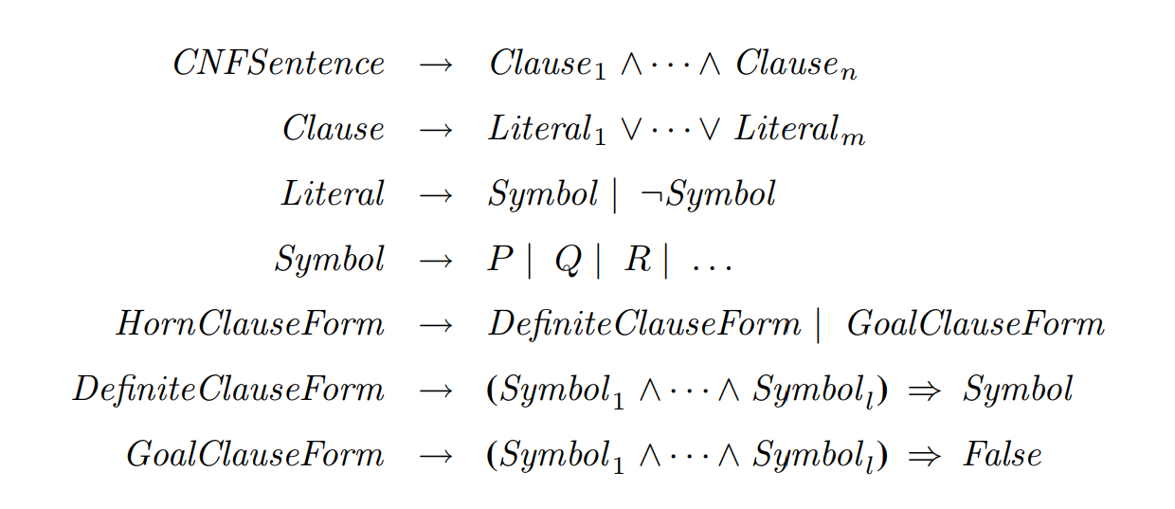
Horn Clauses
Definite clause is a disjunction of literals in which exactly one literal is positive.
In Goal clause – no positive literals

Slide 64
Inference Engine
Backward Chaining
Forward Chaining

Slide 65
Forward Chaining
Forward chaining is a form of reasoning for an AI expert system that starts with simple facts and applies inference rules to extract more data until the goal is reached.

Slide 66
Backward Chaining
Backward chaining is another strategy used to shape an AI expert system that starts with the end goal and works backward through the AI’s rules to find facts that support the goal.

Slide 67
KnowledgeBase (KB)
John’s credit score is 780.
A person with a credit score greater than 700 has never defaulted on their loan.
John has an annual income of $100,000.
A person with a credit score greater than 750 is a low-risk borrower.
A person with a credit score between 600 to 750 is a medium-risk borrower.
A person with a credit score less than 600 is a high-risk borrower.

Slide 68
6. A low-risk borrower can be given a loan amount up to 4X of his annual income at a 10 percent interest rate.
7. A medium-risk borrower can be given a loan amount of up to 3X of his annual income at a 12 percent interest rate.
8. A high-risk borrower can be given a loan amount of up to 1X of his annual income at a 16 percent interest rate.
What max loan amount can be sanctioned for John?
What will the interest rate be?
Use Forward Chaining

Slide 69
KnowledgeBase (KB)
John is taller than Kim
John is a boy
Kim is a girl
John and Kim study in the same class
Everyone else other than John in the class is shorter than Kim
Is John the tallest boy in class?
Use Backward Chaining

Slide 70
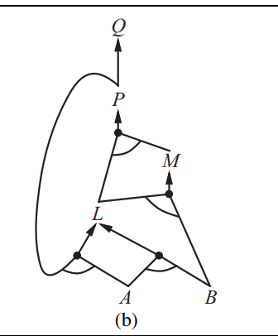
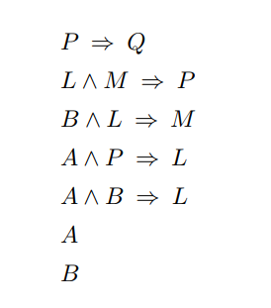
Representation of Horn clauses using AND-OR graph for forward chaining

