Slide 1
First Order Logic
MODULE-IV

Slide 2
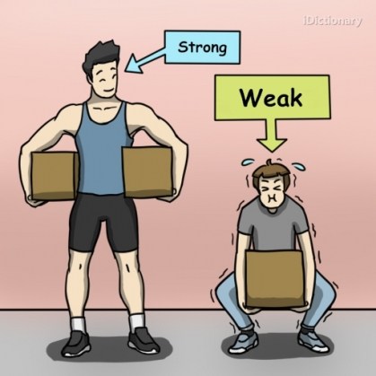
Propositional logic is a puny mechanism to express knowledge and inferencing

Slide 3
Programming languages are formal mechanisms to express
Logic-computations
Data structure-facts
Programming languages lack following:
- deriving facts from other facts
-inferencing not automatic
-lack expressiveness required to handle partial information
-Composionality is missing

Slide 4
Natural languages:
- declarative language
-serves as a medium for communication
-Ambiguity issues

Slide 5
The man saw the girl with the telescope
Syntactic ambiguity
The car hit the pole while it was moving
Semantic ambiguity
The horse ran up the hill. It was very steep. It soon got tired
Anaphoric ambiguity
I like you too
Pragmatic ambiguity

Slide 6
concept is completely absent in a language
Speakers of the Australian aboriginal language Guugu Yimithirr have no words for relative directions, such as front, back, right, or left
“I have a pain in my north arm.”

Slide 7
Language also seems to influence thought through seemingly arbitrary grammatical features such as the gender of nouns
For example, “bridge” is masculine in Spanish and feminine in German.
Describe a photograph of a particular bridge. Spanish - big, dangerous, strong, and towering, German - beautiful, elegant, fragile, and slender.
For non-deductive tasks such as learning from experience, outcomes are necessarily dependent on the form of the representations used

Slide 8
ELEMENTS OF A NATURAL LANGAUGE
Objects
Relations
Functions
Properties

Slide 9
Identify the objects, relations, functions and properties if any in the following examples:
“one plus two equals three”
“Squares neighboring wumpus are smelly”
“Evil King John ruled England in 1200”

Slide 10
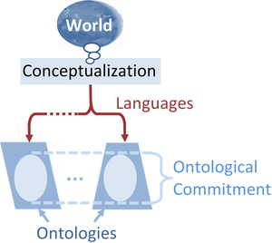
Propositional logic
-facts and rules
First order logic
-objects, relations and functions
Napoleon is one of my ancestors

Slide 11
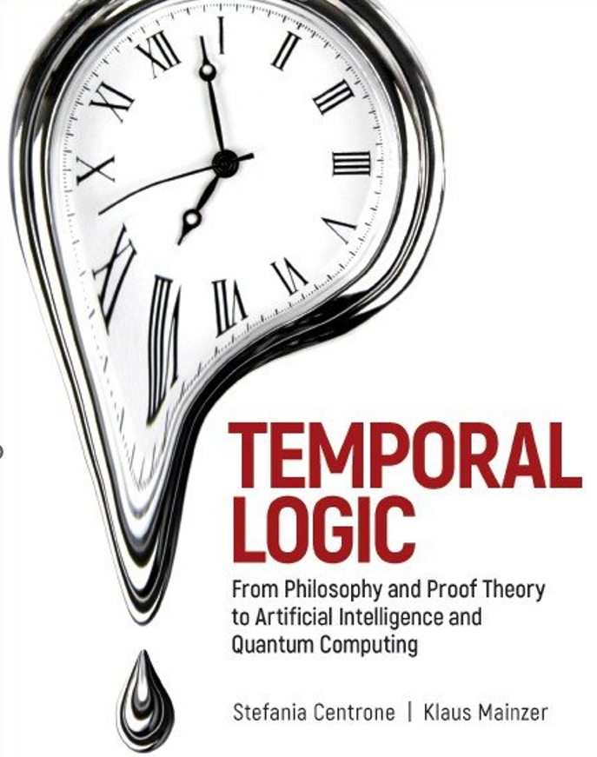
Temporal logic is any system of rules and symbolism for representing, and reasoning about, propositions qualified in terms of time.
Eg: "I am always hungry",
"I will eventually be hungry", or
"I will be hungry until I eat something"

Slide 13
Joe states that whales are gentle creatures, and as such, should never be killed.
Susan replies that killer whales are not 'gentle', in fact, they eat seal pups.
Joe, asserts that killer whales must not actually be whales, because a 'true whale eats plankton.'
If Susan shows Joe a book which asserts that killer whales are, in fact, whales, then Joe might (or might not) decide to withdraw his epistemic commitment to the original statement about whales.

Slide 14
Susan states the killer whales are whales because 'whale' is in their name.
Joe replies that killer whales are not whales but dolphins
Susan, asserts that killer whales must be whales because they look like other whales.
If Joe shows Susan a book showing that killer whales are, in fact, dolphins, then Susan might (or might not) decide to withdraw her epistemic commitment to the original statement about killer whales.

Slide 16
SYNTAX AND SEMANTICS OF FIRST ORDER LOGIC
Model is a collection of objects
Objects are related through relations
Relations are represented as series of tuples
Binary relations have 2 objects (tuples)
Unary relations are also called properties
Relations become functions, when they are specific to an object

Slide 17
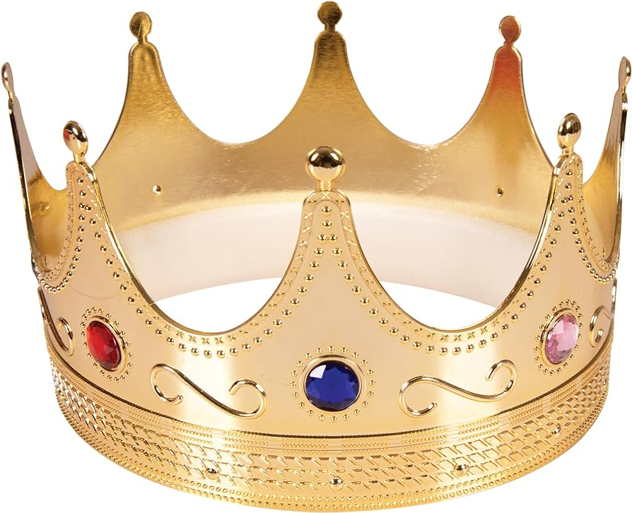
Richard, the Lionheart
King John
Objects- Richard, John, 2 left legs and crown

Slide 18
Objects- Richard, John, 2 left legs and crown
Binary relations:
brotherhood: {<Richard>,<John>}
on head: {<crown>,<John>}
Unary relations (properties):
person: {<Richard>}
person: {<John>}
king: {<John>}
crown: {<John>}

Slide 19
Functions: Relations with mappings
<Richard>->Richards left-leg
<John>->Johns left-leg
Total Functions are functions that must have value for every input tuple

Slide 20
SYMBOLS AND INTERPRETATIONS
Symbols stand for objects, relations and functions
3 types of symbols
Constant symbols-objects
Predicate symbols-relations
Function symbols - functions
Convention adopted that all symbols begin with uppercase letters.

Slide 21
Example constant symbols:
John, Richard
Example predicate symbols:
Brother, OnHead, Person, King
Example function symbols:
LeftLeg

Slide 22
Each model includes an interpretation that specifies exactly which objects, relations and functions are referred to by the constant, predicate, and function symbols
Logician calls it as Intended Interpretation
John, Richard
LeftLeg
Intended Interpretations?

Slide 23
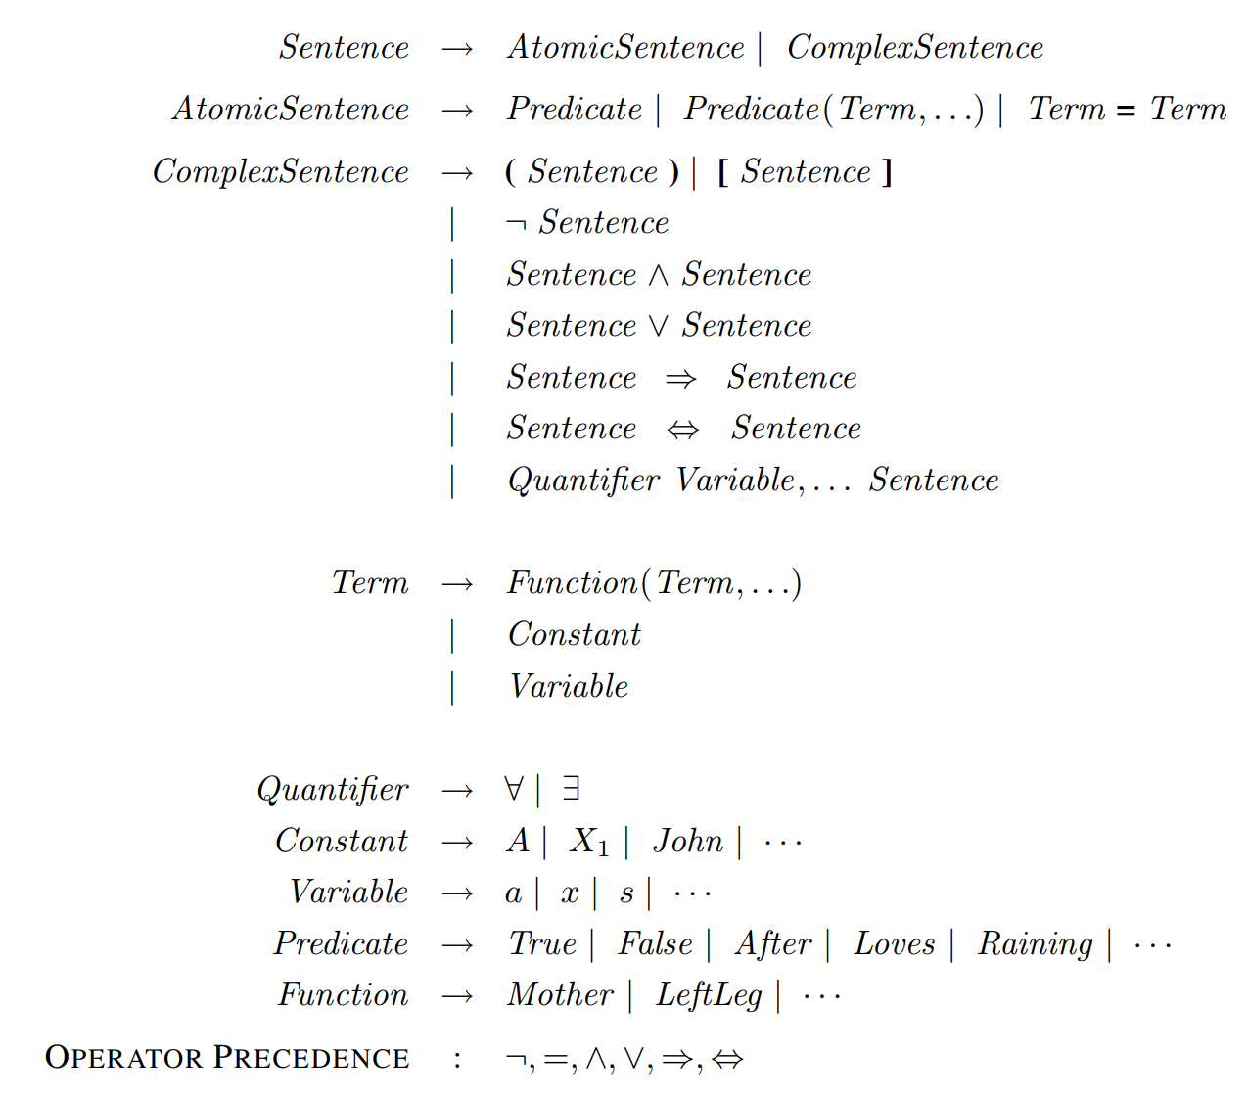
BackNaus Normal Form (BNF)

Slide 24
Terms refer to objects
Constant symbols are terms
Complex term: Function(term,..)
Eg: LeftLeg(John)
Atomic symbols formed by predicate symbol optionally followed by list of terms
Eg: Brother(John, Richard)
Eg:Married(Father(John),Mother(Richard))
Atomic symbol is true if predicate symbol holds for all constituent terms

Slide 25
Complex sentences formed using logical connectives

Slide 26
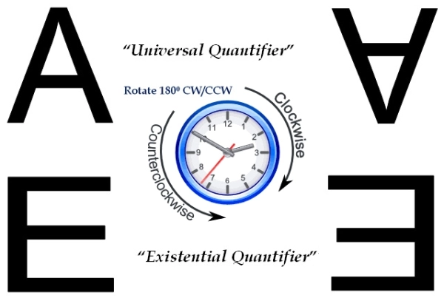

Slide 27
UNIVERSAL QUANTIFICATION
All Kings are persons
$$∀x, King\left(x\right)⇒Person(x)$$
Variable
Universal quantification makes statement about every object
All Extended Interpretations are true

Slide 28
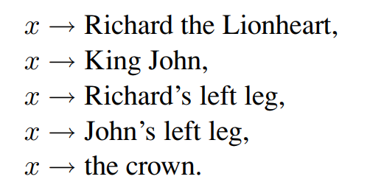

Slide 29
EXISTENTIAL QUANTIFICATION
King John has a crown on his head
$$∋x, Crown \left(x\right)Λ OnHead(x,John)$$
Existential quantification makes statement about some object
Atleast one extended Interpretations is true

Slide 31
NESTED QUANTIFIERS
Brothers are siblings
$$∀x ∀y, Brother\left(x,y\right)⇒Sibling(x,y)$$
Everybody loves somebody
$$∀x∋y, Loves\left(x,y\right)$$
There is someone who is loved by everyone
$$∋x ∀y, Loves\left(x,y\right)$$

Slide 32
Confusion created when same variable name used in nested quantifiers
$∀x (crown\left(x\right) ∨(∋x$ $Brother(Richard,x)))$
Solution: use different variable names
$∀x (crown\left(x\right) ∨(∋z$ $Brother(Richard,z)))$

Slide 33
CONNECTIONS BETWEEN QUANTIFIERS
Everyone dislikes parsnips
There does not exist someone who likes them
$$∀x ¬Likes(x,parsnips)$$
$$¬∋x Likes(x,parsnips)$$

Slide 34
Everyone likes icecreams
There does not exist someone who dislikes icecreams
$$∀x Likes(x,icecreams)$$
$$¬∋x¬Likes(x,icecreams)$$

Slide 35
EQUALITY
Henry is a father of John
$$Father\left(John\right)=Henry$$
Richard has atleast 2 brothers
$∋$ $x,∋ y, Brother\left(x,Richard\right)∧$
$Brother(y,Richard)$ $∧$
$¬(x=y)$

Slide 36
Represent using FORMAL LOGIC
all squares are rectangles
every person who lives in Walla Walla lives in Washington.
NO IDEA IS A BAD IDEA
if x is negative, so is its cube
If two numbers have the same square, then they have the same absolute value

Slide 37
some professor is a JNNCEian
No democrats are republicans,
The sine of an angle is always between +1
and −1
.

Slide 38
ALTERNATE SEMANTICS

Slide 39
DATABASE SEMANTICS
Unique name assumption- Every constant symbol refers to a distinct object
Closed world assumption – Atomic sentences not known to be true are false
Domain disclosure – only elements are constant symbols

Slide 40
Using FIRST ORDER LOGIC
Sentences are added to KB using TELL
Such sentences are called Assertions
Eg:
TELL(KB,King(John))
TELL(KB,Person(Richard))
TELL(KB,$∀x, King(x)⇒Person(x)$)
Ask queries using ASK
Eg:
ASK(KB,King(John))
ASK(KB, $∃x, Person(x))$

Slide 41
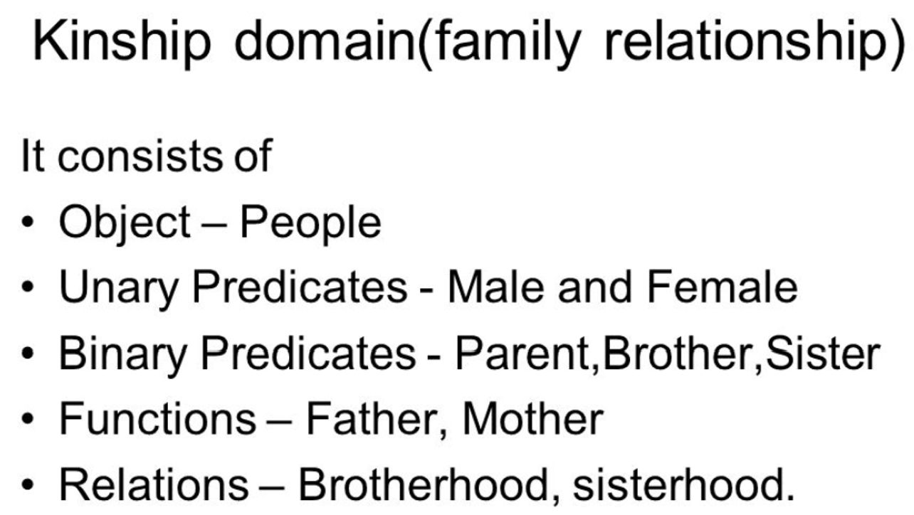
ASKVARS(KB, Person(x))
Getting answers is called substitution or binding list

Slide 42
one’s mother is one’s female parent
$$∀m, c Mother\left(c\right)=m ⇔ Female\left(m\right)∧Parent(m,c)$$
one’s husband is one’s male spouse
$$∀w, h Husband\left(h,w\right)⇔Male\left(h\right)∧spouse(h,w)$$
Male and Female are disjoint categories
$$∀x Male(x)⇔¬Female(x)$$

Slide 43
Axioms are facts/sentences written using the domain predicates and objects
Most axioms are definitions
$$∀x,y Sibling\left(x,y\right)⇔¬\left(x=y\right)∧∃p Parent\left(p,x\right)∧Parent(p,y))$$
Theorems are entailed using axioms
$$∀x,y Sibling\left(x,y\right)⇔Sibling(y,x)$$

Slide 44
Parent and child are inverse relations
$$∀p, c Parent\left(p,c\right)⇔Child\left(c,p\right)$$
A grandparent is a parent of one’s parent
$$∀g, c Grandparent\left(g,c\right)⇔∃p, Parent\left(g,p\right)∧Parent(p,c)$$
A sibling is another child of one’s parent
$$∀x,y Sibling\left(x,y\right)⇔¬\left(x=y\right)∧∃p Parent\left(p,x\right)∧Parent(p,y))$$

Slide 45
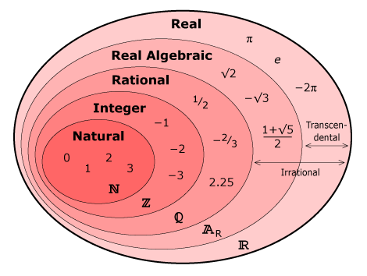

Slide 46
$$NatNum(0)$$
$$∀n, NatNum(n)⇒NatNum(S\left(n\right))$$
$$∀n, 0 ≠S(n)$$
$$∀m,n m ≠n⇒S(m) ≠S(n)$$
$∀m, NatNum(m)$ $⇒+\left(0,m\right)=m$
$$∀m, n NatNum\left(m\right)∧NatNum(n)⇒+\left(S\left(m\right),n\right)=S(+\left(m,n\right))$$

Slide 47
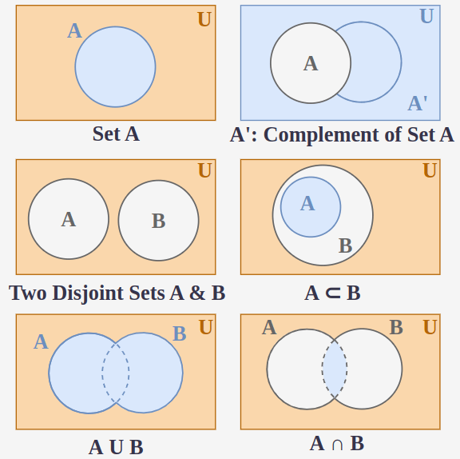

Slide 48
Definition of a set
$$∀s, Set(s) ⇔(s=\{\}∨$$
$(∃x,s_{2} Set(s_{2} )∧s=\{x|s_{2}$}
Empty set
$$¬∃x,s \left\{x | s\right\}=\{\}$$
Adjoining an element already in the set has no effect
∀ x, s x ∈ s ⇔ s = {x|s}

Slide 49
Subset
∀ s1, s2 s1 ⊆ s2 ⇔ (∀ x x ∈ s1 ⇒ x ∈ s2) .
Equal
∀ s1, s2 (s1 = s2) ⇔ (s1 ⊆ s2 ∧ s2 ⊆ s1) .
Intersection
∀ x, s1, s2 x ∈ (s1 ∩ s2) ⇔ (x ∈ s1 ∧ x ∈ s2) .
Union
∀ x, s1, s2 x ∈ (s1 ∪ s2) ⇔ (x ∈ s1 ∨ x ∈ s2)

Slide 51
List is similar to set with 2 differences:
Can contain duplicate elements
Elements are ordered
Nil – Constant List without any elements.
List? – True if it is a list.
Cons(x,y) – Construct a list y from x

Slide 52
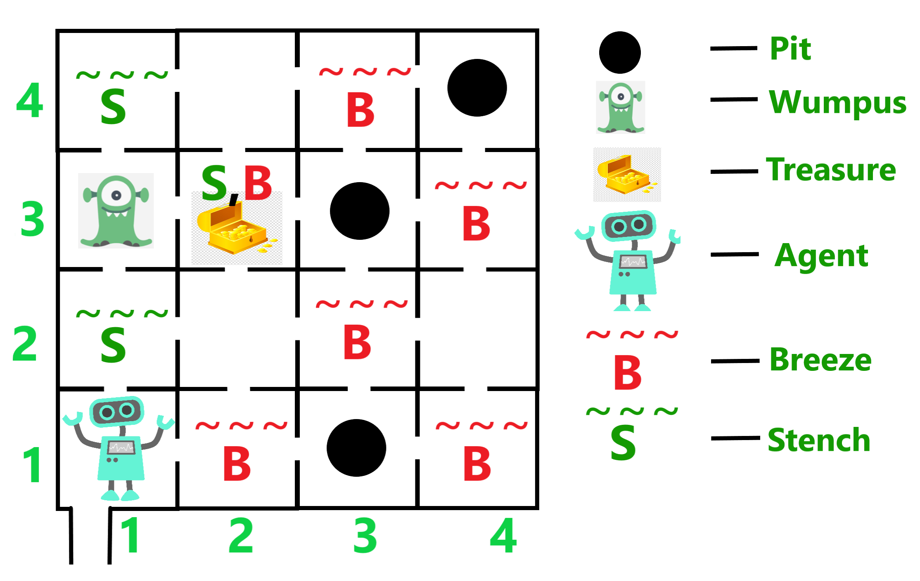
Wumpus world –Expressing in First Logic

Slide 53
Objects – Wumpus, Agents, Pits
Unary predicates:
Turn(Left), Turn(Right)
Binary predicates:
Percept([LIST],t)
Percept([Stench, Breeze,Glitter,Bump, Scream],
t)
ASKVARS($∃a BestAction(a,5))$

Slide 54
There is a breeze at time t
∀ t, s, g, m, c Percept([s, Breeze, g, m, c], t)
⇒ Breeze(t)
Define Glitter as best action
∀ t, Glitter(t) ⇒ BestAction(Grab,t)
Adjacency of 2 squares
∀ x, y, a, b Adjacent([x, y], [a, b]) ⇔
(x = a ∧ (y = b - 1 ∨ y = b + 1)) ∨ (y = b ∧ (x = a - 1 ∨ x = a + 1)) .
Agent location
∀ x, s1, s2, t At(x, s1, t) ∧ At(x, s2, t) ⇒ s1 = s2 .

Slide 56
Universal Instantiation (UI)
Eg:
∀ x King(x) ∧ Greedy(x) ⇒ Evil(x) .

Slide 57
Existential Instantiation
Eg:
∃ x Crown(x) ∧ OnHead(x, John)
Propositionalization
an existentially quantified sentence can be replaced by one instantiation, a universally quantified sentence can be replaced by the set of all possible instantiations

Slide 58
A first order Inference rule
Generalized Modus ponens
Lifted Inference Rules
$$p_{1} is King\left(x\right)$$
$$p_{2} is Greedy\left(x\right)$$
$$p_{1}^{′} is King\left(John\right)$$
$$p_{2}^{′} is Greedy(y)$$
$$q is Evil\left(x\right)$$
$$θ is x/{John},y/{John}\}$$
$$SUBST(θ,q) is Evil(John)$$

Slide 59
Unification
Process of making different logical expressions become same

Slide 60
$$UNIFY\left(p,q\right)=θ when$$
$$SUBST\left(θ,p\right)=SUBST\left(θ,q\right)$$
UNIFY(Knows(John, x), Knows(John, Jane)) =
{x/Jane}
UNIFY(Knows(John, x), Knows(y, Bill)) =
{x/Bill, y/John}
UNIFY(Knows(John, x), Knows(y, Mother(y))) =
{y/John, x/Mother(John)}
UNIFY(Knows(John, x), Knows(x, Elizabeth)) =
fail .

Slide 61
UNIFY(Knows(John, x), Knows(y, z))
= {y/John, x/z}
= {y/John, x/John, z/John}.
{y/John, x/z}
Most General Unifier

Slide 62
KB
STORE
Sentences
FETCH
Knows(x,John)
Employs(x,y)
Maintaining all facts in a single list and unifying is highly inefficient
Indexing KB is efficient
Predicate wise indexing
Employs(x,y) – predicate indexing is still inefficient
Solution: Multi level indexing

Slide 63
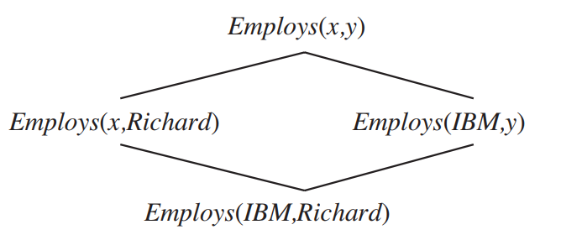
Subsumption lattice
It is a structure created with most generic unifiers at the top and specific at the bottom
It helps to answer queries efficiently
Each bottom level by one substitution

Slide 64
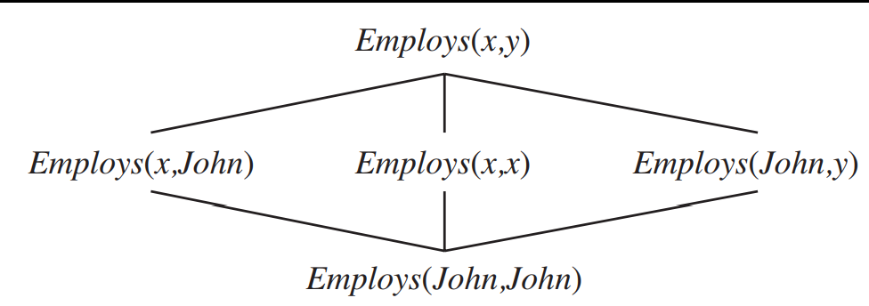

Slide 65
Inference Engine
The inference engine is the component of the intelligent system in artificial intelligence, which applies logical rules to the knowledge base to infer new information from known facts.
Horn Clause and Definite clause:
Horn clause and definite clause are the forms of sentences, which enables KB to use a more restricted and efficient inference algorithm

Slide 66
Definite clause: A clause which is a disjunction of literals with exactly one positive literal is known as a definite clause or strict horn clause.
Horn clause: A clause which is a disjunction of literals with at most one positive literal is known as horn clause. Hence all the definite clauses are horn clauses.
p $∧$ q → k.

Slide 67
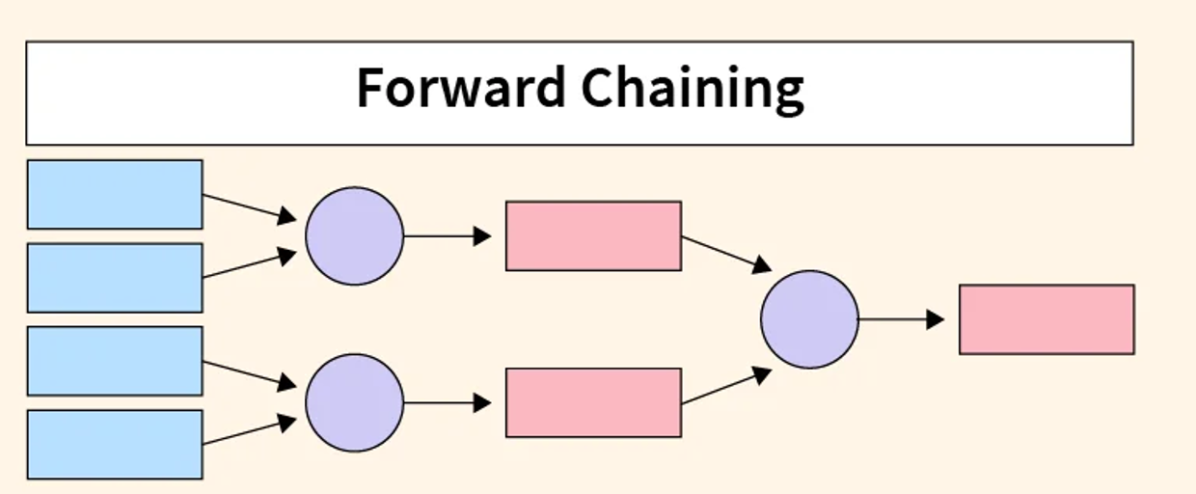
In Forward chaining, start with rules and facts and then derive goal.
To derive new rule or fact, using Generalized modus ponens

Slide 68
"As per the law, it is a crime for an American to sell weapons to hostile nations. Country A, an enemy of America, has some missiles, and all the missiles were sold to it by Robert, who is an American citizen."
Prove that "Robert is criminal."
it is a crime for an American to sell weapons to hostile nations
American(p) $∧$ weapon(q) $∧$ hostile(r) $∧$ sells(p,q,r) → Criminal(p)

Slide 69
Country A, an enemy of America, has some missiles
$∃p$ Owns(A,p) $∧$ Missile(p)
$p/T1$
Owns(A,T1)
Missile(T1)
all the missiles were sold to it by Robert who is an American
$∀p$ Missile(p) $∧$ Owns(A,p) → Sells(Robert,p,A)

Slide 70
Missiles are weapons
$∃ p$ Missile(p) → Weapons(p)
Enemy of America is known as hostile
$∃ p$ Enemy(p,America) → Hostile(p)
Country A is an Enemy of America
$$Enemy(A, America)$$
Robert is American
$$American(Robert)$$

Slide 71
Forward Chaining Proof

Slide 72
Forward Chaining Proof

Slide 73
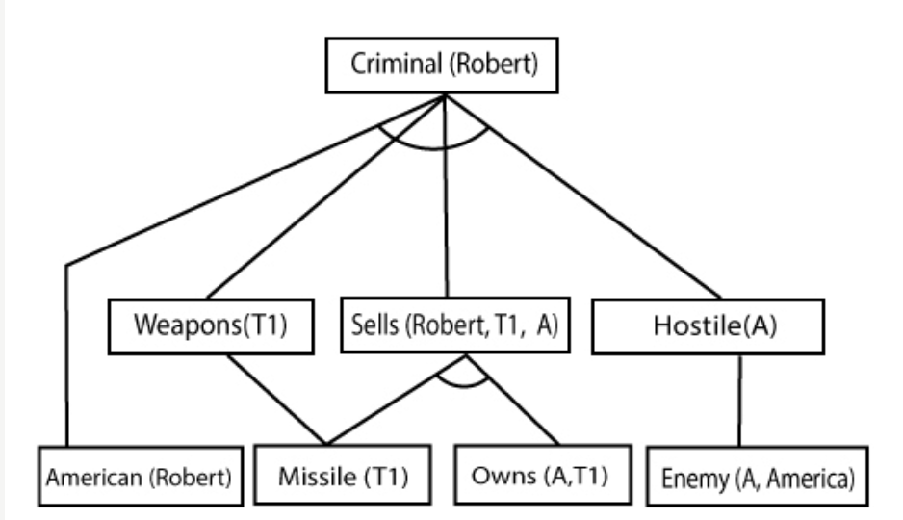
Forward Chaining Proof

Slide 74
Forward Chaining Properties
It is a down-up approach, as it moves from bottom to top.
It is a process of making a conclusion based on known facts or data, by starting from the initial state and reaches the goal state.
Forward-chaining approach is also called as data-driven as we reach to the goal using available data.
Forward-chaining approach is commonly used in the expert system, such as CLIPS, business, and production rule systems.

Slide 75
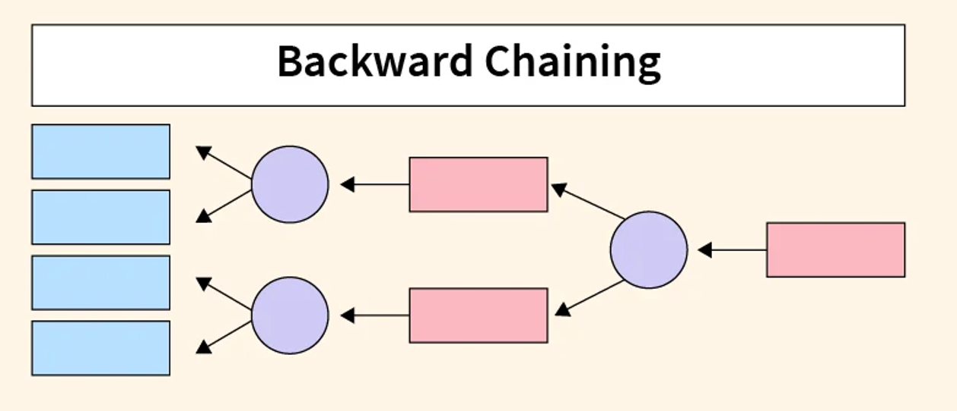
A backward chaining algorithm is a form of reasoning, which starts with the goal and works backward, chaining through rules to find known facts that support the goal.

Slide 76
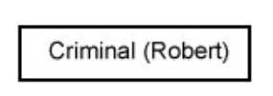
Backward Chaining Proof

Slide 77
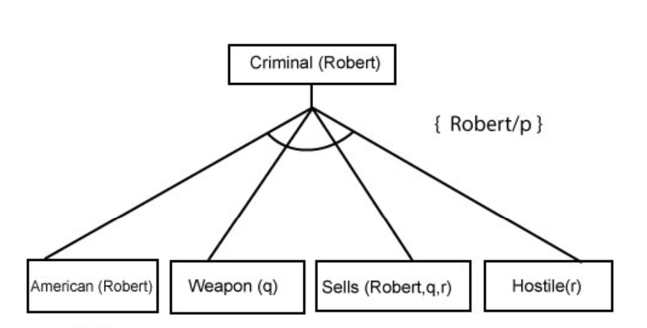
Backward Chaining Proof

Slide 78
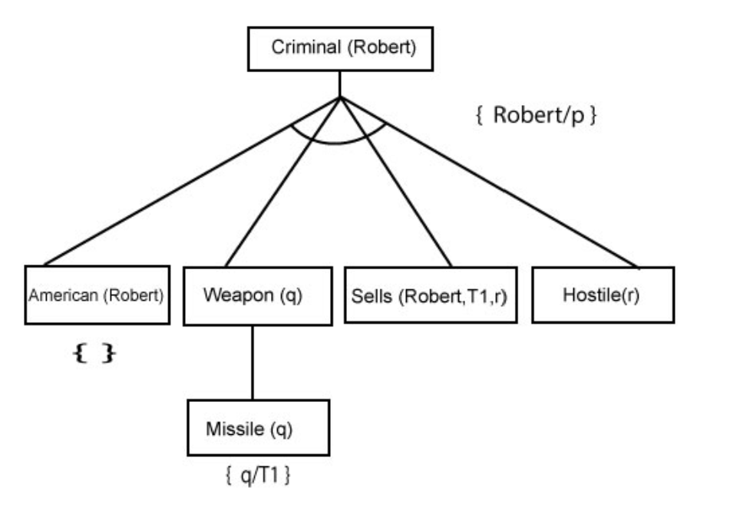
Backward Chaining Proof

Slide 79
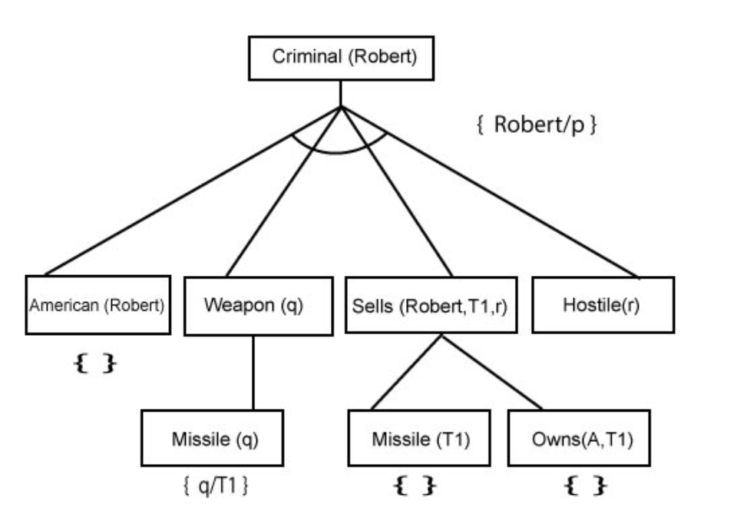
Backward Chaining Proof

Slide 80
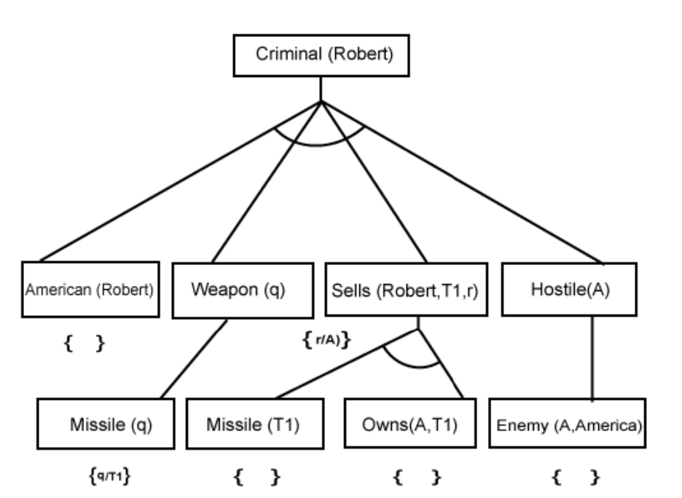
Backward Chaining Proof

Slide 81
Backward Chaining Properties
It is known as a top-down approach.
Backward-chaining is based on modus ponens inference rule.
In backward chaining, the goal is broken into sub-goal or sub-goals to prove the facts true.
It is called a goal-driven approach, as a list of goals decides which rules are selected and used.
Backward-chaining algorithm is used in game theory, automated theorem proving tools, inference engines, proof assistants, and various AI applications.

Slide 82
Conjunctive Normal Form
first-order resolution requires that sentences be in conjunctive normal form (CNF).
A conjunction of clauses, where each clause is a disjunction of literals
∀ x American(x) ∧ Weapon(y) ∧ Sells(x, y, z) ∧ Hostile(z) ⇒ Criminal(x)
∀ x $¬$American(x) V $¬$Weapon(y) V $¬$Sells(x, y, z) V $¬$Hostile(z) ∧ Criminal(x)

Slide 83
Convert to Conjunctive Normal Form
Everyone who loves all animals is loved by someone
∀ x [∀ y Animal(y) ⇒ Loves(x, y)] ⇒
[∃ y Loves(y, x)] .
Eliminate implications:
∀ x [¬∀ y ¬Animal(y) ∨ Loves(x, y)] ∨ [∃ y Loves(y, x)] .
Move ¬ inwards
¬∀ x p | becomes | ∃ x ¬p
¬∃ x p | becomes | ∀ x ¬p

Slide 84
∀ x [∃ y ¬(¬Animal(y) ∨ Loves(x, y))] ∨
[∃ y Loves(y, x)] .
∀ x [∃ y ¬¬Animal(y) ∧ ¬Loves(x, y)] ∨
[∃ y Loves(y, x)] .
∀ x [∃ y Animal(y) ∧ ¬Loves(x, y)] ∨
[∃ y Loves(y, x)]
Standardize variables
∀ x [∃ y Animal(y) ∧ ¬Loves(x, y)] ∨
[∃ z Loves(z, x)]

Slide 85
Skolemize
∀ x [Animal(F(x)) ∧ ¬Loves(x, F(x))]
∨ Loves(G(z), x) .
Drop universal quantifiers
[Animal(F(x)) ∧ ¬Loves(x, F(x))]
∨ Loves(G(z), x) .
Distribute ∨ over ∧:
[Animal(F(x)) ∨ Loves(G(z), x)] ∧ [¬Loves(x, F(x)) ∨ Loves(G(z), x)] .

Slide 86
Steps for Resolution:
Conversion of facts into first-order logic.
Convert FOL statements into CNF
Negate the statement which needs to prove (proof by contradiction)
Draw resolution graph (unification).

Slide 87
John likes all kind of food.
Apple and vegetable are food
Anything anyone eats and not killed is food.
Ajit eats peanuts and still alive
Pooriya eats everything that Ajit eats. Prove by resolution that:
John likes peanuts.

Slide 88
John likes all kind of food.
∀ x food(x) ⇒ Likes(John,x)
2. Apple and vegetable are food
food(Apple) ∧ food(Vegetable)
3. Anything anyone eats and not killed is food.
∀ x,y eats(x,y) ∧ ¬ killed(x) ⇒ food(y)
4. Ajit eats peanuts and still alive
eats(Ajit,peanuts) ∧ alive(Ajit)
5. Pooriya eats everything that Ajit eats.
∀ x eats(Ajit,x) ⇒ eats(Pooriya,x)
Prove by resolution that:
John likes peanuts.

Slide 89
Elimination of all implications
∀ x ¬ food(x) V Likes(John,x)
food(Apple) ∧ food(Vegetable)
∀ x,y ¬ (eats(x,y) ∧ ¬ killed(x)) V food(y)
eats(Ajit,peanuts) ∧ alive(Ajit)
∀ x ¬ eats(Ajit,x) V eats(Pooriya,x)

Slide 90
Move negations inwards
∀ x ¬ food(x) V Likes(John,x)
food(Apple) ∧ food(Vegetable)
∀ x,y ¬ (eats(x,y) ∧ ¬ killed(x)) V food(y)
∀ x,y ¬ eats(x,y) V killed(x) V food(y)
eats(Ajit,peanuts) ∧ alive(Ajit)
∀ x ¬ eats(Ajit,x) V eats(Pooriya,x)

Slide 91
Standardize variables
∀ x ¬ food(x) V Likes(John,x)
food(Apple) ∧ food(Vegetable)
∀ y,z ¬ eats(y,z) V killed(y) V food(z)
eats(Ajit,peanuts) ∧ alive(Ajit)
∀ w ¬ eats(Ajit,w) V eats(Pooriya,w)

Slide 92
Drop Universal Quantifiers
¬ food(x) V Likes(John,x)
food(Apple)
food(Vegetable)
¬ eats(y,z) V killed(y) V food(z)
eats(Ajit,peanuts)
alive(Ajit)
¬ eats(Ajit,w) V eats(Pooriya,w)

Slide 93
Negate the statement to be proved
John likes peanuts.
likes(John,peanuts)
¬likes(John,peanuts)

Slide 94
Draw Resolution Graph
¬likes(John,peanuts)
¬ food(x) V Likes(John,x)
¬ food(peanuts)
¬ eats(y,z) V killed(y) V food(z)
¬ eats(y,peanuts) V killed(y)
eats(Ajit,peanuts)
killed(Ajith)
alive(Ajit)
¬ killed(Ajith)
Contradiction

